Slide 1
SciENcv NIH Common Forms Biosketch and Supplement
Carol Bitzinger (bitzinger.1), MA, CRA
Senior Grants and Contracts Management Analyst, IPR

Slide 2
What are the new NIH requirements?
Common Forms (completed via SciENcv) are required for biosketches and current and pending (other) support, effective for proposals, JITs, and RPPRs due on or after January 25, 2026
ORCiD accounts must be linked to eRA Commons IDs; ORCiDs will now appear on Common Forms
Forms generated from SciENcv must be downloaded and digitally certified by the investigator
Note: delegate access may be granted to research administrators; delegates can assist with certain aspects of Common Forms preparation.

Slide 3

But...

Slide 4
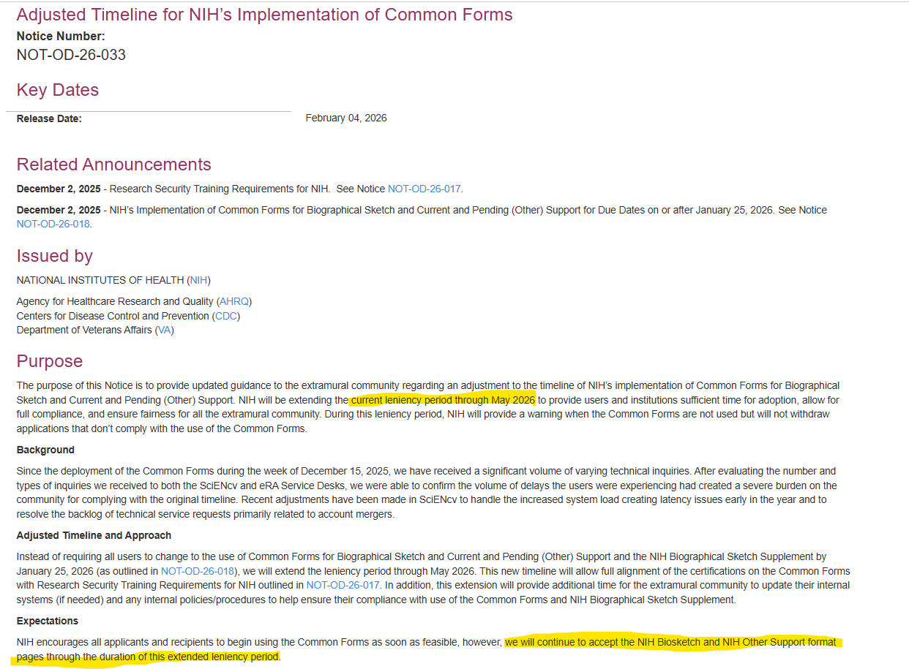
...Revised timeline:

Slide 5
Differences between prior Biosketch and Common Forms Biosketch, pt. I
Feature | Prior Forms | New Forms
Required Associations | eRA Commons – ID required in Biosketch | eRA Commons AND ORCiD: ORCiD will appear on Biosketch. Make sure accounts are linked
Research Products | 24 total -4 in Personal Statement -up to 20 in Contributions to Science | 10 total -5 in "Products Closely Related to the Current Project" -5 in "Other Significant Products, Whether or Not Related to Proposed Project"
Honors, Positions, and Scientific Appointments | Together in a single section; no limit (aside from page count considerations) | -Maximum of 15 Honors in Common Form -All OSU positions and appointments in Supplement; non-OSU positions and appointments from last 3 years in supplement
Contributions to Science | Includes both a paragraph summary and a list of citations/research products | Includes paragraph summary; only research products listed in Common Form may be referenced. No full citations.

Slide 6
Differences bt prior Biosketch and Common Forms Biosketch, pt. II
Feature | Prior Forms | New Forms
My Bibliography | A link to a complete list of citations (using My Bibliography) can be included | A link to complete list of citations (using My Bibliography) cannot be included
Editing | Document can be edited and submitted after download from SciENcv Edits to form can easily be made by research administrators | Document cannot be edited and submitted after download from SciENcv due to digital certification requirement. What this means: -Each revision after an initial certification will need to be downloaded and re-certified -Delegates cannot edit certified copies, but... -Delegates may assist with revisions in SciENcv. They can request certification in the SciENcv system, which will generate an automated email notification for the email account linked to the profile.

Slide 7
Other important biosketch details...
For NIH, use the NIH Common Forms Biosketch with the NIH supplement
  Pay close attention to which form you are using, but...
  If you accidentally use the wrong template, you should be able to convert from the file you began in error.
There is no page limit for biosketches in Common Forms
NIH biosketches certified and downloaded from SciENcv contain hyperlinks, which is a discrepancy with NIH policy for other documents.
At present, uploads of the SciENcv Common Forms will trigger warning messages on applications and eRA Commons submissions (i.e. RPPRs). Warnings will not prevent submission.

Slide 8
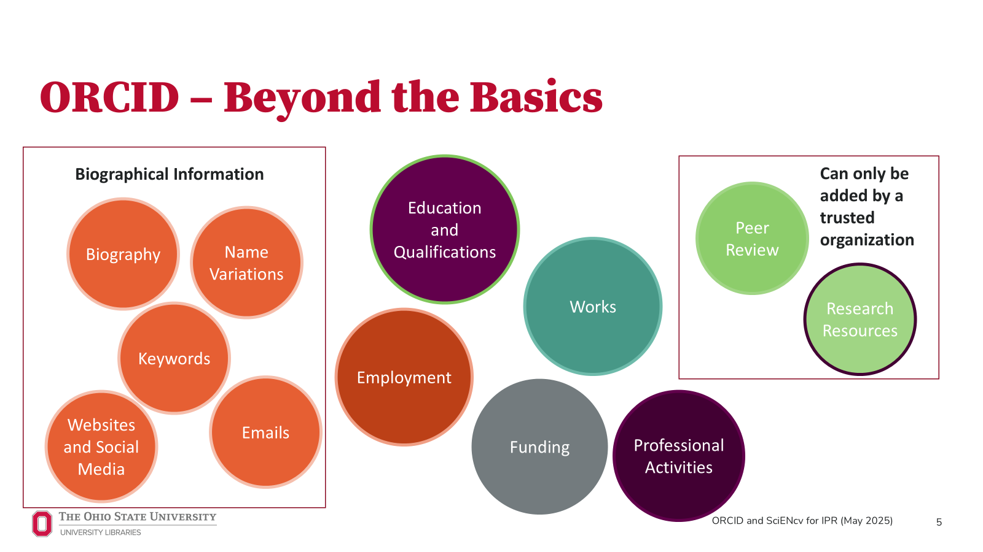
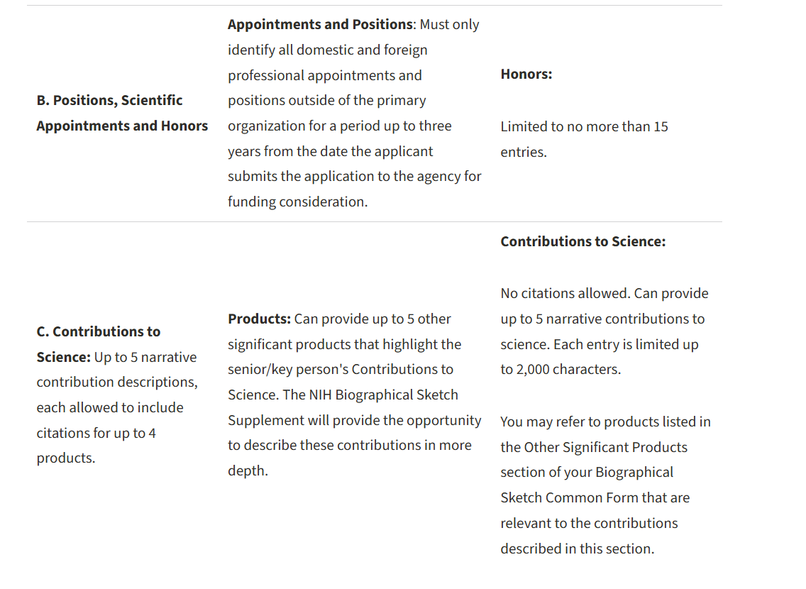
Notable Changes for NIH biosketches

Slide 9
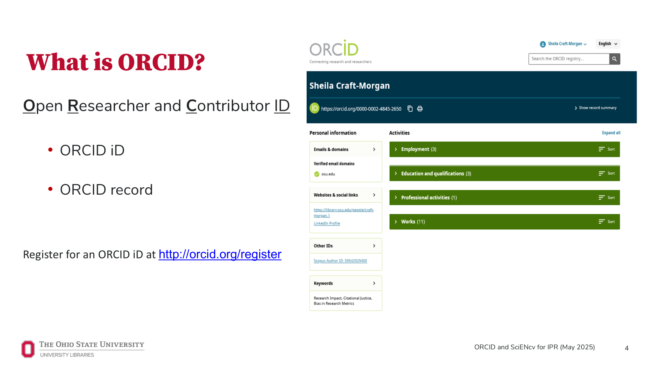
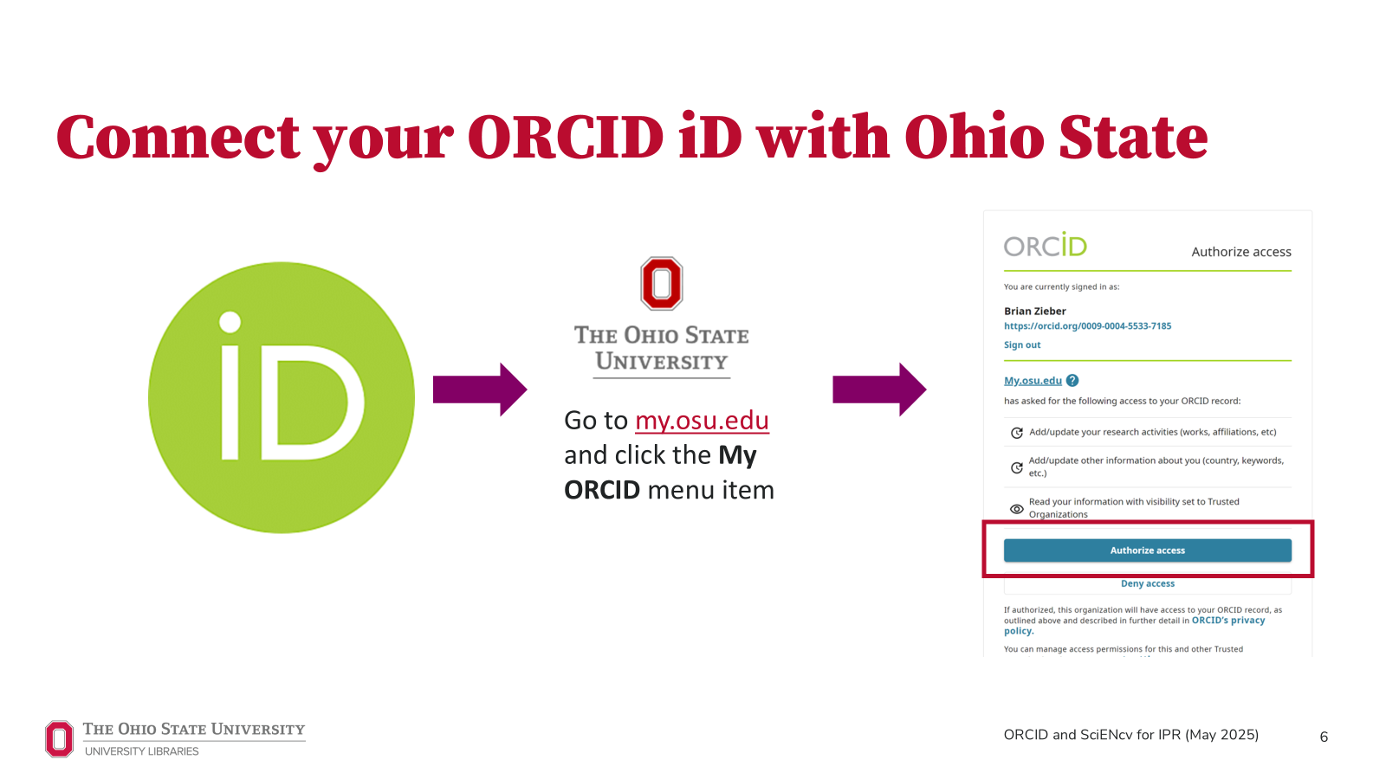

What is ORCID?

Slide 10
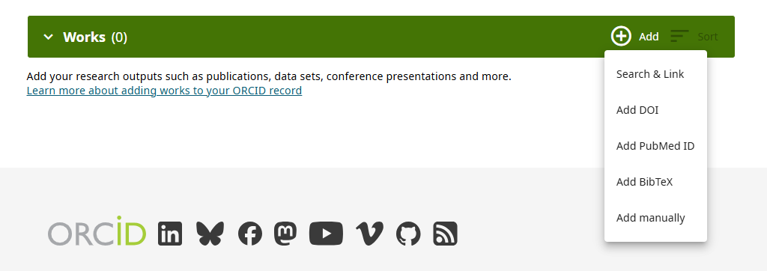
Adding Works in ORCID
Works can be added by clicking on the + sign on the top right of the green "Works" bar
Entries can be added via Search and Link wizards, DOI, PubMed ID, BibTeX upload, or manual citation entry
If you haven't already linked your ORCID to ScienCV, it's a good idea to clean up entries and data before connecting the accounts

Slide 11
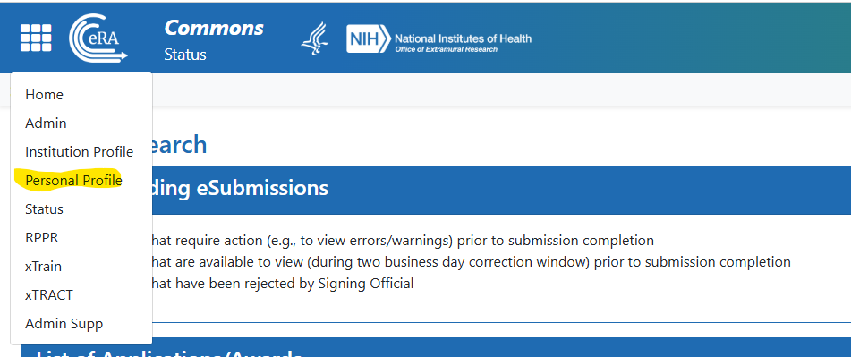
Linking ORCID to eRA Commons
Before starting a new biosketch, it's strongly recommended that you also check that your eRA Commons account (era.nih.gov) is linked to your ORCID.
*Your eRA Commons and ORCID accounts must be linked before a biosketch is certified to avoid errors during application submission.
This can be done by clicking the square grid in the top left corner of your Commons home page, then clicking Personal Profile

Slide 12
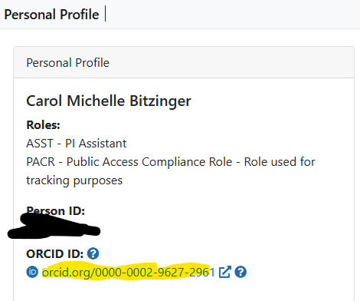
Linking ORCID to eRA Commons, cont'd
Once in your Personal Profile, there will be a box in the top left with your roles, Person ID, and ORCID ID.
If you do not see an ORCID ID listed, you may click on the question marks for help to guide you through how to establish a linkage between your accounts

Slide 13
First time logging into ScienCV
Go to https://www.ncbi.nlm.nih.gov/sciencv/
Recommended that investigators log into SciENcv using the eRA Commons option on the login page: when an investigator logs into SciENcv using their eRA commons credentials that will automatically link the investigator's eRA commons account to the investigator's SciENcv account, which is required for creating NIH Common Forms.
Upon login you will be navigated to either:
  Your My NCBI landing page (URL will be https://www.ncbi.nlm.nih.gov/myncbi/ ). On the lower right of your My NCBI landing page will be a blue Manage SciENcv hyperlink. Click it.
  Alternatively, you may be logged into the My NCBI SciENcv info page (URL will be https://www.ncbi.nlm.nih.gov/sciencv/). On the lower left of this page you should see "You are here: MyNCBI > SciENcv > SciENcv: Science Experts Network Curriculum Vitae". Click on the blue SciENcv hyperlink.

Slide 14
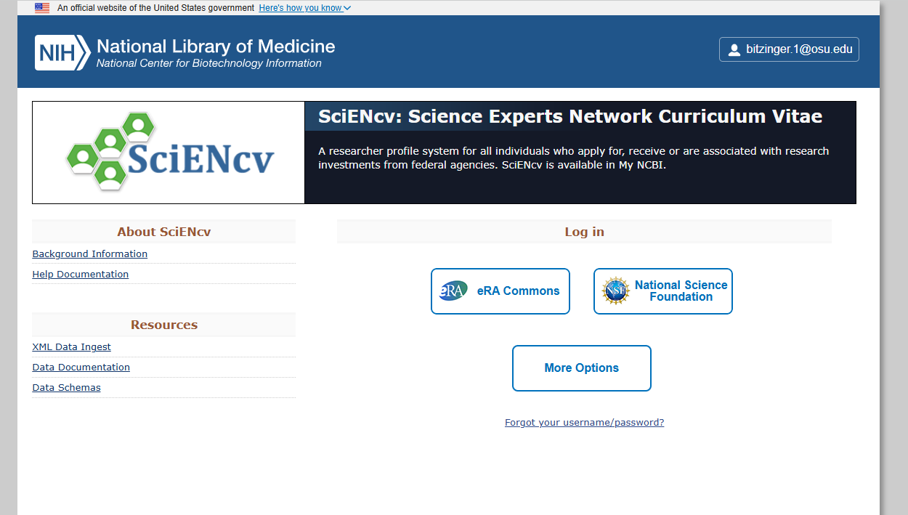

Slide 15
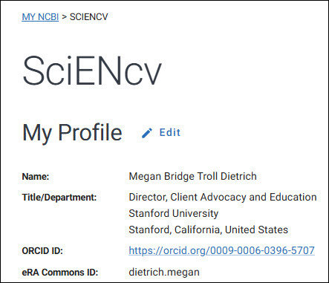
Updating your My Profile information
Review your My Profile, and complete all fields, as needed by clicking on the blue Edit button.
Make sure that ORCID and eRA Commons information is linked.
Note that delegates cannot link ORCID or eRA Commons accounts.

Slide 16
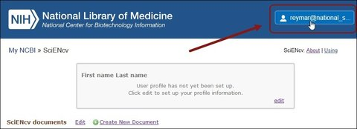
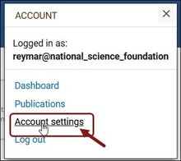
Linking ORCID to SciENcv
Once logged into SciENcv, ideally through the eRA Commons option, click on your displayed email address in the upper right corner of the screen.
Click Account Settings.

Slide 17
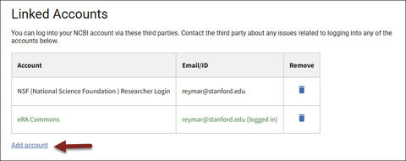
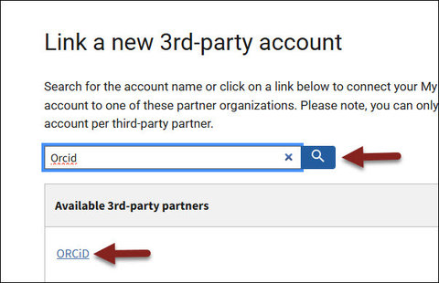
Linking ORCID to SciENcv, cont'd
Scroll down to Linked Accounts, and under Linked Accounts click the blue Add account link.
Search for "ORCID." Click ORCiD.

Slide 18
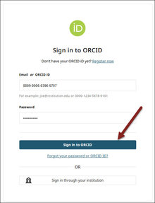
Linking ORCID to SciENcv, cont'd
When you are prompted, log in to your ORCID account.
You may see an "Authorize Access" button. If you do, click this.
The system will take you back to SciENcv, and your ORCID account link will be displayed under Linked Accounts along with a green "New account successfully linked" message below the Linked Accounts table (shown on next slide).

Slide 19
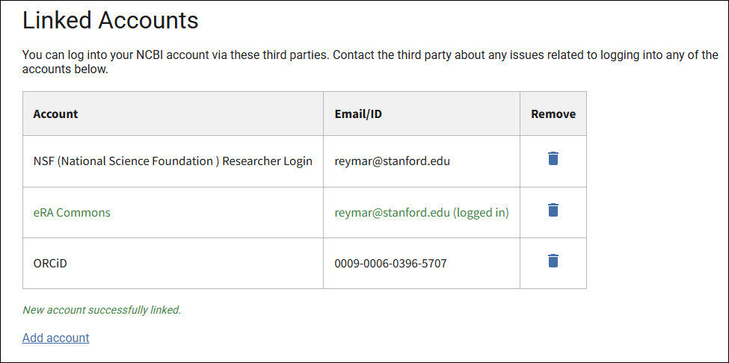

Slide 20

From your SciENcv home page, complete your Profile, including, as needed, clicking on the blue link to link your ORCID ID.
The information entered in an investigator's SciENcv profile will populate the Identifying Information section of any subsequently created biosketches and/or current and pending support documents in SciENcv.
Caution: If an investigator's SciENcv profile is incomplete (especially if the investigator's ORCiD is not displayed in the investigator's Profile) and they or a delegate attempt to create a new biosketch or CPS document, the Identifying Information section will not populate correctly. Any subsequent generated documents may trigger system warnings and/or errors when submitting to NIH.
  Delegates cannot link ORCiD accounts.

Slide 21
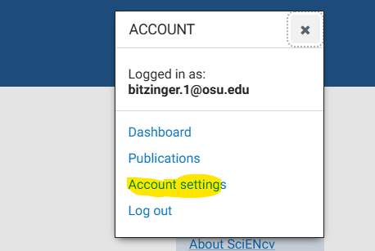
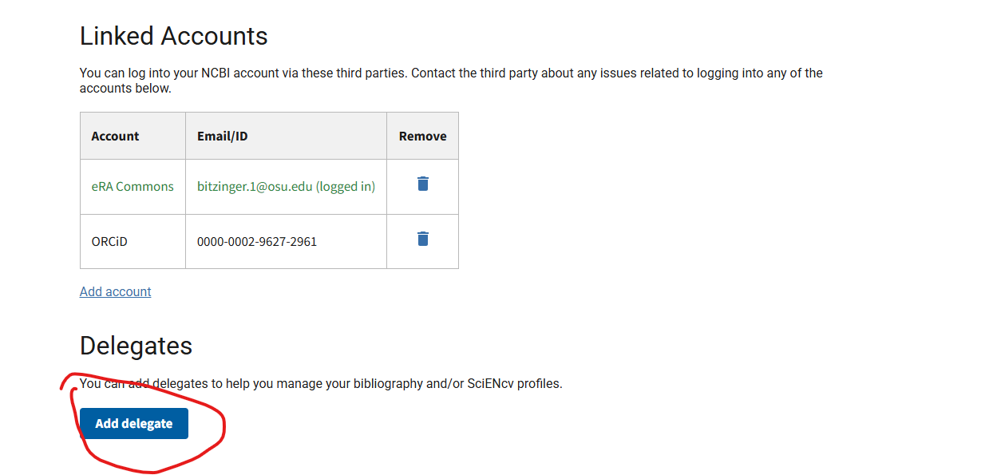
Adding a Delegate
In SciENcv, click on your username on the top right corner.
From the account menu, select "Account settings"
On the next page, under the "Linked Accounts," you will have the option to add a Delegate. Click the blue "Add Delegate" button and type in the email of your delegate.
You may have more than one! (i.e. your friendly IPR administrator and your unit administrator)

Slide 22
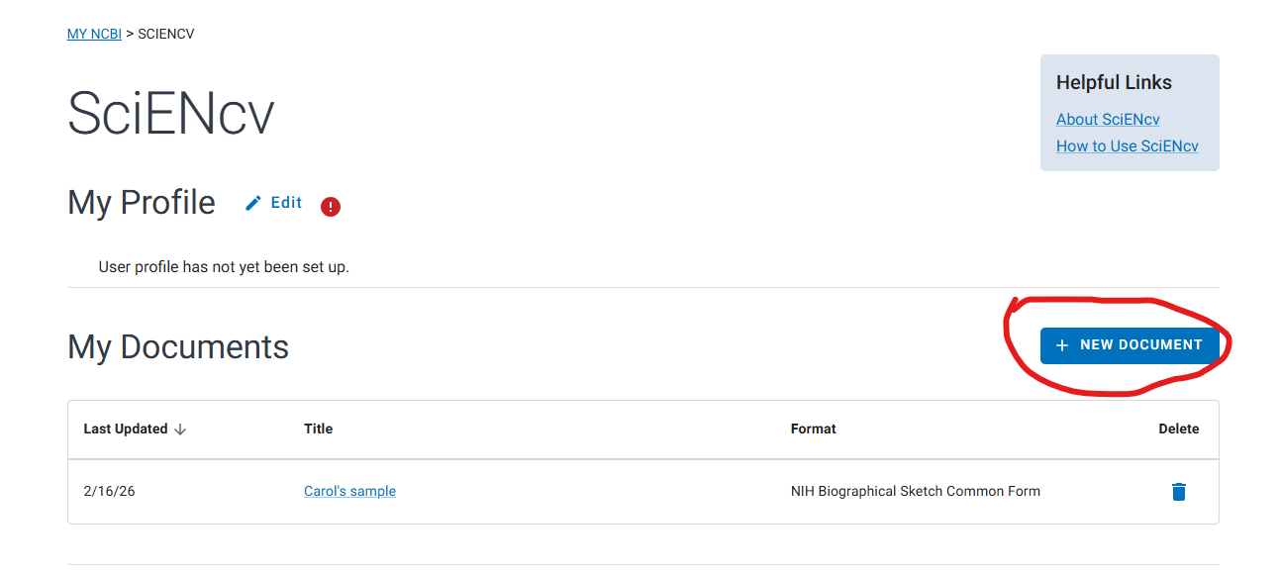
Getting started on the NIH Common Forms Biosketch

Slide 23
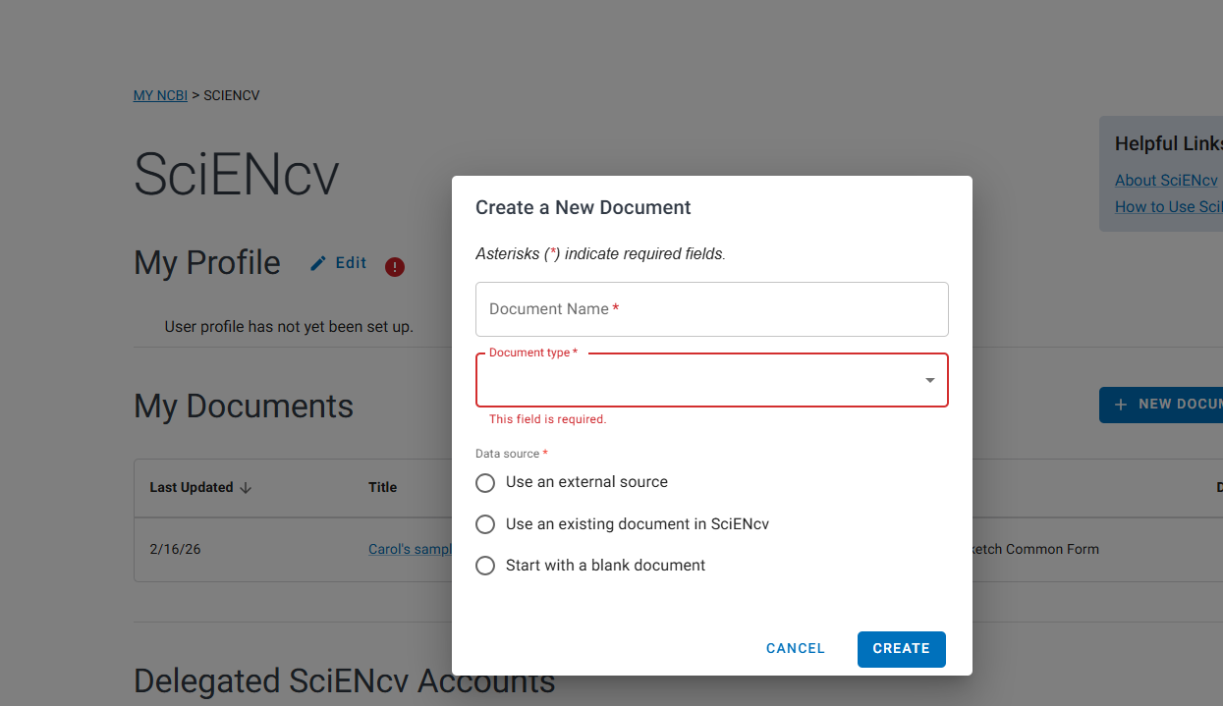
Getting started on the NIH Common Forms Biosketch

Slide 24
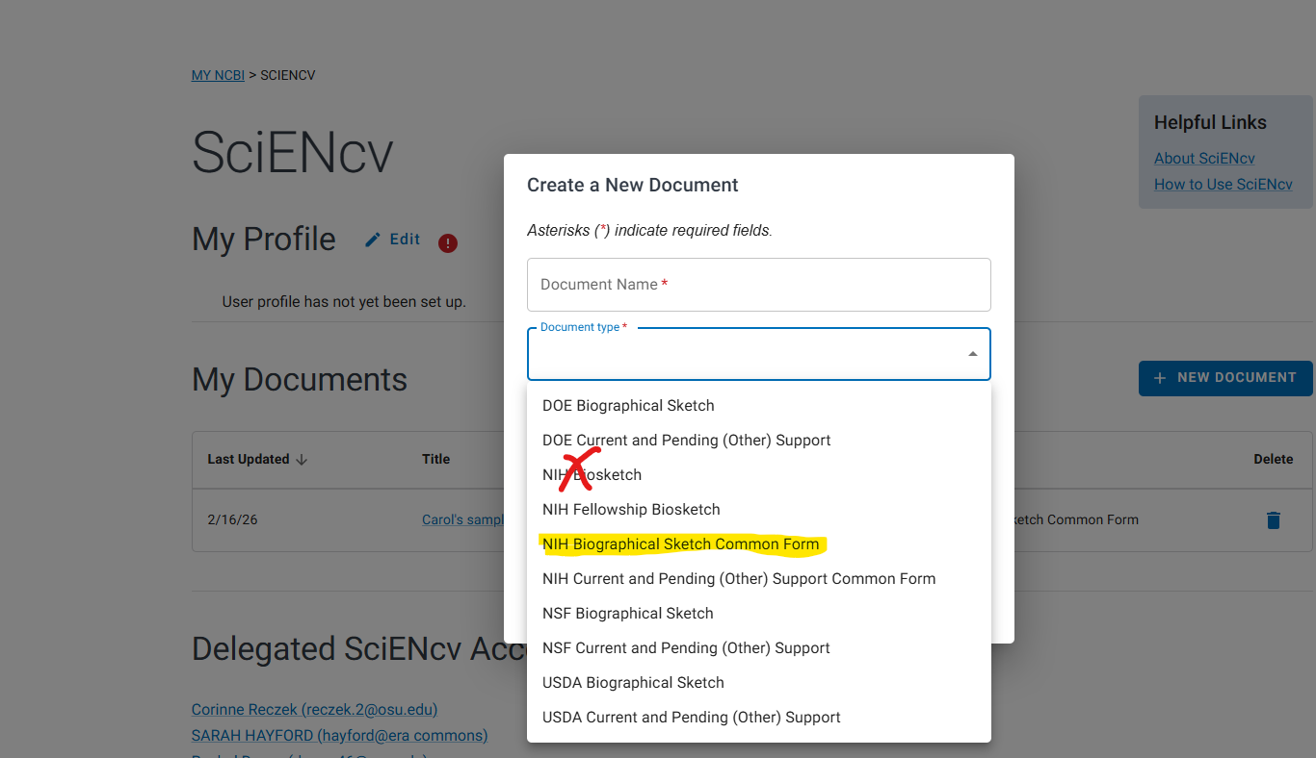
Getting started on the NIH Common Forms Biosketch

Slide 25
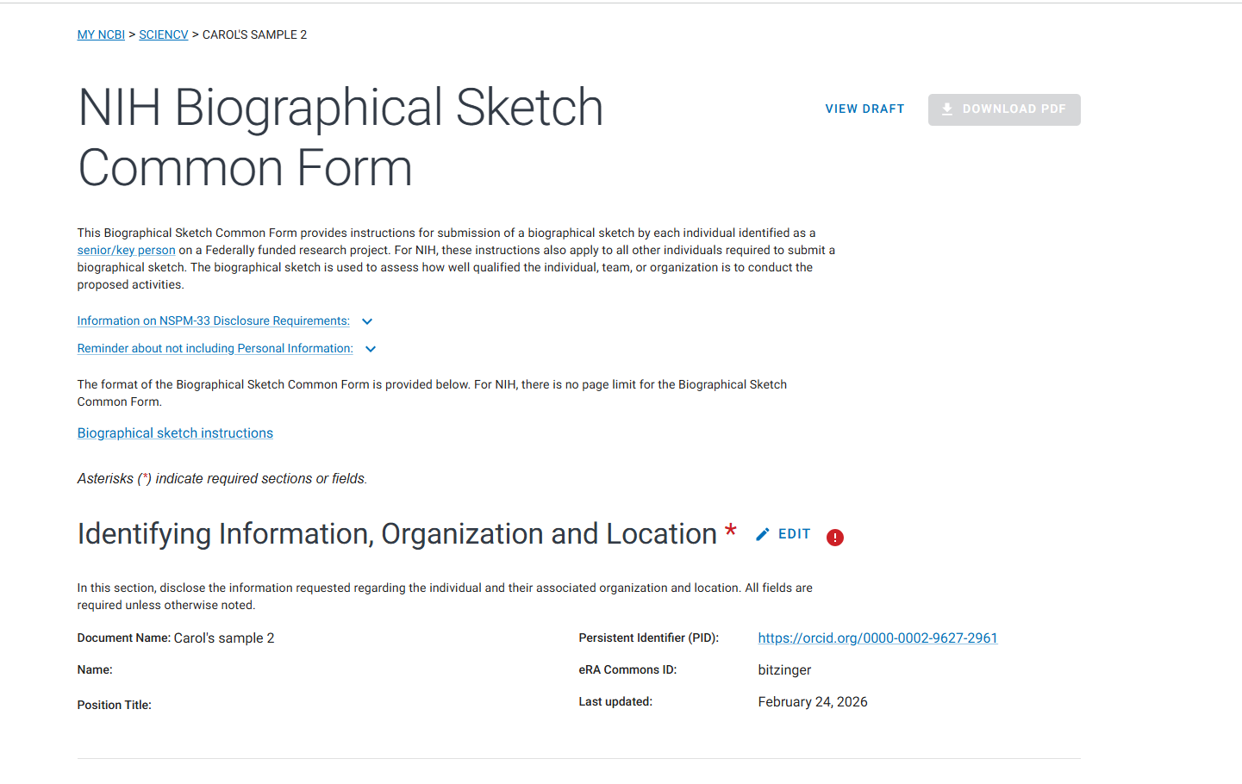
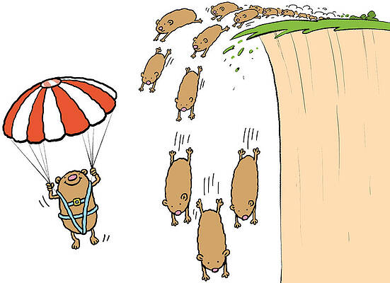
Let's jump in!

