Slide 1

Applying for Research Funding from Foundations
Carol Bitzinger, CRA
Senior Grants Manager, IPR, Sociology, and Communication
Bitzinger.1@osu.edu
Janet Tobler
Sponsored Program Officer
Tobler.13@osu.edu
614-247-9616

Slide 2
Support for Foundation Funding
Roles of OSP, departmental grants administrators, and Foundation Engagement
Tools for finding your support staff:
  Arts and Sciences Research Administrators Directory
  Education and Human Ecology Directory
  College of Public Health
  Office of Sponsored Programs (OSP) - Sponsored Program Officers for all areas across University
  Foundation Engagement - Kristina Markel.8 for Arts & Sciences and Public Health

Slide 3
What do private foundations fund?
Research that matches their priority funding areas
  Funding priorities communicate a foundation's current interest
Innovative pilot studies for service models that have the potential to scale up

Slide 4
Identifying potential funders
Examine previously funded proposals to get a better idea of a sponsor's funding history:
Who they fund
What they fund
Where awards are made
How they fund
Award amount
  Does the available funding match your scope of work? ...Does the duration?

Slide 5
Foundation Engagement
Foundation engagement staff are development/grantwriting professionals who work to connect OSU researchers with private foundations.
Foundation Engagement team supports:
  Prospect identification (identifying possible fits for sponsors and PIs)
  Proposal development (reviewing solicitations, assisting with materials)
  Stewardship (postaward—clearance list of managed sponsors, ongoing relationship-building with sponsors)
Foundation Engagement team partners with:
  Proposal Development Office
  Sponsored Programs
  Grant Managers

Slide 6
Foundation Engagement, pt. II
The Office of Foundation Relations are institutional liaisons
Provide a connection between the Ohio State research community and foundations
Some foundations expressly require that only designated officials approach them
Foundation Engagement recommends you contact their office before you approach a foundation. They can offer background on our current relationship and offer guidance on the best methods of contact.
*Be mindful of limited submissions: sponsors can restrict the number of proposals and institution can submit. If interested in these opportunities, contact OSP or Foundation Engagement.

Slide 7
Foundations Funding Research at Ohio State (not exhaustive)
Alfred P. Sloan Foundation* - We fund research and education in science, technology, engineering, mathematics and economics. Website
American Heart Association - We’re looking for organizations that are translating evidence-based science research and clinical know-how into solutions that address health care access and quality, food security, economic empowerment or a combination of these three social drivers of health. Website
Arnold Ventures* - Dedicated to improving the lives of all Americans through evidence-based policy solutions that maximize opportunity and minimize injustice. This includes education, criminal justice, health, infrastructure, and public finance. Website
Burroughs Wellcome Fund - BWF believes that a diverse scientific workforce is essential to the process and advancement of research innovation, academic discovery, and public service. Website
Charles Koch Foundation- Our support focuses on identifying, exploring, and removing the barriers that keep individuals from realizing their unique potential. Key focus areas are the future of work and liberalism. Website

Slide 8

Columbus Foundation- Works to strengthen and improve our communities in the following areas: arts & culture, health & special populations, basic needs, youth& education, environment, capacity building, neighborhoods, community gardens, and animals. Website
Commonwealth Fund - We support independent research on health care issues and make grants to promote better access, improved quality, and greater efficiency in health care, particularly for society’s most vulnerable, including people of color, people with low income, and those who are uninsured. Website
Doris Duke Foundation - The mission of the Doris Duke Foundation (DDF) is to build a more creative, equitable, and sustainable future by investing in artists and the performing arts, environmental conservation, medical research, child well-being, and greater mutual understanding among diverse communities. Website
Harry Frank Guggenheim Foundation* - The Harry Frank Guggenheim Foundation examines enduring and urgent problems of violence, such as war, crime, and human aggression. Through basic and applied research, we aim to understand the causes, manifestations, and control of violence. Website

Slide 9

Gates Foundation* - Our mission is to create a world where every person has the opportunity to live a healthy, productive life. For over 25 years, the Gates Foundation has been committed to fighting the greatest inequities in the world. Website
Henry Luce Foundation - The Democracy, Ethics, and Public Trust (DEPT) Initiative helps grantees ‌reimagine and reinvigorate democratic culture and practices by expanding networks and encouraging new research and approaches. Website
Herbert W. Hoover Foundation - Advances innovative strategies for community engagement, science, education, and environmental stewardship. Website
John A. Hartford Foundation- We invest in aging experts and practice innovations that transform how the care of older adults is delivered. Website

Slide 10
Foundations (cont'd)
John Templeton Foundation* - The mission of the John Templeton Foundation is to support interdisciplinary research and catalyze conversations that inspire awe and wonder. Website
Joyce Foundation - Investing in the future of the Great Lakes region. What we fund: culture, democracy, education & economic mobility, environment, gun violence prevention & justice reform, and journalism. Website
MacArthur Foundation - We’re committed to building a more just, verdant, and peaceful world. Areas of funding include climate change and criminal justice research. Website
OneOhio Recovery Foundation - Combatting the effects of the Opioid epidemic across Ohio Website
Patient- Centered Outcomes Research Institute (PCORI)* - PCORI’s Research Project Agenda includes a set of broad Topic Themes that speak to a range of health issues facing Americans including children, youth, and older adults and address urgent topics such as violence and trauma, substance use, and mental and behavioral health, as well as widespread conditions including cardiovascular disease, pain management, and sleep health. Website

Slide 11


Robert Wood Johnson Foundation* - We fund programs that inspire bold ideas and encourage collaboration to achieve health equity faster and pave the way, together, to a future where health is no longer a privilege, but a right. Website Rapid Response: Reinvesting in Racial and Indigenous Health Equity Research (due Oct. 1)
The Rockefeller Foundation - We are a philanthropic foundation that promotes the well-being of humanity by finding and scaling solutions that advance opportunity and reverse the climate crisis. Website
Russell Sage Foundation* - RSF funds research projects in four principal programs—Behavioral Science and Decision Making in Context; the Future of Work; Race, Ethnicity, and Immigration; and Social, Political, and Economic Inequality—and in a number of special initiatives. Website
Society for Family Planning* - The Society of Family Planning is the source for abortion and contraception science. Website Bridge funds for terminated NIH awards

Slide 12
Spencer Foundation* - Our programs provide funding for education-focused research projects, research training fellowships, and additional field-building initiatives. Website
Templeton World Charity Foundation* - catalyzes discovery and accelerates progress in the spiritual search for meaning, purpose, and truth. We promote scientific findings and religious exploration to inspire new perspectives on life’s deepest questions. Website
W.K. Kellogg Foundation - W.K. Kellogg believed in the ingenuity of the people who shape children’s lives and the power of collaborative leadership. This spirit threads through our work today, along with our commitments to racial equity and community engagement. Website
The William T. Grant Foundation* - The William T. Grant Foundation invests in high-quality research focused on reducing inequality in youth outcomes and improving the use of research evidence in decisions that affect young people in the United States. Website

Slide 13
Navigating the proposal process
Increased competition for private funding opportunities may impact the application process (i.e. additional application steps)
Budgeting: look closely for language on indirect costs and other budget limitations
  Is tuition allowable? If not, you may need to allow time for a Grad Fee Match request.
Know the process for a specific foundation: Letter of intent (LOI)? Pre-applications? Unique sponsor interfaces?
Make sure you are following new internal deadlines and submitting the Proposal Intake Form on time. Guidelines can be found here.
Keep your departmental grants administrator looped into the process!

Slide 14
Case Studies

Slide 15
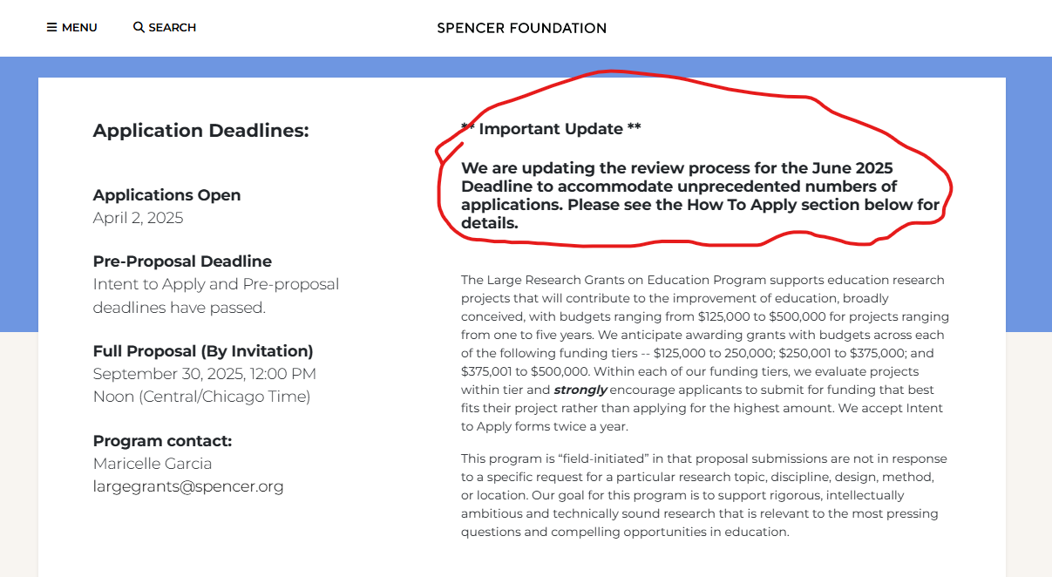
Spencer Foundation
Solicitation: Large Grants on Education

Slide 16
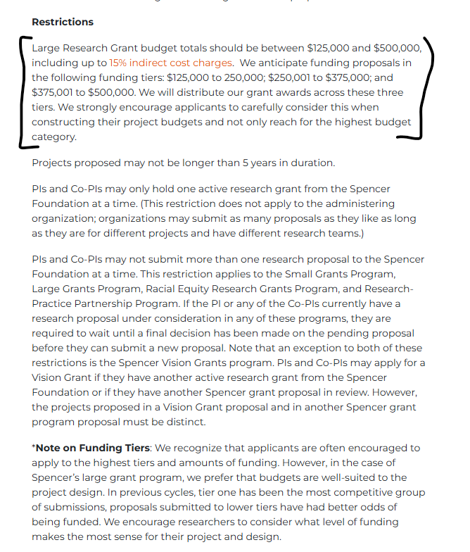
Spencer restrictions

Slide 17
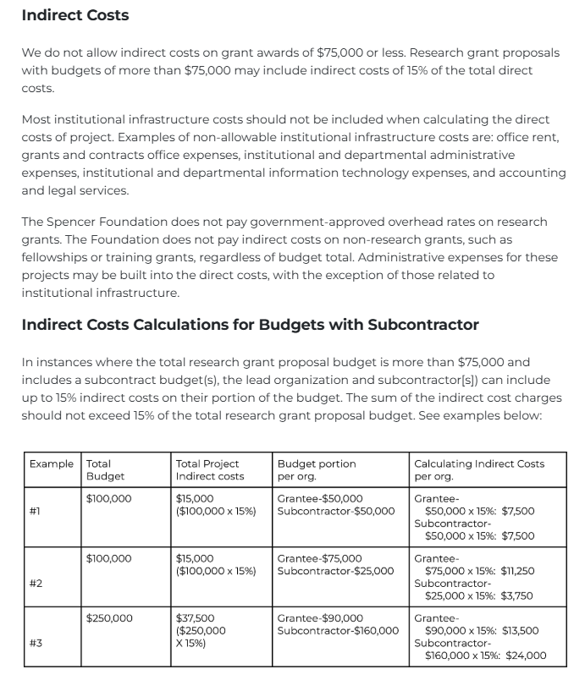
Spencer Restrictions

Slide 18
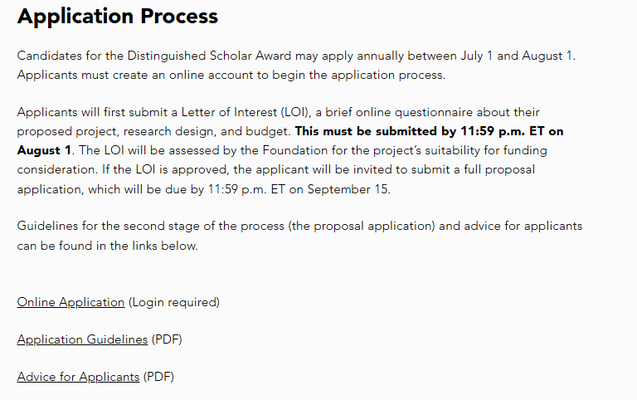

H.F. Guggenheim Distinguished Scholars
Solicitation: Distinguished Scholars site

Slide 19
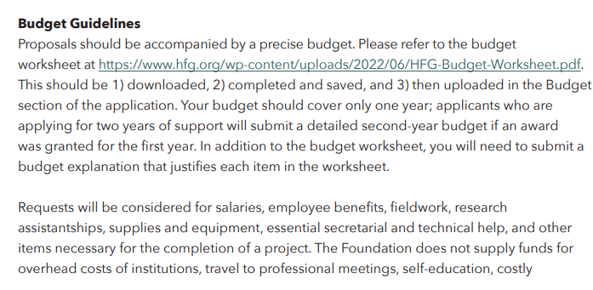
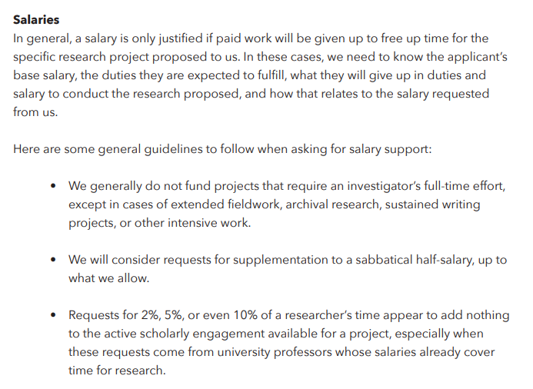
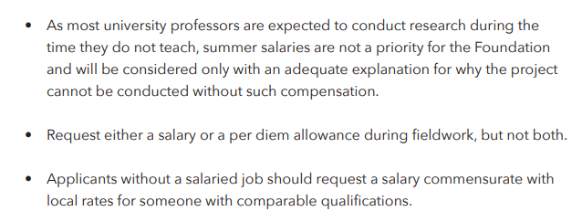
Sample budget guidelines

Slide 20
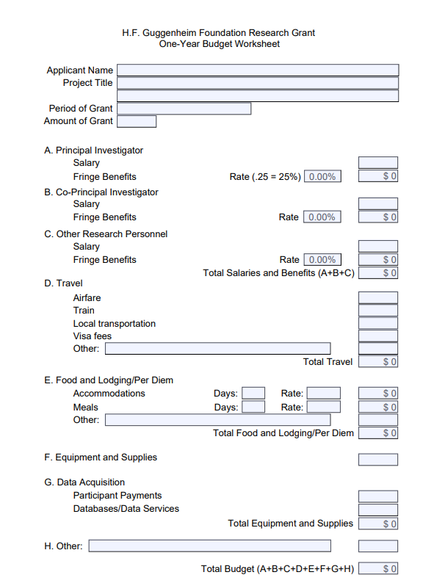
Sample budget

Slide 21
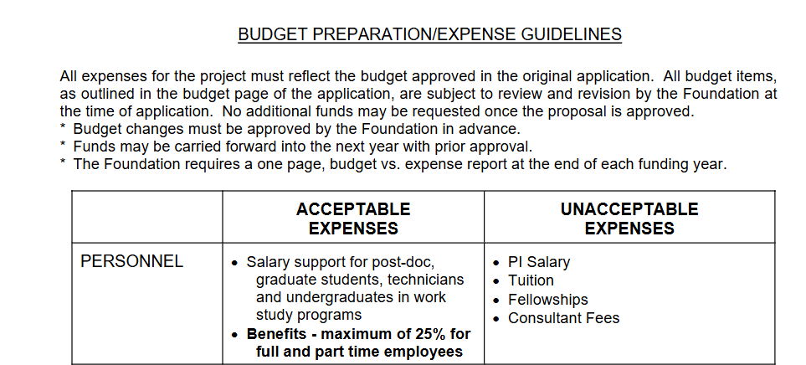
Final Example: Postaward Management

Slide 22

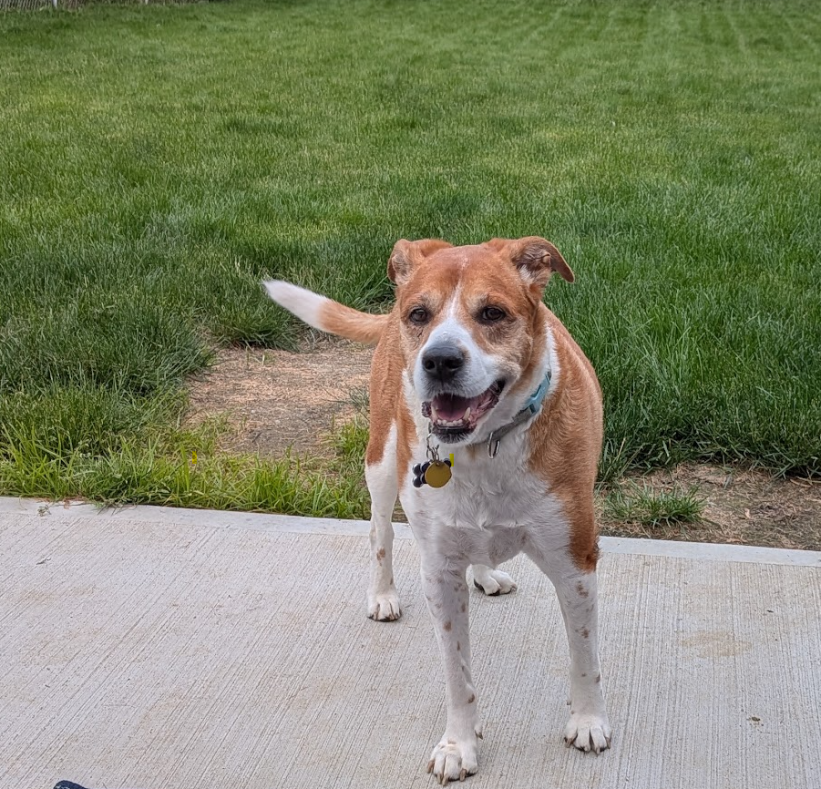
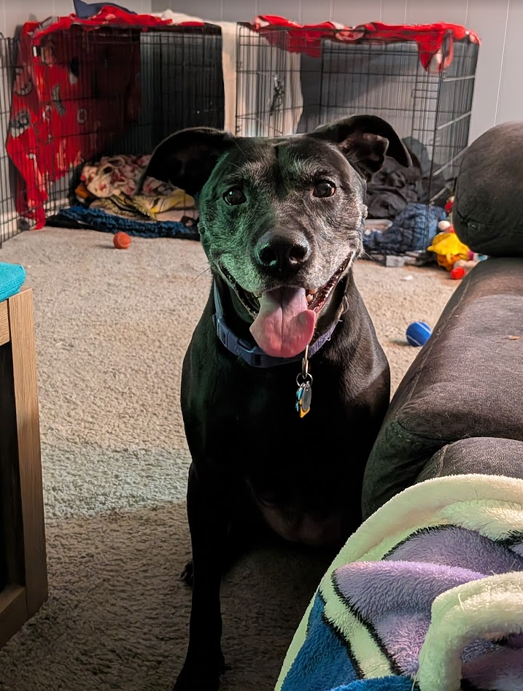
Thank you!

