Slide 1
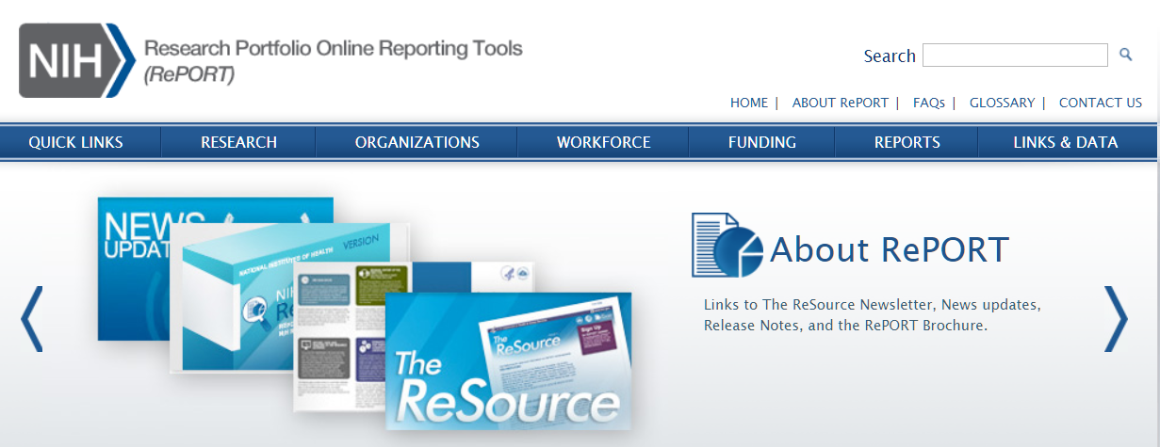
Using NIH’s Research Portfolio Online Report Tool (RePORT) to Your Advantage
November 2019
Megan Columbus
Director, Division of Communications and Outreach
NIH Office of Extramural Research

Slide 2

Objective:
Expose you to the power of using RePORT to explore NIH funding so you can:
RePORT.nih.gov
  search for info on NIH funding by institution, principal investigator, and more;
  identify NIH funded projects and explain how this information can be helpful;
  find which institutes support research like yours
  identify study sections that review applications like yours

Slide 3


How to find RePORT
Finding RePORT
grants.nih.gov homepage links to RePORT

Slide 4
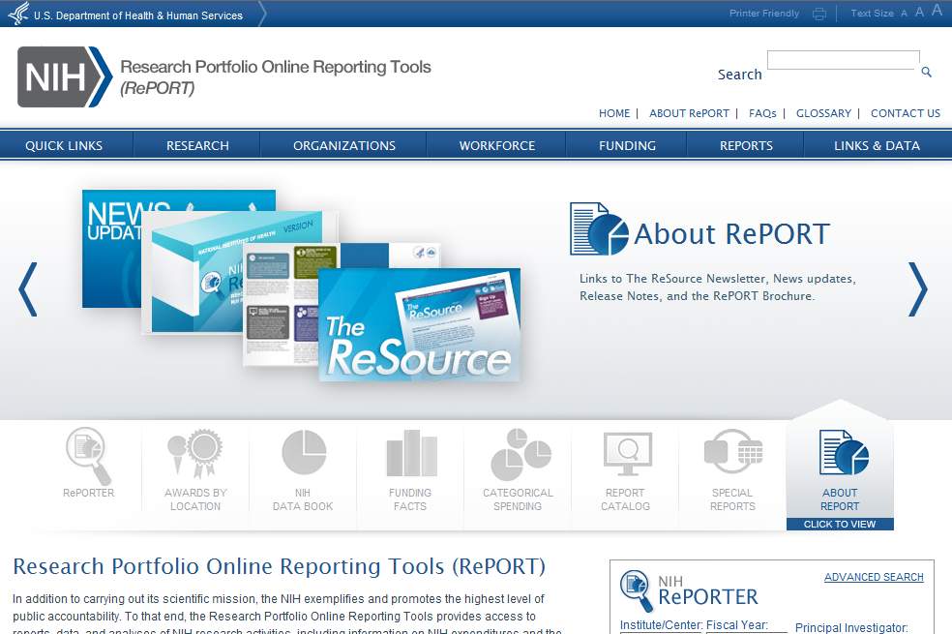
Screenshot of RePORT.NIH.GOV homepage
Report.nih.gov
Main navigation bar
Main navigation bar

Slide 5

Looking for where your research fits at NIH?
From RePORT, use RePORTER to find:
NIH supported projects like yours
Which NIH Institute(s) supports research like yours
Who to talk to at NIH about your area of research
Which study sections review research like yours
The nifty Matchmaker tool
And more

Slide 6

RePORTER = Research Portfolio Online Report Tool (RePORT) Expenditures and Results
NIH intramural and extramural data since 1985
    Patents, publications, news, final reports and other research outcomes
Projects supported by ACF, AHRQ, CDC, FDA, and VA

Slide 7
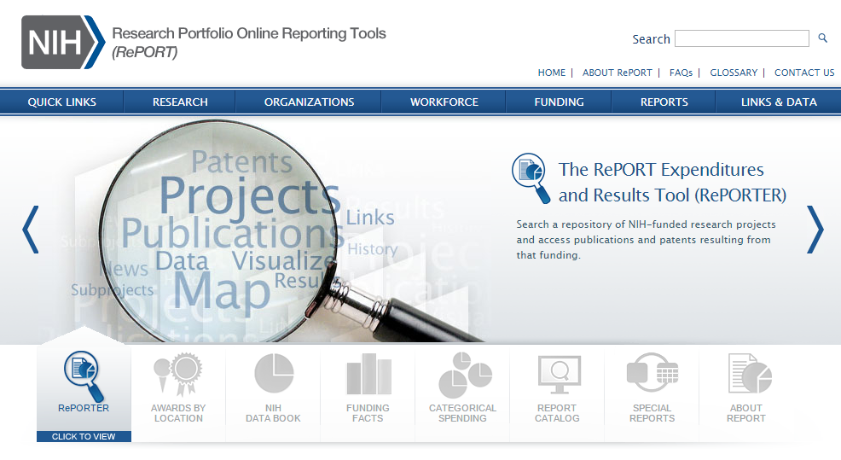
Access RePORTER to Search Database
Search NIH-funded projects

Slide 8
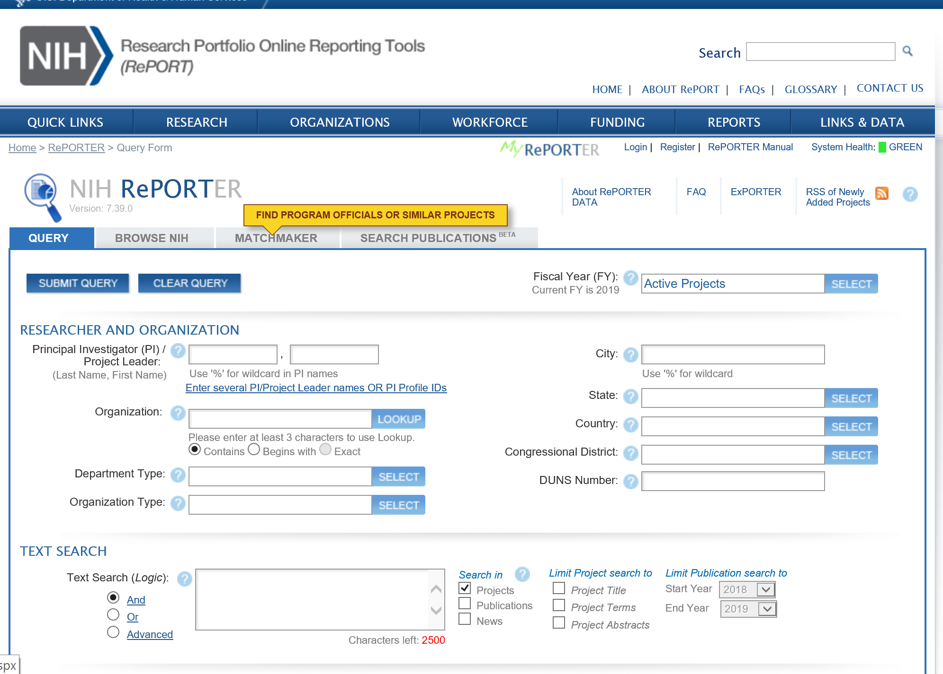
Within RePORTER, Check Out Matchmaker for Research Like Yours and Program Contacts

Slide 9
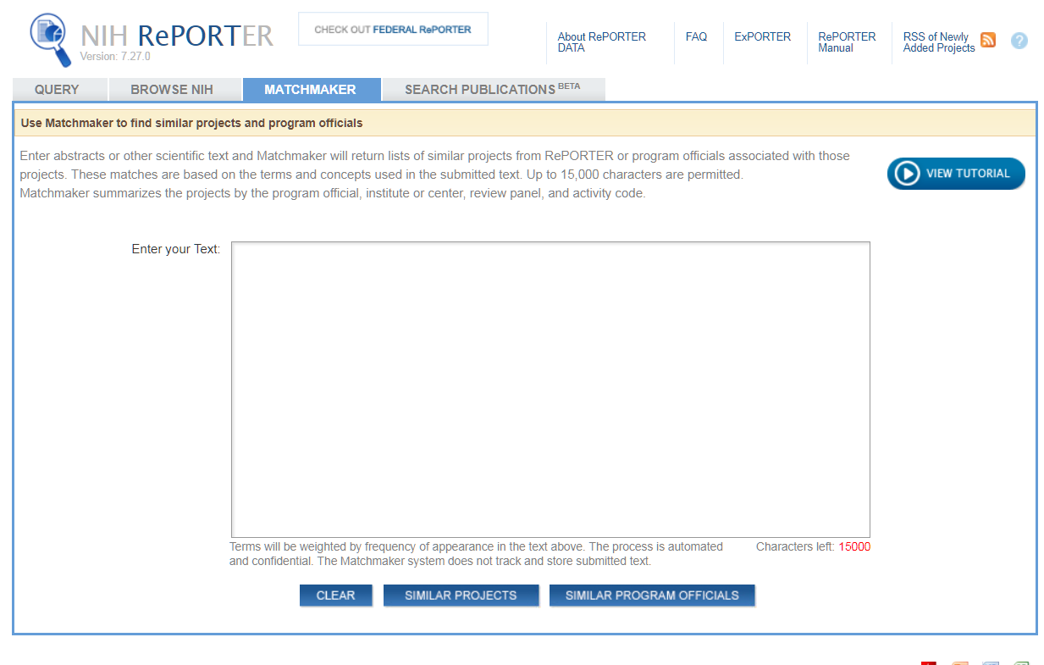
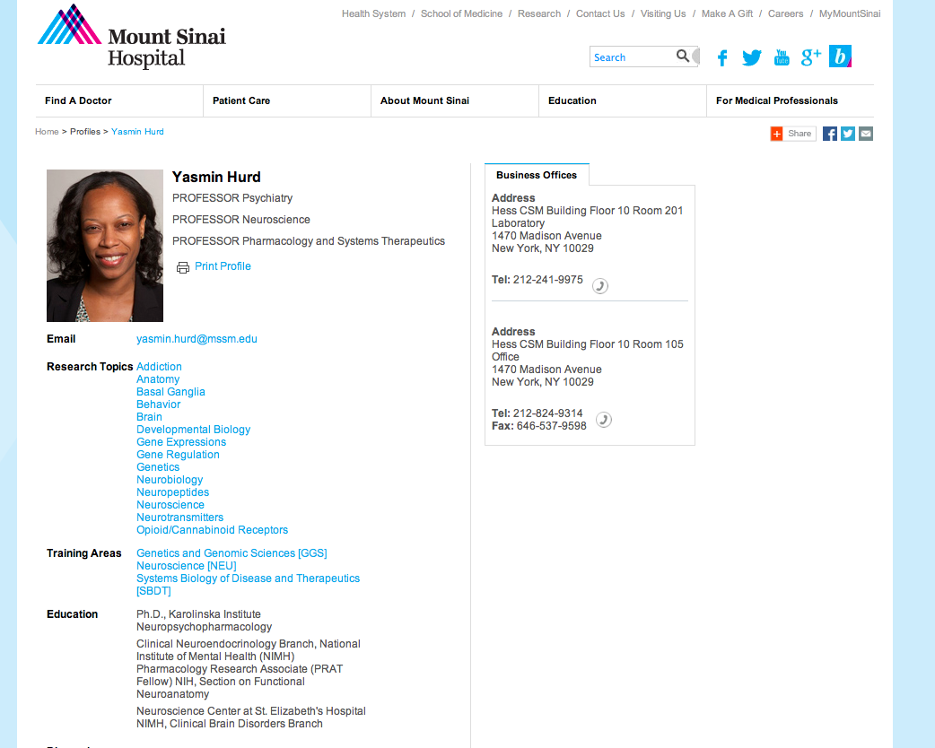
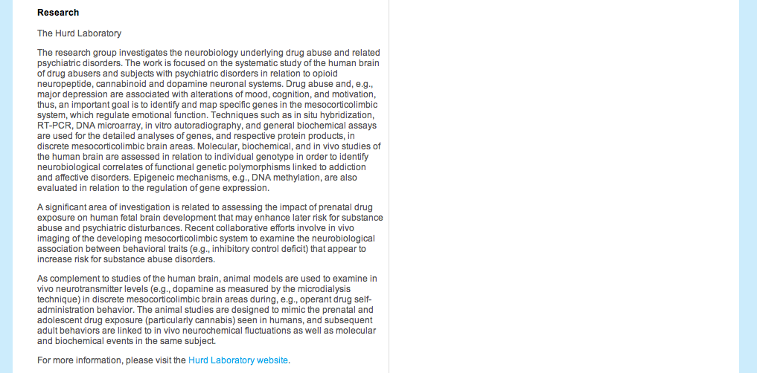
Matchmaker Search
Matchmaker – find similar projects
The research group investigates the neurobiology underlying drug abuse and related psychiatric disorders. The work is focused on the systematic study of the human brain of drug abusers and subjects with psychiatric disorders in relation to opioid neuropeptide, cannabinoid and dopamine neuronal systems. Drug abuse and, e.g., major depression are associated with alterations of mood, cognition, and motivation, thus, an important goal is to identify and map specific genes in the mesocorticolimbic system, which regulate emotional function. Techniques such as in situ hybridization, RT-PCR, DNA microarray, in vitro autoradiography, and general biochemical assays are used for the detailed analyses of genes, and respective protein products, in discrete mesocorticolimbic brain areas. Molecular, biochemical, and in vivo studies of the human brain are assessed in relation to individual genotype in order to identify neurobiological correlates of functional genetic polymorphisms linked to addiction and affective disorders. Epigenetic mechanisms, e.g., DNA methylation, are also evaluated in relation to the regulation of gene expression.

Slide 10
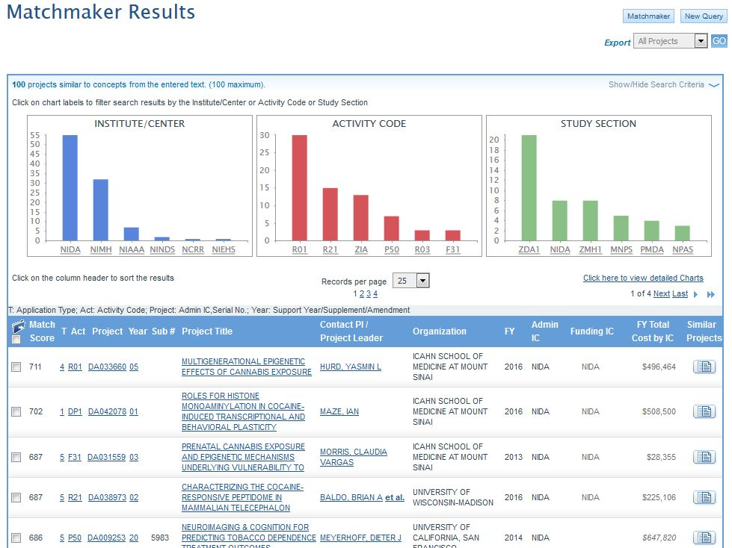
Matchmaker – Similar Project Search Result

Slide 11
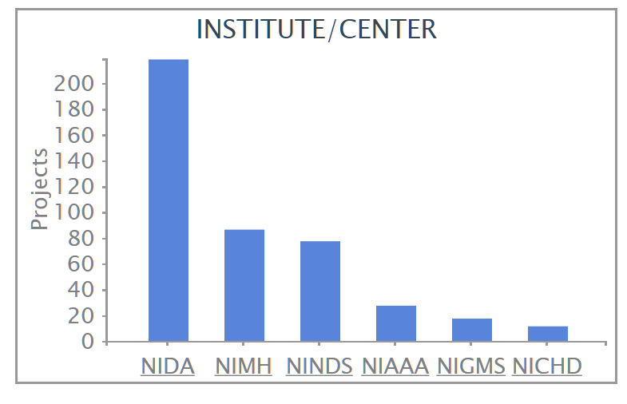
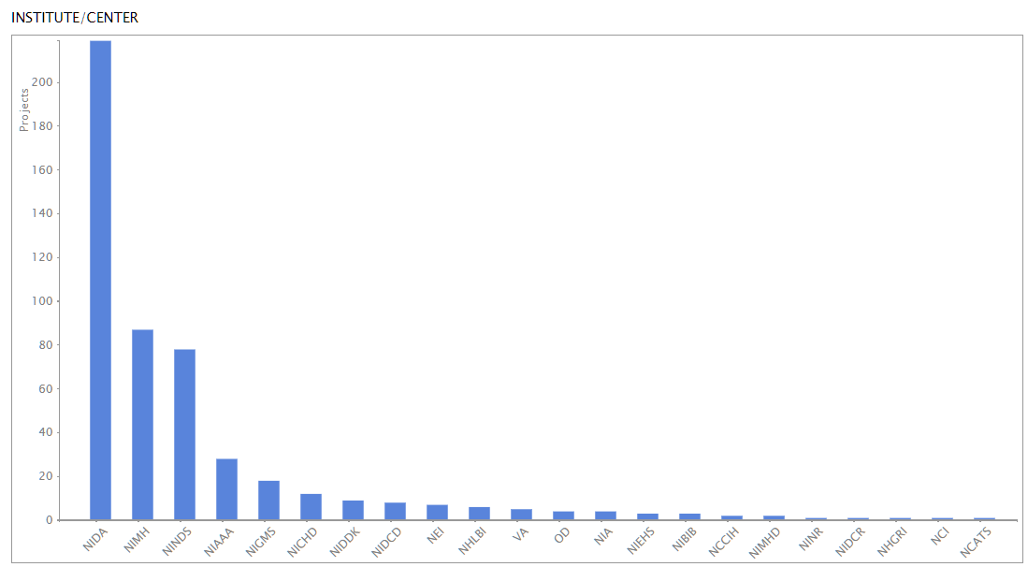
Matchmaker – Similar Project Result- Institute
Detailed chart view

Slide 12
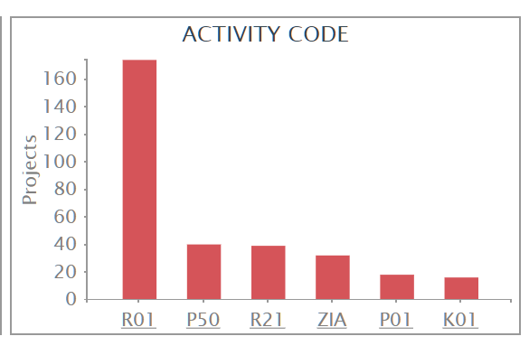
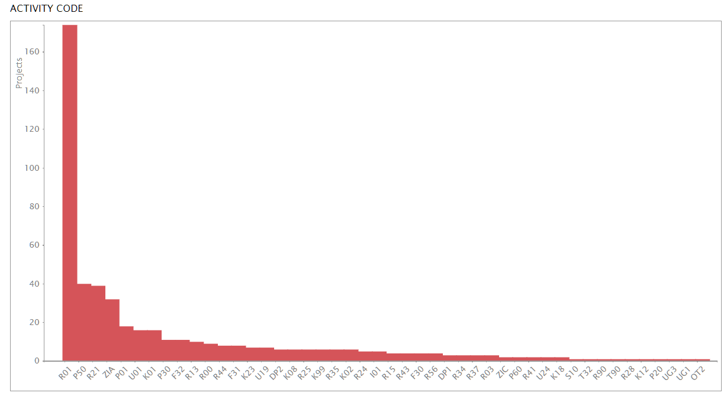
Matchmaker – Similar Project Search Result
– Activity Code
Detailed chart view

Slide 13
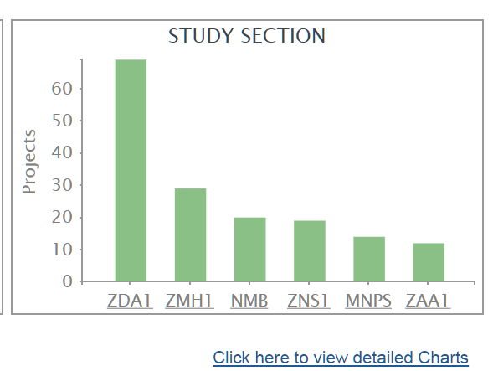
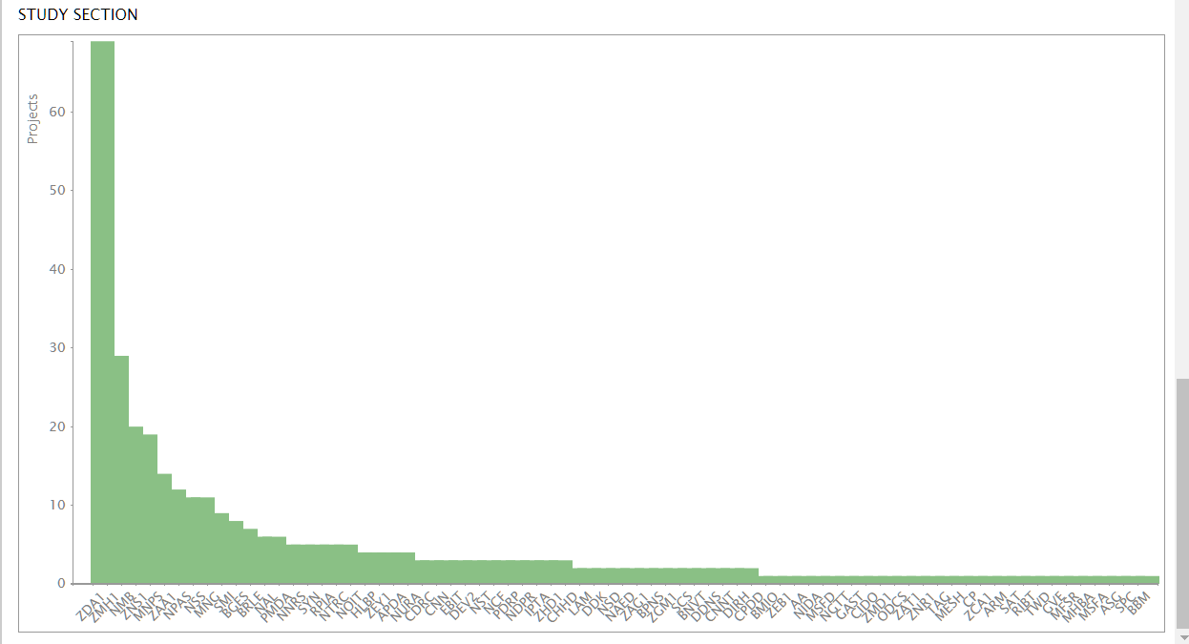
Matchmaker – Similar Project Search Result – Study Section

Slide 14
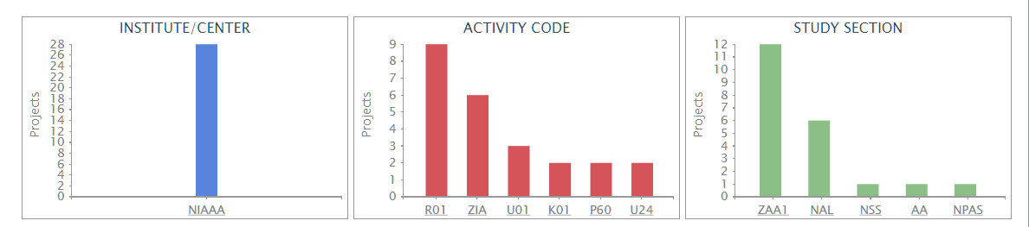
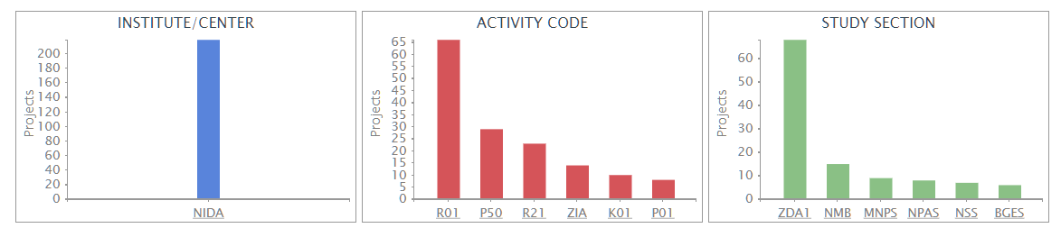
Matchmaker – Similar Project Result
- Explore Further
Select Institute to filter result

Slide 15
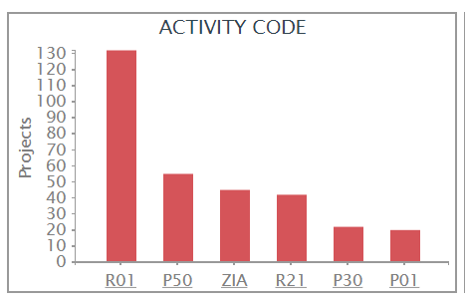
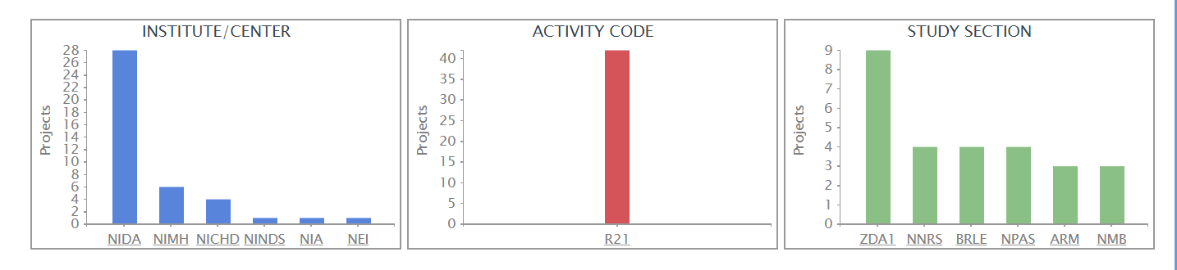
Matchmaker – Similar Project Result - Filtered by activity code
Select activity code to filter result

Slide 16
Matchmaker Search
Matchmaker – find program officials
The research group investigates the neurobiology underlying drug abuse and related psychiatric disorders. The work is focused on the systematic study of the human brain of drug abusers and subjects with psychiatric disorders in relation to opioid neuropeptide, cannabinoid and dopamine neuronal systems. Drug abuse and, e.g., major depression are associated with alterations of mood, cognition, and motivation, thus, an important goal is to identify and map specific genes in the mesocorticolimbic system, which regulate emotional function. Techniques such as in situ hybridization, RT-PCR, DNA microarray, in vitro autoradiography, and general biochemical assays are used for the detailed analyses of genes, and respective protein products, in discrete mesocorticolimbic brain areas. Molecular, biochemical, and in vivo studies of the human brain are assessed in relation to individual genotype in order to identify neurobiological correlates of functional genetic polymorphisms linked to addiction and affective disorders. Epigenetic mechanisms, e.g., DNA methylation, are also evaluated in relation to the regulation of gene expression.

Slide 17
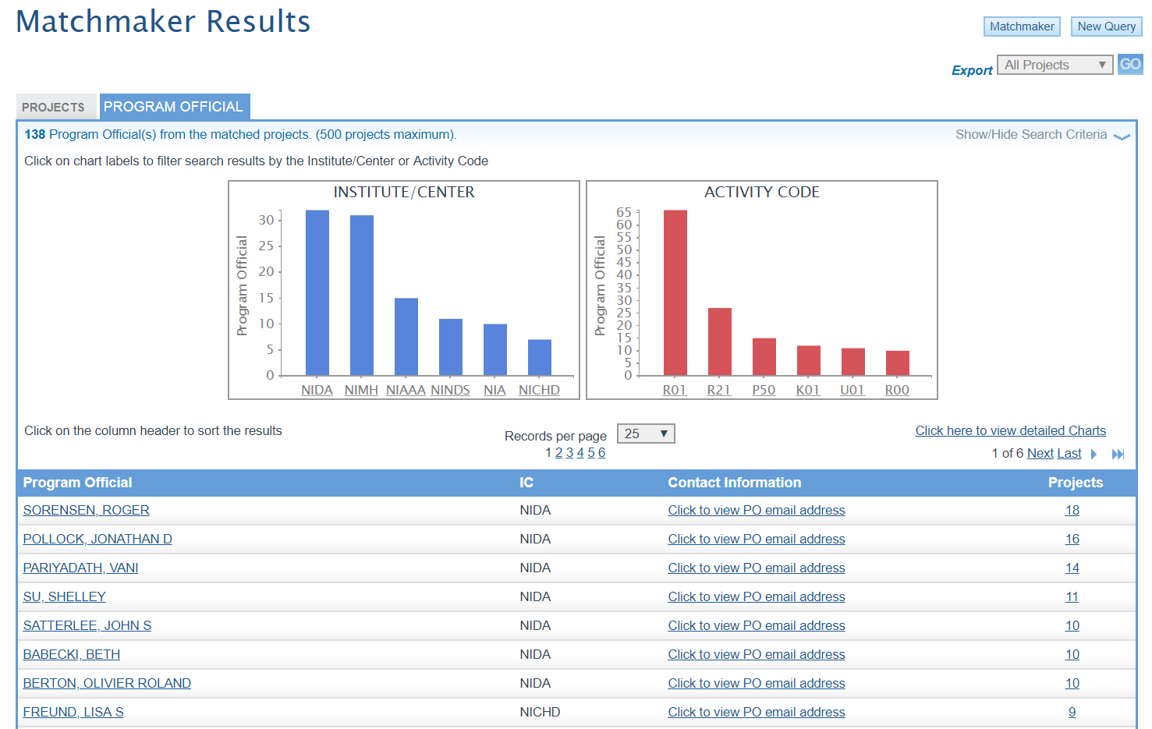
Matchmaker – Program Official Results
Toggle between matching projects and program officials

Slide 18
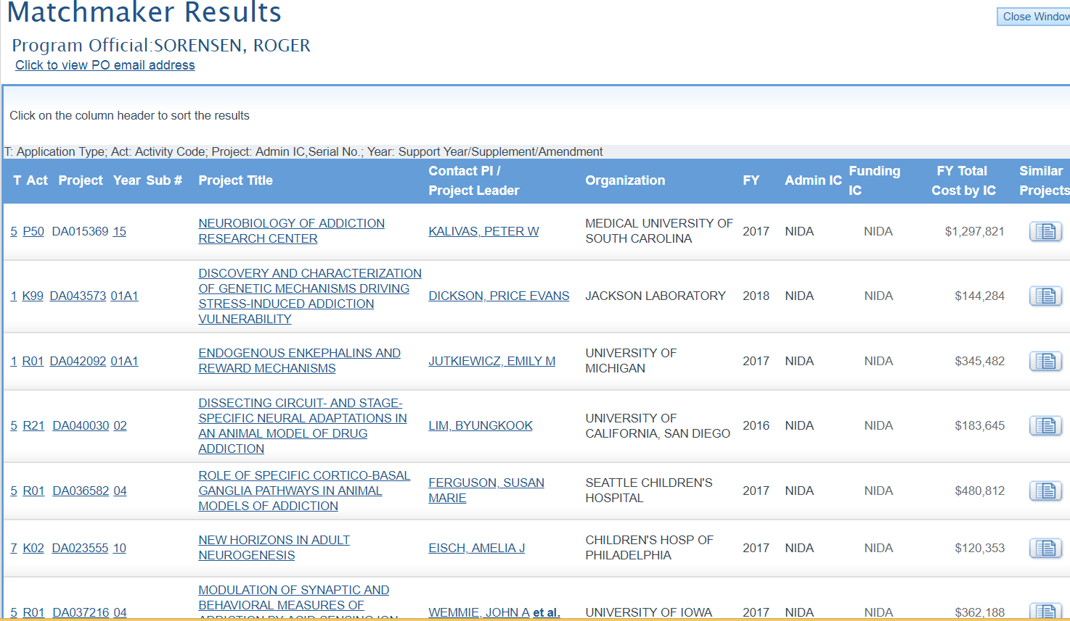
RePORTER/Matchmaker Results
– Drilling Down on Individual Projects
admin details
description of project

Slide 19
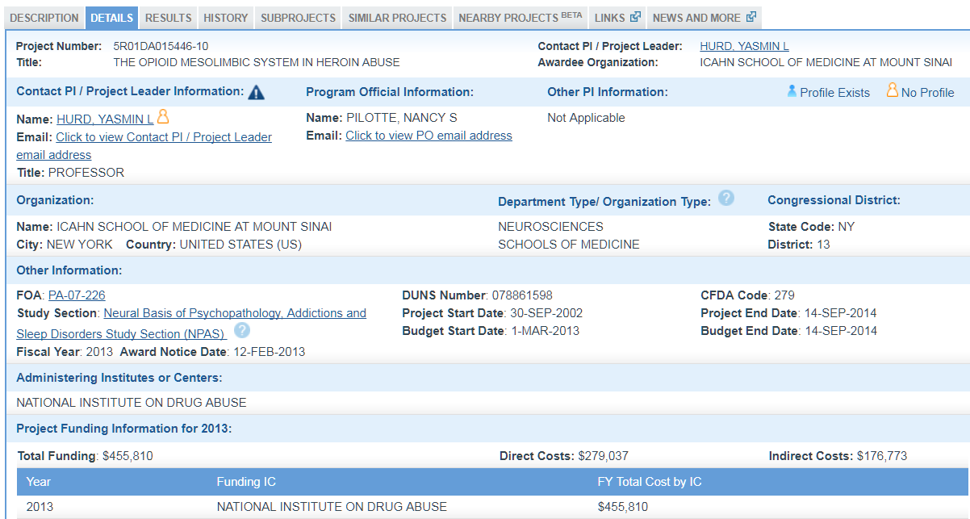
Administrative Details
PI contact info
NIH program official
FOA
Review panel
Funding

Slide 20
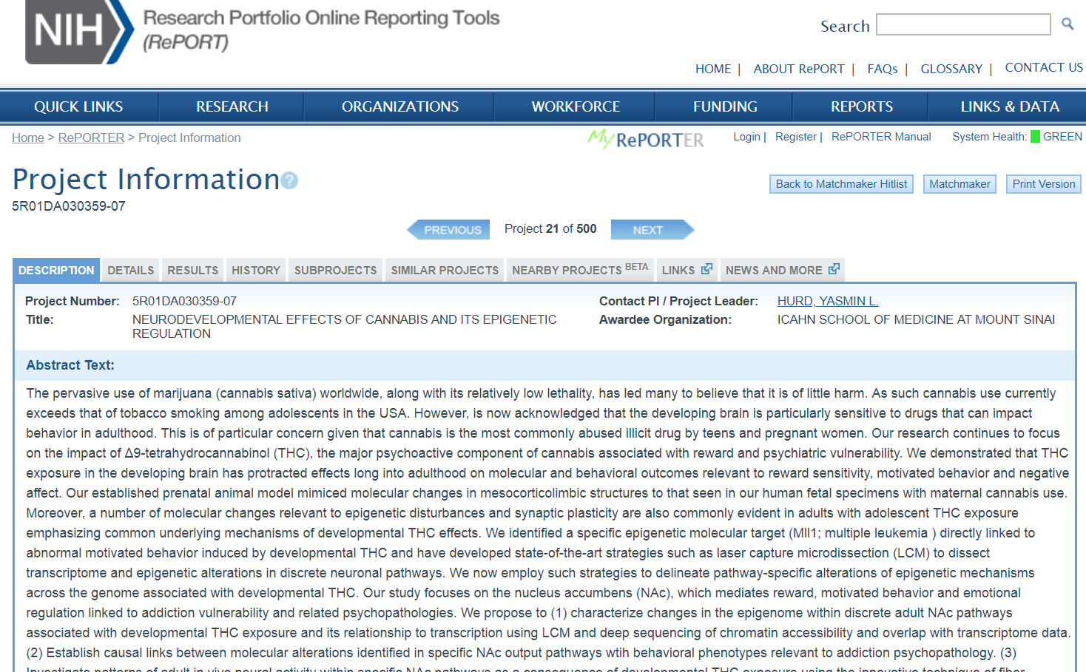
Project Description
Abstract text and public health narrative are public for funded grants

Slide 21
Use RePORTER Search Screen for Detailed Search
Search by:
PI name
Institution
Grant number
FOA
Topic
Study section
Etc.

Slide 22
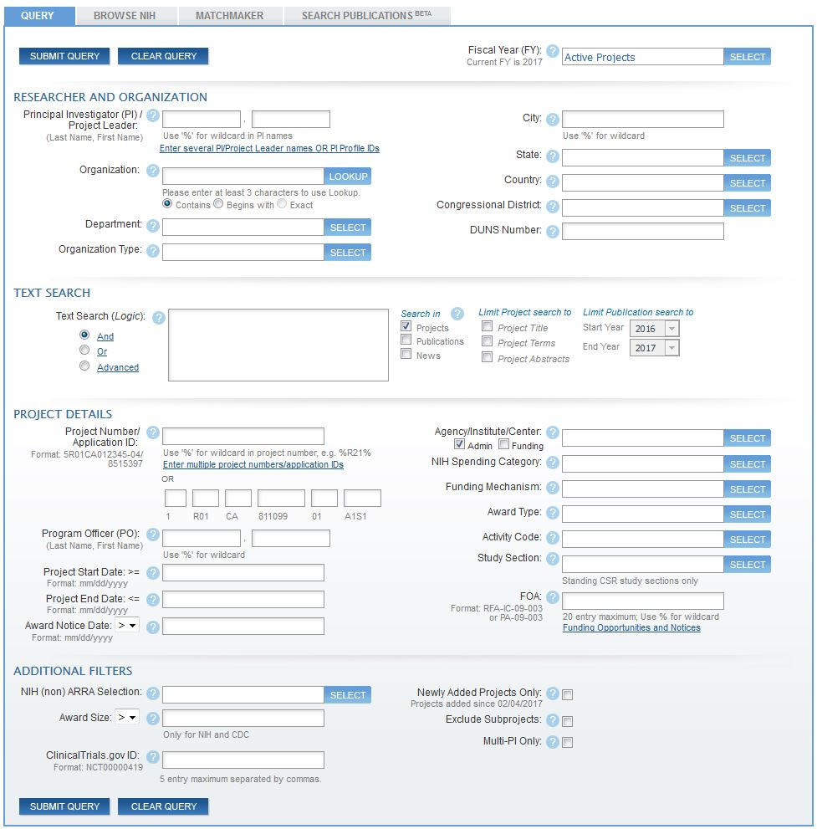
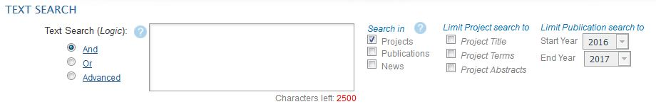
RePORTER—Text Search
"child development" or "early development" or "placental development"
Notes:
text search is one of the most common types of searches on RePORTER.
First, is the box where you can enter your search terms. When entering search terms in the box, the default is for RePORTER to look for projects that contain all of those terms, which we call “AND” logic. For this search, I’ll imagine that I’m looking for recent projects related to infant development, and do an advanced search using advanced logic such as quotes to specify exact phrases.
Then, we have the search targets, where by default you search against projects, but you can also search against the publications and news releases that have been supported by NIH projects.
To the right, we then have options that let you target your project text searches against just the title, terms or abstracts. Project terms are derived through a computer-based text mining process, and when searching against project terms, the search will also retrieve any synonyms. If you are searching against publication text, you can control what years of publications will be searched.
You can combine as many search fields as you like, to find the specific projects that you are looking for. For example, we can use the Agency/Institute/Center search field to limit the results to projects administered by NICHD.
Now that we have this simple search configured, we simply click “submit query”, here on the upper left of the search screen.

Slide 23
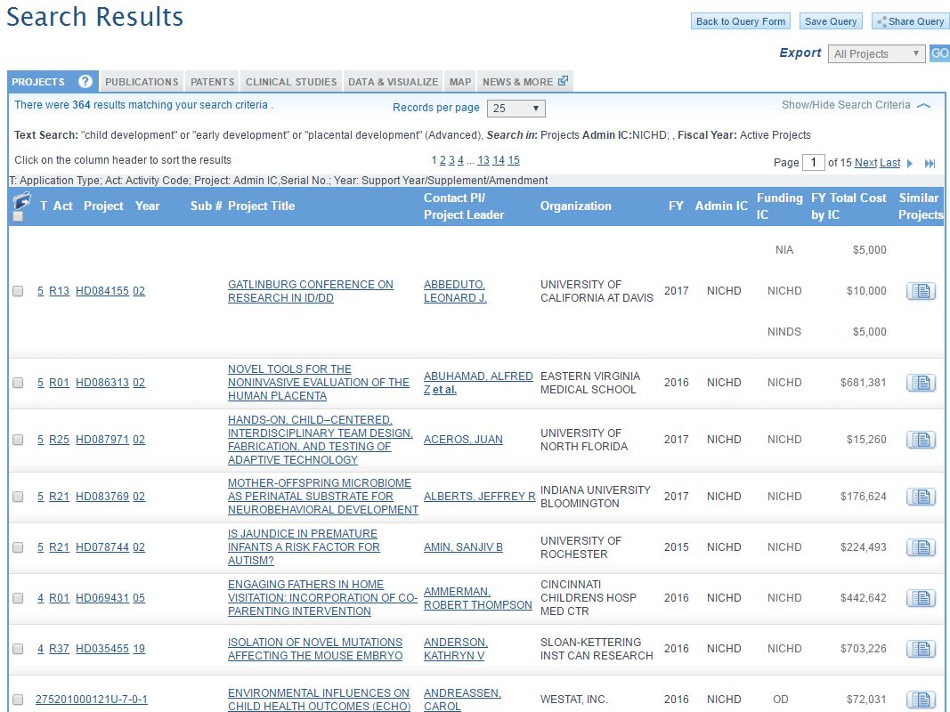
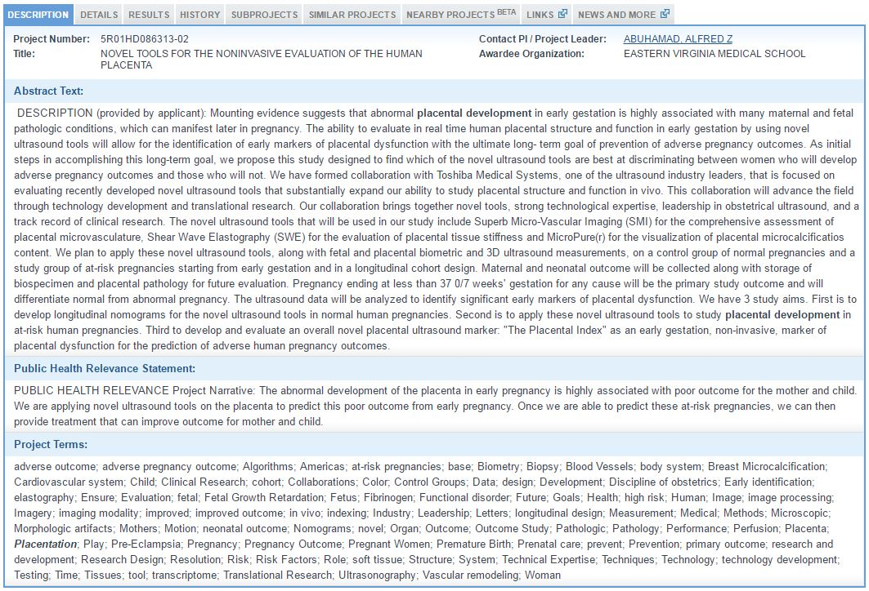
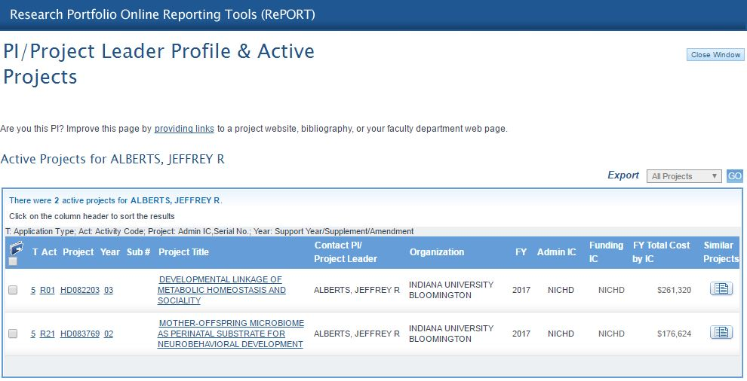
RePORTER-Search Results
23
Notes:
Once the query is complete, RePORTER will return your list of search results, which represents the Active research projects from NICHD that contain any the phrases we searched for. The PROJECTS list includes the Project number, the Title, the PI, the Organization, the fiscal year when this project was funded, which IC or agency funded the research, and how much funding is currently being used.
You can click the hyperlinked text to view the scientific and administrative details about the awarded projects, or get more information about the investigators.
Now I’d like to go through some of the more advanced features of the Search Results page, where we have several tabs of information about what’s on the hitlist.

Slide 24
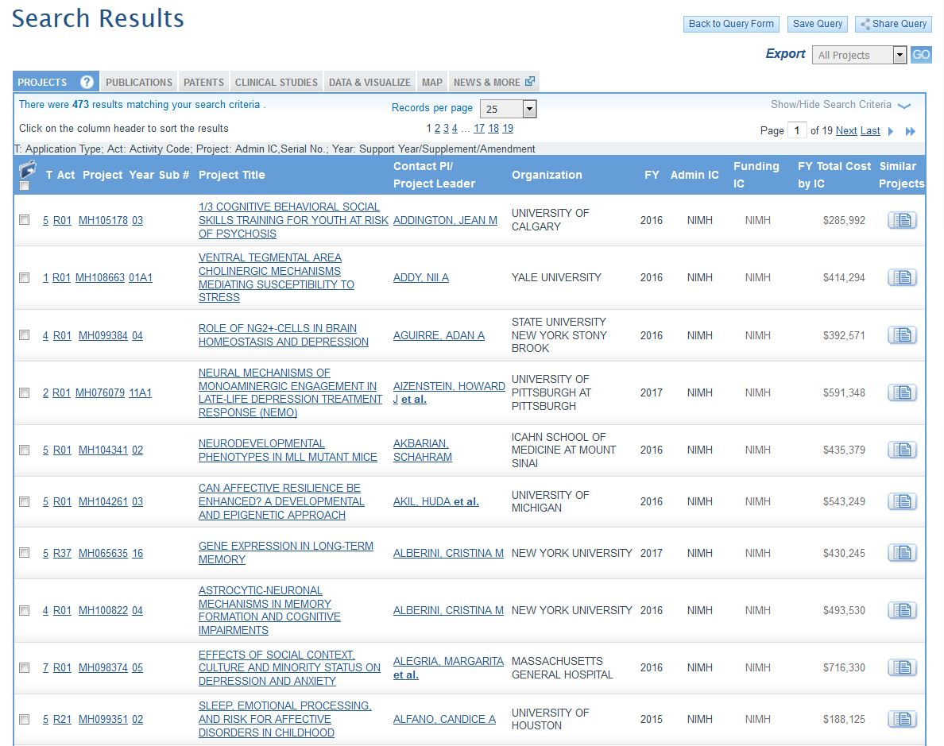
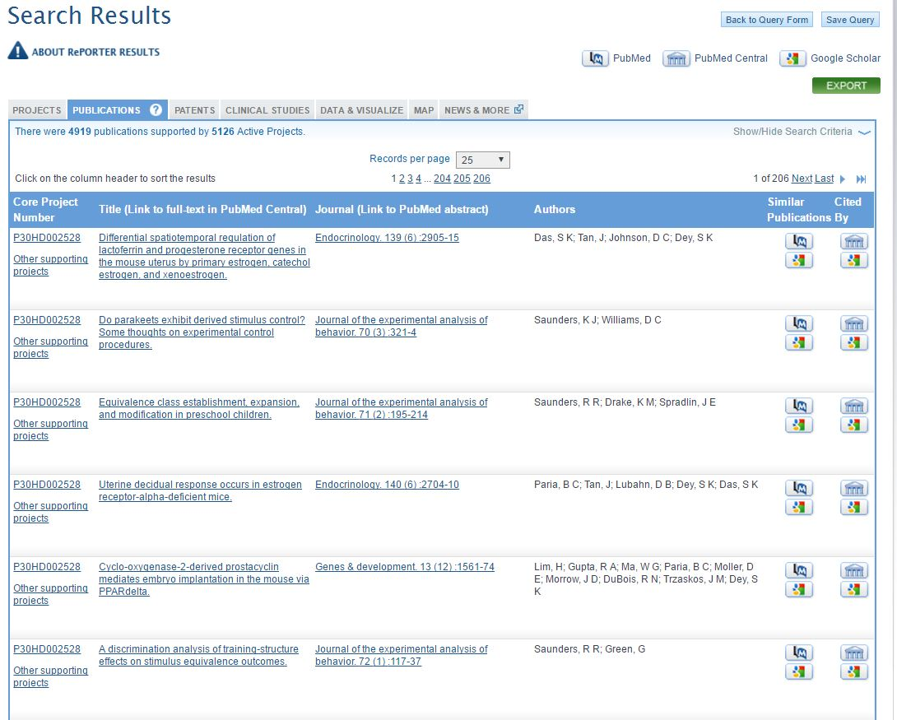
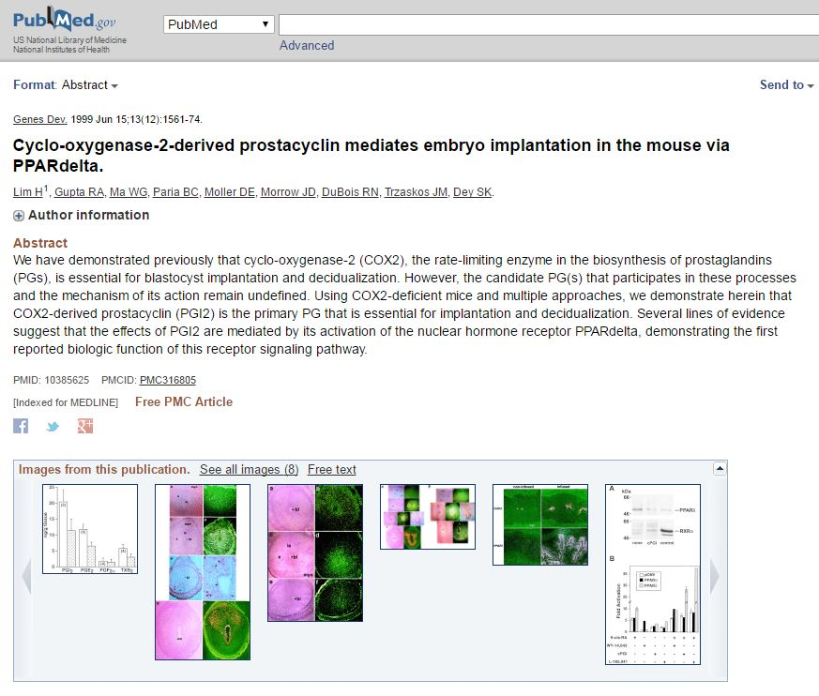
Search Results Publications
Notes:
Next is the publications tab, with the list of publications that were supported by the projects on the first list. This page includes links out to PubMed and PubMed Central, where you can view the abstract or full text of a publication.

Slide 25
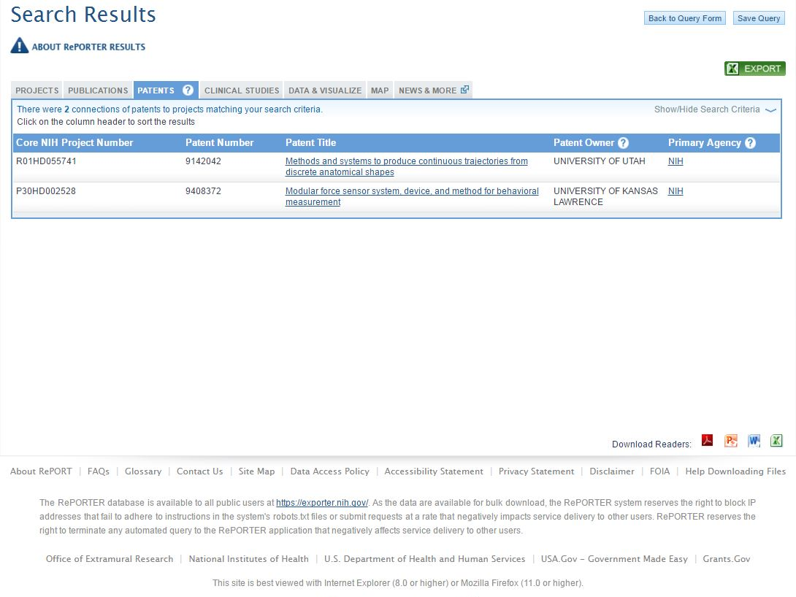
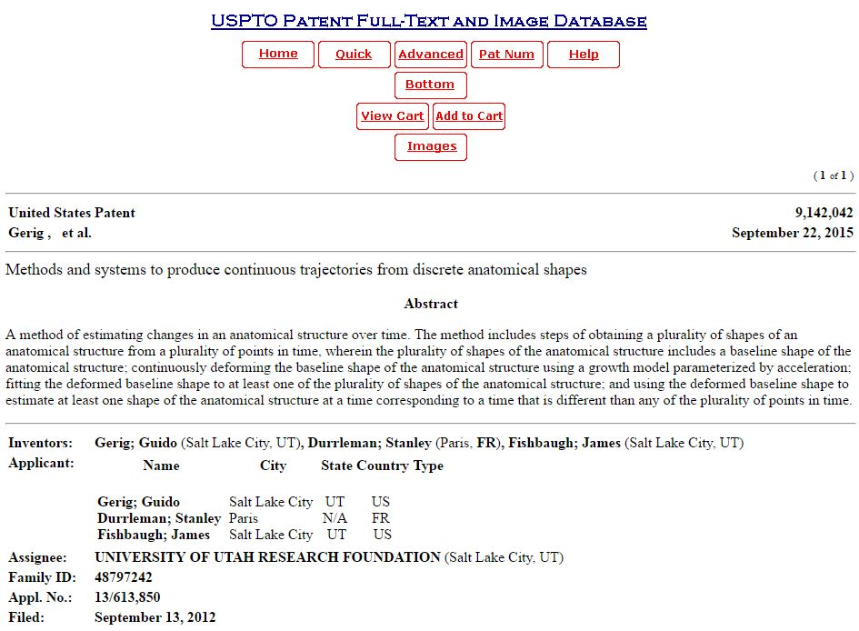
Search Results - Patents
Notes:
We also display any patents that have been linked to NIH awards through the iEdison tool, or through the NIH Intramural Database. Clicking the Patent Title takes you out to the USPTO database, where you can learn more about these patents that have acknowledged NIH support.

Slide 26
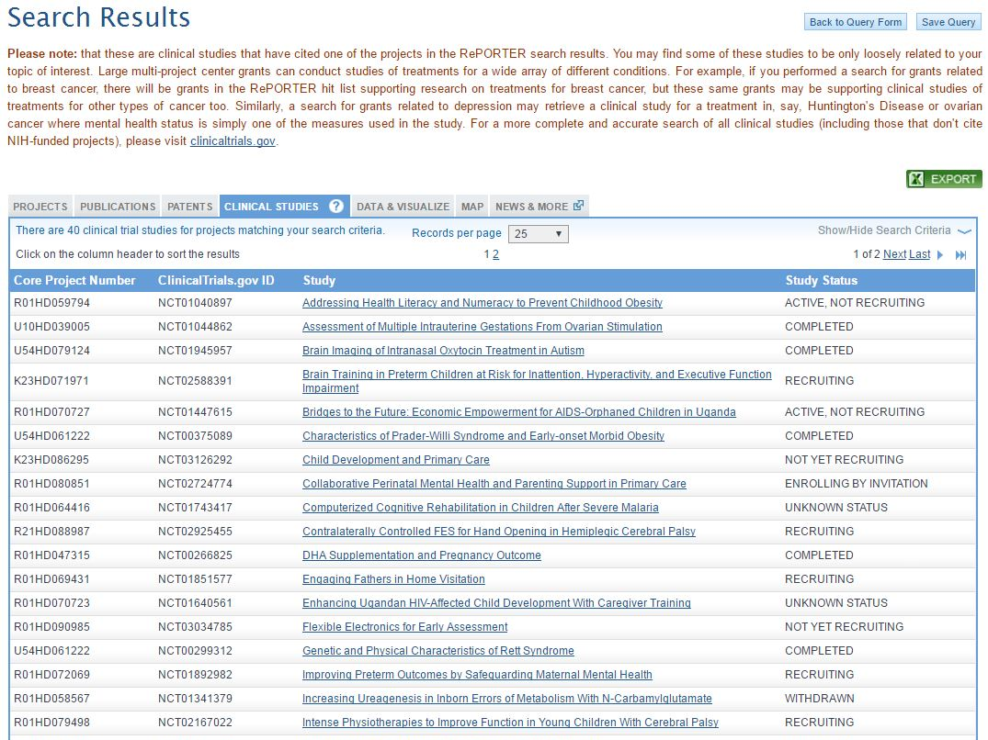
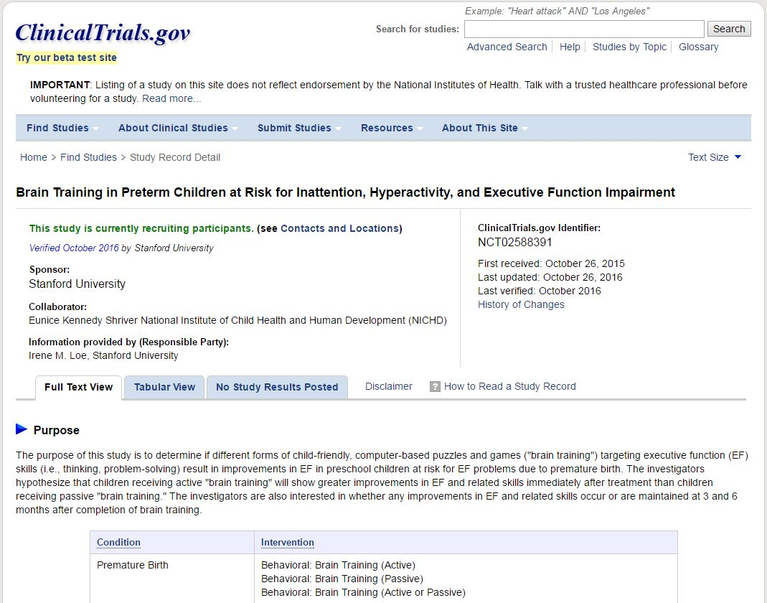
Search Results – Clinical Studies
Notes:
Next over are the clinical studies that are linked to NIH grants through ClinicalTrials.gov. We display the status of the trial reported through ClinicalTrials.gov, so you can easily find out which studies are recruiting participants. You can click the study title to read the details of those studies.

Slide 27
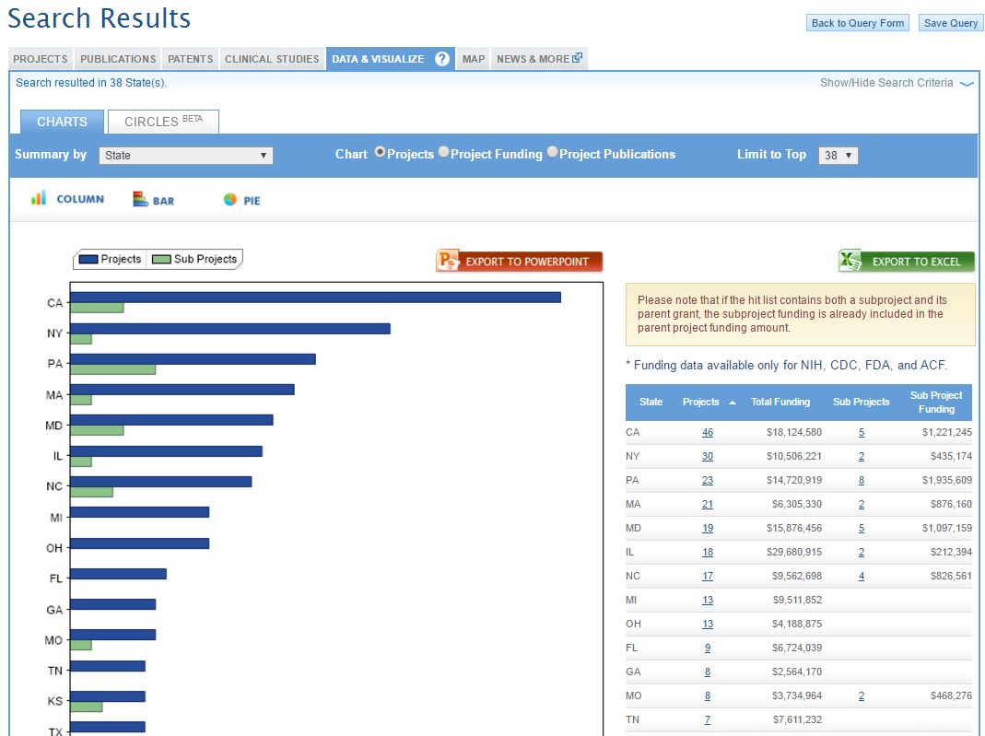

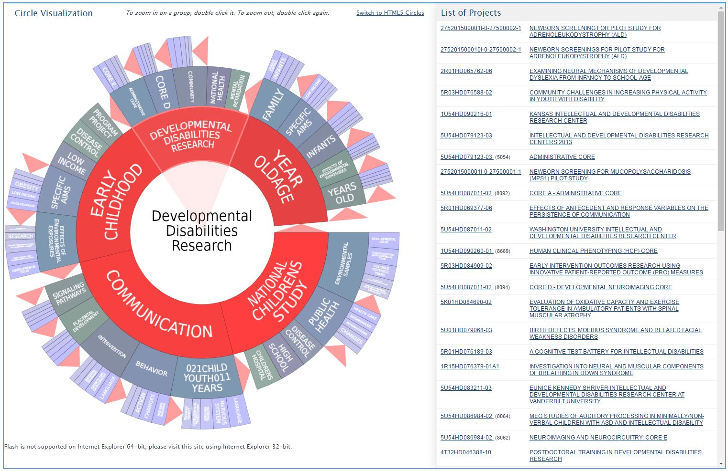
Search Results – Data & Visualize
Notes:
For large lists of projects, we offer tools to visualize the characteristics of your search results on the Data & Visualize tab. You may want to view summaries of your hitlist by the funding agency, the investigator, or the organization. We also provide Circles, which is a dynamic application that allows you to explore the terminology used in the project descriptions, and narrow in on a particular set of projects.

Slide 28
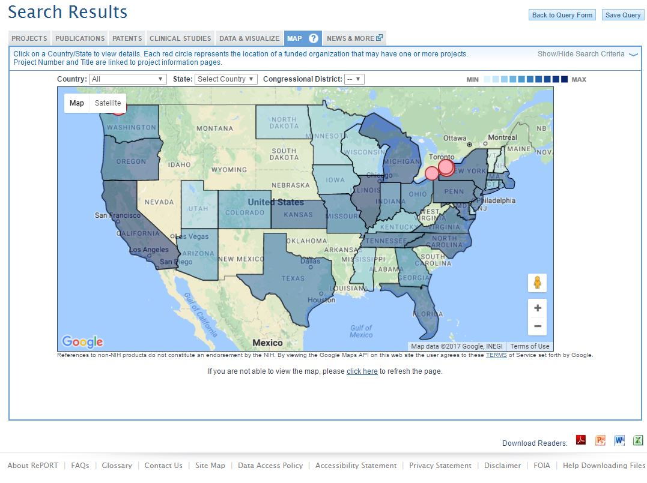
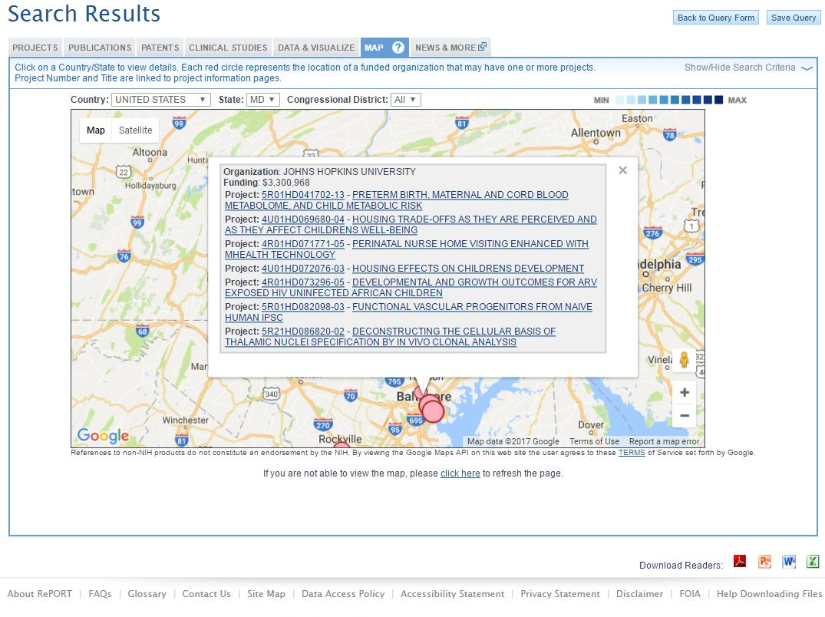
Search Results - Map
Notes:
We also have a dynamic map so you can see what states receive the most funding and where the projects have been awarded. You can drill down by state or congressional district, or use the map controls to zoom in on a particular region of interest.

Slide 29
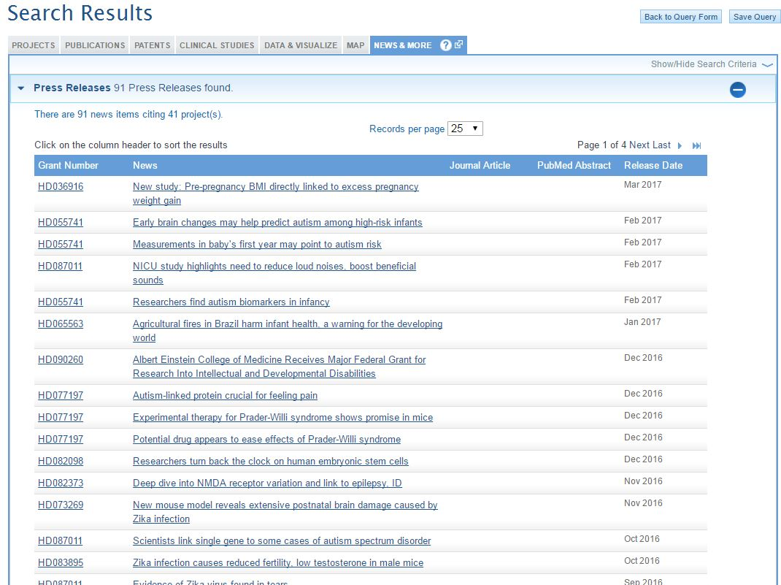
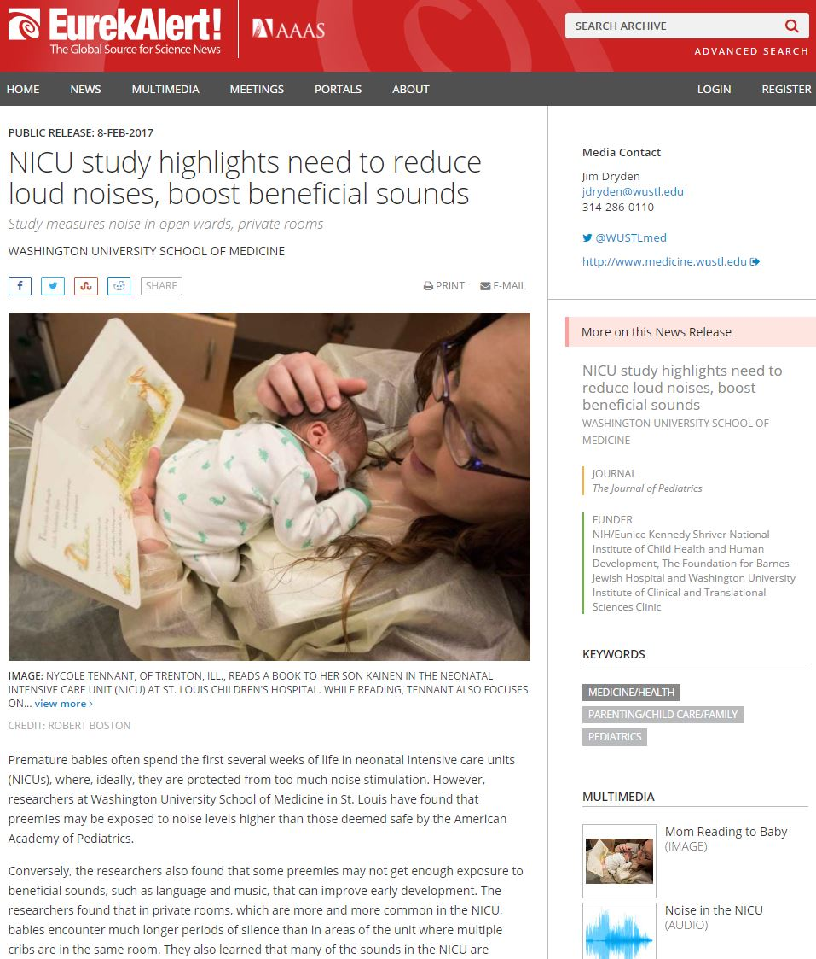
Search Results – News & More
Notes:
Finally, we have the News & More tab that lists news articles and NIH reports that have specifically mentioned projects that are on your hitlist. You can click the title to view the full text of the news item.

Slide 30
Share Query
Share RePORTER Query Result
Notes:
You can share your search criteria by email or otherwise by sharing a unique link. Every time the link is followed, the search criteria will be re-run on RePORTER and the most up-to-date results returned.

Slide 31




Export Search Results
Export RePORTER Query Results
Notes:
Finally, you can export your search results.
By default, you will export all results when you click the Go button, but you can also click these checkboxes along the side to select just the projects you are interested in getting the details for.
After choosing the “Selection” option from the drop-down menu, clicking the Go button will launch a new window where you can set your download options.
Once things are configured the way you like, you can click export and open the file in Microsoft Excel or other tools.

Slide 32

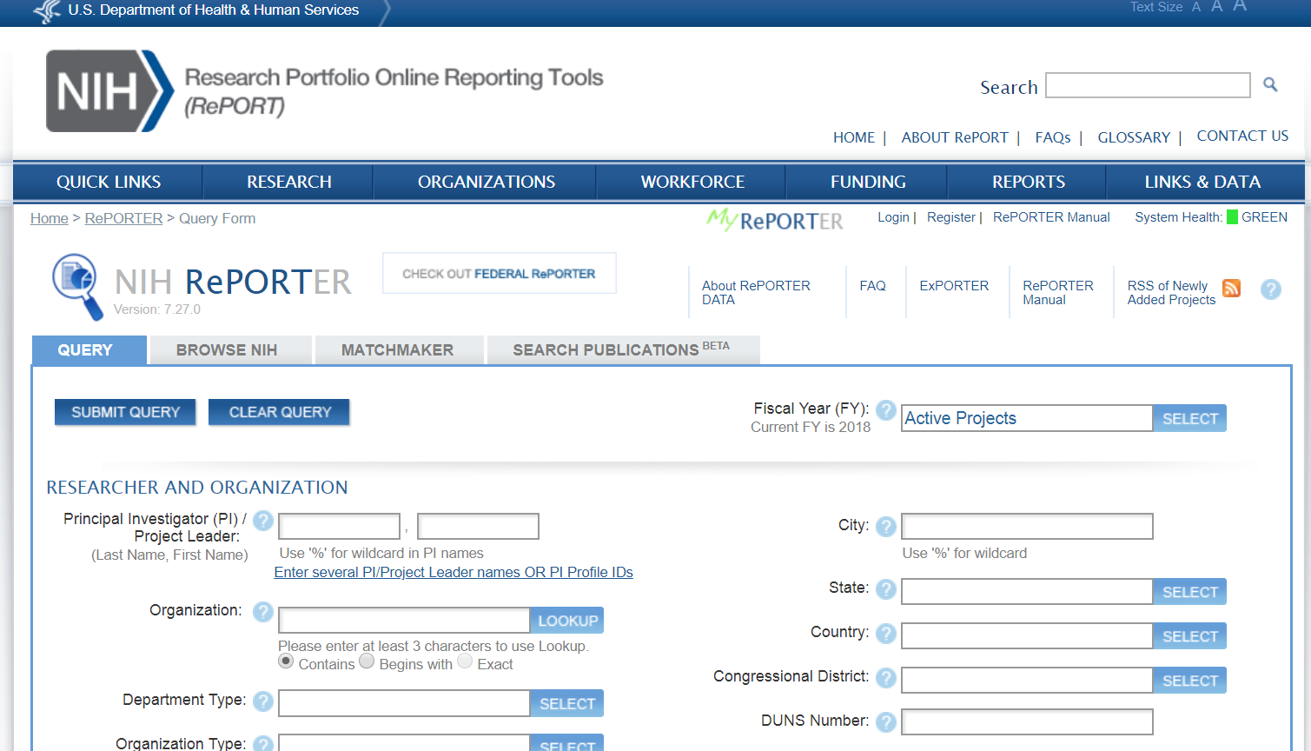
Save and Get Updates with MyRePORTER

Slide 33
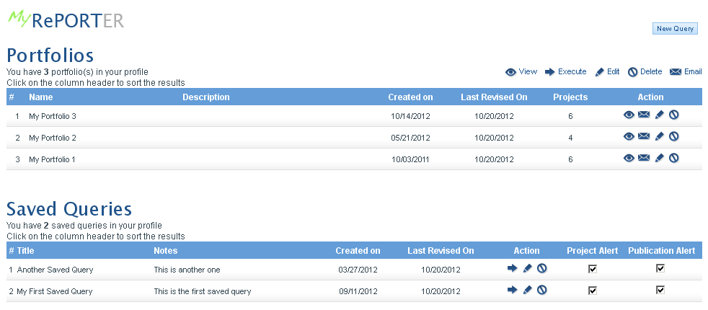
Use My RePORTER to save your portfolios and queries – get emails for updates to your saved searches
Notes:
MyRePORTER enables you to save your common queries and receive email updates for your saved searches on a regular basis.
33

Slide 34
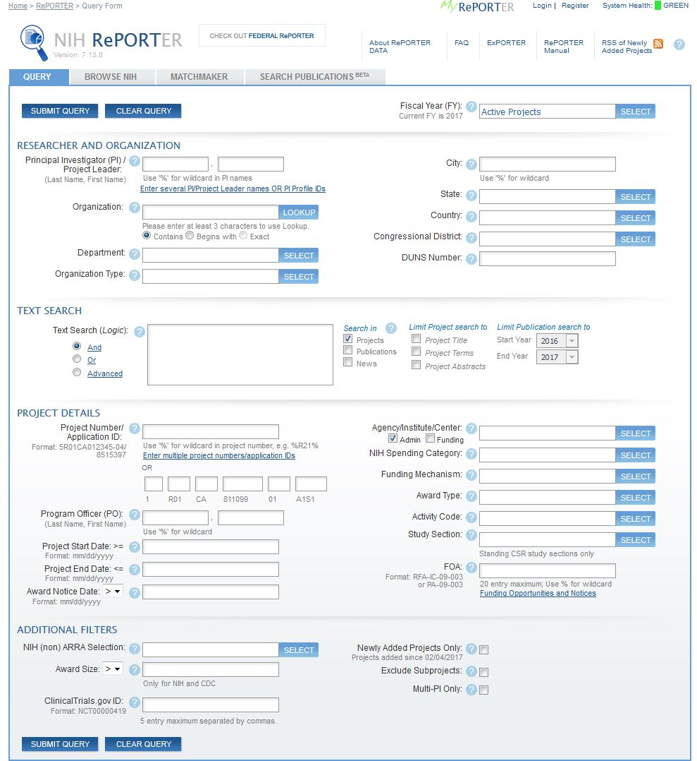

My RePORTER Registration
Notes:
At the top of the RePORTER search page, there is a Register button. Click this button.

Slide 35
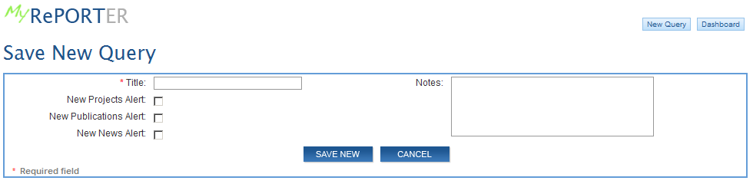
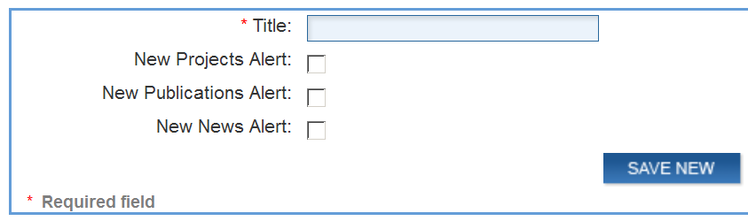


Save Query Options
Franklin and Marshall Active
Notes:
You are taken to a new screen where you can give your saved query a name.
And choose to receive email updates where there are new projects, publication, or news releases associated with this saved query.

Slide 36
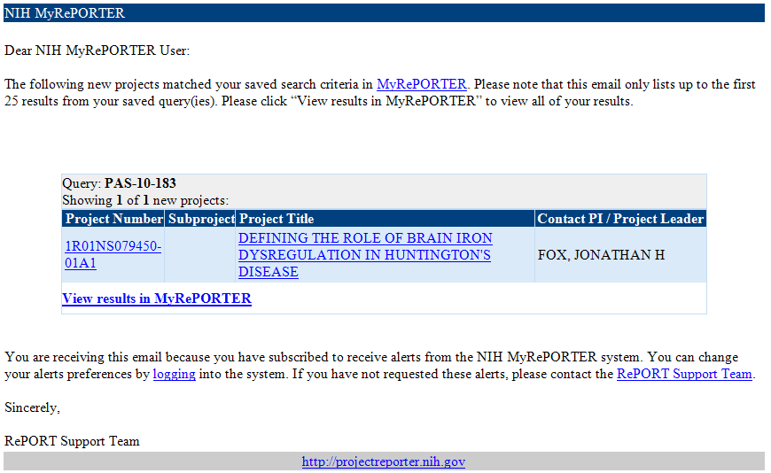
Weekly MyRePORTER Email
Notes:
Once a week, MyRePORTER will send you an email with any new items that match your saved queries, and you can follow links within the email to see all items that match your search, or just the new items. For this example of a publication alert, we can click on the project number to view the details of the project that supported each publication.

Slide 37
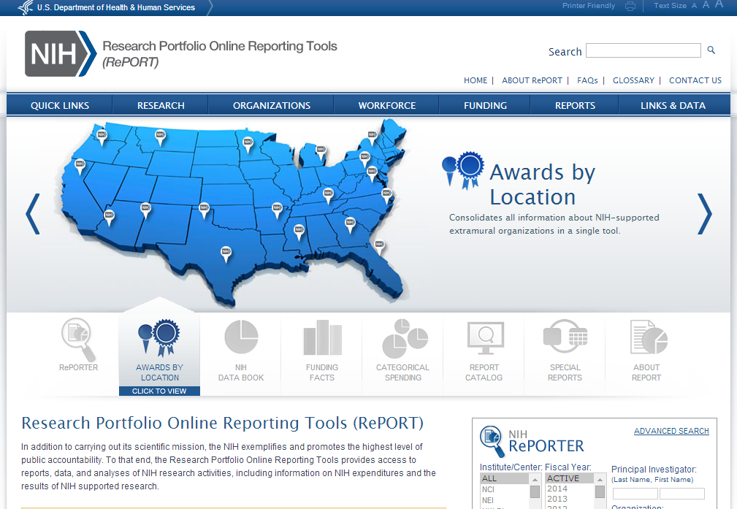
Awards By Location
How much funding in my state and congressional district?
What types of organizations does NIH fund?
What types of organizations does NIH fund?
Who has NIH funding in my university system?

Slide 38
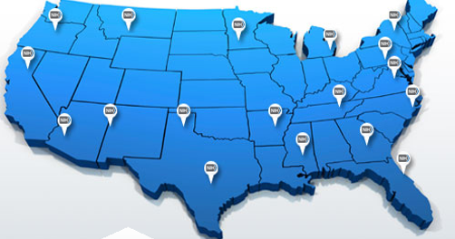
Looking for funding at your organization
(or at someone else’s?)
Use Awards by Location tool to find awards by:
Organization
School
Department
State/country
Congressional district

Slide 39
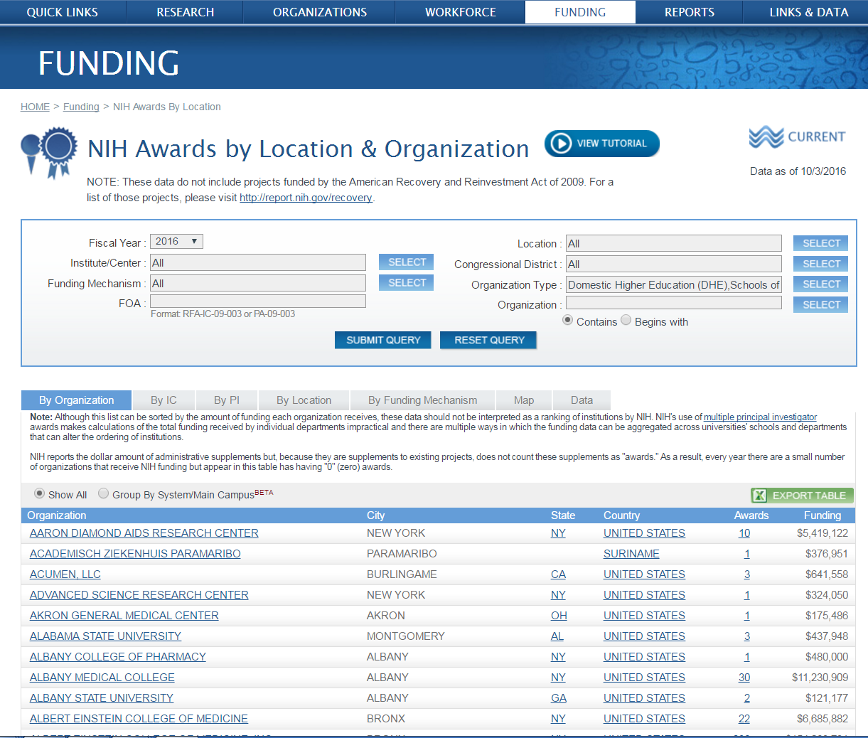
Awards by Location Search Page
Filter with tabs
Select criteria
Sort by heading
Select criteria
Sort by heading
Select output

Slide 40

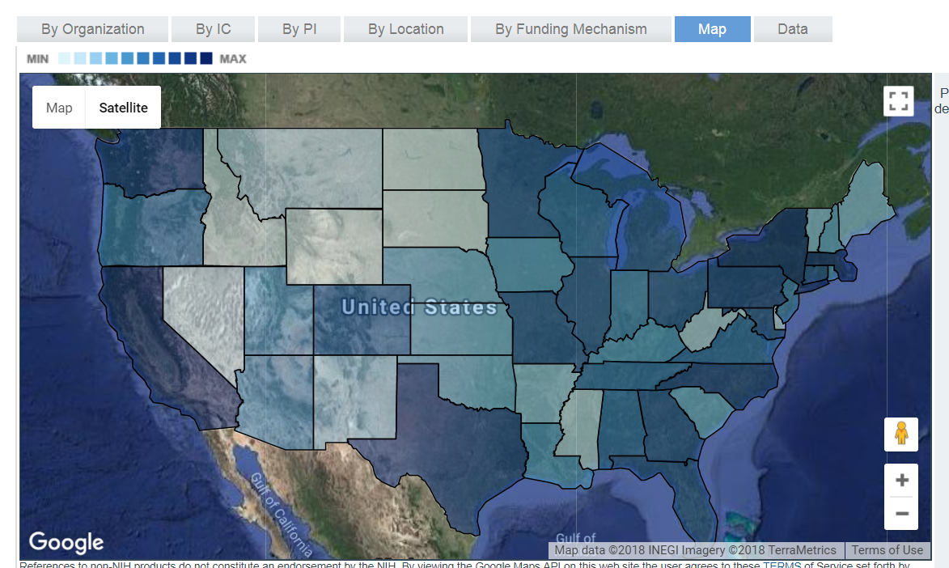
Awards by Location – Explore NIH Funding by Geographic Area

Slide 41

Awards by Location - Search by Organization
University of Maryland Baltimore

Slide 42

Institutional funding - by school

Slide 43

Institutional funding - by dept

Slide 44

Making slides on NIH funding, or looking for data?
Use the NIH Data Book to find latest award info by:
Career stage
Gender
Success rates
Funding type
Degree type
and more…

Slide 45

Quick access to
NIH and workforce statistics: NIH Data Book
Learn about application and award trends over time
How can I learn more about the NIH-funded workforce?
I’d like to learn more about NIH application and award trends over time

Slide 46

NIH Data Book
Answers to commonly asked questions about the NIH budget and extramural programs
Updated annually
February 19, 2019 46

Slide 47



Examples of visualizations

Slide 48




Explore complex data

Slide 49

Need a quick answer about NIH funding?
Funding Facts provides:
Numbers of awards
Funding
Average cost
Success rates
By Institute
By activity code

Slide 50

Quick statistics via Funding Facts
Quick access to stats on funding

Slide 51

Why use Funding Facts?
In aggregate or by year, Institute, mechanism, activity, new/continuing

Slide 52




Funding Facts sample search
Quick searches for
a single answer…
…or retrieve all years and analyze trends over time

Slide 53

How much does NIH spend on…?
Categorical Spending provides levels of NIH funding over time for:
Research areas
Conditions
Diseases

Slide 54

Categorical Spending
How much did NIH spend on a particular disease or research area?

Slide 55

Estimates of Funding for Various Research, Condition, and Disease Categories (RCDC)

Slide 56

Love data? Can’t get enough?
Use ExPORTER to get it all!
Data back to 1985
  Projects
  Abstracts
  Publications
  Patents
  Clinical studies

Slide 57

ExPORTER
Use ExPORTER to get the data to do your own detailed analysis
Notes:
http://exporter.nih.gov/

Slide 58

Finding ExPORTER

Slide 59

Looking for the big picture?
The Special Reports tool provides:
Strategic plans
  For NIH Institutes and Centers
  On trans-NIH topics
High visibility reports on
  NIH organization
  Scientific areas
  Issues impacting funding
Intramural
And more…

Slide 60

Special Reports
Notes:
Special Reports

Slide 61
Want to learn more about RePORT?

Slide 62


Video Tutorials
Notes:
Or by visiting report.nih.gov/tutorial/

Slide 63

Can I get this kind of information for other agencies?
Federal RePORTER provides trans-agency search capabilities for:
  18 agencies including:
    DoD
    EPA
    HHS
    NASA
    NSF
    USDA
    VA
  Close to 1 million projects
  Publications from NIH, FDA, NSF, VA, FS, ARS and EPA
  Updated annually
https://federalreporter.nih.gov/
Notes:
FS= Forest service
ARS = Agricultural Research Service (part of USDA)

Slide 64

Federal RePORTER https://federalreporter.nih.gov/
Notes:
Federal RePORTER combines funded project information from the NIH and several other federal research agencies, accessible from the PePORT home page in the spotlight box.

Slide 65

Federal RePORTER – Smart Search https://federalreporter.nih.gov
Notes:
Search across ~980,000 funding records and 18 agencies using an easy-to-use search form, designed around most frequently-searched terms

Slide 66

Federal RePORTER – Advanced Search
Notes:
You can click the “Advanced Search” button to bring up a search form that includes an agency selector similar to what is on RePORTER, but with additional agencies listed. This can be a useful resource when planning new research projects, to see what federally supported research is already being funded, or to identify potential collaborators with expertise outside your typical area.

Slide 67

Federal RePORTER – Advanced Search Screen

Slide 68





Text mining tools to explore and export projects
Cluster projects
Explore sub-clusters
View and export clustered projects

Slide 69

I encourage you to explore…

