Slide 1
RIGOR AND REPRODUCIBILITY: BACK TO BASICS
Patricia Valdez, Ph.D.
NIH Extramural Research Integrity Officer
National Institutes of Health

Slide 2
Overview
Why the concern about reproducibility?
The NIH response
Updates to grant applications
Training and Resources

Slide 3
Overview
Why the concern about reproducibility?
The NIH response
Updates to grant applications
Training and Resources

Slide 4
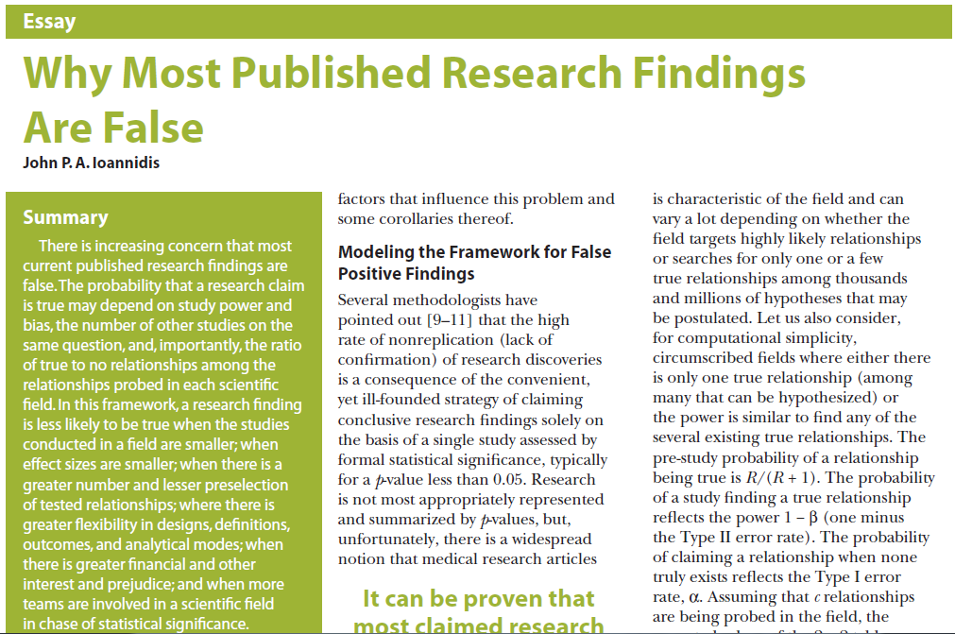
Ioannidis JP. PLoS Med. 2005 Aug;2(8):e124.
Notes:
“There is increasing concern that most current published research findings are false. The probability that a research claim is true may depend on study power and bias, the number of other studies on the same question, and, importantly, the ratio of true to no relationships among the
relationships probed in each scientific field. In this framework, a research finding is less likely to be true when the studies conducted in a field are smaller; when effect sizes are smaller; when there is a greater number and lesser preselection of tested relationships; where there is greater flexibility in designs, definitions, outcomes, and analytical modes; when there is greater financial and other interest and prejudice; and when more
teams are involved in a scientific field in chase of statistical significance.”

Slide 5
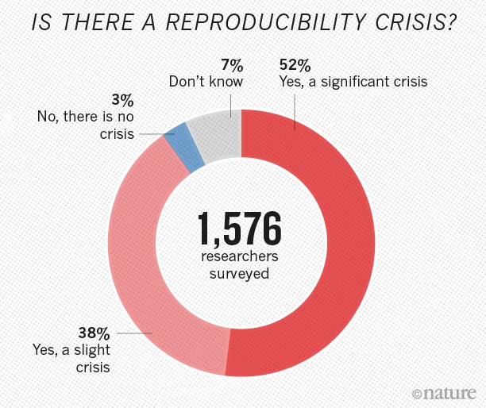
Notes:
Nature's survey of 1,576 researchers who took a brief online questionnaire on reproducibility in research.
90% of respondents thought there was a reproducibility crisis.
Over half thought it was a significant crisis.

Slide 6
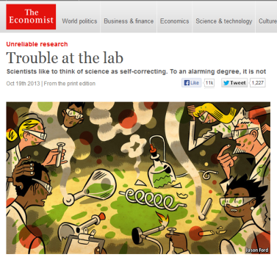
The Reproducibility Challenge
Noted by research community; in multiple publications
Across research areas
Especially in preclinical research
Notes:
Noted by research community; in multiple publications
Across research areas
Especially in preclinical research
Pharmaceutical companies unable to reproduce much of the research in the scientific literature.
Begley – Amgen
Prinz - Bayer

Slide 7
Notes:
In 2002, several studies reported that the drug minocycline increased survival of SOD1 mice, a model of ALS. NINDS funded a trial in which hundreds of ALS patients were treated with minocycline for 9 months. No benefit was found. Published in 2007.
Looking back at the preclinical studies, in many cases, blinding, randomization, sex, and transgene copy numbers were not reported.
In 2012, NINDS convened a workshop that led to publication of this perspective, calling for increased transparency in reporting.
NINDS Workshop: http://www.ninds.nih.gov/funding/areas/channels_synapses_and_circuits/rigor_and_transparency/index.htm
Landis et al article: http://www.nature.com/nature/journal/v490/n7419/full/nature11556.html

Slide 8
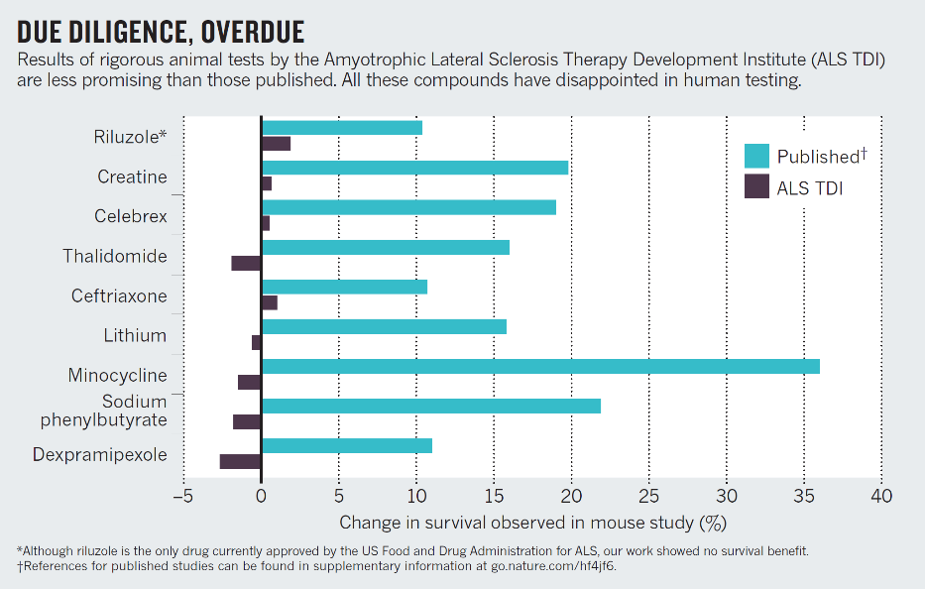
Perrin, Nature 2014; 507: 423-4255
Notes:
One year after the clinical trial data were published, ALS TDI published 5 years worth of rigorous studies exploring the effects of more than 70 drugs in a mouse model of ALS.
None showed a significant effect on the survival of mice, even those drugs previously reported to increase survival.
Small sample sizes likely led to erroneous results
http://www.nature.com/news/preclinical-research-make-mouse-studies-work-1.14913

Slide 9
Challenges to Rigor and Transparency in Reporting Science
Science often viewed as self-correcting
Immune from reproducibility problems?
Principle remains true over the long-term
In the short- and medium-term, interrelated factors can short-circuit self-correction
Leads to reproducibility problem
Loss of time, money, careers, public confidence

Slide 10
Factors That “Short Circuit” Self-correction
Poor training
Inadequate experimental design
Inappropriate use of statistics (“p-hacking”)
Incomplete reporting of resources used and/or unexpected variability in resources
Notes:
Poor training
Inadequate experimental design – fundamental quality characteristics not reported/performed (e.g. blinded assessment, randomization, sample size calculations)
Inappropriate use of statistics (“p-hacking”)
Incomplete reporting of resources used and/or unexpected variability in resources

Slide 11
Factors That “Short Circuit” Self-correction
Publication practices
Difficulty in publishing negative findings
Overemphasis on the “exciting, big picture” findings; leaves out necessary details
Current “hyper-competitive” environment
Historically low funding rates
Grant review and promotion decisions depend too much on “high profile” publications

Slide 12
Overview
Why the concern about reproducibility?
The NIH response
Updates to grant applications
Training and Resources

Slide 13
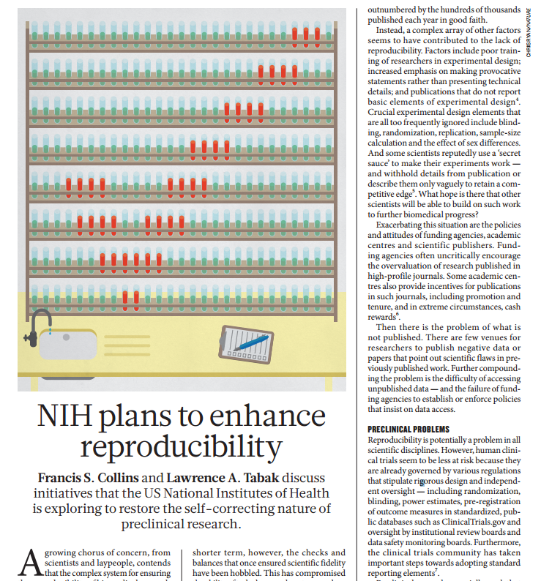
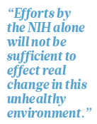

Slide 14
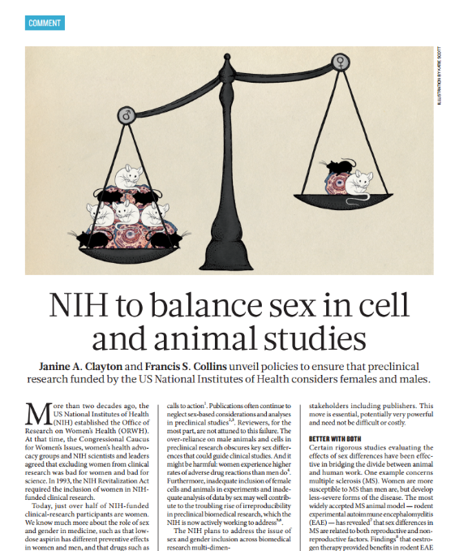
“Over the course of FY 2015, NIH plans to roll out policies that will require applicants to address inclusion of both sexes in biomedical research.”
Notes:
http://www.nature.com/news/policy-nih-to-balance-sex-in-cell-and-animal-studies-1.15195

Slide 15
Biological/Disease Impact of Experimental Design
100
Control
Treatment
80
60
Disease Impact, %
40
20
0
Aggregated
Male
Female

Slide 16
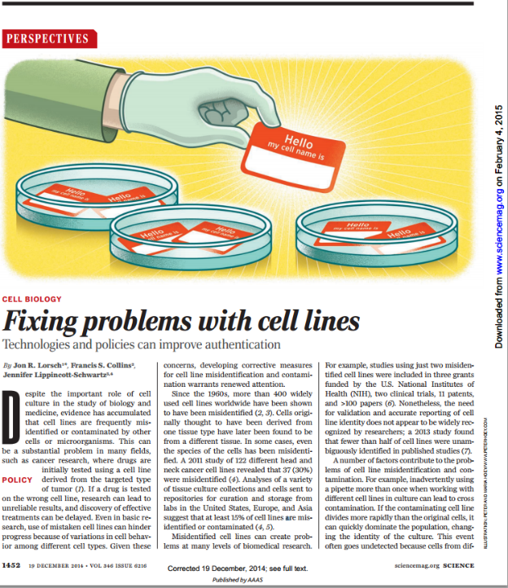
Since the 1960s, more than 400 widely used cell lines worldwide have been shown to have been misidentified
A 2011 study of 122 different head and neck cancer cell lines revealed that 37 (30%) were misidentified
Studies using just two misidentified cell lines were included in 3 grants funded by the NIH, two clinical trials, 11 patents, and >100 papers
Notes:
http://science.sciencemag.org/content/sci/346/6216/1452.full.pdf

Slide 17
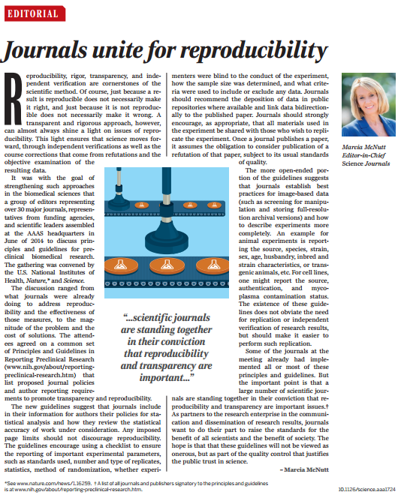
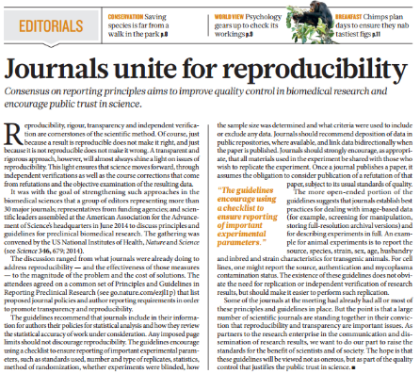
New Journal Policies to Enhance Reproducibility

Slide 18
Principles and Guidelines for Reporting Preclinical Research
Rigorous statistical analysis
Transparency in reporting
Data and material sharing
Consideration of refutations
Consider establishing best practice guidelines for:
Antibodies
Cell lines
Animals
Standards
Replicates
Statistics
Randomization
Blinding
Sample size estimation
Inclusion/exclusion criteria
http://www.nih.gov/about/reporting-preclinical-research.htm
Notes:
http://www.nih.gov/about/reporting-preclinical-research.htm

Slide 19
Our Guiding Principles for Rigor & Transparency
Clarify NIH’s long-standing expectations regarding rigor and transparency in applications
Raise awareness and begin culture shifts in the scientific community
Improve the way that applicants describe their work; provide sufficient information for reviewers
As always, ensure that NIH is investing in the best science and minimizing unnecessary burden
19

Slide 20
Overview
Why the concern about reproducibility?
The NIH response
Updates to grant applications
Training and Resources

Slide 21
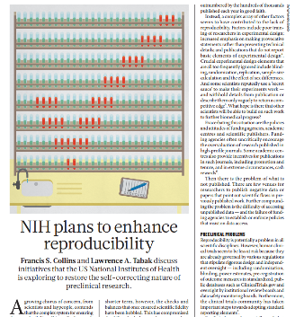
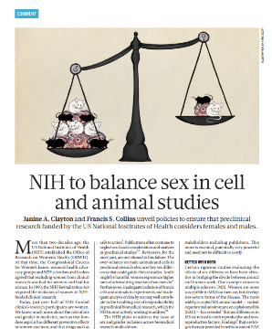
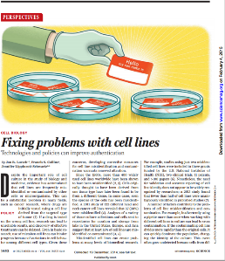
Four Areas of Clarification
Scientific premise
Scientific rigor
Relevant Biological Variables, Such as Sex
Authentication of Key Biological and/or Chemical Resources
Starting with applications due on January 25, 2016

Slide 22
Policy Applies to:
Research
Research
Career Development
Centers
People-based
Program Projects
Small Business
Resource-Related
Training (coming 2020)*
Individual Fellowships
Institutional Training
Institutional Career Dev
*Training in Rigor currently being piloted

Slide 23
RPG Application and Review
Element of Rigor | Section of Application | Criterion Score | Additional Review Consideration | Contribute to Overall Impact?
Rigor of the Prior Research | Research Strategy | Significance | NA | Yes
Rigor of the Prior Research | Research Strategy | Approach | NA | Yes
Scientific Rigor | Research Strategy | Approach | NA | Yes
Consideration of Relevant Biological Variables Such as Sex | Research Strategy | Approach | NA | Yes
Authentication of Key Biological and/or Chemical Resources | Attachment | NA | Acceptable or Unacceptable | No

Slide 24
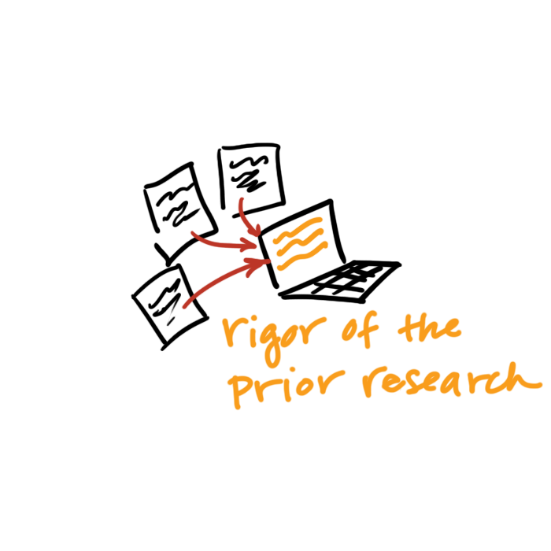
Rigor of the Prior Research
Assess the strength & weaknesses in the rigor of the prior research that serves as key support for the proposed research project.
Prior research can include:
observations,
preliminary data, or
published literature
Describe how the proposed research will address these weaknesses.

Slide 25
Rigor of the Prior Research Application Instructions
Research Strategy: Significance:
Explain the importance of the problem or critical barrier to progress in the field that the proposed project addresses.
Describe the strengths and weaknesses in the rigor of the prior research (both published and unpublished) that serves as the key support for the proposed project.
Explain how the proposed project will improve scientific knowledge, technical capability, and/or clinical practice in one or more broad fields.
Describe how the concepts, methods, technologies, treatments, services, or preventative interventions that drive this field will be changed if the proposed aims are achieved.

Slide 26
Rigor of the Prior Research Application Instructions
Research Strategy: Approach:
Describe the overall strategy, methodology, and analyses to be used to accomplish the specific aims of the project. Describe the experimental design and methods proposed and how they will achieve robust and unbiased results. Unless addressed separately in the Resource Sharing Plan, include how the data will be collected, analyzed, and interpreted, as well as any resource sharing plans as appropriate. Resources and tools for rigorous experimental design can be found at the NIH Enhancing Reproducibility website.
Describe plans to address weakness in the rigor of the prior research that serves as key support for the proposed project.

Slide 27
FAQ: What Do I Include When Describing the Rigor of the Prior Research?
When assessing the rigor of the prior research that serves as key support for the application, consider:
Appropriate sample sizes
Randomization and blinding
Adequate positive and negative controls
Appropriate statistical tests
Consideration of relevant biological variables
Authentication of key resources
Other measures

Slide 28
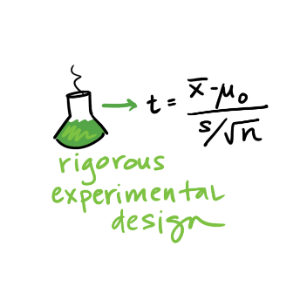
Scientific Rigor
The strict application of the scientific method to ensure robust and unbiased experimental design, methodology, analysis, interpretation and reporting of results.
Notes:
This includes full transparency in reporting experimental details so that others may reproduce and extend the findings.

Slide 29
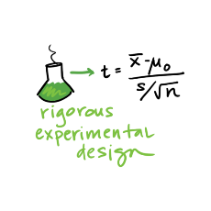
Scientific Rigor Application Instructions
Research Strategy: Approach:
Describe the overall strategy, methodology, and analyses to be used to accomplish the specific aims of the project. Unless addressed separately in the Resource Sharing Plan, include how the data will be collected, analyzed, and interpreted, as well as any resource sharing plans as appropriate. Resources and tools for rigorous experimental design can be found at the Enhancing Reproducibility through Rigor and Transparency website.
Describe the experimental design and methods proposed and how they will achieve robust and unbiased results.

Slide 30
FAQ: How Much Detail Should I Include to Address Scientific Rigor?
Succinctly state what is planned
Include information on sample size estimation, effect size, blinding, randomization, statistical analyses…
Describe experimental animal numbers here (power); VAS no longer requires justification of animal numbers.
Be transparent about your plans for analysis
Stay within page limits

Slide 31
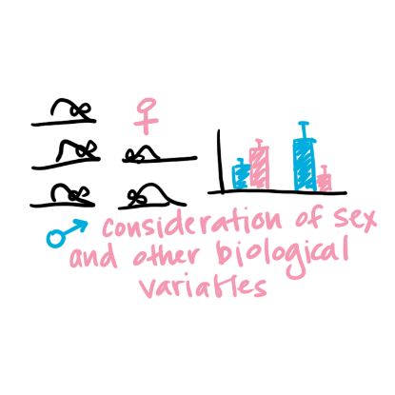
Relevant Biological Variables Such as Sex
Affect health or disease
sex,
age,
weight, and
underlying health conditions
Should be factored into research designs, analyses, and reporting in vertebrate animal and human studies.
Proposing to study one sex?
Need strong justification from the scientific literature, preliminary data, or other relevant considerations
Notes:
Biological variables, such as sex, age, weight, and underlying health conditions, are often critical factors affecting health or disease.
NIH expects that sex as a biological variable will be factored into research designs, analyses, and reporting in vertebrate animal and human studies.
Strong justification from the scientific literature, preliminary data or other relevant considerations must be provided for applications proposing to study only one sex.

Slide 32
Relevant Biological Variables Such as Sex Application Instructions
Research Strategy: Approach:
Explain how relevant biological variables, such as sex, are factored into research designs and analyses for studies in vertebrate animals and humans. For example, strong justification from the scientific literature, preliminary data, or other relevant considerations, must be provided for applications proposing to study only one sex. Refer to the NIH Guide Notice on Sex as a Biological Variable in NIH-funded Research for additional information.

Slide 33
FAQ: Will I Have to Double My Animal Numbers?
May not need to power initial study to detect sex differences
Begin to collect data on sex for early stage research.
Justification should be provided if the application proposes to study one sex
sex-specific condition of phenomenon (e.g., ovarian or prostate cancer),
acutely scarce resources, or
sex-specific hypotheses possible due to known differences between males and females.
Cost and absence of known sex differences are inadequate justifications for not addressing sex.

Slide 34
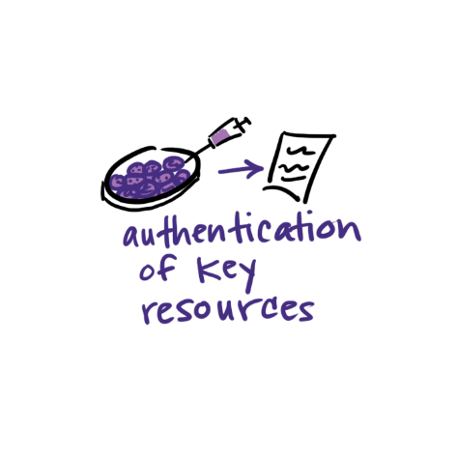
Authentication of Key Biological and/or Chemical Resources
Quality of established resources is critical
Cell lines, Antibodies, Chemicals, Mice, etc.
Provide a plan to regularly authenticate to ensure identity & validity
Each investigator determines which resources are key
Notes:
Each investigator will have to determine which resources used in their research fit these criteria and are therefore key to the proposed research.

Slide 35
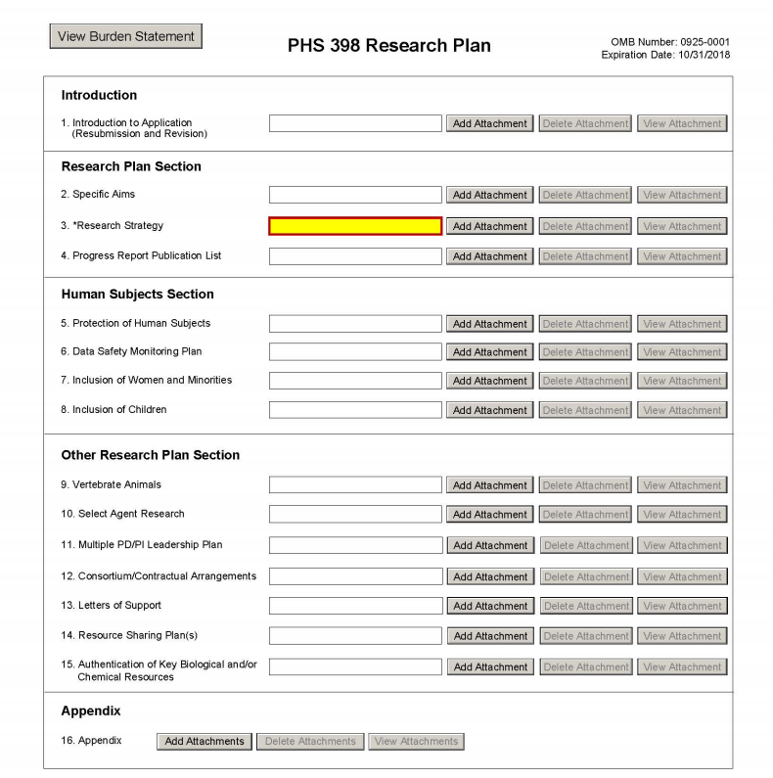
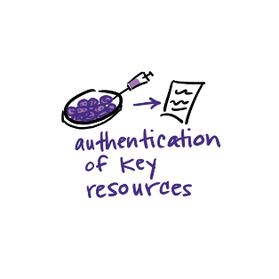
Authentication Plan Attachment
Notes:
Plans for Authentication of Key Biological and/or Chemical Resources should be described in attachment.

Slide 36
Authentication of Key Resources Application Instructions
Other Research Plan Section - Instructions
If applicable to the proposed science, briefly describe methods to ensure the identity and validity of key biological and/or chemical resources used in the proposed studies. No more than one page is suggested.
Key biological and/or chemical resources are characterized as follows.
Key biological and/or chemical resources may or may not be generated with NIH funds and: 1) may differ from laboratory to laboratory or over time; 2) may have qualities and/or qualifications that could influence the research data; and 3) are integral to the proposed research. These include, but are not limited to, cell lines, specialty chemicals, antibodies, and other biologics.
Standard laboratory reagents that are not expected to vary do not need to be included in the plan. Examples are buffers and other common biologicals or chemicals.
See NIH's page on Rigor and Reproducibility for more information.

Slide 37
Reminder: Authentication Of Key Biological and/or Chemical Resources (NOT-OD-17-068)
Definition of key biological and/or chemical resources
Examples (cell lines, chemicals, genetically modified animals or cells)
Do not include:
Plans for authentication of data sets, databases, machinery, or electronics
Plans for the development and authentication of new key biological and/or chemical resources
Plans for authentication of standard laboratory reagents that are not expected to vary
Authentication or other data
Notes:
Key resources refer to established resources that will be used in the proposed research
If key resources have been purchased or obtained from an outside source that provided data on prior authentication, the investigator is still expected to provide their own authentication plans for these key resources.
Do not include authentication data in the Authentication of Key Biological and/or Chemical Resources attachment. Include only a description of the methods proposed to authenticate key resources.
Do not include plans for authentication of data sets, databases, machinery, or electronics in the Authentication of Key Biological and/or Chemical Resources attachment.
Do not include plans for development and authentication of new key biological and/or chemical resources (such as a human cancer cell line). Applications proposing to generate a new key biological and/or chemical resource must describe development and authentication of the resource in the Approach section.
Do not include plans for authentication of standard laboratory reagents that are not expected to vary. Examples are buffers and other common biologicals or chemicals.
We are encouraging scientific societies and the research community to develop standard approaches.
The Authentication plan is not scored, so if the application is meritorious, the applicant may work with the program officer to address any deficiencies prior to award.

Slide 38
Research Performance Progress Reports (RPPR)
B.2 What was accomplished under these goals?
Goals are equivalent to specific aims. In the response, emphasize the approaches taken to ensure robust and unbiased results. Include the significance of the findings to the scientific field.
B.6 What do you plan to do for the next reporting period to accomplish the goals?
Include any important modifications to the original plans, including efforts to ensure that the approach is scientifically rigorous and results are robust and unbiased. Provide a scientific justification for any changes involving research with human subjects or vertebrate animals. A detailed description of such changes must be provided under Section F. Changes.

Slide 39
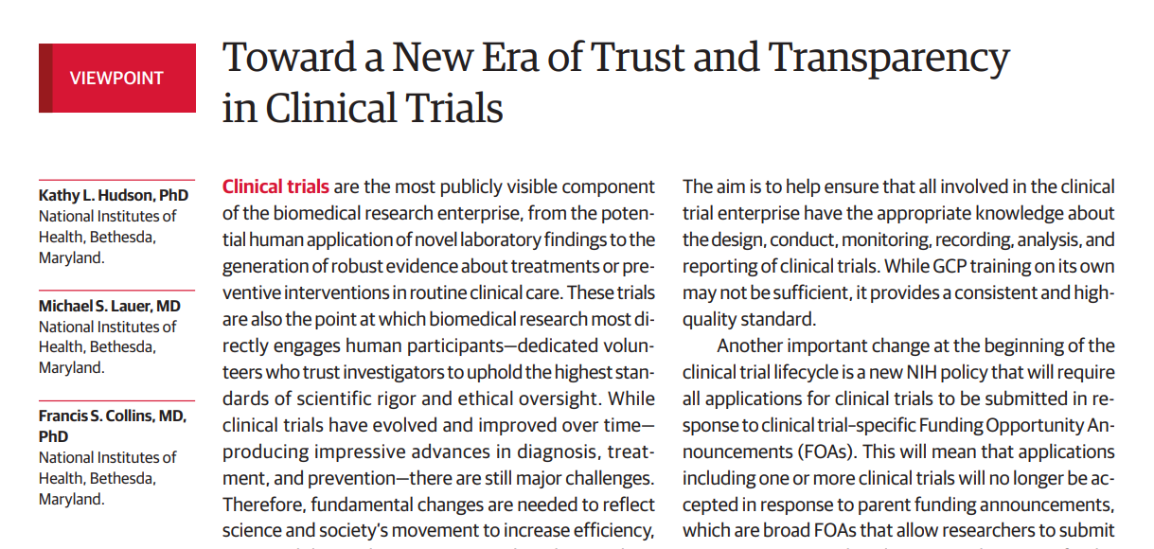
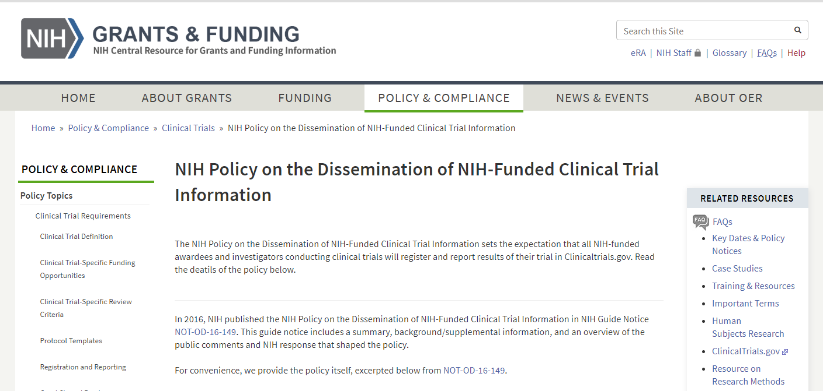
Clinical Trials Results Reporting

Slide 40
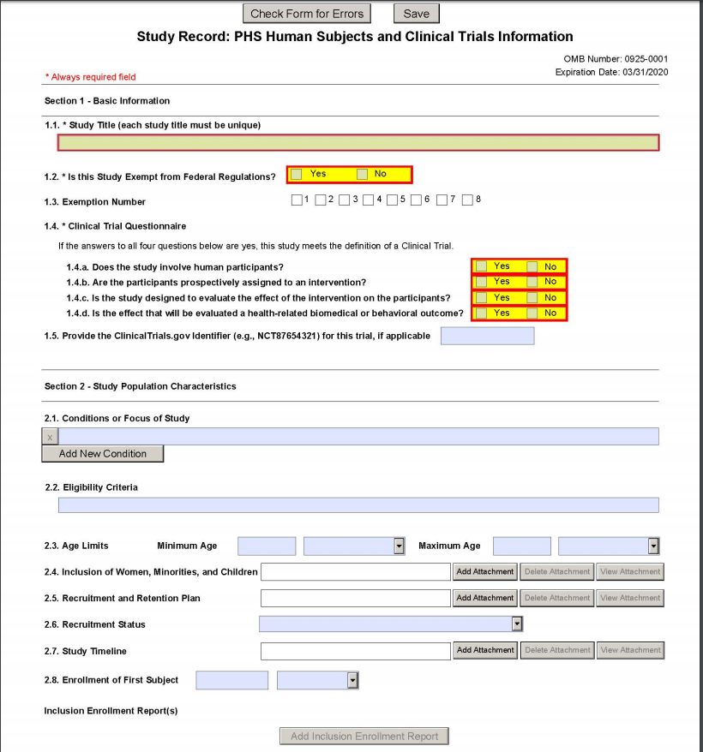
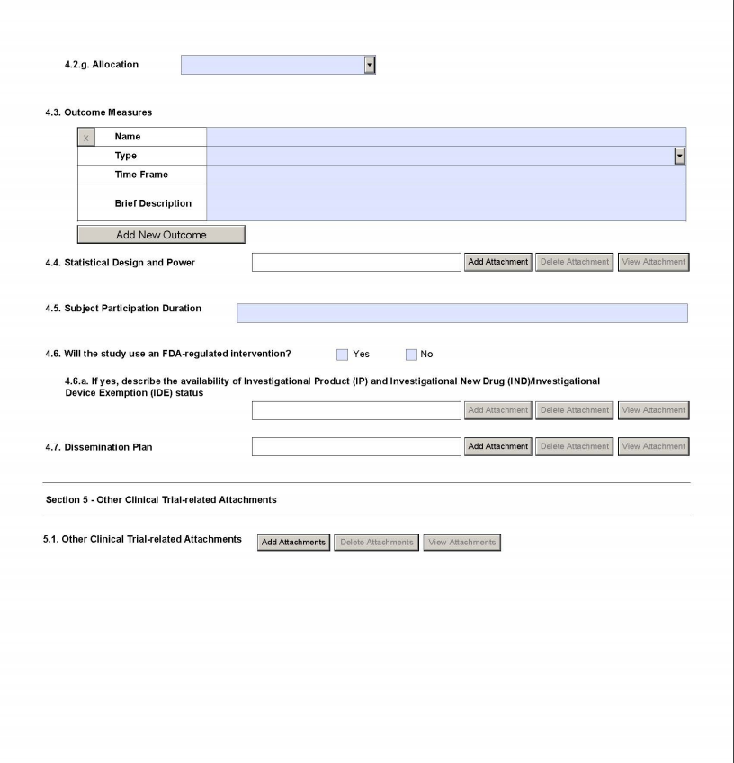
Notes:
Selected pages from Form G.500 PHS Human Subjects and Clinical Trials Information

Slide 41
Overview
Why the concern about reproducibility?
The NIH response
Updates to grant applications
Training and Resources

Slide 42
Training in Rigor
NIH will require a description of instruction in the design and conduct of rigorous experiments.
Institutional training
Institutional career development
Individual fellowships
Will contribute to Overall Impact Score
Now being piloted by several NIH institutes
Requirement expected for May 25, 2020 applications
Notes:
Training in rigor should occur throughout the training experience, on a day-to-day basis.
There is a need for training to focus on rigor and transparency to enhance reproducibility
NIH will create another section of training grants that will be reviewed as an additional review criteria, that can impact overall score
This includes institutional training as well as Fellowships
NIH will require a description of instruction in the design and conduct of rigorous experiments.
Institutional training
Institutional career development
Individual fellowships
Additional guidance on training requirements will be forthcoming, see NOT-OD-16-034
Image courtesy of NIH NIAD

Slide 43
https://www.nigms.nih.gov/training/pages/clearinghouse-for-training-modules-to-enhance-data-reproducibility.aspx
Notes:
NIGMS Clearinghouse for Training Modules to Enhance Data Reproducibility

Slide 44
Sample of Modules Available on the NIGMS Clearinghouse
Statistical Topics for Reproducible Animal Research
Controls in Animal Studies for Rigor and Reproducibility
The BD2K Guide to the Fundamentals of Data Science Series
Cell Line Authentication Training
Society for Neuroscience Rigor and Reproducibility Training Webinars
Let's Experiment: A Guide for Scientists Working at the Bench

Slide 45
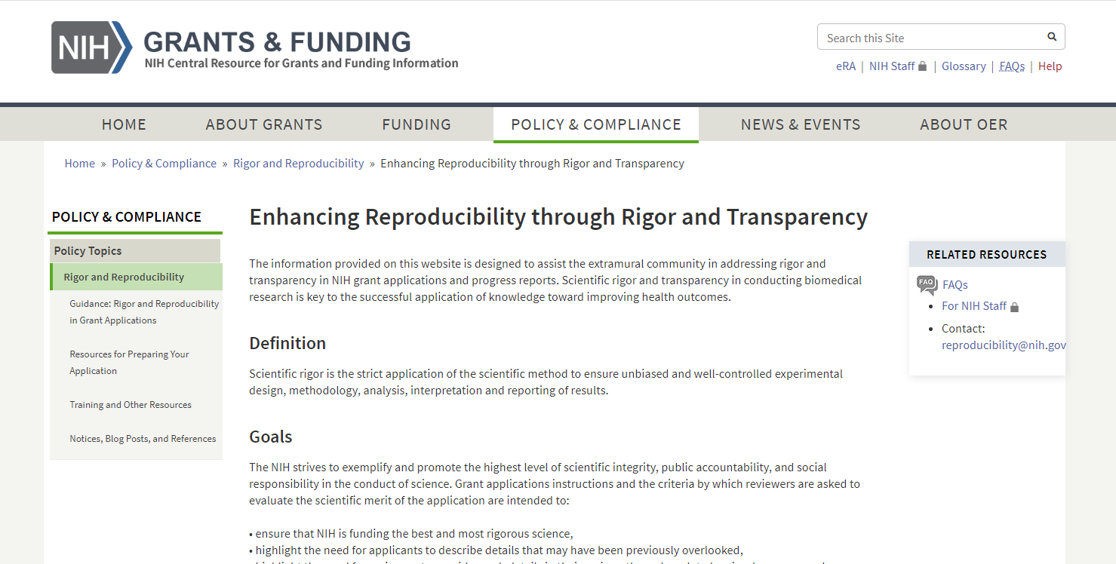
https://grants.nih.gov/policy/reproducibility/index.htm

Slide 46
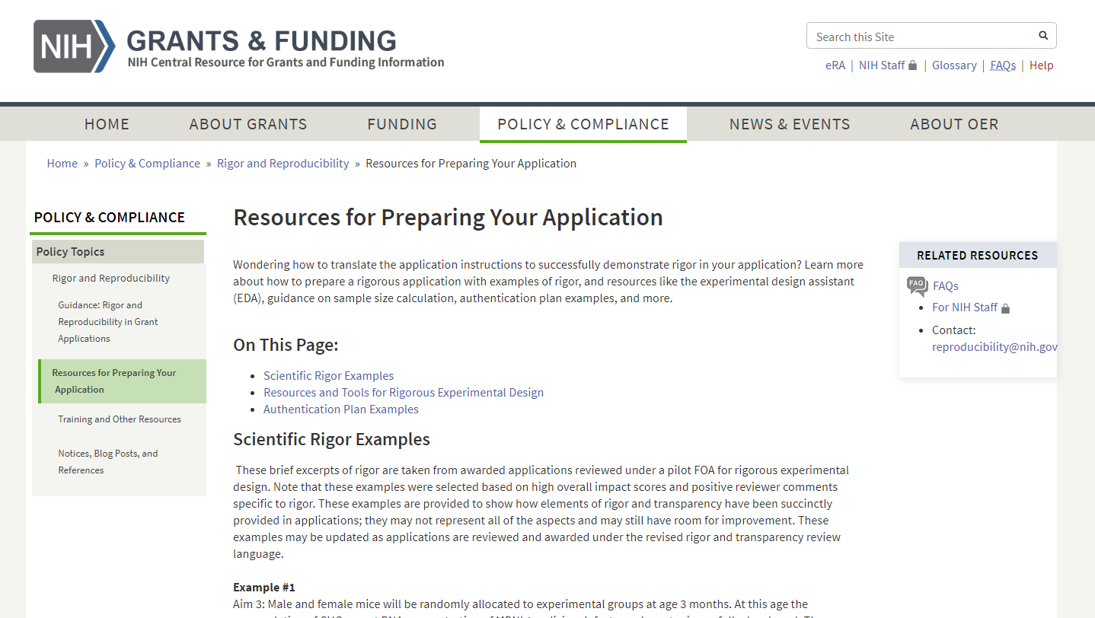

Slide 47
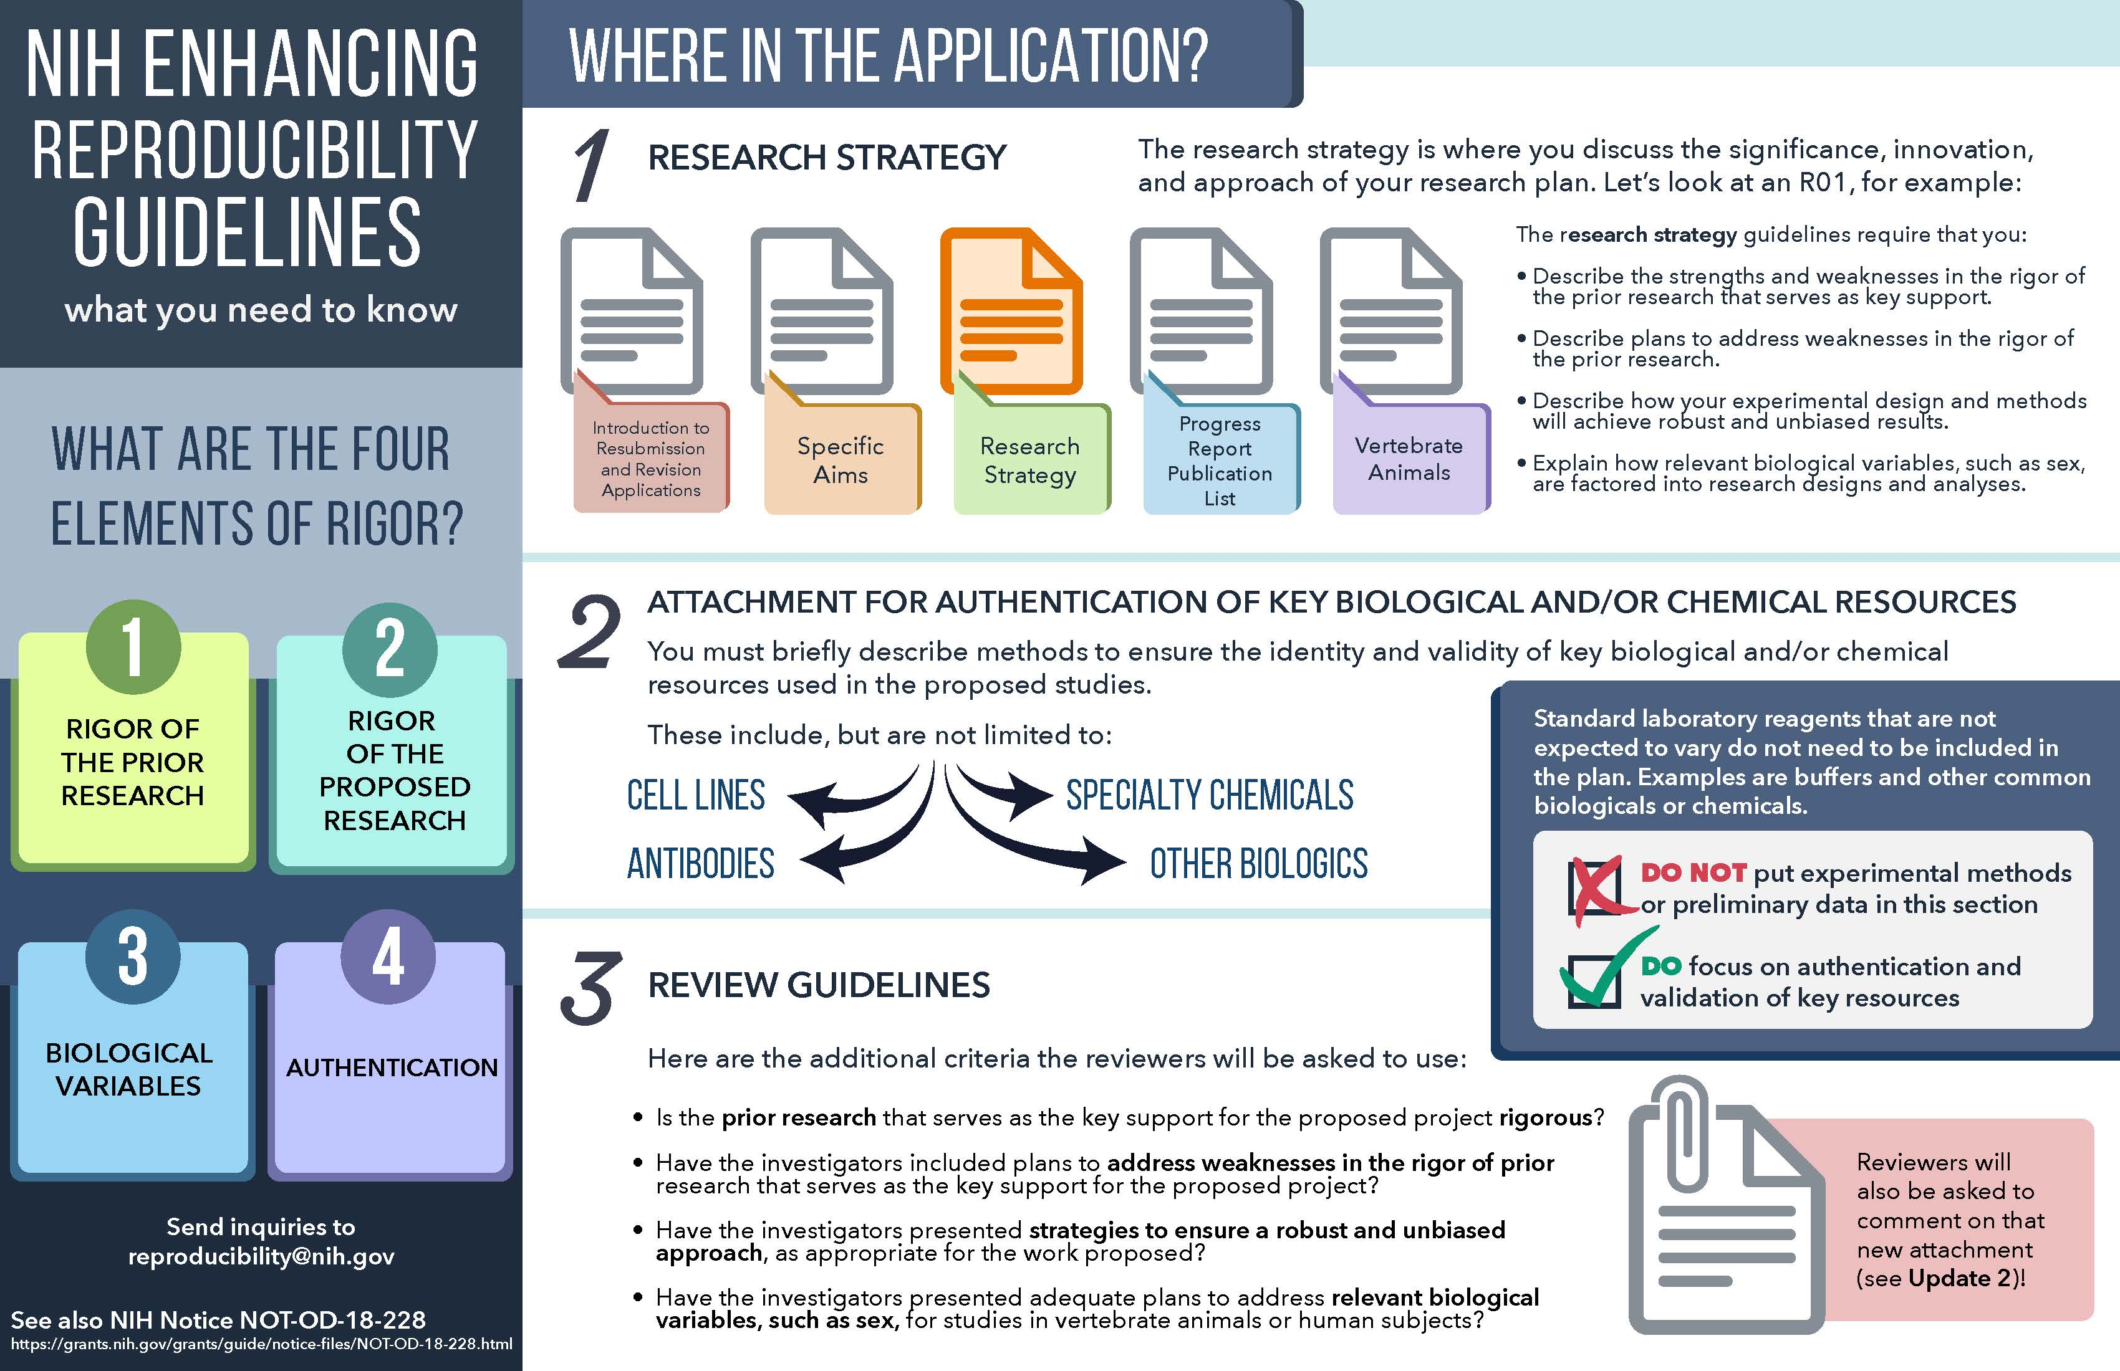

Slide 48
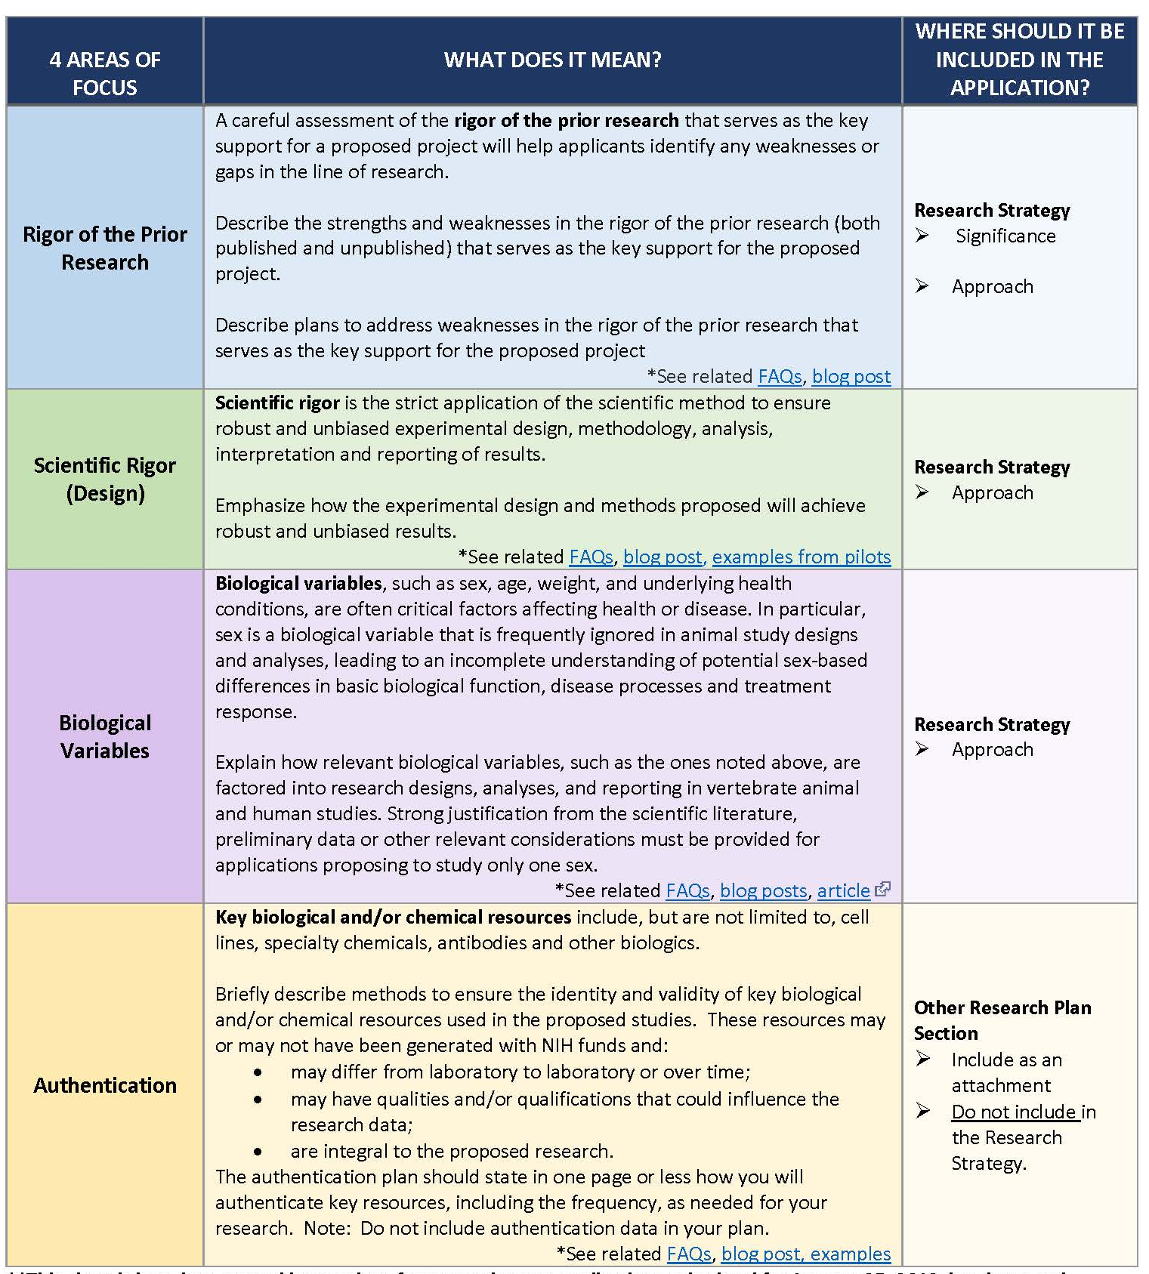

Slide 49
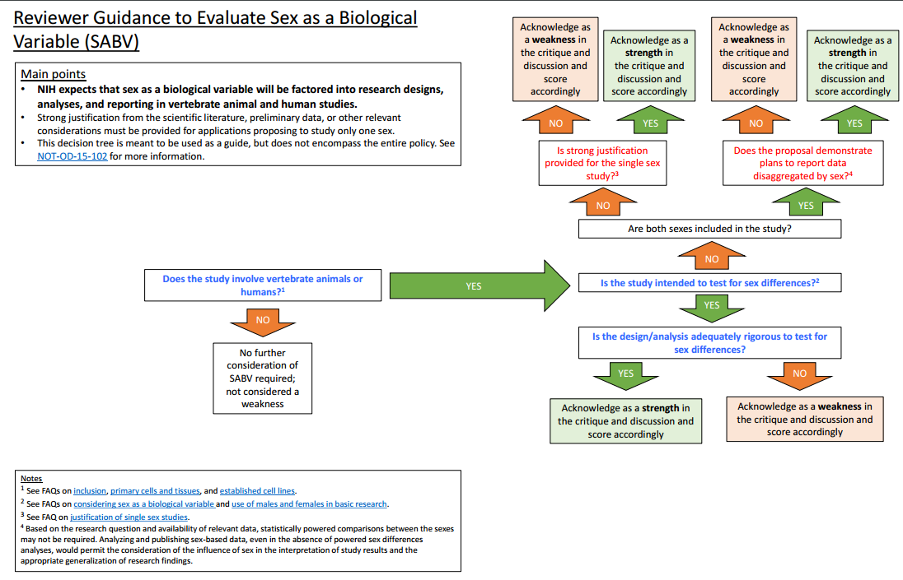

Slide 50
Upcoming: Responsible Data Sharing
Developing draft policy, available soon
Establishes a flexible framework
Asks researchers how they plan to manage and share data
Includes suggested guidance
Will solicit more community input
Final NIH Policy for Data Management and Sharing planned for release in early 2020

Slide 51
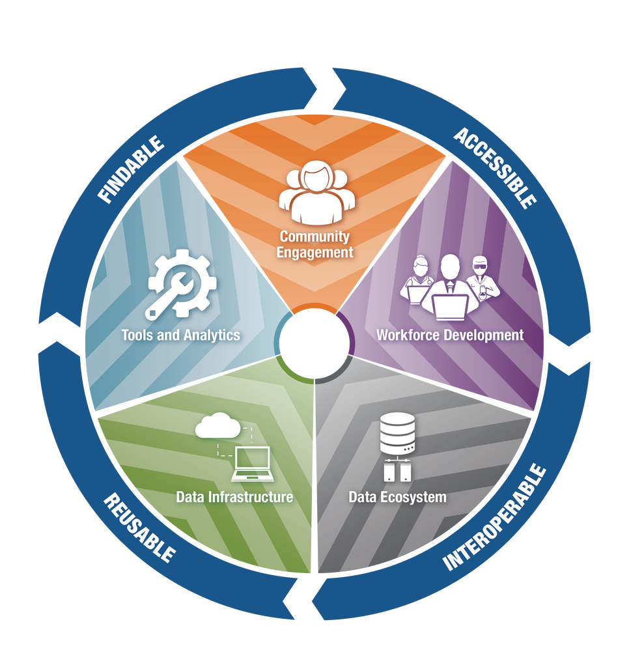
Vision for the NIH Strategic Plan for Data Science
https://datascience.nih.gov/strategicplan
Notes:
NIH’s vision for a modernized, integrated biomedical data ecosystem.
Long-term goal is to have NIH-funded data be findable, accessible, interoperable, and reusable (FAIR)
NIH will work to address the:
findability, interconnectivity, and interoperability of NIH-funded biomedical data sets and resources;
integration of existing data management tools and development of new ones;
universalization of innovative algorithms and tools created by academic scientists into enterprise-ready resources that meet industry standards of ease of use and efficiency of operation; and
growing costs of data management.

Slide 52
Data Sharing
NIH supports repositories for sharing biomedical data
https://www.nlm.nih.gov/NIHbmic/nih_data_sharing_repositories.html
Currently 86 repositories listed
PubMed Central stores datasets associated with publications
Up to 2 GB in size
NIH Science and Technology Research Infrastructure for Discovery, Experimentation, and Sustainability (STRIDES) Initiative
Google Cloud and Amazon Web Services (AWS)
Supports large datasets
Notes:
Currently piloting NIH Figshare as a generalist repository.

Slide 53
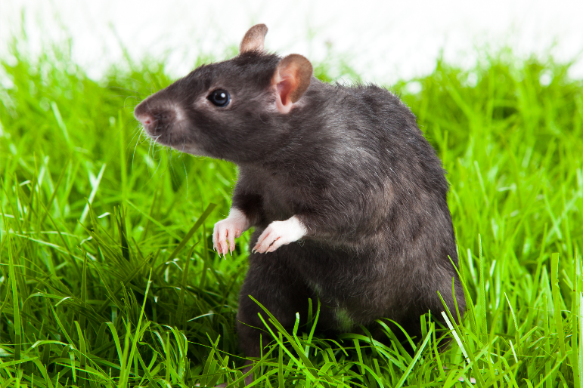
Upcoming: ACD Working Group on Enhancing Reproducibility and Rigor in Animal Research
Identify gaps and opportunities
How animal models of human disease are currently developed, validated, and accepted into routine use
Validating alternative models
Registering animal studies that aim to lead to first in human trials
Financial implications
Training in rigor of animal research
https://acd.od.nih.gov/working-groups/eprar.html
Notes:
Building on the efforts already undertaken by NIH to improve rigor, reproducibility, and transparency, and taking into account work done by outside organizations, including the National Academies(link is external), the National Centre for the Replacement, Refinement, and Reduction of Animals in Research(link is external), and scientific societies e.g. American Physiological Society(link is external), Society for Neuroscience(link is external), the Working Group is charged by the NIH Director to:
Identify gaps and opportunities to improve the rigor, reproducibility, translational validity, and transparency of studies involving animal models, including:
selecting animal models that are most appropriate for the scientific question
strengthening experimental design and statistical analysis, including appropriate statistical power and definition of endpoints
achieving appropriate transparency of methodological measures
considering how the conditions in which animals are housed and bred affects experimental outcomes
enhancing processes to incorporate rigor and transparency into grant application, peer review process, and manuscript publication
Evaluate how animal models of human disease are currently developed, validated, and accepted into routine use, and how this process could be improved
Assess the current state of science for validating alternative models to animal research
Consider the benefits and burdens of registering animal studies that aim to lead to first in human trials (e.g., preregistration of the experimental plan)
Model the financial implications of potential changes in the average costs of grants using animal models, the number of studies funded, or the need to develop multi-lab consortia to achieve appropriate statistical power
Consider how rigor in animal research is incorporated into training (e.g., statistical training; experimental design)

Slide 54
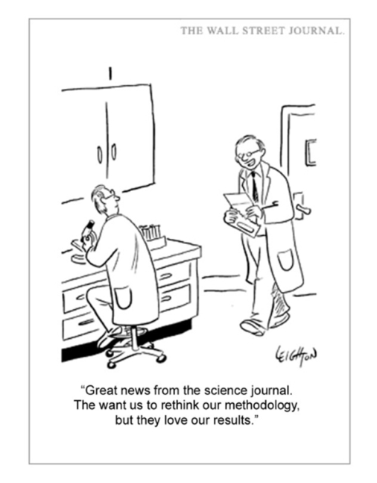
Thank You! Questions? reproducibility@nih.gov

Slide 55
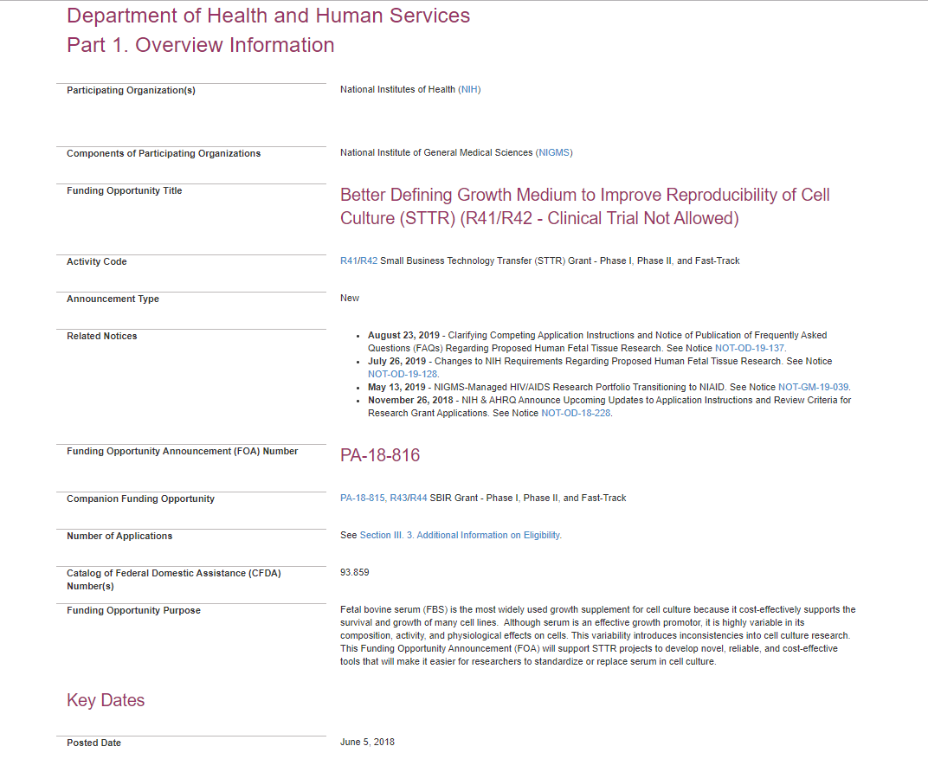
Notes:
Funding Opportunity Purpose
Fetal bovine serum (FBS) is the most widely used growth supplement for cell culture because it cost-effectively supports the survival and growth of many cell lines. Although serum is an effective growth promotor, it is highly variable in its composition, activity, and physiological effects on cells. This variability introduces inconsistencies into cell culture research. This Funding Opportunity Announcement (FOA) will support STTR projects to develop novel, reliable, and cost-effective tools that will make it easier for researchers to standardize or replace serum in cell culture.

Slide 56
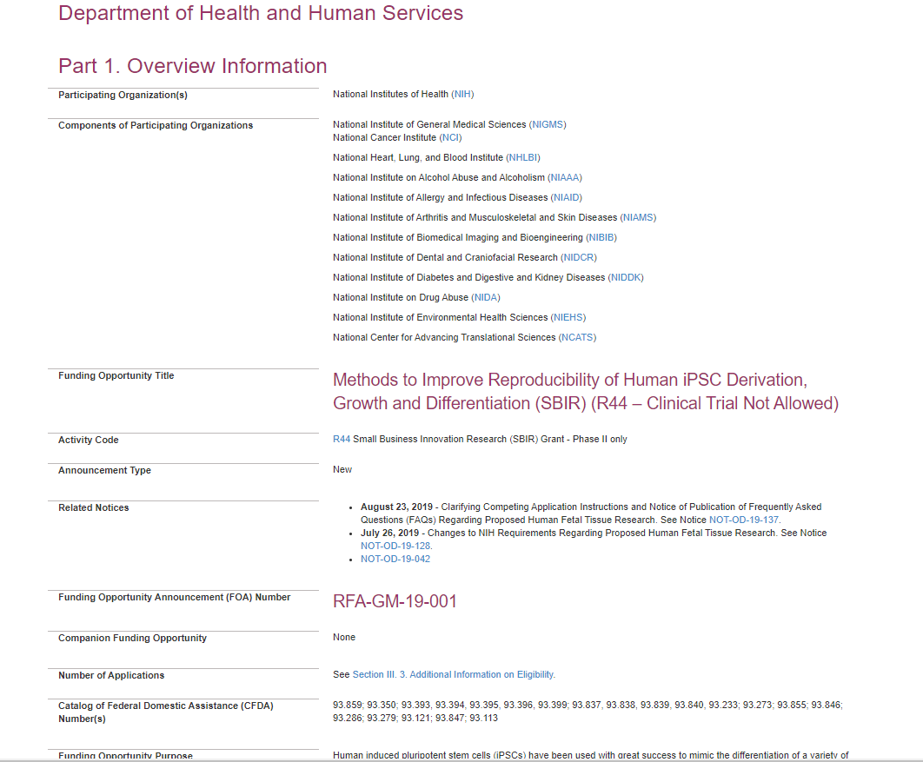

Slide 58
