Slide 1
Research and Development Contracts: Finding Opportunities & Writing Proposals
Presented by: George Kennedy
Chief, Acquisition Management and Policy Branch
National Institute of Allergy and Infectious Diseases
National Institutes of Health
Brian O’Laughlin
Deputy Director and Chief, Green Contracts Management Branch
Office of Acquisition
National Institute on Drug Abuse

Slide 2
Contents
Scope and Types of R&D Contract Solicitations at NIH
Contracts vs. Grants
Locating and Responding to Contracting Opportunities
Proposal to Award
Considerations for Pursuing Contracts

Slide 3
Contracting Offices at NIH
Consolidated Operations Acquisition Centers (COAC) | Institutes / Centers Included
CC | CC
NCI | NCI, NCCIH
NHLBI | NHLBI, CSR, NIAMS, NIDCR, NIBIB, NHGRI
NIAID | NIAID
NICHD | NICHD, NIAAA, FIC
NIDA | NIDA, NINDS, NIMH, NIA, NCATS
NIEHS | NIEHS
NITAAC | NITAAC
NLM | NLM, CIT, NIDDK
OLAO | NEI, NIDCD, NIGMS, ORS, OD, NINR, NIMHD
ORF | NIH Facilities
Notes:
Eleven Contracting offices, know as COACs, at NIH are organized to serve one or more of the 27 Institutes which comprise the NIH.

Slide 4
Examples of NIH R&D Contracts
Therapeutics against pathogens
Vaccine development (e.g. ebola vaccine)
Animal research support (e.g. animal model development)
Protocol development
Clinical research studies
Reagent development
Clinical data coordination
Biologic specimen repository

Slide 5
Contract Overview
Notes:
* Source: https://grants.nih.gov/funding/contracts.htm

Slide 6
Contract Overview
Contracts are governed by large body of statutes, regulations and policies:
Competition in Contracting Act (CICA)
Federal Acquisition Regulation (FAR)
HHS Acquisition Regulations (HHSAR)
Precedent: United States Court of Federal Claims (COFC); Government Accountability Office (GAO)
Overlap: Human subjects and animal research; financial conflicts of interest; salary rate limitations; cost principles

Slide 7
Types of Contracts (FAR Part 16)
Fixed Price
Used when risk is minimal, or can be predicted with an acceptable degree of certainty.
Examples: Firm-Fixed-Price; Fixed-Price w/ Economic Price Adjustment; Fixed-Price, Incentive
Preferred type; required for Commercial Items, Sealed Bidding
Cost Reimbursement
Used only when requirements cannot be defined sufficiently, or uncertainties do not permit costs to be estimated with sufficient accuracy.
Examples: Cost; Cost-Plus-Fee (Fixed, Incentive, Award); CPFF- Completion; CPFF-Term
Indefinite-Delivery
Used when exact time/exact quantities are not known at time of contract award.
Work is awarded through Delivery/Task Orders
Examples: Definite-Quantity; Indefinite-Quantity; Requirements
Notes:
R&D contracts are typically Cost Reimbursement type contracts.

Slide 8
Solicitations
FAR 2.101:
“Solicitation” means any request to submit offers or quotations to the Government. Solicitations under sealed bid procedures are called “invitations for bids.” Solicitations under negotiated procedures are called “requests for proposals.” Solicitations under simplified acquisition procedures may require submission of either a quotation or an offer.
Notes:
Research and Development contracting, the focus of this presentation, primarily uses negotiated procedures governed under FAR Part 15. For more information on sealed bid procedures and invitation for bids, please refer to FAR Part 14 - Sealed Bidding.

Slide 9
Requests for Proposals (RFP)
Communicates Government requirements to prospective contractors and solicits proposals.
Also describes the—
Anticipated terms and conditions that will apply to the contract;
Information required to be in the offeror’s proposal; and
Factors and significant subfactors that will be used to evaluate the proposal and their relative importance.
Notes:
The purpose and required content for Requests for Proposals is described in FAR Part 15.203.

Slide 10
Requests for Proposals (RFP)
Section – Title
Part I – The Schedule
A – Solicitation/Contract Form
B – Supplies or Services and Prices/Costs
C – Description/Specifications/Statement of Work
D – Packaging and Marking
E – Inspection and Acceptance
F – Deliveries or Performance
G – Contract Administration Data
H – Special Contract Requirements
Part II – Contract Clauses
I – Contract Clauses
Part III – List of Documents, Exhibits, and Other Attachments
J – List of Attachments
Part IV – Representations and Instructions
K – Representations, Certifications, and Other Statements of Offerors or Respondents
L – Instructions, Conditions, and Notices to Offerors or Respondents
M – Evaluation Factors for Award
Uniform Contract Format (UCF)
(FAR 15.204-1)
Notes:
Requests for Proposals (RFP’s) for research and development requirements are typically assembled following the Uniform Contract Format (UCF) prescribed under FAR 15.204-1. Exceptions to use of the UCF can be found at FAR 15.204 – Contract Format.

Slide 11
Broad Agency Announcement (BAA)
FAR 2.101: A general announcement of an agency’s research interest including criteria for selecting proposals and soliciting the participation of all offerors capable of satisfying the Government’s needs.
FAR 35.016(a): For the acquisition of basic and applied research and that part of development not related to the development of a specific system or hardware procurement…directed toward advancing the state-of-the-art or increasing knowledge or understanding rather than focusing on a specific system or hardware solution.
Notes:
The Broad Agency Announcement is a method for soliciting proposals to meet the Government’s research needs in the interest of advancing the state-of-the-art or increasing knowledge or understanding. While not necessarily following the Uniform Contract Format previously discussed, you will see that the substance of the solicitation, and the process by which proposals are handled, are very similar.

Slide 12
Small Business Innovative Research (SBIR)
Statutory program aimed at strengthening the role of innovative small business concerns in Federally-funded research or research and development.
Administered through grants and contracts.
Contract solicitation released annually
HHS Components: NIH, CDC
https://sbir.nih.gov/
Notes:
Information about the SBIR Program at NIH can be found at: https//sbir.nih.gov . Links to both the Grant announcements and the annual Contract solicitation are available there. The Contract solicitation is typically made available in mid-summer, with proposals due in the fall.

Slide 13
NIH Contract Opportunities are Advertised
Governmentwide point of entry (GPE): FedBizOpps
www.fbo.gov (beta.SAM.gov)
NIH Guide
https://grants.nih.gov/funding/index.htm
Individual Institute Websites
Funding Opportunities Pages
HHS Forecast
Procurementforecast.hhs.gov
Notes:
In addition to the FBO and the Department’s procurement forecast, another source for information on contract opportunities is the websites of the individual institutes. The Institutes have pages devoted to their specific funding opportunities. In addition, another avenue to explore is the “About Pages” of the institutes. These pages provide information on the structure and scientific focus of the Institute.

Slide 14
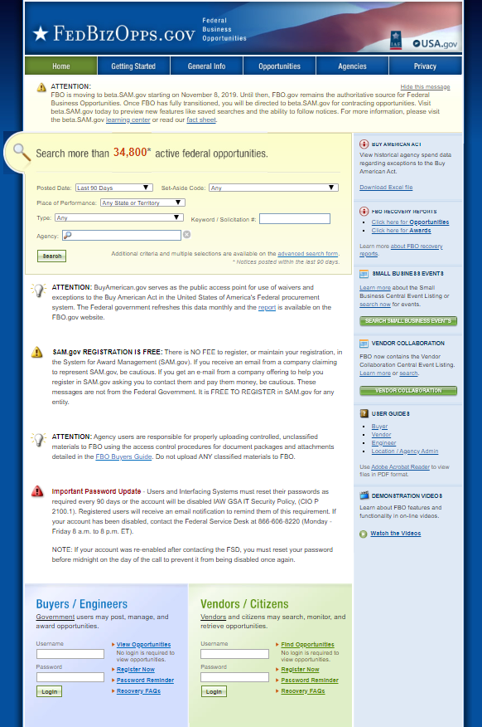
Locating Contracting Opportunities: FBO
Notes:
All contract actions are published in FedBizOpps, the Government-wide portal for contract opportunities. From this site you can view potential opportunities and advance plans in Sources Sought and Request for information; awards that have been made; and, most importantly, solicitations. We’re now going to bring up the FBO and show you how to navigate the system.

Slide 15
Locating Contracting Opportunities: FBO → beta.SAM.gov

Slide 16
Locating Contracting Opportunities: FBO → beta.SAM.gov

Slide 17
NIH Guide
Notes:
The NIH Guide for Grants and Contracts (NIH Guide) is the official publication for NIH biomedical and behavioral research grant policies, guidelines and funding opportunities.
The NIH Guide links to contract information: https://grants.nih.gov/funding/contracts.htm#findingacontractsolicitation, allowing for searches of opportunities, and links to the Government wide point of entry: FedBizOpps.gov.

Slide 18
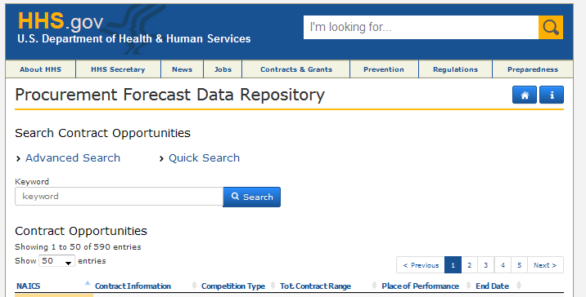
Locating Contracting Opportunities: HHS Procurement Forecast
Notes:
In addition to FEDBizOpps, the Department maintains a website that lists projected contracts for all of HHS. https://procurementforecast.hhs.gov/Contract

Slide 19
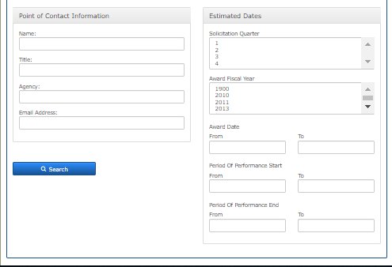
HHS Procurement Forecast – Advanced Search

Slide 20
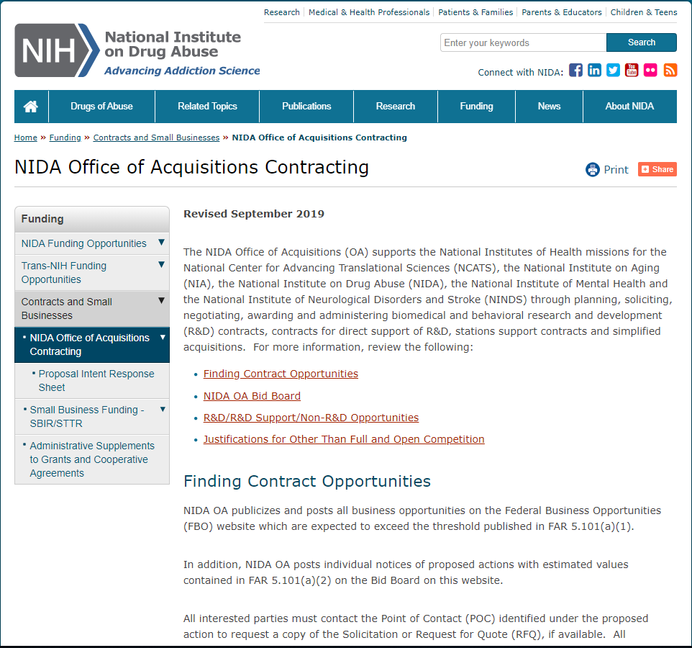
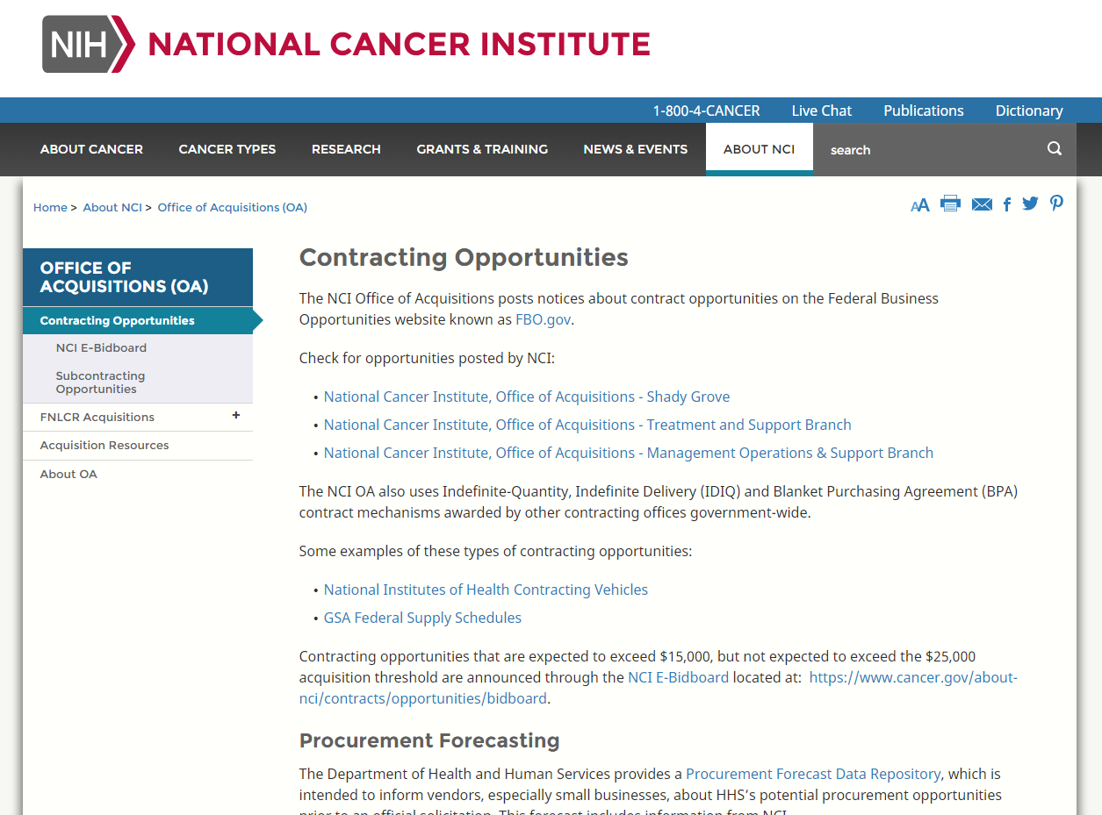
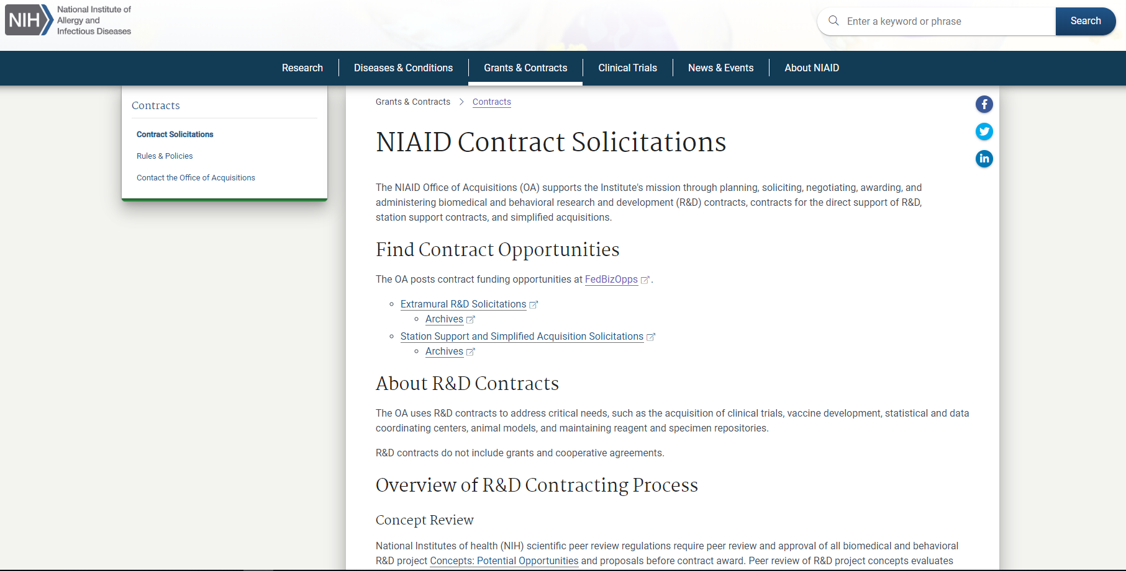
Locating Contracting Opportunities: IC Websites
Notes:
Locating contract opportunities is best achieved through the use of the governmentwide point of entry: FedBizOpps.gov. However, alternative sources of information regarding funding opportunities are often found on the respective NIH IC websites. Examples are included here.

Slide 21
R&D Contracts – Award Process
Acquisition Planning & Market Research
Solicitation
Proposal Evaluation
Technical/Peer Review
Cost
Past Performance
Negotiation
Source Selection
Notes:
The process of a concept moving from the planning stages through award of contracts is shown here. The initial steps develop a plan for soliciting the Government’s need, and involve examining the market to determine the viability of an acquisition concept. A SOW and contract requirements are developed which are then used to create a solicitation.
Following receipt of your proposal, the potential exists for negotiation and selection for award.

Slide 22
Proposal Evaluation - Technical
Peer review of technical criteria stated in solicitation.
Examples: Understanding of the Project; Technical Approach; Management Plan; Personnel Qualifications; Facilities
Often weighted using numerical scores or percentages
Peer Review committee
The members of the peer review provide scores/ratings and comments on strengths, weaknesses, deficiencies and technical acceptability.
The written minutes of the review provide the information needed to assess technical capability and points of negotiation.
75% of Peer Review Group must not be Federal Employees
Peer Review Group does not receive the Business Proposal
Notes:
In R&D contracts the technical proposal is a significant part of the overall evaluation of a proposal. The solicitation provides the specific criteria that must be followed in evaluating the proposals for that solicitation. NIH utilizes numerical scores base on the criteria and the weights stated in the solicitation. The peer reviewers provide their technical assessment of the technical proposal. The assign scores based on the criteria and provide their comments on the strengths, weaknesses an deficiencies of the technical proposal. They also determine if the proposal is technically acceptable. If a proposal is technically unacceptable, that proposal cannot be considered for award. CO Reviews for Page Limitations, and Failure to meet material terms and conditions prior to forwarding for Peer Review.

Slide 23
Proposal Evaluation - Cost
FAR 15.305(a)(1): When contracting on a cost-reimbursement basis, evaluations shall include a cost realism analysis to determine what the Government should realistically expect to pay for the proposed effort, the offeror’s understanding of the work, and the offeror’s ability to perform the contract.
Examples of cost elements: labor; subcontracts; consultants; travel; other direct costs; indirect costs; fee (as applicable).
Common mistakes: salary rates exceed limitations; profit margins exceed limitations; options not priced; travel costs exceed rate limitations; unallowable costs
Notes:
The cost proposal is used to determine whether the proposed cost is reasonable and to establish the competitiveness of the proposal. The solicitation will describe what information should be included in the cost proposal. Most often, the solicitation will also include a format for submission of the cost information. In determining the realism of the proposal, we will also consider the effects of changes in the costs based on the technical strengths and weaknesses.

Slide 24
Past Performance Evaluation
The currency and relevance of the information, source of the information, context of the data, and general trends in contractor’s performance shall be considered. (FAR 15.305(a)(2))
Offerors are given the opportunity to identify past or current contracts for similar work; Government may also obtain information from other sources (PPIRS; past performance questionnaires).
If no relevant past performance is available, the offeror may not be evaluated favorably or unfavorably on past performance.

Slide 25
Competitive Range and Negotiations
Based on the ratings of each proposal against all evaluation criteria, the contracting officer shall establish a competitive range comprised of all of the most highly rated proposals. FAR 15.306(c)
Can be reduced for purposes of efficiency.
Negotiations
Government must tell offerors all deficiencies and significant weaknesses in the proposal and adverse past performance information.
Government can also negotiate price.
Offeror has opportunity to revise its proposal.
Notes:
Once all of the reviews are completed the Contracting Officer determines a Competitive Range consisting of the most highly rated proposals and will then commence negotiations. During negotiations, the Government will provide the deficiencies and significant weaknesses to allow the offeror to improve its proposal. Also, the Government will provide any adverse past performance information that was found. In addition, the cost or price will be negotiated. During negotiations the offer may revise its proposal and at the conclusion of negotiations, the Government will request Final proposal Revisions from all offerors in the Competitive Range.

Slide 26
Source Selection
The Contracting Officer selects awardees based on the Evaluation Factors for Award stated in the solicitation.
Example:
Selection of an offeror for contract award will be based on an evaluation of proposals against three factors. The factors in order of importance are: technical, cost, and past performance. Although technical factors are of paramount consideration in the award of the contract, past performance and cost/price are also important to the overall contract award decision. All evaluation factors other than cost or price, when combined, are significantly more important than cost/price. The Government intends to make an award(s) to that offeror whose proposal provides the best overall value to the Government.
Notes:
After the Final Proposal Revisions are received the Contracting Officer shall make award selection based on the selection factors stated in the solicitation. The example shown here is commonly used in R&D solicitations. Once the decision is made, the Contracting Office drafts a contract, obtains funding, and executes the contract.

Slide 27
Considerations
Notes:
Source: NIH Office of Extramural Research, Grants and Funding webpage: https://grants.nih.gov/funding/contracts.htm

Slide 28
Closing Remarks
Scope and Types of R&D Contract Solicitations at NIH
Contracts vs. Grants
Locating and Responding to Contracting Opportunities
Proposal to Award
Considerations for Pursuing Contracts
Good Luck!
Notes:
In conclusion, we have covered the topics of R&D Contract Solicitations at NIH, distinguishing characteristics between Contracts and Grants, locating contract requirements, the process undertaken from receipt of proposals through contract award, and considerations for submitting a proposal.
We hope you have found this information helpful, and wish you the best of luck in your future pursuits!

Slide 29
Regulations and Policy
Federal Acquisition Regulations (FAR):
https://www.acquisition.gov/?q=browsefar
DHHS Acquisition Regulations:
http://www.hhs.gov/grants/contracts/contract-policies-regulations/hhsar/index.html
Peer Review Regulations: 42 CFR 52h (Select Title 42 from Drop Down Box)
NIH Manual Chapters:
https://policymanual.nih.gov/ (See the 6000 and 7000 Series Chapters)
NIH Office of Acquisitions and Logistics Management
OALM: https://oalm.od.nih.gov/
Notes:
The additional references provided here represent an excellent source of information covering the topics discussed today.
The NIH Manual Chapters are the policies of the NIH: Acquisition and Grants specific policies are found in the 6 and 7000 numbered chapters.
The NIH Office of Acquisitions and Logistics Management provides leadership, guidance, and oversight for acquisition and logistics at NIH. The OALM web pages provide guidance and links to other sources of acquisition information.

