Slide 1
My application has been reviewed…so now what?
Grace Shen, Ph.D.
Group Leader and Program Director, Retinal Diseases Program
Division of Extramural Science Programs, Vision Research Program
National Eye Institute, NIH
Notes:
Alternate text: Title Slide: My application has been reviewed…so now what?

Slide 2

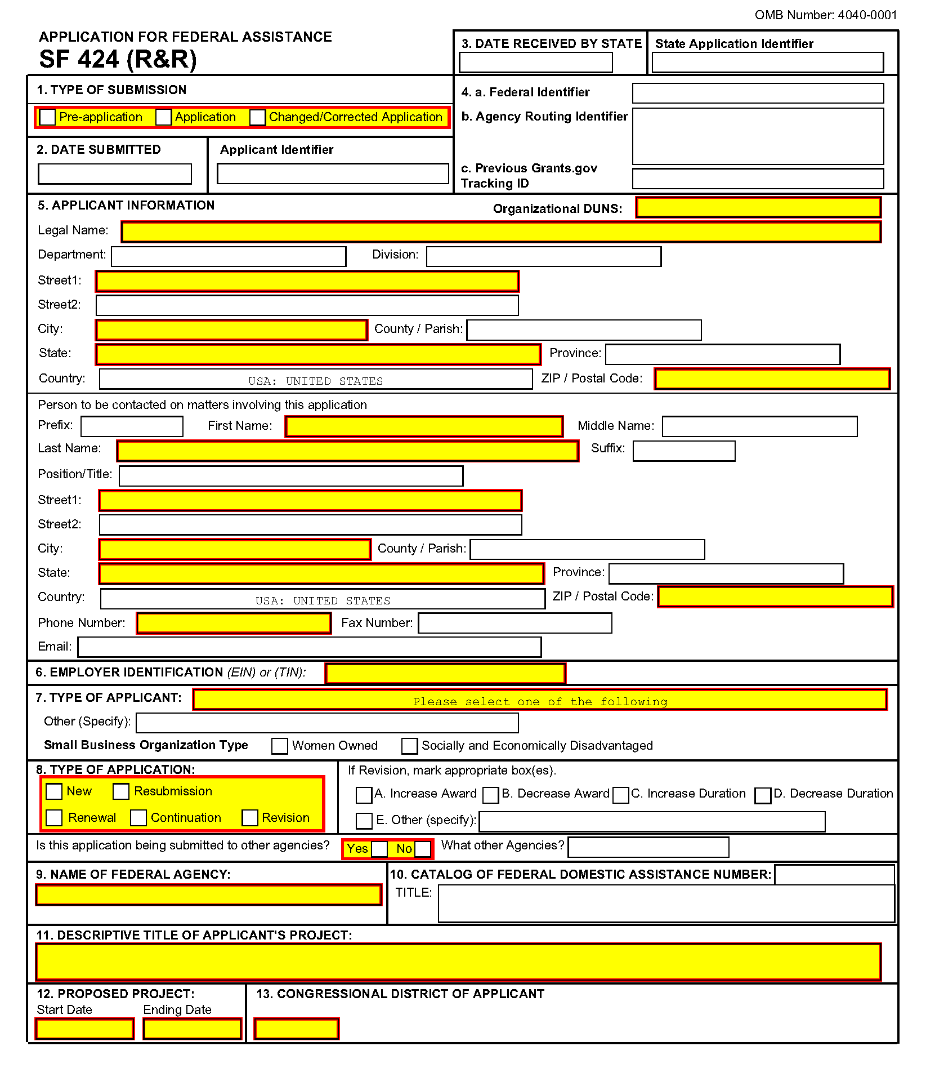

Today’s Session Goals…
Great idea
NIH
Application
Funding!!
Notes:
Alternate text: The goal for today’s session is how to start with your great idea as in a light bulb, complete an NIH grant application, and navigate the NIH black box that could lead to dollars for your research.

Slide 3
Learning Objectives
After this session, attendees should be able to:
  Explain what happens after peer review
    Timeline and roles of parties involved
    Understanding your score and Interpreting your Summary Statement
  Assess the appropriate actions if you disagree with the initial study section review
    Appeal? Or not appeal to council, second level of review?
  Determine the actions necessary if the application is selected for award
    Resolving concerns from peer review
    Meeting just-in-time (JIT) requirements and procedures
    Notice of Award (NoA)
  Determine the actions necessary if I’m not selected for funding
    How to revise and resubmit?

Slide 4
NIH Extramural Administrative Team
Program Officer (PO)
YOU (PI) Authorized Organization Representative (AOR)
Grants
Management
Specialist (GMS) & Grants Management Officer (GMO)
Scientific Review Officer (SRO)
Notes:
Alternate text: This is a Venn diagram with three overlapping circles that describes the relationship between the Scientific Review officer, the Program Officer, and the Grants Management Specialist who comprise the NIH Extramural Administrative Team and where the applicant and their institution fits in as engaging with each of these team members. Team is italicized to highlight the importance of that concept as it applies to how these individuals work together in the management and oversight of extramural grant applications and awards and work with applicants and funded investigators.

Slide 5
How Well Do You Know your NIH Acronyms?
PI (Grantee Institution)
AOR
CSR (Review)
SRO
IC (Funding)
PO/PD/MO
GMS
GMO
Notes:
Alternate text: This is a list of the acronyms that stand for the different players in the application, review and funding process

Slide 6
Program/Medical Officer
(PO/PD, MO)
Roles and Responsibilities:
Interacts with PIs on their grant applications
Participates in IC funding priorities discussion/recommendation
Manages a portfolio of grants
Also:
Conduct site visits
Attends scientific meetings; serves on professional and IC committees
Plans NIH-sponsored scientific meetings/grantee meetings
Communicates scientific advances to the Branch, Center, and
Institute Directors
When to contact: Prior to application submission, after receiving a summary statement, during the processing of award, through final close out

Slide 7
Scientific Review Officer
(SRO)
Roles and Responsibilities:
Recruits reviewers and develops member slates for study section meetings (scientific expertise and panel diversity)
Assigns applications to reviewers; explains/interprets review criteria
Runs study section meeting
Calculates impact score and percentile
Drafts resume of discussion, edits reviewer critiques (minimal edits), and releases Summary Statement
When to contact: After application submission through release of Summary Statement

Slide 8
Grants Management
Specialist
(GMS, GMO)
Roles and Responsibilities:
Acts as an agent of the GMO
Assures compliance with Federal laws and NIH policies and procedures
Analyzes grant applications and works with PO prior to award
Prepares award for GMO release
Reviews and responds to grantee prior approval and re-budgeting requests
Assures documentation of official grant files
When to contact: After receiving a potentially fundable score through the issuance of awards until close out

Slide 9
Know who to talk to and when…
PI and AOR submit application
CSR Receipt & Referral Officer receives and makes assignments
IC Referral Officer
$NoA
Notice of award
PO
SRO
PO and GMO
PI revises and resubmit A1 application
PO assigned by funding IC
IC determines funding plan and funds application
SRO assigns reviewers; study section reviews application
Upper half applications receive a priority score/percentile; Summary Statement prepared for all applications
Second level of Review IC Council
Notes:
life cycle” of a grant application
Alternative text: the graphic depicts a circle of arrows with text describing the steps in the grant process. The right half describes events prior to review and the left half describes events after the review.

Slide 10
Review System for Grants
  Scientific Review Group (SRG)
  Independent outside review (Study Section, SEP) managed by NIH
  Evaluate scientific merit, significance, other
  Provides priority score
  Recommend length and level of funding
1st level
Output: Impact Score and Summary Statement
  Advisory Council
    Assess quality of SRG process
    Offers recommendation to Institute/Center Director and staff
    Evaluates program priorities and relevance
    Advises on policy
~3 - 7 months
2nd level
Output: Approval for IC to proceed with Funding of Applications
  Institute/Center Director
    Makes final decision based on Council input, programmatic priorities
    Must also pass administrative review
~ 1 - 3 months
Output: Awards or Resubmission
Notes:
10
Alternate text:
Box 1: Title is Scientific Review Group (SRG)
This box describes the first level of review at the NIH. It includes an independent, outside review group managed by NIH that evaluate the scientific merit, significance and other review criteria. This group provides a priority score and recommends the length of award and level funding. The output is an impact score and summary statement.
Box 2: Advisory Council
Approximately 3-7 months later the second level of review is conducted at the NIH Institute or Center Advisory Council. This group assesses the quality of the SRG process, offers funding recommendations to the Institute/Center Director and staff. It evaluates program priorities and relevance and advises the Institute/Center Director and staff on policy. The output includes funding recommendations.
Box 3: Institute/Center Director
Approximately 1-3 months after Advisory Council meeting, the Institute/Center Director makes the final funding decisions based on Council input, assessment of programmatic priorities, etc. The applications must also pass administrative review to ensure compliance with policies, procedures, and regulations. The output is either an award to the grantee or a resubmission by the grantee.

Slide 11
First Level of Review
eRA: NIH Scientific Review Group (SRG) Roster Index
https://public.era.nih.gov/pubroster/
Review Panels & Dates | NIH Center for Scientific Review
https://public.csr.nih.gov/RevPanelsAndDates
Notes:
The links here provide the site where you can find out about the dates of upcoming review meetings and the review group rosters.

Slide 12
How is a Priority Score/Percentile generated?
Assigned reviewers: scores for each criterion and an overall impact/priority score (PS)
All reviewers score privately from 1 (best) to 9 (worst).
Overall scores are averaged, rounded to one decimal place, and multiplied by 10 e.g., a 1.34 average is a score of 13.
Percentiles (1 to 99%) indicate a relative rank of your application compared to others reviewed by your study section at the last three meetings.
Notes:
Alternate text: The graphics at the bottom of this slide are three individuals sitting at a table holding up score cards.

Slide 13

I have a percentile, but my colleague doesn’t……
Percentiles are only meaningful when there is a good comparison group such as all R01 applications reviewed by the CSR “XYZ” Study Section for the last 3 meetings
Not meaningful when…
  Special emphasis panel (SEP)
  Small number of one type
  Major change in process impacts some but not all applications
Notes:
Alternate text: The graphics at the bottom of this slide are three individuals sitting at a table holding up score cards.

Slide 14

Impact/Priority score
Score with percentile
Score with no percentile
++/Not Discussed/Unscored
  Scientific merit in the lower 50% of the applications or beyond the group likely to be competitive for funding
Not Recommended for Further Consideration
  Indication of serious concerns.
  Usually not eligible for funding
Notes:
Alternate text: The graphics at the bottom of this slide are three individuals sitting at a table holding up score cards.

Slide 15
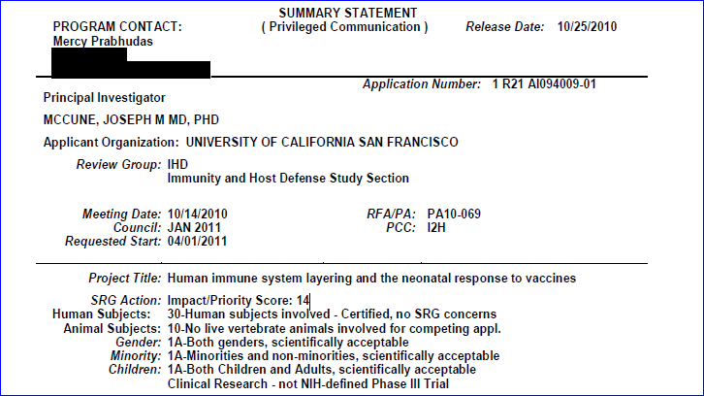
Sample Summary Statement*
*Summary statement shown with permission for training purposes
Notes:
After the meeting, all reviewed applications receive an overall impact score and summary statement prepared by the SRO.
NIH releases scores to you and your program officer in the Commons within three business days and uploads your summary statement within 30 days.
Your summary statement has a lot of information:
bulleted critiques from your assigned reviewers
brief summary of the discussion
overall impact score and percentile for R01s
criterion scores from your assigned reviewers
recommended budget
human and animal subjects codes
any administrative comments
If necessary, you'll use this information to revise a fixable application as we describe in Part 6. If Not Funded.
But keep in mind that although your summary statement gives you critical feedback, it is not an exhaustive critique or a teaching tool containing every point reviewers found to be problematic. We tell you more in Assess Peer Review Results in What to Do if You Get Bad News in Part 6.

Slide 16
Understanding your PS/%tile
After the meeting, reviewers may edit their criterion scores and critiques, but not the overall impact/priority scores.
  Note: Reviewers do not always edit to reflect the discussion. Depends on the reviewer and the panel.
Your priority score in your Commons account within 3 business days after the peer review
Your Summary Statement typically available within 4-8 weeks.
Notes:
Alternate text: The graphics at the bottom of this slide are three individuals sitting at a table holding up score cards.

Slide 17
Sample Summary Statement*
CRITIQUE 1:
Significance: 2
Investigator(s): 1
Innovation: 1
Approach: 1
Environment: 1
Overall Impact:
The research in this application should lead to a paradigm shift in our understanding of the development of the neonatal immune system, particularly the shift from a tolerogenic phenotyp utero to a highly responsive phenotype after birth. The hypothesis is clearly presented, and the experiments are expected to unequivocally prove or disprove the hypothesis. Either way, the r be of great interest. If the hypothesis proves to be true, it may become possible to identify those newborns at the highest risk for serious or life-threatening infections, and to tailor immunization strategies to an individual’s immune maturity status.
*Summary Statement shown with permission for training purposes

Slide 18

Dos and Don’ts post receiving PS/%tile
Why?
  X Call the SRO?
  X Call or email your PO right away?
  X Celebrate and tell everyone you are sure to get the award?
  X Deep dive into depression?
  Review the “Next Steps” guidance
  http://grants.nih.gov/grants/next_steps.htm

Slide 19

  Wait until you have a Summary Statement before contacting your Program Officer
  Review and “digest” it before calling your PO
  If possible, discuss with your colleagues and/or mentors
Notes:
Alternate Text: Picture of a figure holding up the best practice sign

Slide 20

The PO may be able to provide guidance on the following issues:
Further discussion of the reviewers’ comments (the PO may have been present at the review)
The acceptable basis for appealing the peer review process
The likelihood of NIH funding the application (be patient)
  Note: Council does not rereview each application, but conducts review only on individual application identified to receive special review. Council may provide advice to the Institute/Center director but does not make final funding decisions.
Notes:
Alternate text: The image at the top of the slide is a stick figure with a light bulb over their head and their hand raised by the light bulb.

Slide 21

Timeline of Funding…
-it depends
October to January
No budget yet (maybe)
Operate under a continuing resolution previous FY $ level
Fund a limited number of applications.
Other awards delayed
Winter Until Spring
A budget is usually in place
Congress passes appropriations bill, president signs into law, setting NIH's budget levels
DHHS needs several weeks to analyze budget
Notes:
Alternate text: The graphics at the top of this slide are dollar bills with a $ and smiley face and feet.

Slide 22
Timeline of Funding…
-it depends
Spring to Early Summer
Budget arrives at Institutes
Number crunching
Each institute sets their financial management plan
Fund grants within payline/pay range
Fund grants through special funding programs
July to September
Close of fiscal year
Number crunching
Revisit payline if needed
Pay deferred applications
Special pay programs
Notes:
Alternate text: The graphics at the top of this slide are dollar bills with a $ and smiley face and feet.

Slide 23
Timeline of Funding…
-it depends
At the start of the fiscal year, you will more likely have to wait for an award because funding is limited.
If your application missed the cut, it may get funded later in the fiscal year.
Institutes may have funding pools to use for high priority or special need areas (e.g. selective pay, Bridge awards).
Stay in touch with your Program Officer
Notes:
Alternate text: The graphics at the top of this slide are dollar bills with a $ and smiley face and feet.

Slide 24

What to do if I am being considered for funding?
Resolve concerns
  e.g., human subject protections, vertebrate animal protections, inclusion of women, minorities, and children
Complete Just-In-Time Requirements
Restricted Awards
Notes:
Alternate text: The graphics at the top of this slide is a stick figure with a question mark over the head.

Slide 25
Sample Summary Statement*
Protections for Human Subjects:
Acceptable Risks and/or Adequate Protections
          No concerns
Data and Safety Monitoring Plan (Applicable for Clinical Trials Only):
Inclusion of Women, Minorities and Children:
Gender: 1A - Both Genders, Acceptable
Minority: 1A - Minority and Non-minority, Acceptable
Age: 1A – Children, Adults, Older Adults, Scientifically Acceptable
Vertebrate Animals:
Not Applicable (No Vertebrate Animals)
Biohazards:
Acceptable no concerns
*Summary Statement shown with permission for training purposes
Notes:
Roster follows

Slide 26

Resolving Concerns
A concern is a Bar to Award:
  Animal Subjects Protection Concern code = 44 (changed to 54 when resolved)
  Human Subjects Protection Concern code = 48 (changed to 30 when resolved, 10 if no human subjects, or E1-E7 for exempt studies)
How to resolve concerns
  Read your Summary Statement
  Determine the issue(s) e.g., source of materials, identifiers, risks, protections, informed consent, missing inclusion information, poorly justified sample
  Contact your Program Officer
  Submit requested materials via the just-in-time module
  Resolution takes time, so start early and work with your business office on all official grant actions
Restricted award may be issued
  Typically at the end of the fiscal year
  Activity with concern may NOT commence without resolution
Notes:
Alternate text: The graphics at the bottom of this slide is a stick figure with a clipboard with a checklist.

Slide 27
Other potential bars to funding
  Lack of assurance code = 20
Research Misconduct
  Institutions are required to establish and maintain an assurance that certifies they have a process for responding to allegations of research misconduct.
  This does not appear in the Summary Statement
  Generally due to institution not updating ORI their research misconduct assurance or not having a misconduct assurance in place (usually new institutions, first time grantees)
Notes:
Alternate text: The graphics at the bottom of this slide is a stick figure with a clipboard with a checklist.

Slide 28

Just in Time Requirements
What is just in time information?
  Information that NIH requests after the initial peer review
  Information NIH needs to make an award but doesn’t require in your application
  Application within the range of possible funding; JIT request doesn’t mean that your application will be funded.
  See Section 2.5.1 of the NIH Grants Policy Statement for more information: http://grants.nih.gov/grants/policy/nihgps_2013/nihgps_ch2.htm#just_in_time_procedures
Notes:
Alternate text: The graphics at the top of this slide is a stick figure sitting on an hourglass.

Slide 29
Just in Time Requirements
Where do I send the information?
  Electronic Submission of Just-in-Time Information NIH Guide Notice NOT-OD-12-101
  Your business official will submit through eRA Commons.
Be prepared
  Know what we will ask for and when to send it
  Contact person: Grants Management
Notes:
Alternate text: The graphics at the top of this slide is a stick figure sitting on an hourglass.

Slide 30
Just in Time Requirements
How will I know to submit just in time?
  Standard email from NIH.
    The NIH issues automatic just-in-time emails for all applications that get an overall impact/priority score of 40 or less. These requests should arrive to you and your business office within 15 days after you get your review scores.
  Personalized email from individual institute or center.
    Grants Management staff issues personal just-in-time requests when funding is likely.
Notes:
Alternate text: The graphics at the top of this slide is a stick figure sitting on an hourglass.

Slide 31
Just in Time Requirements
Details required for just in time information?
  Current Other Support for all key personnel
  (may need update after 120 days)
  Human subjects: IRB approval date or Institutional Assurance
  Documentation of required education in Protection of Human Subjects Research Participants for key personnel
  Animal Research: IACUC approval date
Notes:
Alternate text: The graphics at the top of this slide is a stick figure sitting on an hourglass.

Slide 32
Other Just in Time Requirements
  Confirm administrative information such as Entity Identification Number (EIN)
  Confirm F&A agreement date and rate
  Responses to Summary Statement Concerns
  Patient Care Costs
Notes:
Alternate text: The graphics at the top of this slide is a stick figure sitting on an hourglass.

Slide 33

Differences Between Request and Award
Peer review may have recommended changes to budget, performance period, or your research plan
Overlap may cause funding levels to be lower
Programmatic reduction
  Some ICs reduce award budgets when the annual appropriation doesn’t allow funding at council approved levels.
Notes:
Alternate text: The graphics at the top of this slide are two stick figures shaking hands.

Slide 34
Notice of Award (NoA)
Legally binding document
Award data and fiscal information
Grants payment information
Terms and conditions of award
  Terms and Conditions in FOA
  Terms and Conditions in your NoA
  Used to clarify information, provide programmatic structure, or restrict how you can use funds.
Where to get information?
  eRA Commons; use the Status module or Issued Notice of Award query.
Your institution accepts the terms and conditions of award when you spend the money
34
Notes:
Alternate text: The graphics at the top of this slide are two stick figures shaking hands.

Slide 35

Reporting After Award
Annual Research Progress Performance Report (RPPR)
Annual federal financial reporting
Subaward reports
Invention reporting
Yearly audits (as applicable)
Closeout reporting
35
Notes:
Alternate text: The graphics at the top of this slide are two stick figures communicating through cans connected with string.

Slide 36
Additional Reporting related to the research
Examples:
  Clinical Research and/or Trials
    Protocols registered in Clinical trials.gov
    Inclusion enrollment reporting at least annually
    Institute/Center-specific reporting requirements
  Human subjects IRB approval every year
  Animal subjects IACUC approval every 3 years
  Data Sharing
  Model Organisms
  Public Access
Notes:
Alternate text: The graphics at the top of this slide are two stick figures communicating through cans connected with string.

Slide 37
Learning Objectives
After this session, attendees should be able to:
  Explain what happens after peer review
    Timeline and roles of parties involved
    Understanding your score and Interpreting your Summary Statement
  Assess the appropriate actions if your application is not selected for award
    Appeal? Or not appeal?
  Determine the actions necessary if the application is selected for award
    Resolving concerns from peer review
    Meeting just-in-time (JIT) requirements and procedures
    Notice of Award (NoA)
  What if I’m not selected for funding?

Slide 38
What if I’m not selected for funding?
Don’t be discouraged, you are in the majority!
Talk to your Program Official
  Are there options for special funding (Institutional Development Awards (IDeA), Women’s health, etc)??
Ask the PO about
  Reviewer support for your idea
  Additional insight from the review
  Any issues with the presentation
Notes:
Alternate text: The graphics at the top of this slide is a stick figure with a question mark over the head.

Slide 39
Unsuccessful Applicants should:
Assess peer review results and read Summary Statement carefully
  Can you readily fix reviewers concerns?
  Can you clarify things that reviewers misunderstood?
  Did reviewers have conceptual problems that you can address?
  Discuss options with colleagues and/or mentors
  Evaluate your options
  Prepare to re-apply, if applicable
Notes:
Alternate text: The graphics at the top of this slide is a stick figure with a question mark over the head.

Slide 40
When to go in a new direction?
Hard to fix Problems –
Low-impact research topic.
  Philosophical issues, e.g., the reviewers do not think the work is highly significant.
  Hypothesis is not sound or not supported by the data.
  Work has already been done.
  Methods proposed were not suitable for testing the hypothesis.

Slide 41
Resources for Investigators
NIH Grants Process Overview
  Homepage: http://grants.nih.gov/grants/grants_process.htm
  Award Management page: https://grants.nih.gov/grants/pre-and-post-award-processes.htm
  NIH Grants Process: The Big Picture (YouTube)
  https://www.youtube.com/watch?v=rNwsg_PR90w
Policy pages dedicated to specific topics
  Examples: Human subject protections, inclusion of women, minorities, and children, animal protections, peer review, public access, etc.
Institute/Center-specific resources
  Grants process
  Funding plans
  Reporting and award requirements
Notes:
Alternate text: The image at the top of the slide is a stick figure with a light bulb over their head and their hand raised by the light bulb.

Slide 42
Thank you for your time and attention!
Any questions?
Grace Shen, Ph.D.
Group Leader and Program Director, Retinal Diseases Program
Division of Extramural Science Programs, Vision Research Program
National Eye Institute, NIH

