Slide 1
NOTICE OF AWARD ARRIVES…NOW WHAT?
SAMANTHA Tempchin
Chief grants management officer
National library of medicine
CRYSTAL WOLFREY
Chief grants management officer
National CANCER INSTITUTE
NIH REGIONAL SEMINAR
November 2019

Slide 2
Objectives
Description of Key Elements of the Notice of Award (NOA)
NIH Reporting Requirements
Prior Approvals
Closeout Requirements

Slide 3
Session Objective 1
Describe key elements of a Notice of Award (NoA)

Slide 4
Notice of Award (NoA)
What are the most critical pieces of information you look for in a NoA?

Slide 5
Cover Letter
See Part II Section 5 of the NIH Grants Policy Statement

Slide 6
Section I – Award Data
Recommended future year total cost support, subject to the availability of funds and satisfactory progress of the project.
NOT-OD-20-003: NIH Operates Under a Continuing Resolution: NIH will issue non-competing awards at a level below that indicated on the most recent NoA (generally up to 90% of the previously committed level). Upward adjustments will be considered after FY20 appropriations are enacted.

Slide 7
Section II – Payment/Hotline Information
For payment and HHS Office of Inspector General Hotline information, see the NIH Home Page at
http://grants.nih.gov/grants/policy/awardconditions.htm.

Slide 8
Section III – Terms and Conditions
Carry over of an unobligated balance into the next budget period requires Grants Management Officer prior approval

Slide 9
Section IV – Institute/Center (IC) Special Terms and Conditions
ANIMAL SUBJECTS RESTRICTION:
Under governing PHS Policy, no funds may be drawn down from the Payment Management System and no obligations may be made against federal funds for research involving live vertebrate animals prior to submission of a valid Institutional Animal Care and Use Committee (IACUC) approval in accordance with the PHS policy on Humane Care and Use of Laboratory Animals. This restriction applies to the applicant organization and all performance sites (e.g., Collaborating Institutions, Subcontractors, and Subrecipients). Certification of IACUC approval must be sent to the Grants Management Specialist noted below.

Slide 10
Staff Contacts
Prior approval requests signed by an Authorized Organizational Representative should be submitted in writing to the Grants Management Specialist. Requests may be made via e-mail.

Slide 11
Session Objective 2
Identify NIH Reporting Requirements

Slide 12
Reporting Requirements
Annual Reporting
*Inventions and Patents
*Financial Conflict of Interest (FCOI)
*Audit Reporting
Research Performance Progress Report (RPPR)
Federal Cash Transaction Report
*Federal Financial Report (FFR)
* If applicable
Closeout Reporting
Final or Interim RPPR
Final FFR
Final Invention Statement and Certification

Slide 13
Inventions and Patents
Section 8.2.4 NIH Grants Policy Statement
The Bayh-Dole Act of 1980 (Public Law 96-517; 35 U.S.C. 200-212; EO 12591; 37 CFR 401 et al; updated April 14, 2018) provides NIH funding recipients incentives to promote the utilization of inventions conceived or reduced to practice (Subject Invention) in the performance of federally supported research and development. Unless waived by NIH or the funding agreement is for education purposes, e.g. fellowships, training grants or certain types of career development awards, the Bayh-Dole Act applies to all NIH research and development funding granted to for-profit organizations regardless of size and all non-profit entities (see 45 CFR 75 and 37 CFR 401.1 (b))

Slide 14
Inventions and Patents
RPPR:
All Bayh-Dole compliance actions are required to be submitted to NIH by using the iEdison data base (see 37 CFR 401.16). All issues or questions regarding extramural technology transfer policy and reporting of inventions and their utilization should be referred to the Division of Extramural Inventions and Technology Resources, OPERA/OER at edison@nih.gov

Slide 15
Inventions and Patents
See iEdison & Intellectual Property FAQs and Resources for more information

Slide 16
Financial Conflict Of Interest
Section 4.1.10 NIH Grants Policy Statement
NIH requires recipients and investigators (except I SBIR/STTR applicants and recipients) to comply with the requirements of 42 CFR 50, Subpart F, “Responsibility of Applicants for Promoting Objectivity in Research for which PHS Funding is Sought.” The requirements under the 2011 revised regulation (Published on August 25, 2011 in the Federal Register) promote objectivity in research by establishing standards that provide a reasonable expectation that the design, conduct, or reporting of research funded under PHS grants or cooperative agreements will be free from bias by any conflicting financial interest of an Investigator, regardless of title or position. The signature of the AOR certifies that:
There is in effect at the Institution an up-to-date, written and enforced administrative process to identify and manage FCOIs
The Institution shall promote and enforce Investigator compliance with the regulation’s requirements including those pertaining to disclosure of financial interests
The Institution shall identify and manage FCOIs and provide initial and ongoing FCOI reports to the NIH
When requested, the Institution will promptly make information available to the NIH/HHS relating to any Investigator disclosure of financial interests
The Institution shall fully comply with the requirements of the regulation
See also: http://grants.nih.gov/grants/policy/coi/index.htm
FCOICompliance@mail.nih.gov

Slide 17
Financial Conflict Of Interest
See eRA Commons Financial Conflict of Interest (FCOI) External User Guide and the NIH Office of Extramural Research Financial Conflict of Interest webpage for more information

Slide 18
Audit Reporting
$750K or more in Federal awards
State and local governments and non-profit organizations
45 CFR Part 75, Subpart F
Single Audit reporting package submitted on-line
Federal Audit Clearinghouse
For-Profit Organizations
45 CFR Part 75.501
Applies to foreign organizations
Two options:
Government Auditing Standard (Yellow Book)
Audit that meets the requirements of 45 CFR Part 75, Subpart F
Submit to HHS Audit Resolution Division
See Section 8.4.3 of the NIH Grants Policy Statement.
Notes:
For-profit organization audit reports should be sent to:
Attn: Ms. Robin Aldridge Department of Health & Human Services Audit Resolution Division HHH Building, Room 549D 200 Independence Avenue, SW Washington, DC 20201

Slide 19
Audit Reporting
See Federal Audit Clearinghouse for more information

Slide 20
Financial Reporting
Federal Financial Report (FFR) (SF-425)
FFRs are expected to be submitted timely and accurately
Two types of financial reports:
Federal Cash Transaction Report
Federal Expenditure Report

Slide 21
Financial Reporting
Federal Cash Transaction Report
Submitted quarterly to the Payment Management System (PMS), HHS
Federal Expenditure Report
Submitted annually (non-SNAP) or at the end of the project (SNAP) to NIH through eRA Commons

Slide 22
Annual Federal Financial Report (FFR)
See Section 4.4.1.5.2 NIH Grants Policy Statement &
NIH Office of Extramural Research Federal Financial Report (FFR) webpage for more information
Notes:
Section 4.4.1.5.2 NIH Grants Policy Statement
Reports of expenditures are required as documentation of the financial status of grants according to the official accounting records of the recipient organization. NIH requires all financial expenditure reports to be submitted using the Federal Financial Report (FFR) system located in the eRA Commons.
Except for awards under SNAP and awards that require more frequent reporting, the FFR is required on an annual basis. An annual FFR is required for awards to foreign organization made prior October 1, 2012 and Federal institutions made prior to October 1, 2013, whether or not they have are under SNAP.
When required on an annual basis, the report must be submitted for each budget period no later than 90 days after the end of the calendar quarter in which the budget period ended.
The report must cover any authorized extension in time of the budget period. If more frequent reporting is required, the NOA will specify both the frequency and due date.

Slide 23
FFR Expenditure Data Report (to NIH via eRA Commons)
Timely - Must adhere to submission deadlines:
Annual – (Non-SNAP Awards)
FFR submitted no later than 90 days after the end of the calendar quarter (CQ) in which the budget period ended.
Final – (SNAP and Non-SNAP Awards)
FFR submitted within 120 days following the end of the period of performance end date

Slide 24
Federal Cash Transaction Reporting (via PMS)
Domestic recipients only
Cash Transaction Reporting (CTR) data due within 30 days after the end of each fiscal year quarter and within 90 days after the end of your project.
Quarter Begins | Quarter Ends | CTR Due
October 1 | December 31 | January 30
January 1 | March 31 | April 30
April 1 | June 30 | July 30
July 1 | September 30 | October 30
See Section 8.4.1.5.1 of the NIH Grants Policy Statement and Payment Management System, for more information

Slide 25
Federal Cash Transaction Report (FCTR) Payment Management System (PMS)
See Overview of the FFR (FCTR)

Slide 26
RPPR
Streamlined Non-Competing Award Process (SNAP)
In general includes K and R (except R35) activity codes
RPPR is due approx. 45 days before the next budget period start date
Automatic carryover
Non-SNAP
In general includes Ts, Us, Ps, non-Fast Track Phase I SBIR & STTR awards, clinical trials and R35
RPPR is due approx. 60 days before the next budget period start date
Detailed budget request
Annual FFR*
Carryover requires prior approval*
See Section 8.4.1.2 of the NIH Grants Policy Statement

Slide 27
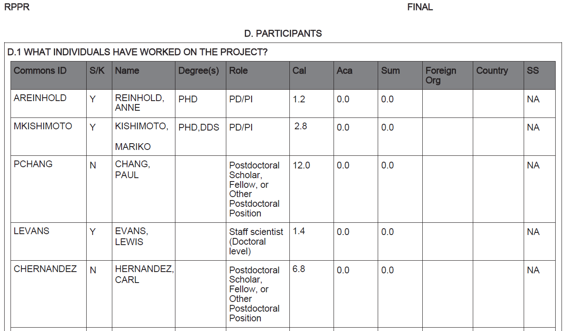
NIH Now Allows Decimals in Effort Reporting Field in RPPR
See NIH Guide Notice NOT-OD-18-20

Slide 28
RPPR Section D.2.c
Changes in Other Support
Should pending support be listed in other support?
No, per the PHS 2590/RPPR Other Support Format Page only active support is required
See NIH’s Guidance on Other Support and RPPR Section D.2.c Changes in Other Support
25
Notes:
Other support information should be submitted only for the PD/PI and for those individuals considered **by the grantee** to be key to the project for whom there has been a change in other support. Senior/key personnel are defined as individuals who contribute in a substantive measurable way to the scientific development or execution of the project, whether or not a salary is requested.

Slide 29
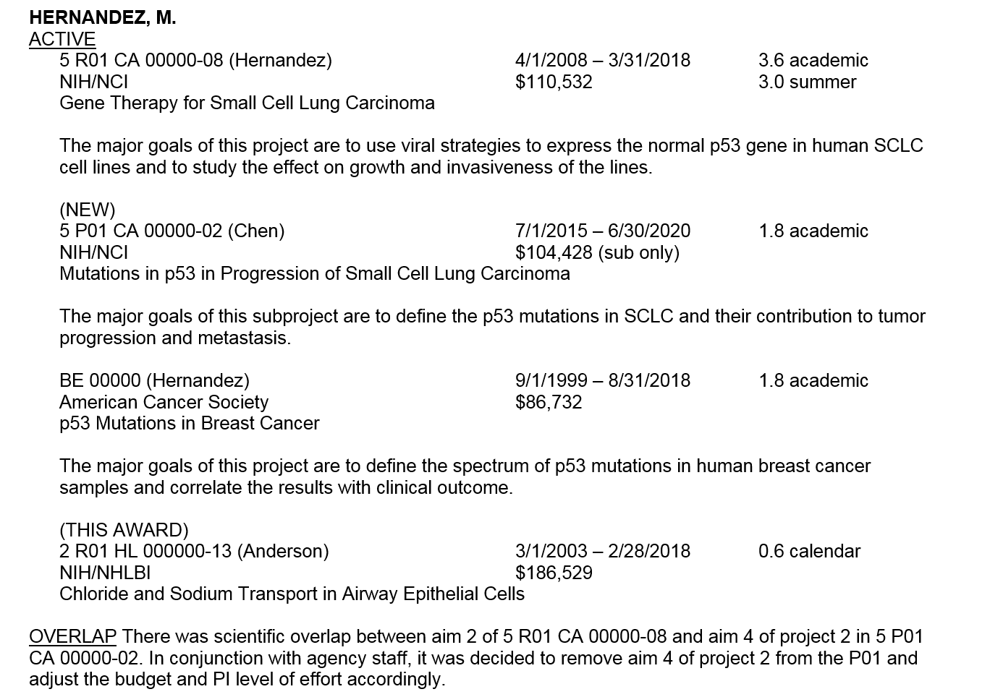

Slide 30
RPPR Section G.10
Estimated Unobligated Balance (uob)
G.10.a
Is it anticipated that an estimated unobligated balance (including prior year carryover) will be greater than 25% of the current year’s total approved budget? If yes, provide the estimated unobligated balance.

Slide 31
How Should the UOB be Calculated to Report in Section G.10?
For SNAP Awards:
Est. UOB of Current Yr.’s Total Approved Budget (Current Award Amt. + Prior Yr. CO*)
Current Year’s Award Amt.
For Non-SNAP Awards:
Est. UOB of Current Yr.’s Total Approved Budget (Current Award Amt. + Approved CO*)
Current Year’s Award Amt.
*Carryover

Slide 32
What’s the Current Year’s Total Approved Budget and Est. UOB?
Y2 Award Amt.: $250,000
Prior Yr. CO: $50,000
Est. Amt. Expended in Y2: $275,000

Slide 33
Session Objective 3
Identify grant changes that require prior approval.

Slide 34
Prior Approval Requirements
Change in Scope
Change in Status of PI and Other Senior Key Personnel
Change of Recipient Organization
Carryover of Unobligated Balances
No Cost Extensions
Alterations and Renovations
Capital Expenditures
Change of Recipient Organization Status
Deviation from Award Terms
Addition of Foreign Component
Subawards Based on Fixed Amounts
Need of Additional NIH Funding without Extension of Budget/Project Period
Need of Additional NIH Funding with Extension of Budget/Project Period
Pre-Award Costs
Rebudgeting of Funds from Trainee Costs
Rebudgeting of Funds Between Construction and Non-Construction Work
Retention of Research Grant Fund When a Career Development Award (K) is Issued
See Section 8.1.2 of the NIH Grants Policy Statement

Slide 35
Prior Approval Requests
Section 8.1.3 NIH Grants Policy Statement
All requests for NIH awarding IC prior approval must be made in writing (including submissions by e-mail) to the GMO no later than 30 days before the proposed change, and signed by the AOR. If the request is e-mailed, it must provide evidence of the AOR’s approval; a cc to the AOR is not acceptable. Failure to obtain required prior approval from the appropriate awarding IC may result in the disallowance of costs, termination of the award, or other enforcement actions within NIH’s authority.
E-mail requests must be clearly identified as prior approval requests, must reflect the complete grant number in the subject line, and should be sent by the AOR to the GMO that signed the NOA.

Slide 36
Prior Approval Requests
See eRA Commons User Roles for more information

Slide 37
Change in Scope
Section 8.1.2.5 NIH Grants Policy Statement
In general, the PD/PI may make changes in the methodology, approach, or other aspects of the project objectives. However, the recipient must obtain prior approval from the NIH awarding IC for a change of scope. Potential indicators of a change in scope include, but are not limited to, the following:
Change in the specific aims approved
Substitution of one animal model for another
Change from the approved use of live vertebrate animals
Change from the approved involvement of human subjects
Shift of the research emphasis from one disease area to another
A clinical hold by FDA under a study involving IND or an IDE
Application of a new technology; e.g. changing assays
Inclusion of a foreign sub-award
Significant re-budgeting
Incurrence of research patient care costs if these costs were not previously approved by NIH
Purchase of a unit of equipment exceeding $25,000

Slide 38
Change in Status, Including Absence of PD/PI and Other Senior/Key Personnel Named in the NoA
Section 8.1.2.6 NIH Grants Policy Statement
The recipient is required to submit a prior approval request to the NIH awarding IC if:
Key personnel, including PD/PI named in the NOA will reduce effort by 25 percent or more.
Change from an MPI to a single PD/PI model
Change from a single PD/PI model to an MPI
There is a change in the makeup of the PD/PIs on a multiple PD/PI award

Slide 39
Key Personnel Named in the NoA Will Reduce Effort by 25 Percent or More
RPPR Section D.2.a - Participants:
Level of effort. Will there be, in the next budget period, either (1) a reduction of 25% or more in the level of effort from what was approved by the agency for the PD/PI(s) or other senior/key personnel designated in the Notice of Award, or (2) a reduction in level of effort below the minimum amount of effort required by the Notice of Award?
Selecting Yes constitutes a prior approval request to the agency and the issuance of a subsequent year of funding constitutes agency approval of the request.
See Section D.2 Personnel Updates of the RPPR Guidelines

Slide 40
Change of Contact PI
RPPR Section A - Cover Page:
If there is a change to the Contact PD/PI (Multiple-PD/PI awards only), select the Yes radio button and enter the Commons ID of the new Contact PD/PI in the associated field. The change in Contact PD/PI does not take effect until the agency accepts the report and issues a NoA. The Contact PD/PI must have a PD/PI role in the eRA Commons and must be associated with the grantee institution.
See Section A Cover Page of the RPPR Guidelines

Slide 41
Multiple Program Director/Principal Investigator (MPI)
Section 9.1 NIH Grants Policy Statement
Multiple PD/PI awards are an opportunity for multidisciplinary efforts and collaboration through a team of scientists under a single grant. All PD/PIs share equally the authority and responsibility for leading and directing the project, intellectually and logistically. The applicant/recipient organization is responsible for securing and retaining the required written assurance signatures from each identified PD/PI on all applications, post-submission information, progress reports, and post-award prior approval request and must make these signatures available to NIH or other DHHS or Federal officials upon request.

Slide 42
Rotate the Role of the Contact PD/PI
NIH’s Multiple Principal Investigators - FAQs
It will be possible, and may even be desirable, for the grantee institution to periodically designate a change in Contact PD/PI. For example, it may be desirable to rotate the role of Contact PD/PI among the multiple PD/PIs on an annual basis at the time of grant renewal. Note that the Contact PD/PI must be associated with the applicant/awardee institution.
For more information see NIH’s Multiple Principal Investigators FAQs

Slide 43
Contact PD/PI Changes Institutions
Section 9.5 NIH Grants Policy Statement
If the Contact PD/PI changes institutions, the recipient institution will need to consider options. Since it is required that the Contact PD/PI be affiliated with the recipient institution in the Commons, the institution may choose to designate another PD/PI as the Contact. Another option would be to relinquish the grant and allow it to be transferred. Contact PD/PIs considering transferring should consult with the NIH awarding IC early in the process to discuss options.

Slide 44
Change in Recipient Organization
Section 8.1.2.7 NIH Grants Policy Statement
NIH prior approval is required for the transfer of the legal and administrative responsibility for a grant-supported project or activity from one legal entity to another before the completion date of the approved project period (competitive segment). This may be accomplished under most NIH grants if any of the following is met:
The original recipient agrees to relinquish responsibility for an active project before the completion date of the project period
The grant to be transferred has been terminated in accordance with 45 CFR part 75.372
A non-competing continuation award that is within an approved project period has been withheld because of the recipient’s actions
A change of recipient that involves the transfer of a grant to or between foreign organizations also must be approved by the IC’s Advisory Council or Board.

Slide 45
Change in Recipient Organization
In general, the award belongs to the recipient organization on record
Original recipient must formerly relinquish the award (Relinquishing Statement - PHS 3734) and provide the Final Invention and Certification Statement and Federal Financial Report (FFR)
The new recipient can now submit the transfer application electronically (PA-18-590)

Slide 46
Change in Recipient Organization
Budget pages for current and future years
If the budget for the original award was submitted in a modular format, use the R&R Detailed Budget form for all electronic applications. Recipient may either complete all of the fields in the R&R Detailed Budget as appropriate or complete only the costs for the PD/PI (Section A), and include the remainder of the direct costs under Section F (Other Direct Costs) Item 8, and Section H (Indirect Costs).
Budgets should not exceed the direct costs previously recommended for direct costs (plus applicable F&A costs at the new institution) for any budget period.
For transfers during the course of a budget period, the budget for the initial year must be based on the direct costs relinquished by the former recipient.

Slide 47
eRA Prior Approval Module
Withdraw from a successfully submitted grant application
Request to submit an unsolicited application with direct costs $500K or more (excluding consortium F&A)
Change of PD/PI
No Cost Extension
Carryover Request
See ERA Help for the Prior Approval Module and the eRA Commons User Guide

Slide 48
Carryover Request
Requires a timely, written request submitted through the AOR that includes a detailed budget and budget justification
Justification requires a rationale for why funds were not spent in the year in which they were awarded and how they will be spent in the next year
Justification must be tied to the scientific aims and goals of the project
Be sure to have a timely FFR submission
See Section 8.1.1 of the NIH Grants Policy Statement

Slide 49
Carryover Request
Submit when there is true financial need for the funds
Requested carryover should be fully expended in the budget period of the request
Example: A recipient submits a carryover request for $250K from the Year 10 unobligated balance to Year 11. If the carryover request is approved, NIH’s expectation is the project will fully expend the Year 11 award amount in addition to the $250K in carryover by the end of the budget period.
Notes:
Q14. On an FFR, how do we reflect the dollars associated with stipends and tuition for appointments that cross over into the next budget period (late appointments)? Should they be shown as an unobligated balance, or an unliquidated obligation?
A. These monies should be reflected as an unliquidated obligation since these are bona fide expenses charged/incurred to the Stipend and Tuition categories but have not yet been paid. As a reminder, if the FFR report covers the final budget period of the project period, it must have no unliquidated obligations and must indicate the exact balance of unobligated funds.

Slide 50
Session Objective 4
Identify what is required to close out a grant

Slide 51
NIH Closeout Requirements
NIH recipients must submit three final reports within 120 days of the project period end date:
Final RPPR (F-RPPR)
Final Federal Financial Report
Final Invention Statement and Certification
As of January 1, 2017 NIH replaced the Final Progress Report with the F-RPPR to satisfy grant closeout requirements.
See: NOT-OD-17-022 for NIH implementation of F-RPPR; NOT-OD-17-085 for F-RPPR for SBIR/STTR grants; and, NIH FAQs for grants closeout

Slide 52
Differences Between the Annual RPPR vs. Final RPPR
NIH Annual RPPR
NIH Final RPPR
Cover Page
Accomplishments
Products
Participants
Impact
Changes
Special Reporting Requirements
Budget
Cover Page
Accomplishments
Products
Participants and Other Collaborators
Impact – SBIR/STTR only
Changes
Special Reporting Requirements
Budget
Project Outcomes

Slide 53
Requirements for Project Outcomes
A new section of the RPPR specifically designed to be made publicly available by the agency (analogous to the abstract in the competing application)
Reporting in the Outcomes section is limited (by the federal-wide RPPR format) to 8,000 characters
The Outcomes should provide a concise summary of the findings of the award written in lay language for the general public
In an effort to increase transparency NIH will make the Outcomes data available in RePORTER
See Extramural Nexus – Open Mike posted 02/01/17

Slide 54
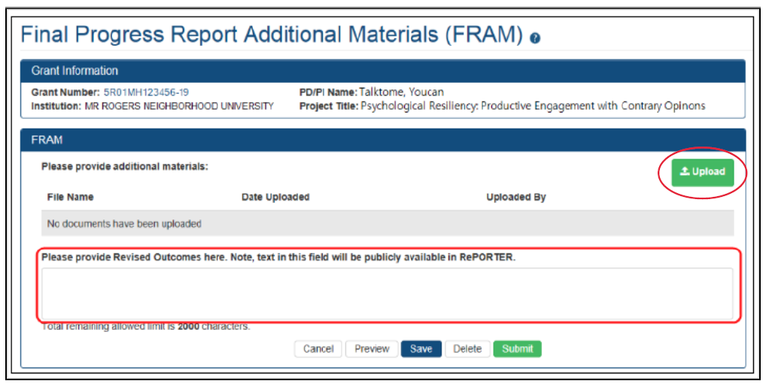
Final RPPR Additional Materials (FRAM)

Slide 55
Interim-RPPR (I-RPPR)
Effective February 9, 2017
Submit I-RPPR while a renewal application
(Type 2) is under consideration
Like the Final-RPPR, recipients are required to report on Project Outcomes in the I-RPPR.
See NOT-OD-17-037 for more information.

Slide 56
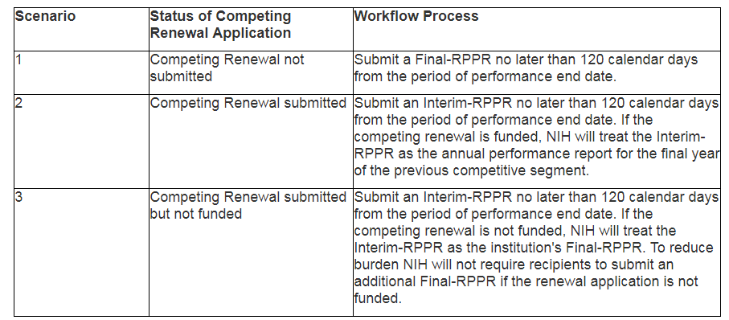
Do I Submit a F-RPPR or I-RPPR?

Slide 57
Final Federal Financial Report (Final FFR)
At time of closeout, ensure there are no discrepancies in reporting between:
Final FFR expenditure data (in eRA Commons) and
FFR cash transaction data (in PMS)

Slide 58
Financial Reporting Reminder
Failure to submit an acceptable final FFR in a timely manner may result in disallowed costs or federal debt
If a recipient fails to submit a final FFR expenditure data report:
NIH must use the last recorded quarterly cash disbursement level
If the final FFR expenditure data does not match the amount reported on last FFR cash disbursement report to PMS:
NIH must use the lower amount - results in federal debt
See Section 8.6.1 NIH Grants Policy Statement
Notes:
Section 8.6.1 NIH Grants Policy Statement
A final FFR is required for
Any grant that is terminated
Any grant that is transferred to a new recipient
Any award, including awards under SNAP, which will not be extended through award of a new competitive segment
Recipients are required to electronically submit the final FFR through eRA Commons. The final FFR must cover the entire competitive segment or as much of the competitive segment as has been funded before termination. Final FFRs must indicate the exact balance of unobligated funds and may not reflect any unliquidated obligations. There must be no discrepancies between the Federal share of expenditures reported on the final FFR and the net cash disbursements reported to PMS on the Transactions section of the FFR. It is the recipient’s responsibility to reconcile reports submitted to PMS and to the NIH awarding IC.

Slide 59
Final Invention Statement and Certification
Section 8.6.3 NIH Grants Policy Statement
The recipient must submit a Final Invention Statement and Certification (HHS 568), whether or not the funded project results in any subject inventions, and whether or not inventions were previously reported. The HHS 568 must list all inventions that were conceived or first actually reduced to practice during the course of work under the project, and it must be signed by an AOR. If there were no inventions, the form must indicate “None.” For questions, the recipient should contact the NIH awarding IC for specific instructions.
When invention reporting is required, the HHS 568 does not relieve the responsible party of the obligation to assure that all inventions are promptly and fully reported directly to the NIH, as required by the terms of award.

Slide 60
Final Invention Statement and Certification
See NIH Forms and Applications for more information

Slide 61
Questions?
tempchins@mail.nih.gov
wolfreyc@mail.nih.gov

Slide 62
Appendix

Slide 63
Where do I report accomplishments related to a diversity supplement in a RPPR?
Section B.3 Competitive Revisions/Administrative Supplements
See Section B.3 of the RPPR Instruction Guide

Slide 64
When can a mentored K awardee request an effort reduction in the final two years of the award?
NOT-OD-04-007
Released 11/14/03
Compete successfully for a research awards from NIH.
NOT-OD-08-065
Released 04/10/08
Compete successfully for peer-reviewed research awards from any Federal agency.
NOT-OD-18-157
Released 04-06-18
Compete successfully for peer-reviewed research awards from any Federal agency.
Peer-reviewed research grant of at least $100K in DC from non-Federal sources

Slide 65
Awarded salary, fringe and applicable F&A must be adjusted when a request for effort reduction is approved
NOT-OD-08-065
Released 04/10/08
NIH may adjust the total salary amounts committed to the K award if consistent with the adjusted level of effort.
NOT-OD-18-157
Released 04-06-18
NIH will adjust the total salary support committed to the K award consistent with the adjusted level of effort.

