Slide 1



The NIH peer review process
The NIH Peer Review Process
NIH Regional Seminars 2019
Sally A. Amero, Ph.D. Amy Wernimont Ph.D.
NIH Review Policy Officer Scientific Review Officer
Extramural Research Integrity Liaison Officer IMST IRG
Office of Extramural Research Center for Scientific Review
National Institutes of Health National Institutes of Health

Slide 2
NIH Peer Review
Cornerstone of NIH extramural research
Standard of excellence worldwide
Two-stage review process
Receipt and Referral
Initial Peer Review
National Advisory Council
Review
Submit your
application
Funding
decision
2

Slide 3




NIH Does A Lot of Peer Review!
In FY2018:
> 80,000 applications reviewed
> 2,600 review meetings
> 26,000 reviewers
Filled
> 52,000 reviewer “slots”
NIH Data Book (https://report.nih.gov/nihdatabook/)
Notes:
Serves as central receipt point for grant applications submitted to NIH and some other DHHS agencies
Assigns applications to CSR review groups/study sections or Institute scientific review groups
Assigns applications to NIH Institute(s)/Center(s) as potential funding component(s)
Conducts initial scientific merit review of most research applications submitted to the NIH in about 240 Study Sections and regularly recurring Special Emphasis Panels
Almost 300 Scientific Review Officers at CSR – doctoral level professional with strong scientific background

Slide 4
Division of Receipt and Referral (DRR)
Key decisions
  Policy compliance (format, timeliness, etc.)
  Assignment to Institute(s) for funding consideration
  Assignment to study section for initial peer review
Funding Institute(s)
Scientific Review Group
Initial Review Groups (CSR or ICs)
Scientific Focus & Mission Relevance
Program Officials (POs)
Scientific Review Officers (SROs)
DRR
Council
IC
Director
Application

Slide 5
Applications are assigned to:
Institutes or Centers (IC) based on…
  Overall mission and guidelines of the Institute or Center(s);
    Specific programmatic mandates and interests of the Institute or Center(s)
Integrated Review Groups (IRG) based on…
        Specific review guidelines for each IRG.
Standing Study Sections (SRG) based on…
          Match of subject matter to the referral guidelines for the SRG.
          OR
          Special Emphasis Panels (SEPs) based on…
When certain types of grants are sought (e.g., fellowships, SBIRs); When the subject matter does not fit into any SRG;
          When assignment of an application to the most appropriate study section creates a conflict of interest.

Slide 6
The NIH is comprised of 27 Institutes and Centers.
Office of Research
Infrastructure Programs
Office of the Director
National Institute on Aging
National Institute on Alcohol Abuse and Alcoholism
National Institute of Allergy and Infectious Diseases
National Institute of Arthritis and Musculoskeletal and Skin Diseases
National Cancer Institute
National Institute of Child Health and Human Development
National Institute on Deafness and Other Communication Disorders
National Institute of Dental and Craniofacial Research
National Institute of Diabetes and Digestive and Kidney Diseases
National Institute on Drug Abuse
National Institute of Environmental Health Sciences
National Eye Institute
National Institute of General Medical Sciences
National Heart, Lung, and Blood Institute
National Human Genome Research Institute
National Institute of Mental Health
National Institute of Neurological Disorders and Stroke
National Institute of Nursing Research
National Institute on Minority Health and Health Disparities
National Institute of Center for Complementary and Integrative Health
Fogarty International Center
National Center for Advancing Translational Sciences
National Library of Medicine
National Institute of Biomedical Imaging and Bioengineering
NIH Clinical Center
Center for Information Technology
Center for Scientific Review
Notes:
Each IC has a different mission, priorities, budget, funding strategy.
Different authorizations by congress.

Slide 7

Submitting a Cover Letter
The cover letter conveys important information:
  Application title
  FOA # and title
  Any special situations (such as a late application)
  Statement if proposed studies will:
    Generate large-scale genomic data or
    Involve Human Fetal Tissue research
  If a video will be submitted

Slide 8
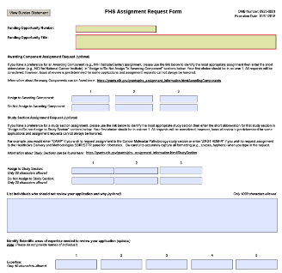
PHS Assignment Request Form
The PHS Assignment Request form conveys:
  Awarding component assignment requests
  Study section assignment requests
  Individuals who should not review your application and why
  Expertise needed to review the application
Optional form in all NIH application form packages.

Slide 9
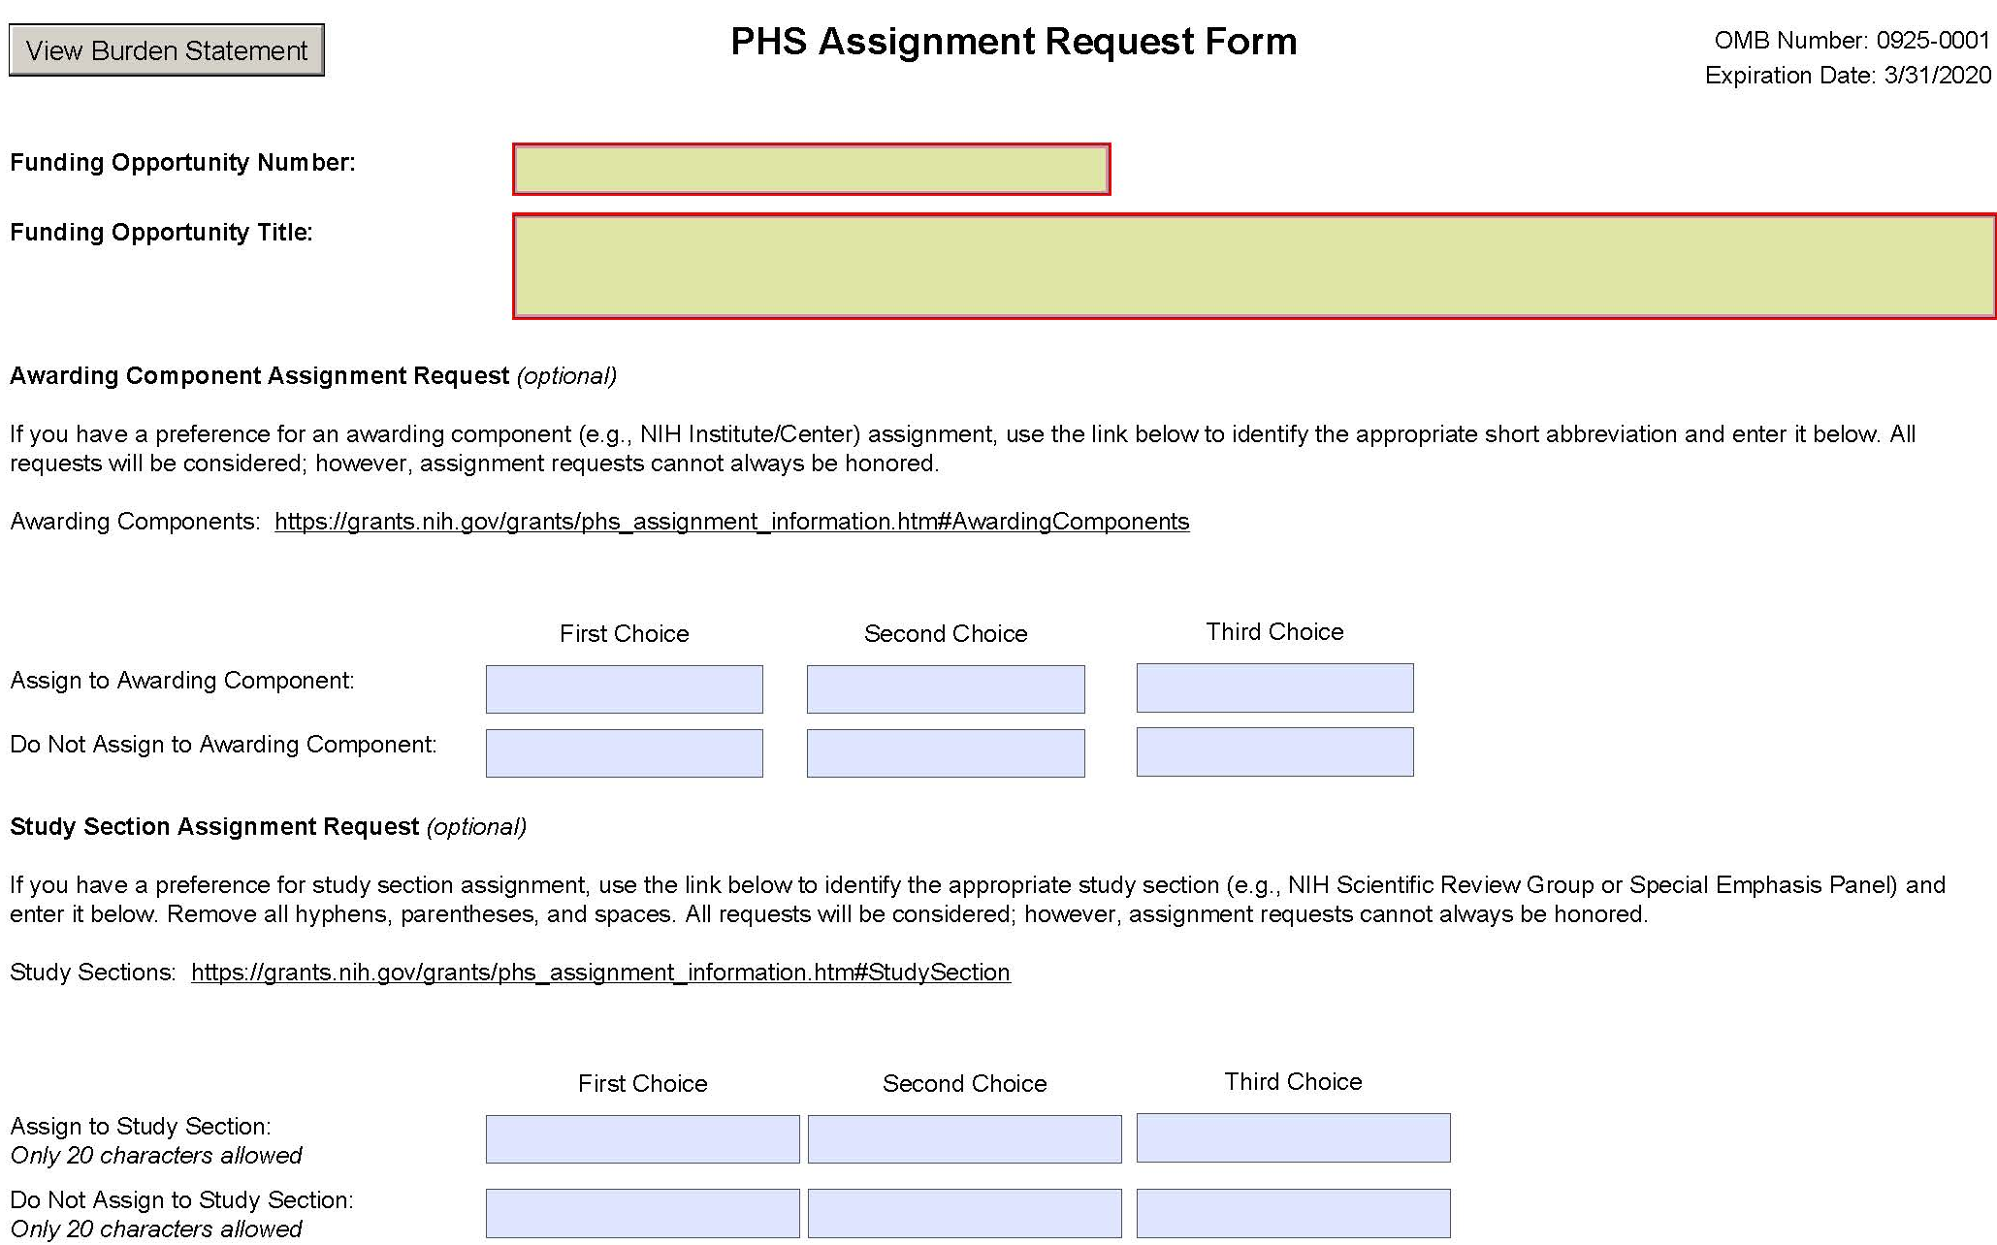
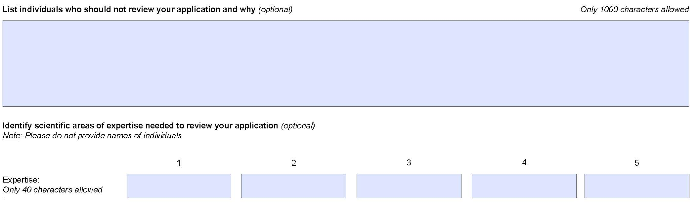
New PHS Assignment Request form

Slide 10
Identify an Appropriate Study Section
Information about study sections:
  Center for Scientific Review study sections http://public.csr.nih.gov/StudySections/Pages/default.aspx
  Assisted Referral Tool (ART)
  https://art.csr.nih.gov/ART/selection.jsp
  Rosters are available on NIH websites https://public.era.nih.gov/pubroster/
  http://www.csr.nih.gov/Committees/rosterindex.asp
  eRA Like (A Thesaurus-based Search Tool)
      http://era.nih.gov/services_for_applicants/like_this/likethis.cfm
Not all study section/IC requests can be honored.

Slide 11

Post-Submission Materials
Submitted after the application, and must:
    Result from an unforeseen administrative event
    Conform to format policy and page limits
    Be submitted to the SRO 30 days before the review
    Demonstrate concurrence of Authorized Organization Representative
  Some Funding Opportunity Announcements may
    Specify other allowable materials
    Change the time window

Slide 12
Post-Submission Materials
Among Materials Allowed | Among Materials Not Allowed
News of an article accepted for publication: List of authors and institutional affiliations Title of the article Journal or citation (if available) | Pre-prints, reprints
New biosketch (e.g., loss of an investigator) | Corrections due to mistakes in submission
Revised budget (e.g., catastrophic loss)
Citations of issued patents | Interim Research Products
Videos: see NOT-OD-12-141 | Micrographs, devices, new data
See NOT-OD-19-083

Slide 13

Integrity in Peer Review
NIH needs to identify the best science and maintain public trust.
  All participants and stakeholders are responsible for upholding the integrity of peer review.
  All questions must be referred to the SRO.
  All confidential materials, discussion notes, documents are deleted,
  retrieved, or destroyed.
From the NIH Photo Gallery:
“EGG Electrodes”

Slide 14

Review Integrity: Right or Wrong?
You are the PI on an application in review. Is it okay to:
  Contact reviewers about the application?
  Send data to reviewers?
  Offer collaboration to a reviewer?
  Have a friend talk to a reviewer on your behalf?

Slide 15

Possible Consequences for Violations
Withdrawn or deferred application(s)
Notification of applicant organization or reviewer’s organization
Termination of service in peer review
Pursuit of referral for suspension and debarment
Notification of the Office of Management Assessment, possible referral to the
Office of Inspector General
See: NOT-OD-18-115

Slide 16
Level 1: Initial Peer Review
Key decisions
  Scientific and technical merit of the work proposed
  Overall impact
  Appropriate justification for human subject protection, inclusion, and vertebrate animals
Managed by Scientific Review Officers (SROs)
Funding Institute(s)
Scientific Review Group
Initial Review Groups (CSR or ICs)
Scientific Focus & Mission Relevance
Program Officials (POs)
Scientific Review Officers (SROs)
DRR
Council
IC
Director
Application

Slide 17

Level 1: Initial Peer Review
Reviewers
      How they are chosen
      Expectations for reviewers
Review Policy
    Review criteria
    Scoring system
What happens at the meeting?
After the meeting
Picture courtesy of the
NIH Center for Scientific Review

Slide 18

Reviewers
General Qualifications:
    Expertise
    Stature in field
    Mature judgment
    Impartiality
    Ability to work well in a group
    Managed conflicts of interest
    Balanced representation
    Availability
Picture courtesy of the
NIH Center for Scientific Review

Slide 19

Reviewer Recruitment
      Expertise of the reviewer
      Suggestions from the PI on expertise – not names!
      Suggestions from Program staff and Study Section members
      Managing conflicts of interest
      Balancing workload

Slide 20

Managing Conflict of Interest
Types of Conflict of Interest (COI)
      Financial - Professional associates
      Employment - Study Section membership
      Personal - Other interests
Appearance of COI
Depending on the COI, the reviewer with a COI must be:
    Excluded from serving on the Study Section, or
    Recused from discussion and scoring of a particular application.
https://grants.nih.gov/grants/peer/peer_coi.htm

Slide 21

What Reviewers Do Before the Meeting
    Assignments are confidential!
    Examine assignments (~ six weeks in advance)
    May participate in an orientation teleconference
    Sign Conflict of Interest and Confidentiality certifications
    Read applications, prepare written critiques
    Enter preliminary scores, critiques into secure website
    Read and consider critiques and preliminary scores from other Study Section members

Slide 22
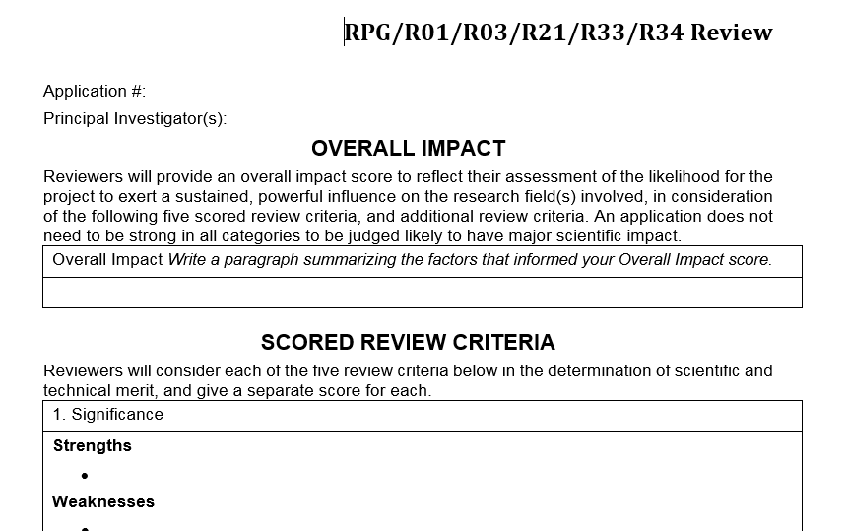
Written Critiques
Five Scored Criteria
Other Criteria
Overall Impact

Slide 23

Review Criteria: Overall Impact
Overall consideration for all NIH
applications
Defined differently for different
types of applications
    Research grant applications: Likelihood for the project to
      exert a sustained, powerful influence on the research
      field(s) involved

Slide 24
Types of Review Criteria
Category* | Criteria (Research) | Criterion Scores? | Affect Overall Impact Score?
Scored Review Criteria | Significance Investigators Innovation Approach Environment | Yes | Yes
Additional Review Criteria | Study Timeline (CT only) Human Subjects** Vertebrate Animals** Inclusion** Biohazards | No | Yes
Additional Review Considerations | Foreign Institutions Select Agents Resource Sharing Authentication of Key Resources | No | No
* Found in every Funding Opportunity Announcement
** If Unacceptable, award cannot be issued until resolved

Slide 25

Rigor and Transparency
Four components
  Rigor of the prior research that led to the proposed work*
  Scientific rigor of the work proposed*
  Consideration of relevant biological variables*
  Authentication of key biological/chemical resources
Implemented for most:
  Research grant applications
  Mentored Career Development Award applications
See Rigor and Reproducibility: http://grants.nih.gov/reproducibility/index.htm
(*Can affect the scores)

Slide 26
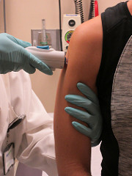
Clinical Trials
NIH initiatives to enhance the accountability and transparency of clinical research
For peer review:
  Clinical Trial-specific Funding Opportunities (FOAs)
  Clinical Trial-Specific Review Criteria
Picture courtesy of the
NIH Communications Office

Slide 27

The peer review process: scoring
The peer review process: Scoring
5 “Scored” Review Criteria
Overall Impact
Each scored from 1-9
Scored from 1-9
High impact |  |  | Moderate impact |  |  | Low impact
1 | 2 | 3 | 4 | 5 | 6 | 7 | 8 | 9
Exceptional | Outstanding | Excellent | Very good | Good | Satisfactory | Fair | Marginal | Poor
Notes:
Score applications on five core criteria using a scale of 1-9
Preliminary overall impact/priority score using 1-9 scale
Discussed applications receive an overall score from each eligible (i.e., without conflicts of interest) panel member, and these scores will be averaged to one decimal place, and multiplied by 10. The 81 possible priority scores will thus range from 10-90.
All applications will receive scores:
Not discussed applications will receive initial criterion scores from the three assigned reviewers.

Slide 28
Streamlining Applications
Allows discussion of more meritorious applications
  Less meritorious applications
    Not discussed at the meeting
    Designated “Not Discussed” (ND)
ND requires full concurrence of the entire study section
ND
Scored

Slide 29

At the Review Meeting
    Any member in conflict with an application leaves the room.
    Reviewer 1 introduces the application and presents critique, including all score-able issues (scored criteria, human subjects protection, vertebrate animals, etc.).
    Reviewers 2 and 3 highlight additional issues and areas that significantly impact scores.
    Disagreements are discussed,
    clarified
Picture courtesy of the
NIH Center for Scientific Review

Slide 30

At the Review Meeting
Continued…
      Chair summarizes.
    Assigned reviewers provide final scores (setting range).
    All members provide final scores privately (if voting out of range, rationales are given).
    Non-score-able issues discussed: budget, data sharing plan, foreign applications, etc.
Picture courtesy of the
NIH Center for Scientific Review

Slide 31
Final Impact Scores
Each member votes based on discussion
Not just assigned reviewers
Final Impact Scores range from 10 through 90
Calculated by averaging all reviewers’ scores and multiplying by 10
Percentiled for some mechanisms
90 – Lowest Impact
10 – Highest Impact

Slide 32
After the Review
eRA Commons (https://public.uat.era.nih.gov/commons)
    Final Impact Score within 3 days
    Summary statement available within 4 – 8 weeks to:
        Funding Institute Program Officer
        PD/PI
        Other NIH Officials
        Advisory Council members

Slide 33
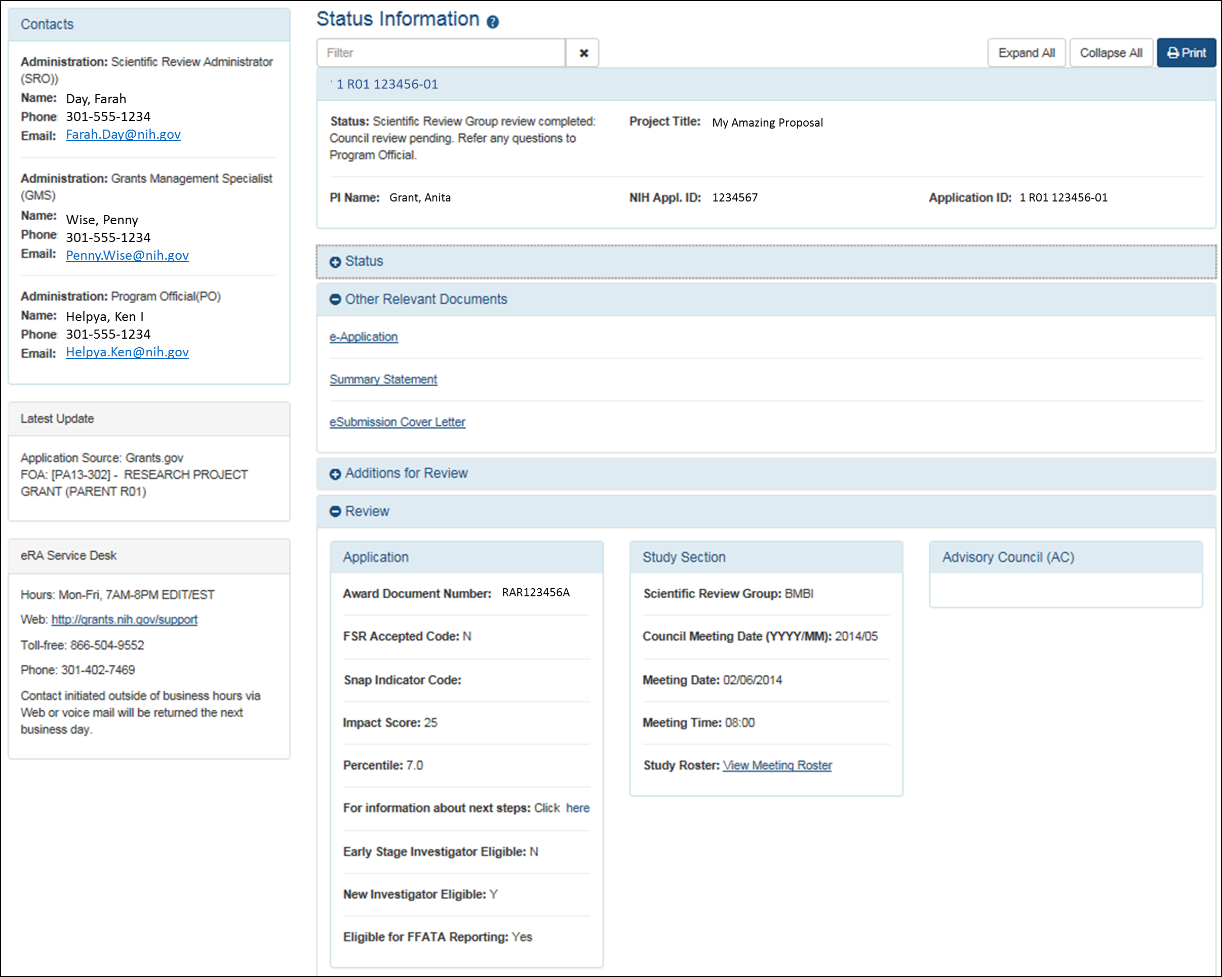
Check Application Status in the eRA Commons

Slide 34
Summary Statement
Summary statements contain:
    Reviewer critiques
    Criterion scores
First page
  NIH Program Official (upper left corner)
  Final Impact Score or other designation
  Percentile (if applicable)
  Codes (human subjects, vertebrate animals, inclusion)
  Budget request
A favorable score does not guarantee funding!

Slide 35

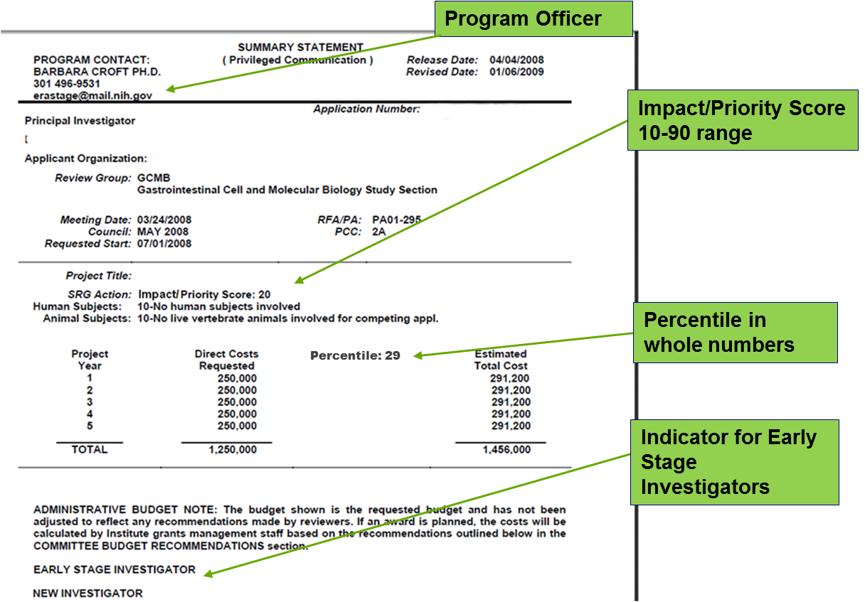
After review: the Summary Statement
Notes:
SRO Prepares summary statements
Provides information to NIH Institutes and Centers:
Essentially unedited critiques
Scores for each review criterion
Administrative notes, if any
For discussed applications only:
Summary of review discussion
Overall impact/priority score & percentile ranking
Budget recommendations
New and early stage investigator status does make a difference – clustered and identified.

Slide 36

Summary Statement - continued
Subsequent Pages
          Resumé and Summary of Discussion (if discussed)
          Description (provided by applicant)
          Criterion scores from assigned reviewers
          Reviewer critiques – essentially unedited
          Administrative Notes
          Meeting roster
Picture courtesy of the
NIH Center for Scientific Review

Slide 37

After the Review Meeting
  Your point of contact is the assigned NIH
  Program Official.
  You may need to:
      Submit Just-in-Time (JIT) information
      Resolve human subject, vertebrate animal, inclusion codes
    Consider your options:
          Submit a new application
          Revise and resubmit your application
          Appeal the review outcome (NOT-OD-11-064)

Slide 38
Level 2 of NIH Peer Review: Councils
Key Decisions:
    Funding recommendations
    Program priority
Funding Institute(s)
Scientific Review Group
Initial Review Groups (CSR or ICs)
Scientific Focus & Mission Relevance
Program Officials (POs)
Scientific Review Officers (SROs)
DRR
Council
IC
Director
Application

Slide 39

National Advisory Councils
  Broad and diverse membership
              Basic/research scientists
              Clinician scientists
              “Public” members
  Awards cannot be made without Council approval
  Council procedures vary across IC’s
  Council is chaired by Institute Director, advised by IC extramural research staff

Slide 40

National Advisory Councils
Advise IC Director about
      Research priority areas
      Diverse policy issues
      Concept clearance for future initiatives
      Funding priorities
Recommend applications for funding
      Expedited awards
      En bloc concurrence
Consider unresolved appeals and grievances related to initial peer review

Slide 41

Funding Decisions: IC Director
The IC Director makes the final funding decisions
Based on:
    Mission of the NIH Institute or Center
    Program priorities, Congressional mandates
    Outcome (score/percentile) of initial peer review
    Additional outside expertise, if needed
    Recommendation of IC Program Staff
    Recommendation of the IC Advisory Council
    Available Funds

Slide 42

New Considerations!
For the January 25, 2019 due date:
  Revised review criterion language
  Scientific premise – Rigor of the Prior Research
  Inclusion across the lifespan
  New Parent Announcements
For the September 25, 2019 due date:
  HHS requirements for human fetal tissue research
  NOT-OD-19-137 and NOT-OD-19-128

Slide 43
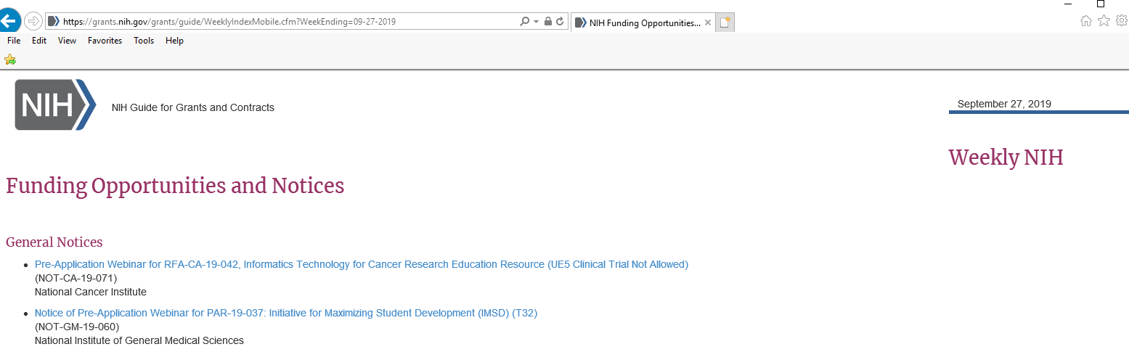
Get the Latest News!
  Join the Guide Table of Contents (TOC)!
  http://grants.nih.gov/grants/guide/listserv.htm

Slide 44

NIH Live Mock Study Section!
Today at 4:45 – 5:30
See typical scenarios from NIH study sections
Ask questions of NIH staff
Picture courtesy of the
NIH Center for Scientific Review

Slide 45
Peer Review Timeline
Initial peer review: ~ 4 months (minimum)
Submission to award: ~ 9 months
Funding Announcement
Prepare
Submit
DRR
SRG
Assign
SRO
Recruit
Assign
Reviewer
Critique
Meeting
(Score)
Summary Statement
Program
Assess
Council
DECISION

Slide 46
Additional Information
Office of Extramural Research
http://grants.nih.gov/grants/peer_review_process.htm
Peer Review Policies & Practices
http://grants.nih.gov/grants/peer/peer.htm
Center for Scientific Review
http://public.csr.nih.gov/Pages/default.aspx
NIH Guide to Grants and Contracts
http://grants.nih.gov/grants/guide/index.html
NIH RePORTER Matchmaker https://projectreporter.nih.gov/reporter_matchmaker.cfm

