Slide 1
The NIH Biosketch and SciENcv
NIH Regional Seminar 2019
Pritty Joshi, Ph.D., Ph.D.
Office of Extramural Research
National Institutes of Health
Bart Trawick, Ph.D.
NCBI, NIH

Slide 2
Session Plan
Review the NIH biosketch
Discuss SciENcv, an online tool to simplify biosketch creation for multiple agencies

Slide 3
The NIH Biosketch
Pritty Joshi, Ph.D.
Health Science Policy Analyst
Office of Extramural Research
NIH
Notes:
Thank you, the slides I’m using today are streamlined from the ones you have. We’ll have the final version available from the program website later.
The biosketch is the only opportunity to tell reviewers how the investigator is uniquely qualified to lead a project. Similarly, this is required for all key personnel, so they may wish to customize their biosketch to the proposal being prepared. Remember, this is part of the peer review score and under the Investigator criterion.
Reviewers use the bio sketch to evaluate whether you have the experience to carry out the research plan and will look at your team’s biosketches to see you have asked for the right mix of people, time, and expertise.

Slide 4
Why?
Allows applicants to:
describe the magnitude and significance of their scientific contributions (including publications)
provide detailed information about their research experience in the context of the proposed project
Forms, instructions, and samples available at:
https://grants.nih.gov/grants/forms/biosketch.htm
Notes:
Since the biosketch is required for all types of grant programs,
today we want to make sure you understand the sections of the biosketch and how important it is to customize this for your applications.
In particular, you will want to emphasize the significance of the investigator’s scientific contributions and provide details about their research experience and career in general.
This is the only place in the application to make this case and for the investigator to talk about themselves.

Slide 5
Who?
All senior/key personnel and other significant contributors (OSCs) must include biographical sketches (biosketches).
Notes:
Grant applications must include biosketches for all key personnel and other significant contributors
Remember that the investigator and many of your key personnel also need to register in commons, postdocs and students, and so make sure that is handled well in advance.
Other significant contributors are those that are zero-person months or ‘as needed’, and they do not expect to provide measurable effort towards the project

Slide 6
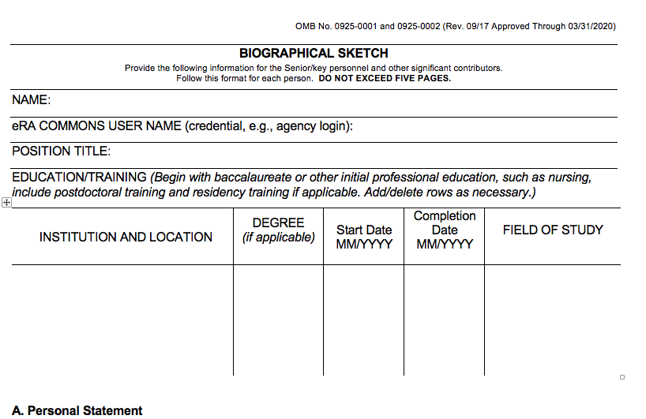
NIH Biosketch Form
Be sure to include eRA Commons ID
Forms, instructions, and samples available at:
https://grants.nih.gov/grants/forms/biosketch.htm
Notes:
You can find the biosketch template forms on the NIH website at the link below, and I can provide the updated slides for you after the talk.
This is the current form, but If you use SciENcv to prepare your bio sketch, you will always be using the latest version of the template.
The first thing you need to know is that there is a five-page limit.
How you use the pages for the multiple sections is up to you, but you should review and compare with your colleagues
At the top of the form are where you put your name, title and commons information, along with your educational and any medical residency positions, all of which are pretty self-explanatory.
Remember that the investigator and many of your key personnel also need to register in commons, postdocs and students, and so make sure that is handled well in advance.

Slide 7
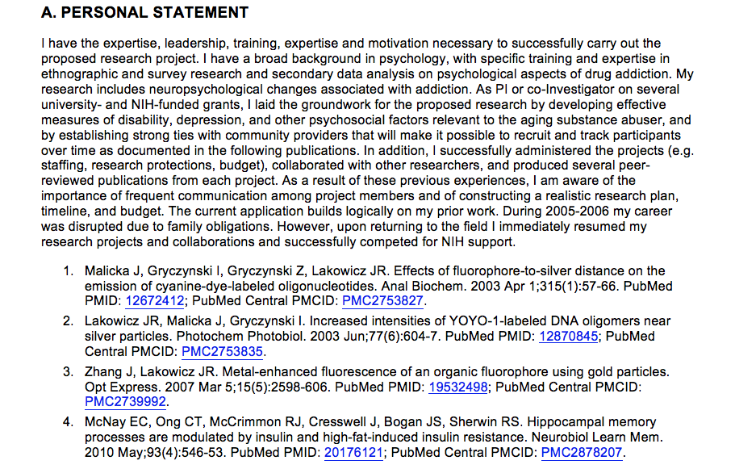
NIH Biosketch, Section A
Explain factors affecting productivity (e.g. family care responsibilities)
Highlight your experience and qualifications for this project
Your qualifications for your role on the project
Notes:
Next up is the Personal Statement section, where you make your case why you are well-suited to your role on the project.
You might include key aspects of training or past experience, technical expertise, significant collaborations, and past performance
This is also an opportunity to explain anything else you’d like the reviewers to know about your career and research directions.
For instance, this is where you can describe how you are proposing work in a new direction, or significant training or mentorships relationships, or any personal or family situations such as parental leave, child care, elder care, or medical conditions
Finally, you can provide information on up to 4 publications or research products, and this is not limited to publications—it could be key software, videos, research methods or models, or a variety of other interim products. I have a slide later that specifically mentions the policies regarding these interim products.

Slide 8
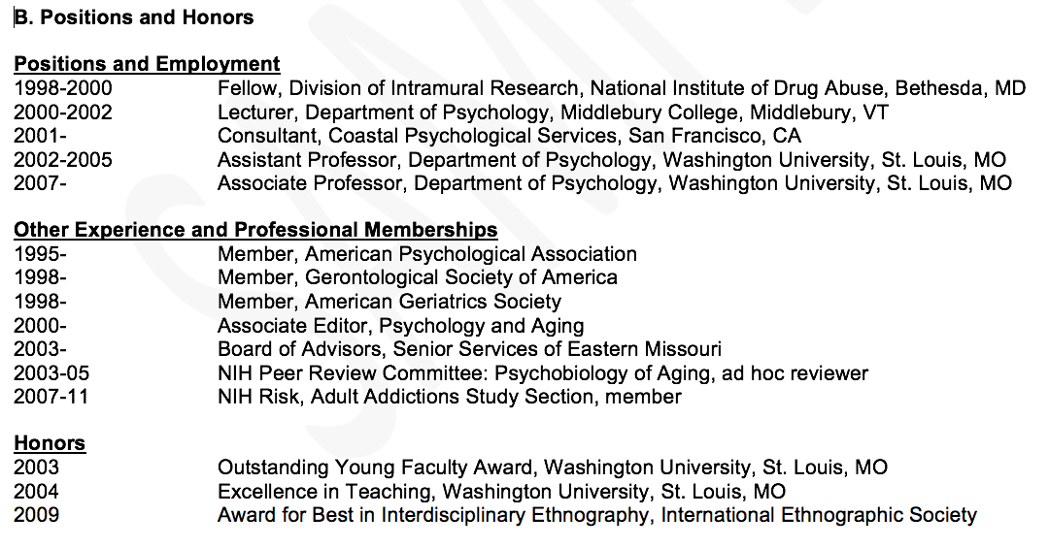
NIH Biosketch, Section B
Add new positions with an expected start date
Your relevant positions and honors
Notes:
Section B for positions and honors is fairly self-explanatory, where you can list your current and past positions that are relevant to the proposal.
If you are moving to a new organization, you can note the expected start date.
You may also wish to include any board certifications or clinical licensures that are relevant.

Slide 9
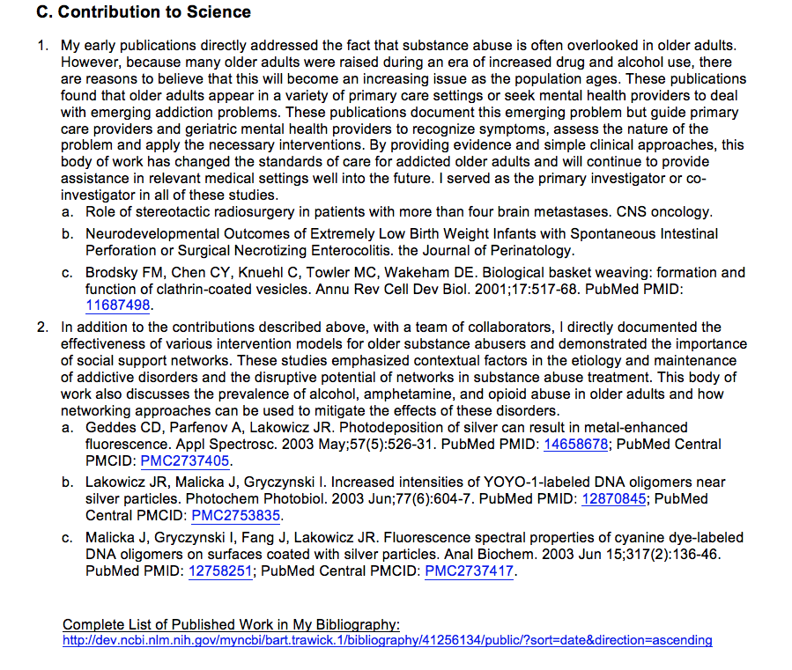
NIH Biosketch, Section C
Make this personal!
URL must be to a Federal Government website
Your general scientific contributions and achievements
Notes:
In the Contributions section, applicants may list up to 5 significant contributions, each around a half page in length, and each with up to 4 publications. You note the historical background, the central finding, how that affected your field or the application to health or technology, and most importantly, your role in the work.
Make this personal!
For junior investigators, it’s expected that they will have fewer contributions, but they can cite conference proceedings such as meeting abstracts, posters or other presentations, (in-progress products can be mentioned, but not cited), and the citations do not have be authored by the investigator , but do have to be relevant to your contributions.
You can also submit a hyperlink to an on-line bibliography but it must be hosted on federal (.gov) website.

Slide 10
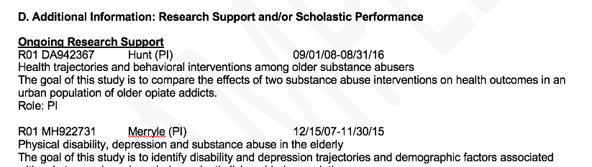
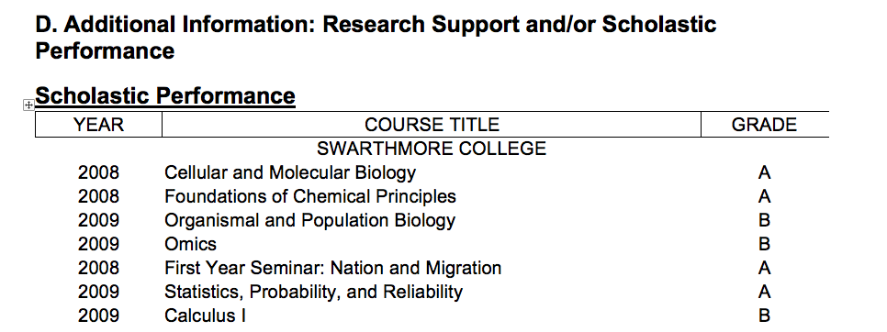
NIH Biosketch, Section D
Non-Fellowship Application
Fellowship Application
Your Research Support and/or Scholastic Performance
Notes:
Additional Information: Research Support and/or Scholastic Performance
This section should be straightforward to complete. You can list any of your ongoing or completed research support, focusing on the goal of the research and your role. The description is likely something you can pull right from the abstract.
Fellowship applicants list their courses and grades, and are not expected to list research support, but they can if they have some, which may be important for post-doctoral applicants.

Slide 11
Biosketch Summary
General advice
  Make it personal
    Only opportunity to tell the reviewers about you, your career, and expertise
    Seek advice and examples from peers and senior colleagues about what a biosketch looks like
  Help the reviewers!
    Demonstrate that you are the most qualified investigator to do the work
    Reviewers instructed that publication track record for early career investigators will not match more senior investigators
    Favor clarity over detail and jargon
  Provide a URL to publications via a federal (.gov) website
Questions about the biosketch?
Notes:
In closing, this is your one opportunity for the investigator to show they are the best, most appropriate person to lead the study, and the only place to share important information about your career, and any personal or family responsibilities that have caused a gap
In crafting this, make sure you look at the online examples and get examples from your colleagues.
Help the reviewers make a case for you in the study section. Reviewers are instructed to take your career stage into account, but make sure to make that case yourself.
Be concise and clear, and don’t overstuff the section. Try to use shorter sentences, bullets and shorter paragraphs
Look for opportunities to cite interim research products if you have them, and if you want to share your full bibliography you can do so on a .gov website.

Slide 12
SciENcv Overview
Bart Trawick, Ph.D.
Director, Customer Services Division
NCBI, NIH

Slide 13
SciENcv = Science Experts Network Curriculum Vitae
  Vision- Let investigators harvest their data from multiple systems to support funding applications, reporting and collaboration with less burden and complexity
Goals
  Reduce burden of applying for federal funds and maintaining federal profiles
  Track impact of federal investments in science and scientist careers through scientist-curated data
  Support collaboration and networking services to find reviewers, collaborators, mentors, etc.
Products to date
  NIH biosketches, NSF biosketch, Ed IES biosketch
  Embedded XML
  Integration with ORCID, Fastlane, PubMed and eRA
  Bulk upload of citations from reference manager software
  Internal refinements: user testing, adopting agile software principles

Slide 14
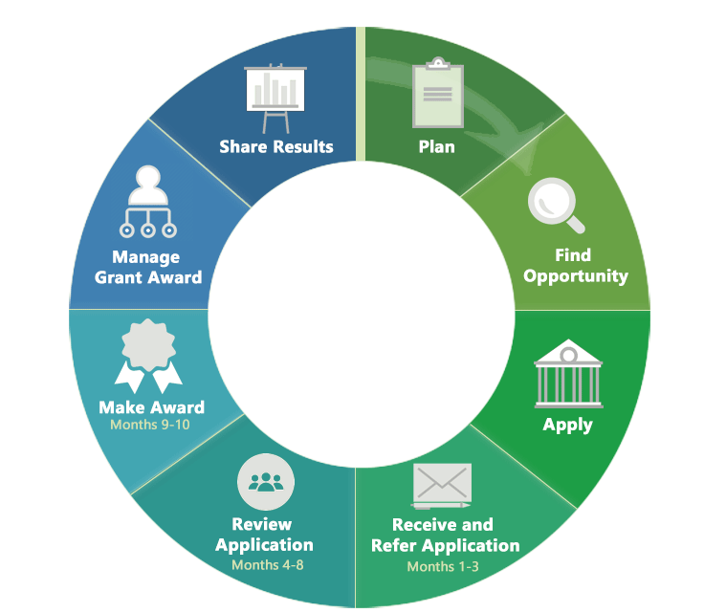
Research Funding Cycle
My Bibliography
SciENcv
Source: https://grants.nih.gov/grants/grants_process.htm

Slide 15
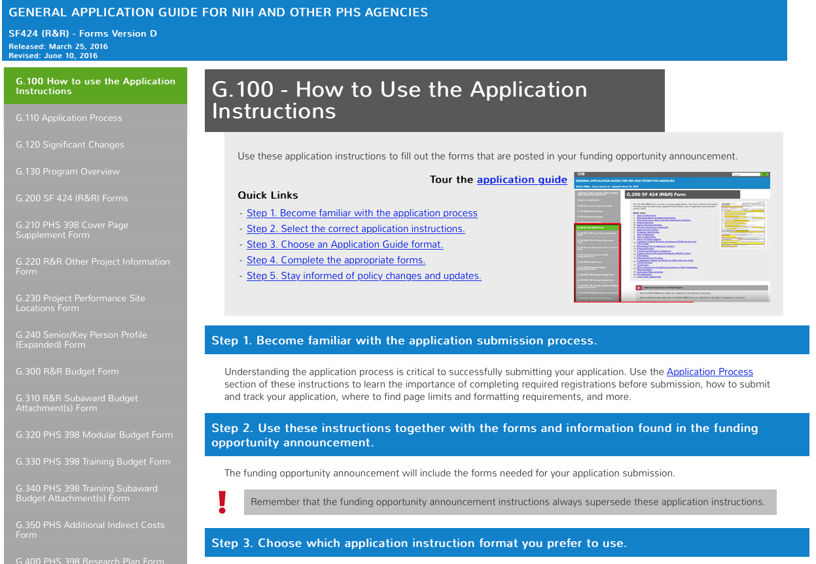
SF424 Application guide, 245 pages

Slide 16



Grants.gov
Cover letter
Budget
Research Plan
Biosketches
Bibliography
Facilities
Animal Welfare
Load to eRA
Completeness?
Determine area
Assign to IC
Assign to Review
SRO
Scoring
SciENcv

Slide 17




SciENcv = Science Experts Network Curriculum Vitae
  Leveraging existing data to support applications, reporting and collaboration
NIH grant/paper
reporting systems
SciENcv
My NCBI
Report Formats
SciENcv
NIH biosketch
NSF
Biosketch (pilot)
My
Bibliography
NIH RPPR
eRA
Other Established
Inputs
User supplied RIS
CV format
PubMed
NIHMS
Federal API
RePORT?
Star Metrics?
COI/Reviewer tool?
PMC
Published
Articles
Author
Manuscripts

Slide 18
Getting Started with SciENcv
Notes:
N: Bart, how do we access SciENcv?

Slide 19
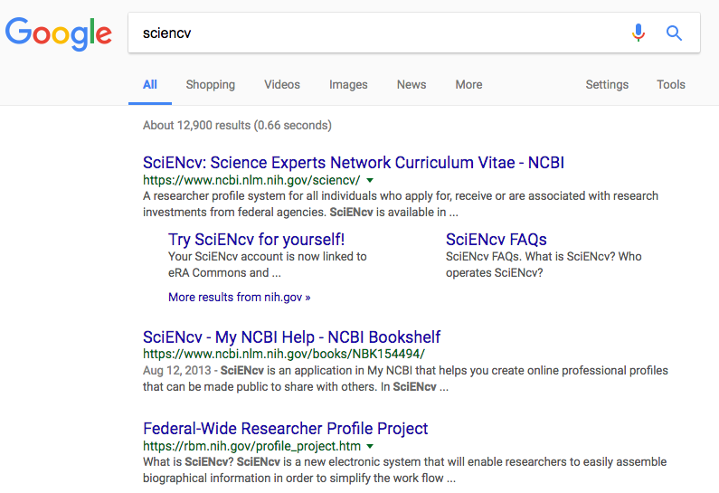
Where to start?
SciENcv homepage: http://www.ncbi.nlm.nih.gov/sciencv

Slide 20
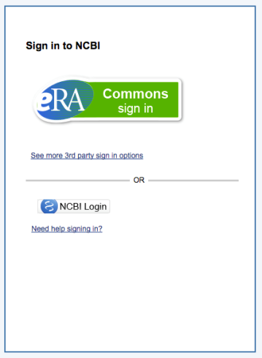
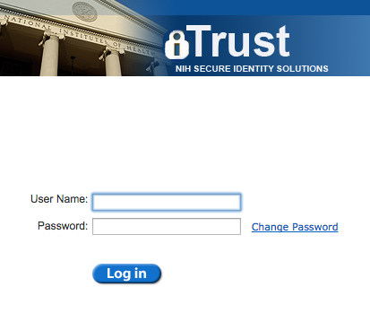
Linking an eRA Commons account

Slide 21
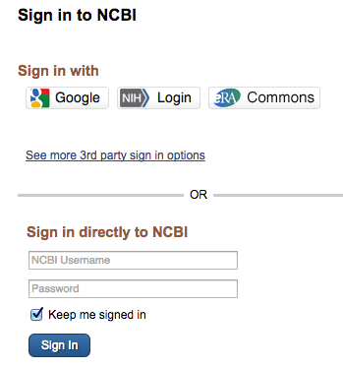
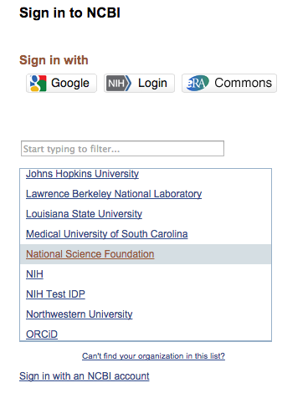
Other sign in options
Notes:
N: Bart, can NIH employees use SciENcv too?

Slide 22
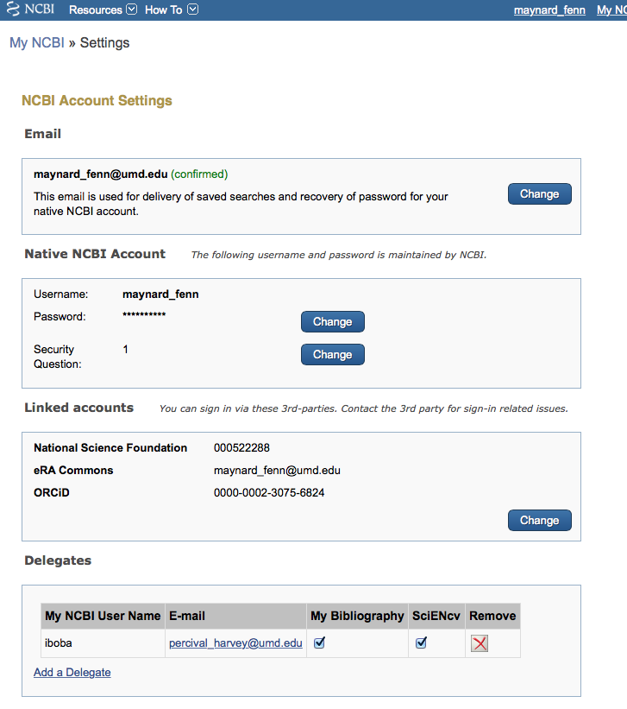
Linked accounts

Slide 23
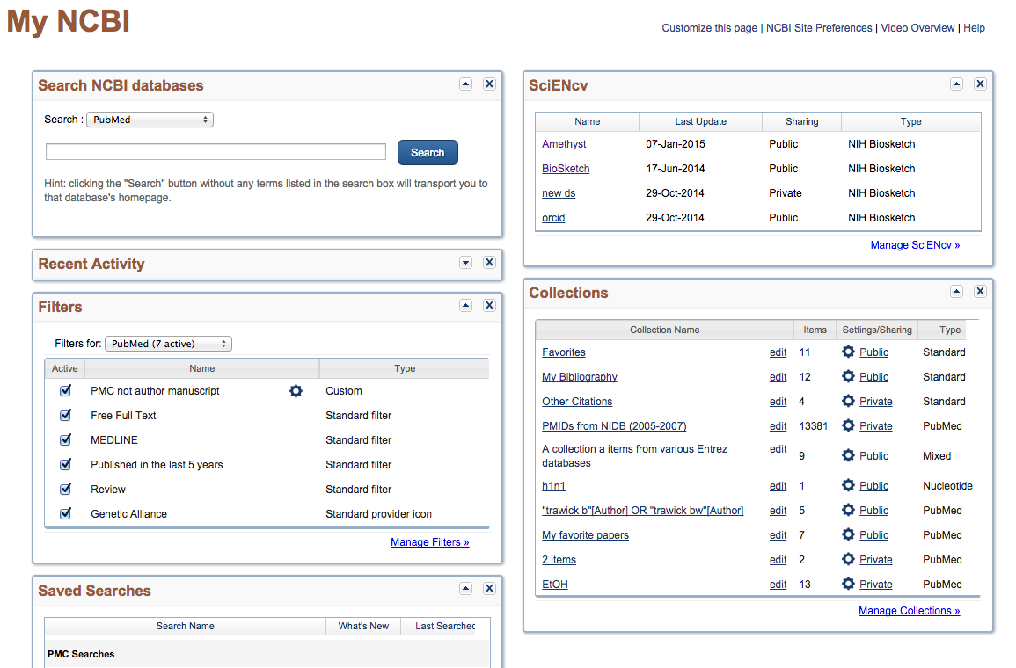
My NCBI main page
Notes:
N: Bart, what are all these windows for?

Slide 24
SciENcv main page
Notes:
N: Bart, What is a profile on sciENcv?

Slide 25



Creating a new SciENcv profile
From Scratch
From an external source (Including ORCiD)
Duplicate an existing profile
Notes:
N: Bart, what is ORCID?

Slide 26
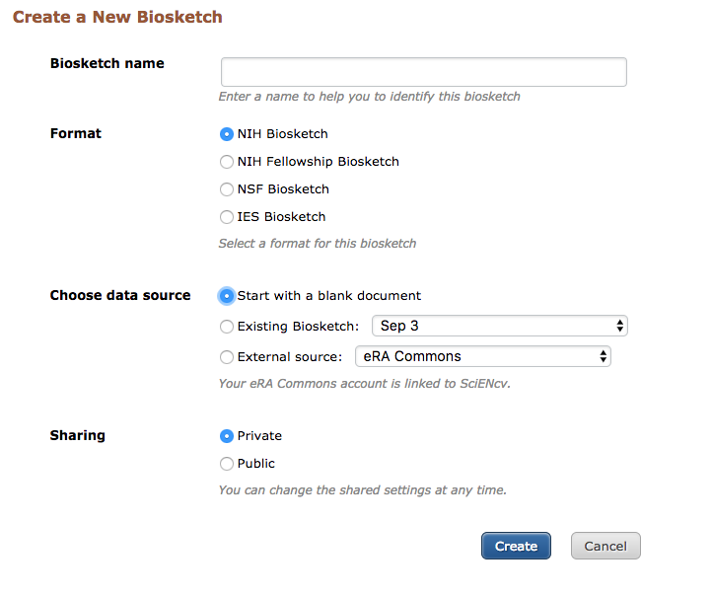
Create a new SciENcv profile page
Notes:
N: Bart, who can see a profile? Why would someone want to share it?

Slide 27
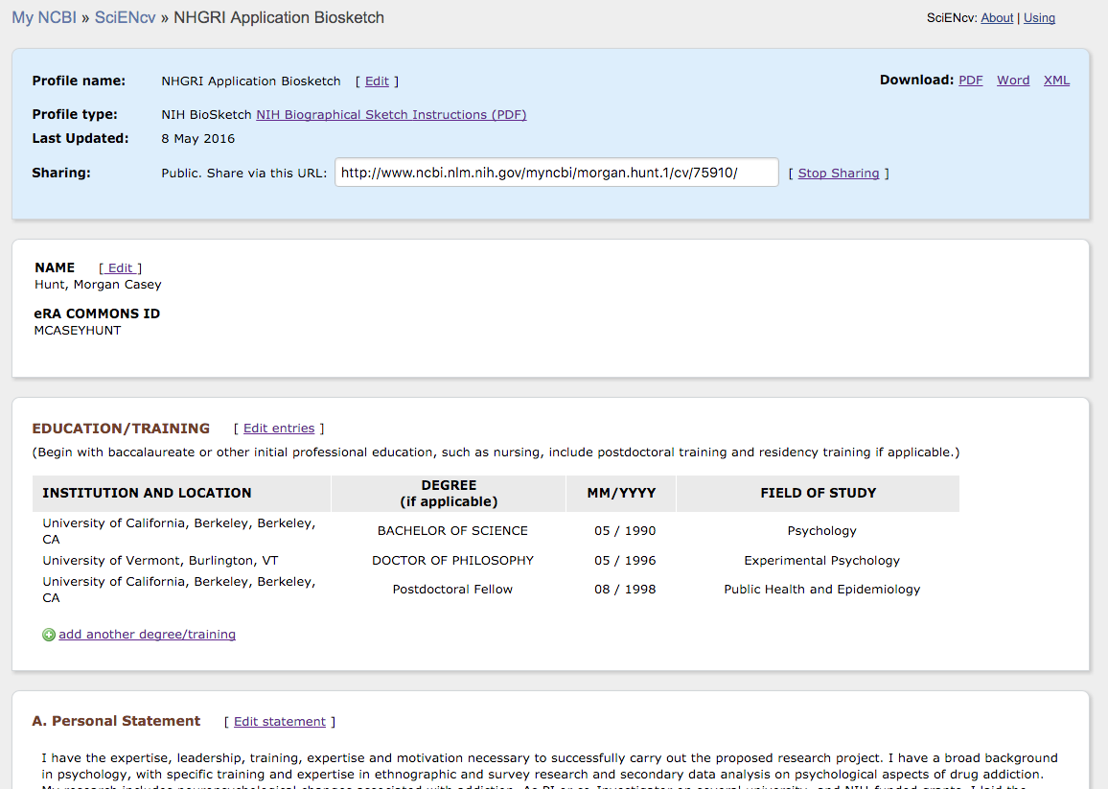
NIH Biosketch page
Metadata
& options
Biosketch
form

Slide 28
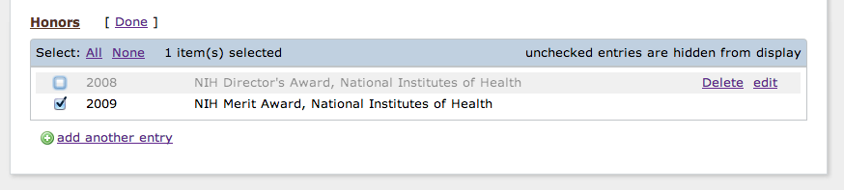
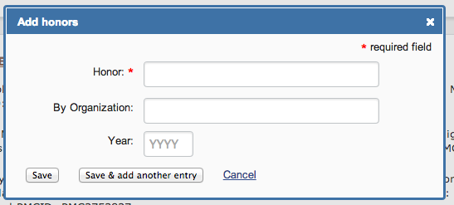
Controls for editing data
Show/hide item
Delete/edit existing items
Create new entry
New entry
dialog box

Slide 29
  Populating sections with linked data – pick lists
Pick list can dynamically update via feed.

Slide 30
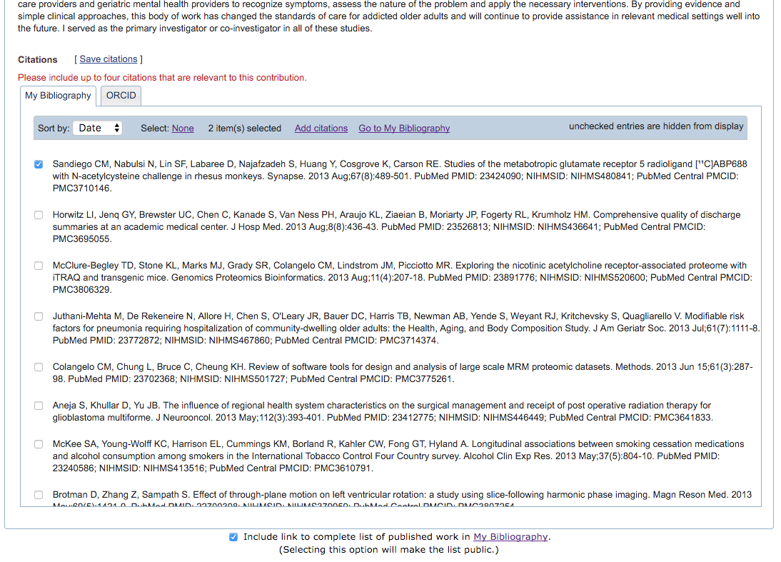
Selecting citations
Show/hide pick list
Data feeds
Notes:
N: Bart, what if my paper is not listed here? Should I add them to My Bibliography or ORCID? How do I decide?

Slide 31
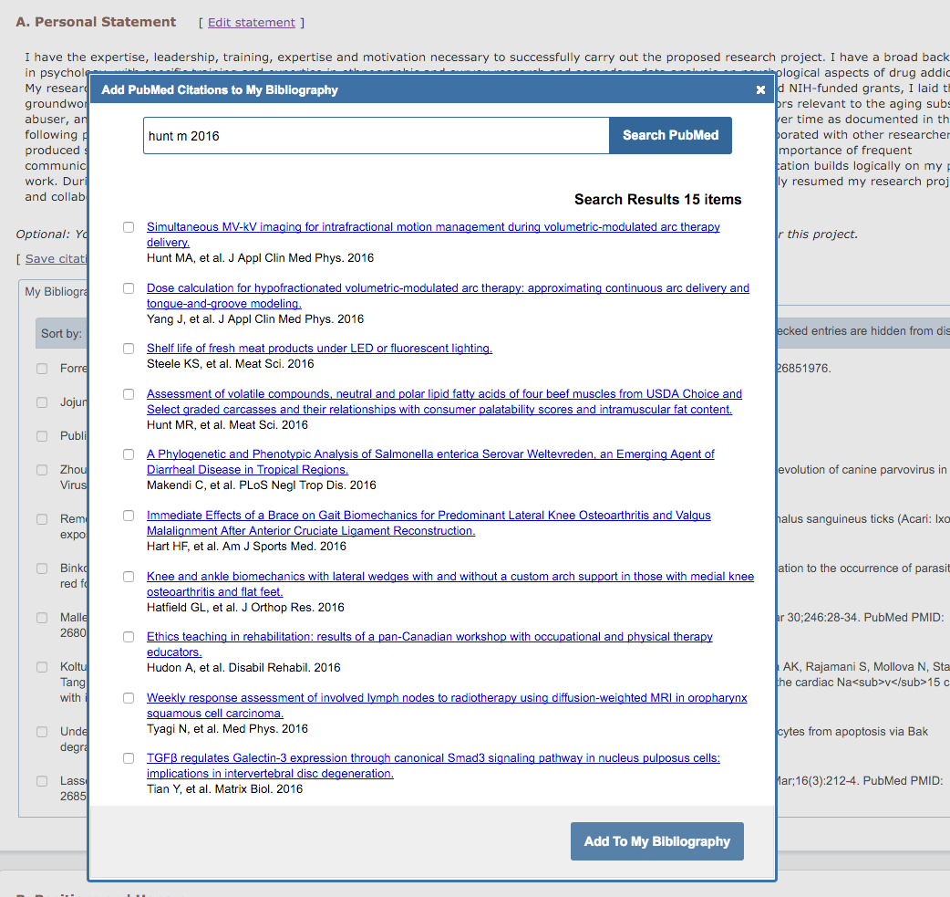
Search PubMed directly from SciENcv

Slide 32
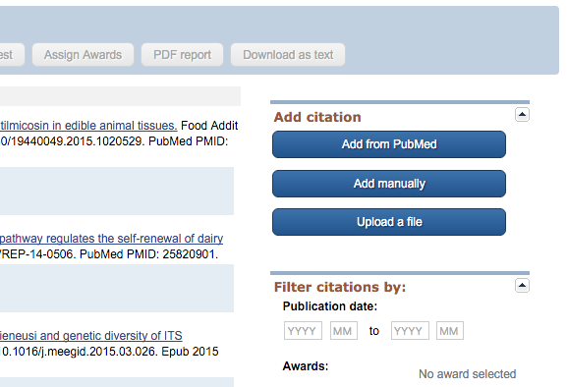
Options for adding citations to My Bibliography

Slide 33
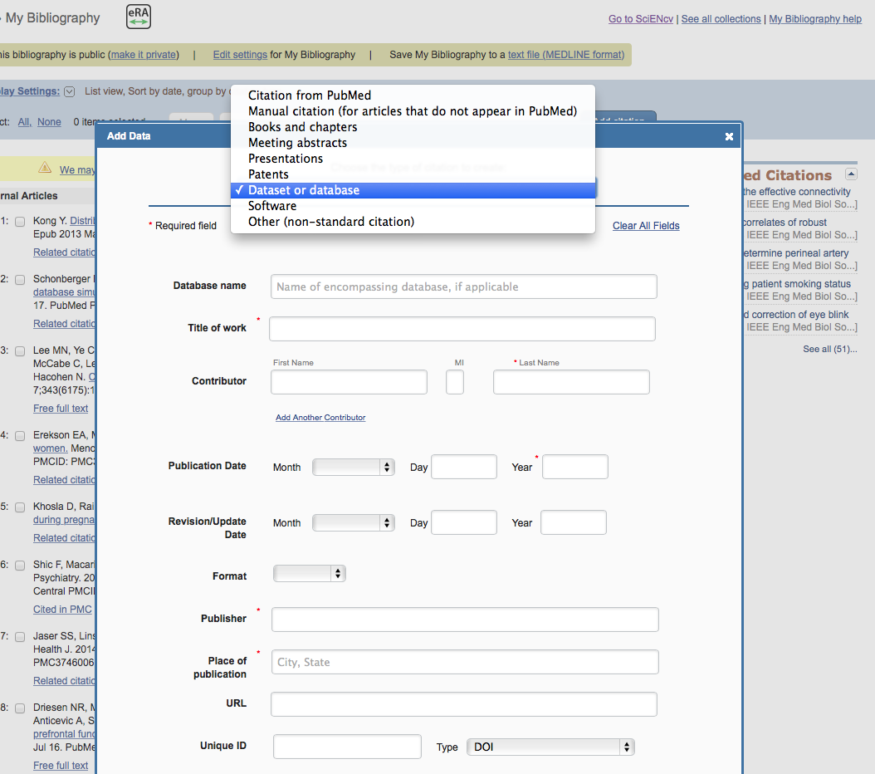
Additional citations types added to My Bibliography

Slide 34
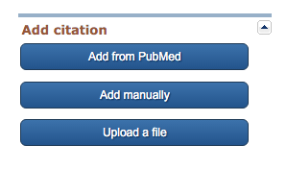
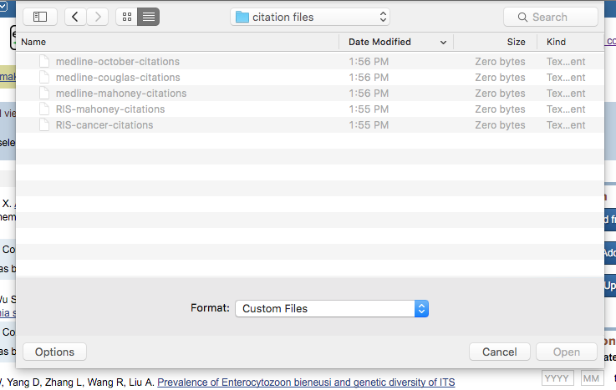

Bulk upload citations in MEDLINE or RIS formats
1. Click “Upload a file” button
2. Choose MEDLINE or RIS file
3. Success message

Slide 35
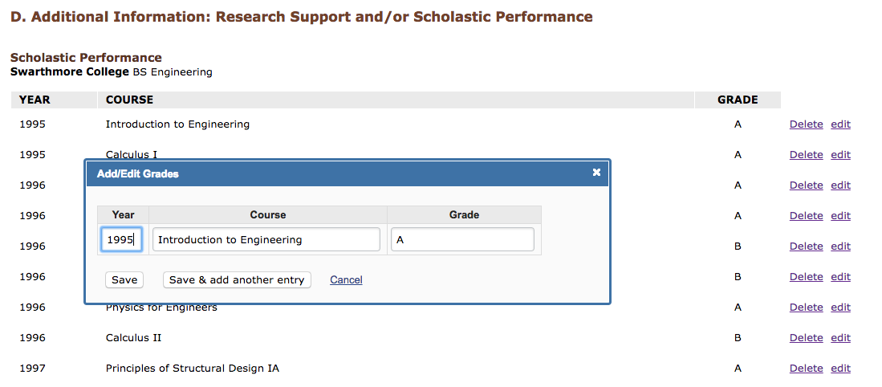
Fellowship biosketch
Add/Edit
grades
Notes:
N: Bart, what is the user tab? Is that manual entry?

Slide 36
Fellowship biosketch
Final Display
Notes:
N: Bart, what is the user tab? Is that manual entry?

Slide 37
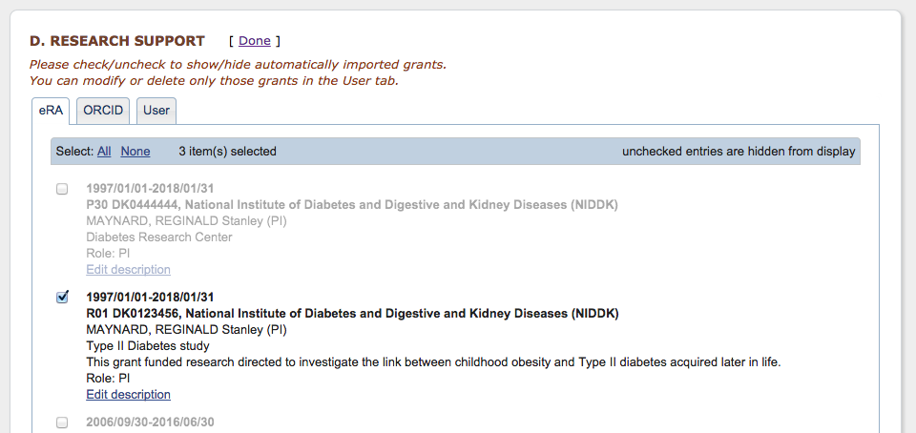
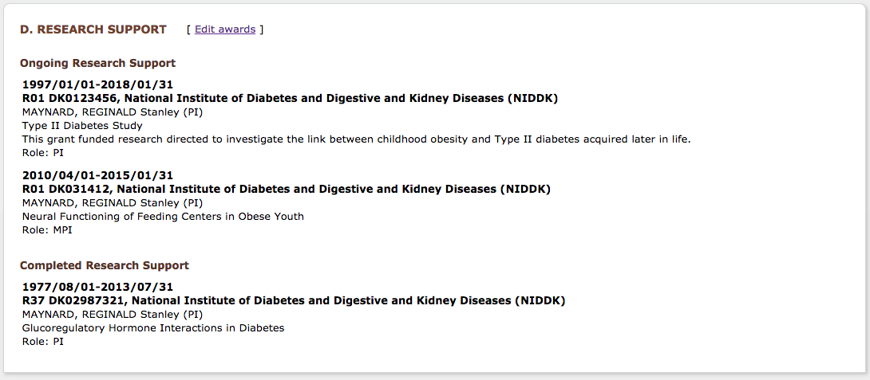
Selecting awards
Award data feeds
Show/hide pick list
Final Display
Notes:
N: Bart, what is the user tab? Is that manual entry?

Slide 38
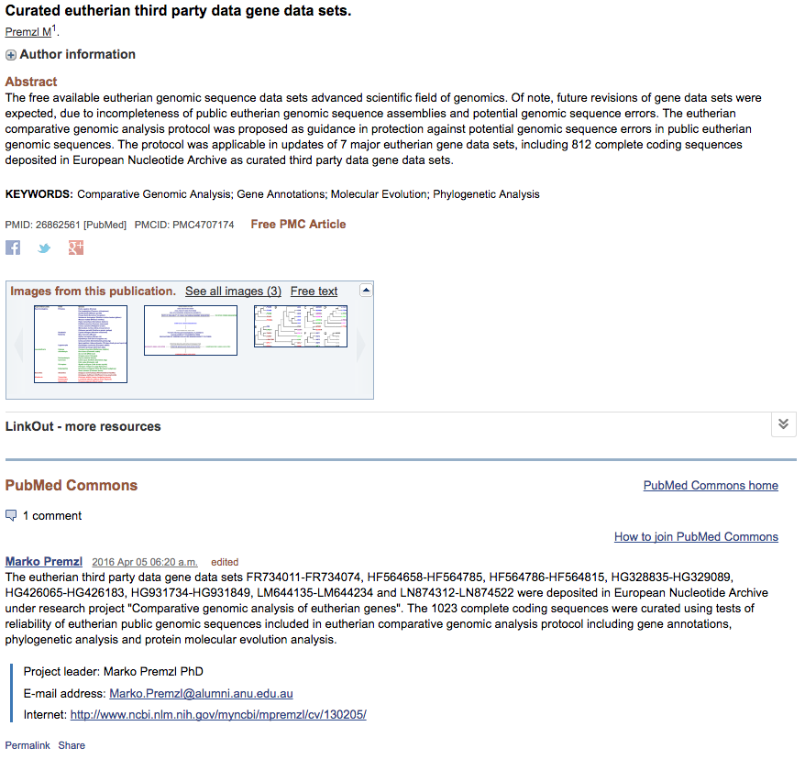
Sharing SciENcv Profiles

Slide 39
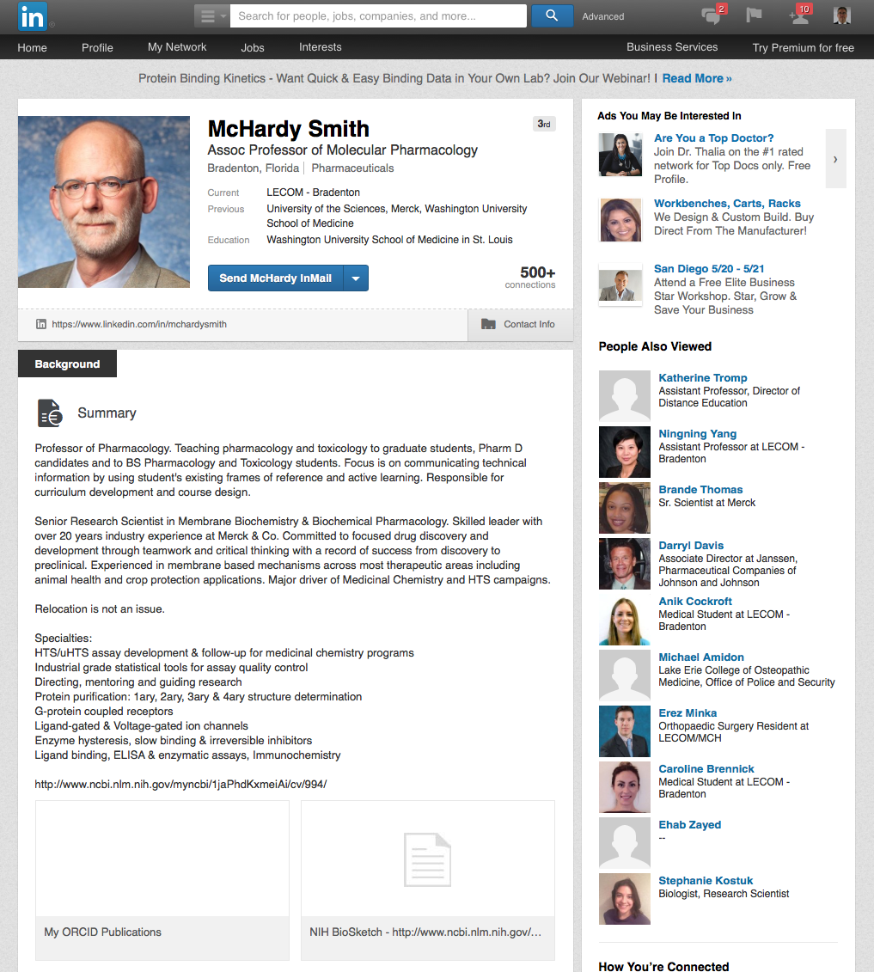
Sharing SciENcv Profiles

Slide 40
Helpful Links
My NCBI documentation:
http://www.ncbi.nlm.nih.gov/books/NBK3843/
Movie tutorial on managing compliance:
http://youtu.be/JYODIOD_YYE
NIH Public Access Policy homepage:
http://publicaccess.nih.gov/
SciENcv is available at:
  http://www.ncbi.nlm.nih.gov/account/
SciENcv documentation: http://www.ncbi.nlm.nih.gov/sciencv
SciENcv video overview: http://youtu.be/PRWy-3GXhtU
Provide feedback to info@ncbi.nlm.nih.gov

Slide 41
Interim Research Products
Where
  RPPRs: Preprints in Section C1; other products in section C5
  Applications: Progress Report Publication List, Biosketch
Citation format standards: DOI, list object type (e.g. Preprint, protocol)
Example: Bar DZ, Atkatsh K, Tavarez U, Erdos MR, Gruenbaum Y, Collins FS. Biotinylation by antibody recognition- A novel method for proximity labeling. BioRxiv 069187 [Preprint]. 2016 [cited 2017 Jan 12]. Available from: https://doi.org/10.1101/069187.
To cite preprints arising from NIH awards DOI Recommend CC-BY license Statement: not peer-reviewed Acknowledge funding Declare competing interests | Repository best practices FAIR principles (Findable, Accessible, Interoperable, Reusable) Open metadata Machine accessible and readable Transparent policies Versioning links to published version Tracks key changes Permanent/archival plan
Guide notice: Reporting Preprints and Other Interim Research Products
https://grants.nih.gov/grants/guide/notice-files/NOT-OD-17-050.html

