Slide 1
The NIH Public Access Policy
NIH Regionals
Phoenix, AZ
November 2019
Joel Snyderman, Bart Trawick, Patricia Chappell-West
Posted at http://publicaccess.nih.gov/communications.htm

Slide 2
Today’s Discussion: The NIH Public Access Policy
The Basics
Awardee Tasks
NIHMS: Processing Manuscripts
Reporting Papers
My NCBI: Track & Report Publications
Enhancing Compliance
Compliance Monitoring for Institutions
Ways Institutions Can Ensure Compliance

Slide 3
The NIH Public Access Policy
        The Basics:
        The Policy
        Its Implications

Slide 4
The NIH Public Access Policy Is Mandatory
The Policy implements Division G, Title II, Section 218 of PL 110-161 (Consolidated Appropriations Act, 2008) which states:
The Director of the National Institutes of Health shall require that all investigators funded by the NIH submit or have submitted for them to the National Library of Medicine’s PubMed Central an electronic version of their final, peer-reviewed manuscripts upon acceptance for publication, to be made publicly available no later than 12 months after the official date of publication: Provided, That the NIH shall implement the public access policy in a manner consistent with copyright law.
Where to Make Public
What to Submit
When to Submit
When to Make Public
4
4
Notes:
4

Slide 5
The Policy Applies to Any Manuscript That…
Is peer-reviewed;
Is accepted for publication in a journal
And, resulting from research supported in whole or in part by:
  Any direct funding from an NIH grant or cooperative agreement, or;
  Any direct funding from an NIH contract, or;
  Any direct funding from the NIH Intramural Program, or;
  An NIH employee.
NIH Grants Policy Statement 8.2.2 “NIH Public Access Policy”
5
5
Notes:
5

Slide 6
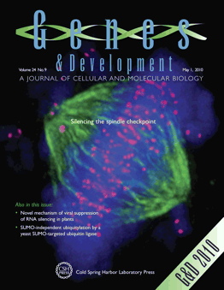

Definitions: Article Types
Final Published Article
Journal’s authoritative copy of the paper
Includes peer review modifications plus
copyediting and formatting changes
Submitted by Publishers/Journals to PMC
(Methods A&B)
Final Peer-Reviewed Manuscript:
Author’s final manuscript of a peer-reviewed
paper accepted for journal publication
Includes all modifications from the peer review
process
Submitted by Authors and Publishers/Journals
to PMC (Methods C&D)

Slide 7

PubMed vs PubMed Central (PMC)
  Free resources developed by the U. S. National Library of Medicine
Biomedical journal citations + abstracts
Some links to full text articles at PMC and publisher websites.
Unique identifier: PMID followed by a series of numbers.
vs
Digital archive of full-text, peer-reviewed journal papers.
Unique identifier: PMCID followed by a series of numbers.

Slide 8
PubMed Central: NLM’s full-text archive
https://www.ncbi.nlm.nih.gov/pmc/
5.7+ Million full-text articles
2,293 full participation journals
335 NIH portfolio journals
5,236 selective deposit journals

Slide 9
PubMed Central: NLM’s full-text archive
https://www.ncbi.nlm.nih.gov/pmc/
2.5 million daily users
accessing 5 million articles

Slide 10
Awardee Tasks
        Address Copyright
        Posting Papers
        Documenting Compliance

Slide 11
Address Copyright
  Institutions and investigators are responsible for ensuring full compliance with the Public Access Policy.
Make sure the copyright transfer agreement allows the final peer-reviewed manuscript to be submitted to NIH.
We encourage authors to consider
Who will submit the paper and/or approve the submission?
What version of the paper will be made available on PMC?
When will it be submitted and when will the paper be made public on PMC?
11
11

Slide 12

Posting Papers: Methods A & B straight to PMC
A&B: Publisher submits

Slide 13

Posting Papers: Methods C&D
Manuscript Submission via NIHMS
C: Author submits
D: Publisher submits
NIHMS

Slide 14
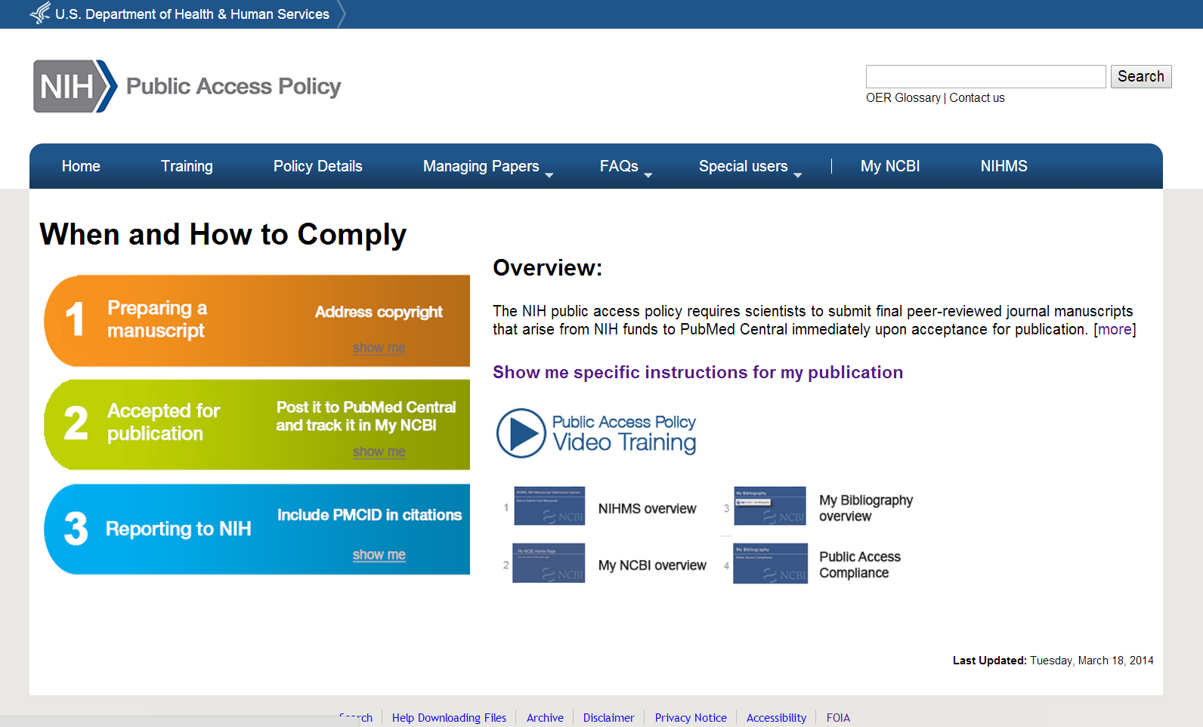
Identifying Submission Method by Journal Name
http://publicaccess.nih.gov

Slide 15
NIH Manuscript Submission System
(NIHMS)
Submitting and tracking manuscripts

Slide 16
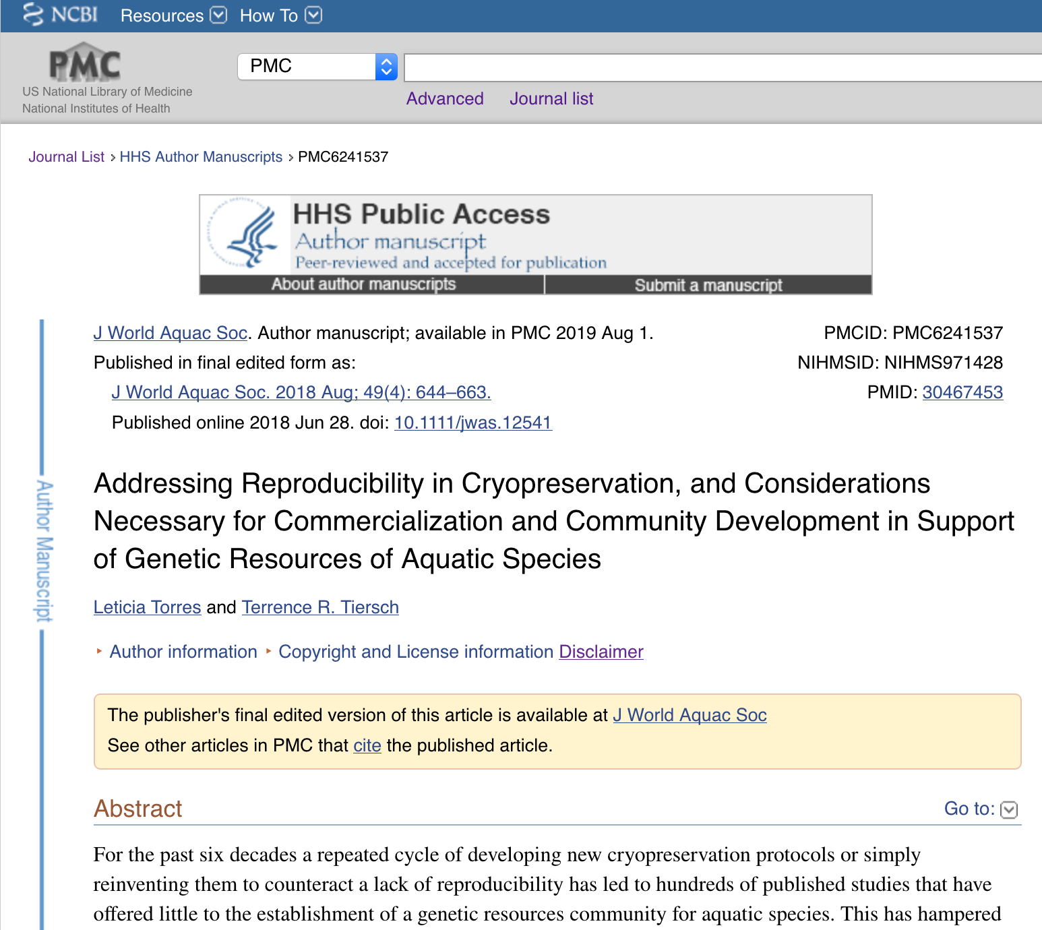
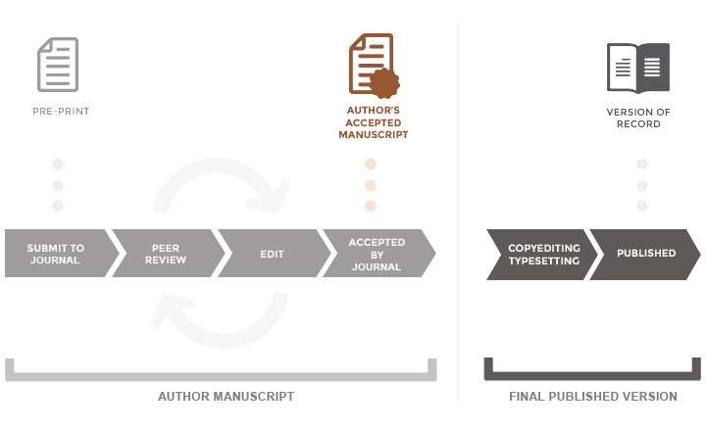
The NIHMS System
… supports the deposit of author manuscripts into PubMed Central (PMC), as required by the public access policies of NIH and other participating funders, as well as the conversion of the submission into PMC format.
https://www.nihms.nih.gov

Slide 17
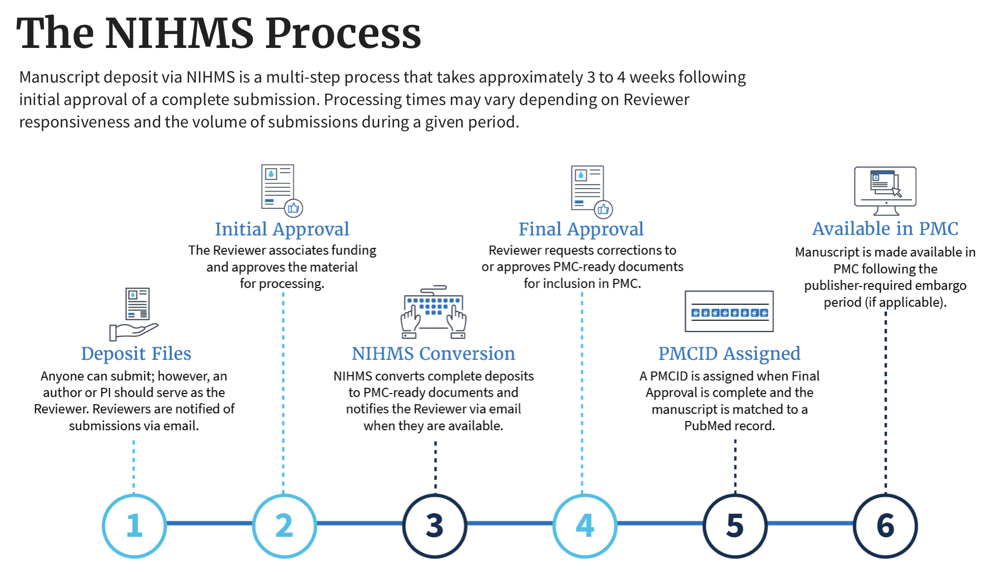
https://www.nihms.nih.gov

Slide 18




NIHMS Tips for Researchers
Use the same sign in route each time.
Plan Ahead.
Deposit at time of acceptance.
Avoid delays by ensuring submissions are complete.

Slide 19




Streamlined submission and approval process
NEW NIHMS SYSTEM FORTHCOMING
WHAT TO EXPECT?
Same requirements for submission and approval steps
Easy access to previous log in routes and step-by-step guidance

Slide 20
Public Access Compliance Monitor: Monitor compliance for your institution

Slide 21

How to monitor compliance at your institution
How will it be deposited in PMC?
What is it’s compliance status?
Does a
paper fall under the policy?
Maybe it already was deposited?

Slide 22


Public Access Compliance Monitor
The Public Access Compliance Monitor (or PACM) is a database of articles associated with an institution’s (i.e., IPF’s) grants and organized by their compliance status with the NIH Public Access Policy.
Provides global view of ALL papers associated with awards made to your institution
Provides article-level data (identifiers, key dates, compliance status, etc.)
https://www.ncbi.nlm.nih.gov/pmc/utils/pacm/
Notes:
PACM is a database of articles associated with an institution’s grants and organized by their compliance status with the NIH Public Access Policy.
It allows a grant administrator to track compliance at a global level across your institution. The associations between papers and grants may be made in NIHMS, My Bibliography, or in paper acknowledgments picked up by indexers or via text mining.
Administrators can also look for data associated with a specific award.
For all articles associated with an institutions grants, PACM includes article-level data as well, including key identifiers, Method A status of the journal, and any relevant NIHMS submission information.
Regularly monitoring PACM, alls you to more readily follow up with investigators and ensure timely compliance with the policy.

Slide 23



Is PACM the right tool for you?
You monitor the compliance of a number of awards.
YES! Give me access to PACM!
You want to provide different departments with compliance status reports.
You want to quickly check the compliance of a specific paper.
https://www.ncbi.nlm.nih.gov/pmc/utils/pacm/

Slide 24




Gaining Access to PACM
Access to PACM available the next day
PACR
Send request
Your institution’s Signing Officer (SO)
https://www.ncbi.nlm.nih.gov/pmc/utils/pacm/
Notes:
If this sounds like the right tool for you, the first step is to contact your institution’s signing officer and ask that the PACR role be assigned to your eRA Commons account. Once granted, you will have access to PACM the following day.
A full user guide on how to leverage the full functionality of PACM is available as a PDF download from URL shown here.

Slide 25
Reporting

Slide 26
Documenting Compliance
How to cite papers in press (epub ahead of print),
or within 3 months of publication
For Method A and B Journals, use “PMC Journal - In Process”.
  Example: Sala-Torra O, et al. Connective tissue growth factor (CTGF) expression and outcome in adult patients with acute lymphoblastic leukemia. Blood. PMCID: PMC Journal - In Process
For Method C and D Journals, use the NIHMSID.
  Example: Cerrato A, et al. Genetic interactions between Drosophila melanogaster menin and Jun/Fos. Dev Biol. In press. NIHMSID: NIHMS44135
NIHMSIDs will not be accepted 3 months after publication.
    PMCIDs are assigned around the time of publication.
    Use the PMCID once it is assigned.
NB: yellow highlighting not part of compliance requirement
26
26
Notes:
26

Slide 27
Documenting Compliance
How to cite papers archived in PMC
  When citing a paper in NIH applications, proposals, and progress reports, include the PMCID at the end of the full citation.
  Applies to papers that fall under the Policy and are authored or co-authored by you.
  Example
    Bar DZ, Atkatsh K, Tavarez U, Erdos MR, Gruenbaum Y, Collins FS. Biotinylation by antibody recognition-a method for proximity labeling. Nat Methods. 2018 Feb;15(2):127-133. doi: 10.1038/nmeth.4533. Epub 2017 Dec 18. PubMed PMID: 29256494; PubMed Central PMCID: PMC5790613.
NB: yellow highlighting not part of compliance requirement

Slide 28
My NCBI:
Tools to assist with
NIHPA compliance
grant reporting & grant applications

Slide 29
What is My NCBI?
My NCBI is a free account system that provides customized services for many NCBI databases, such as PubMed.
Key features:
Links with eRA Commons accounts
eRA Commons-linked users can associate publications with NIH grants
Tracks NIH Public Access compliance
The only way to enter publications into section C.1 of the RPPR
Creates a PDF report format for other NIH reporting

Slide 30
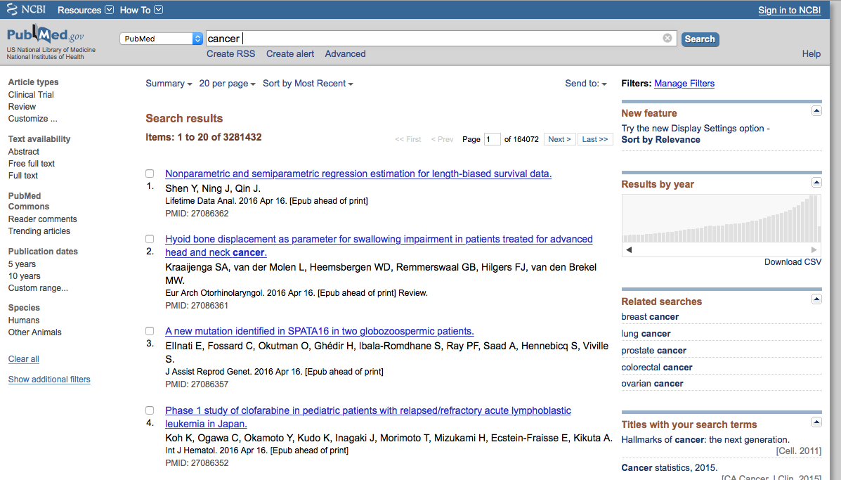
Signing in to NCBI

Slide 31
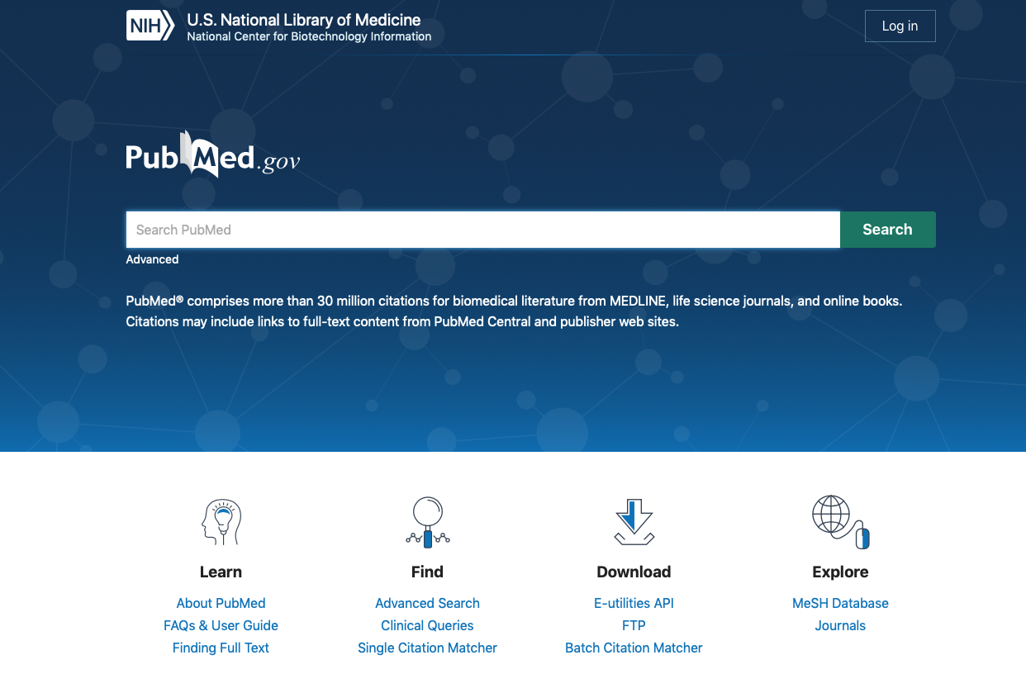
Signing in to NCBI

Slide 32
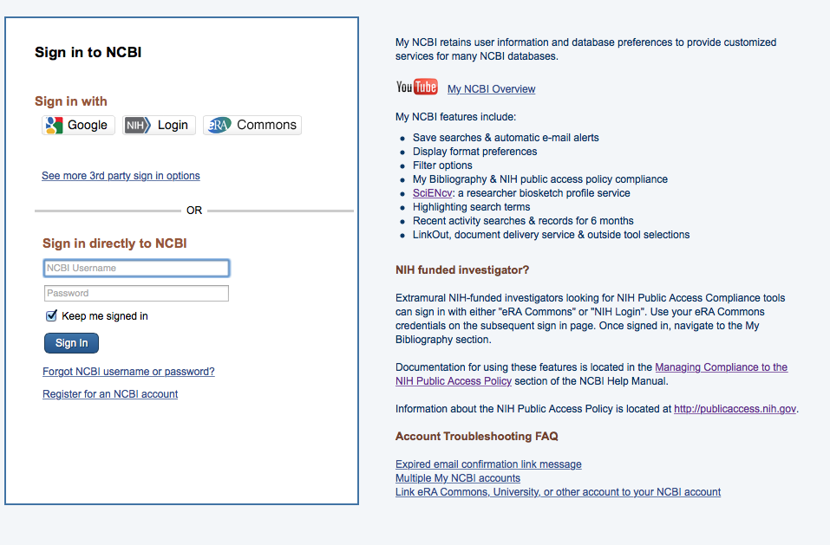
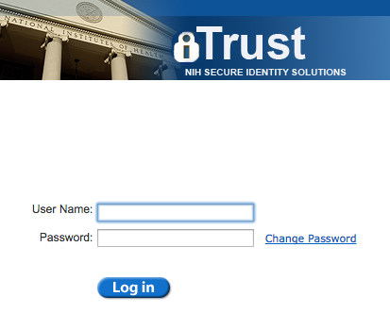
Signing in to NCBI

Slide 33
Which eRA users should have linked My Bibliography accounts?
Principal Investigators
Anyone else with NIH support who is or was an author
  Post-Doctoral Role
  Graduate Student Role
  Scientist Role
  Project Personnel Role
http://era.nih.gov/files/eRA_Commons_Roles.pdf

Slide 34
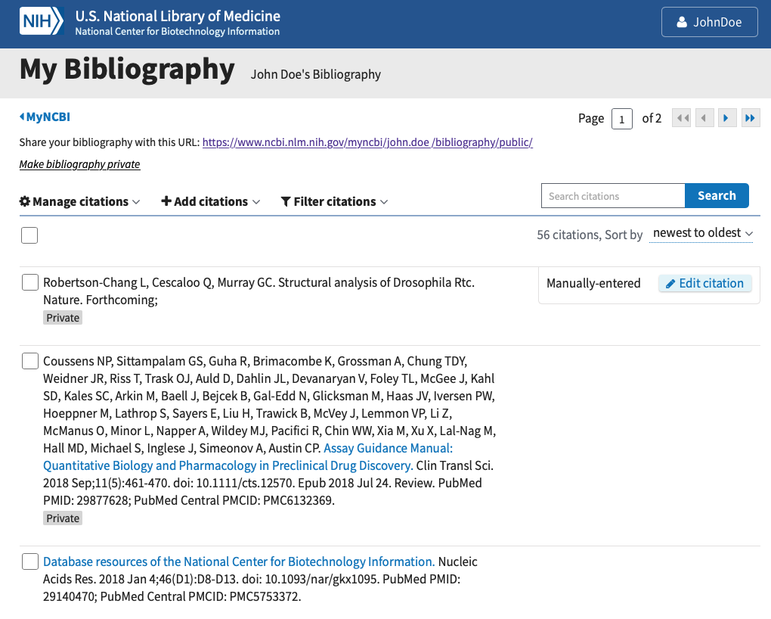
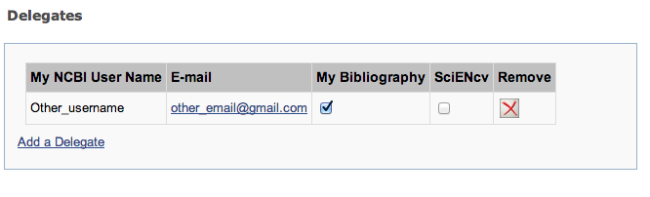
Delegation in My Bibliography

Slide 35
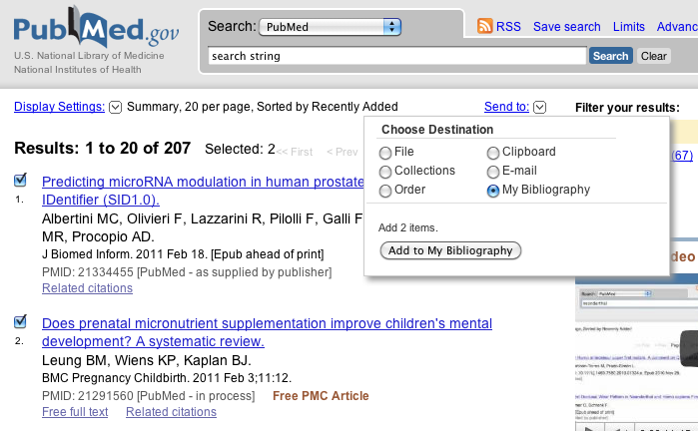
Adding citations from PubMed to My Bibliography

Slide 36
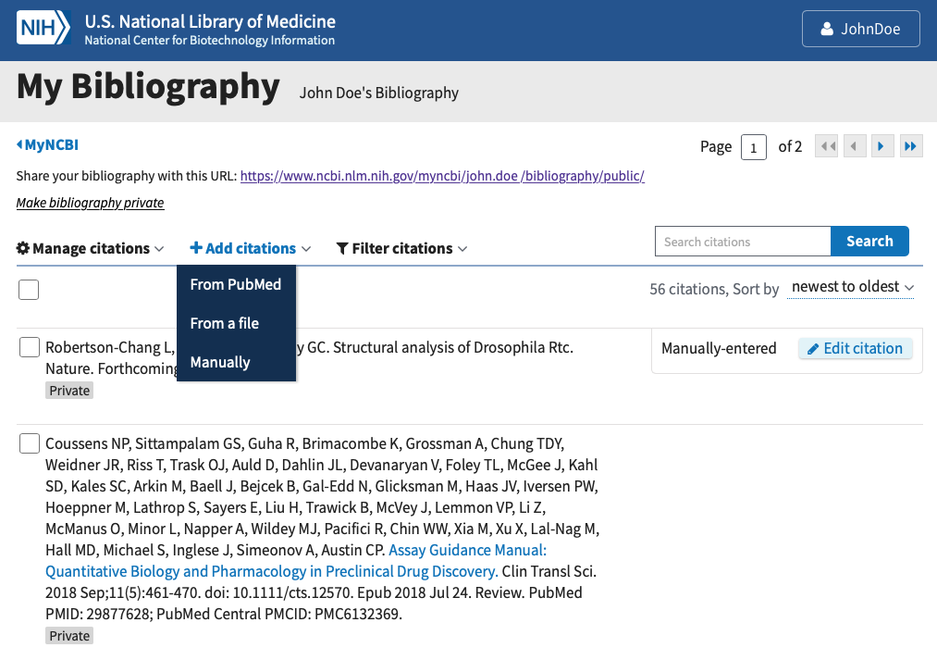
Adding citations from within My Bibliography

Slide 37
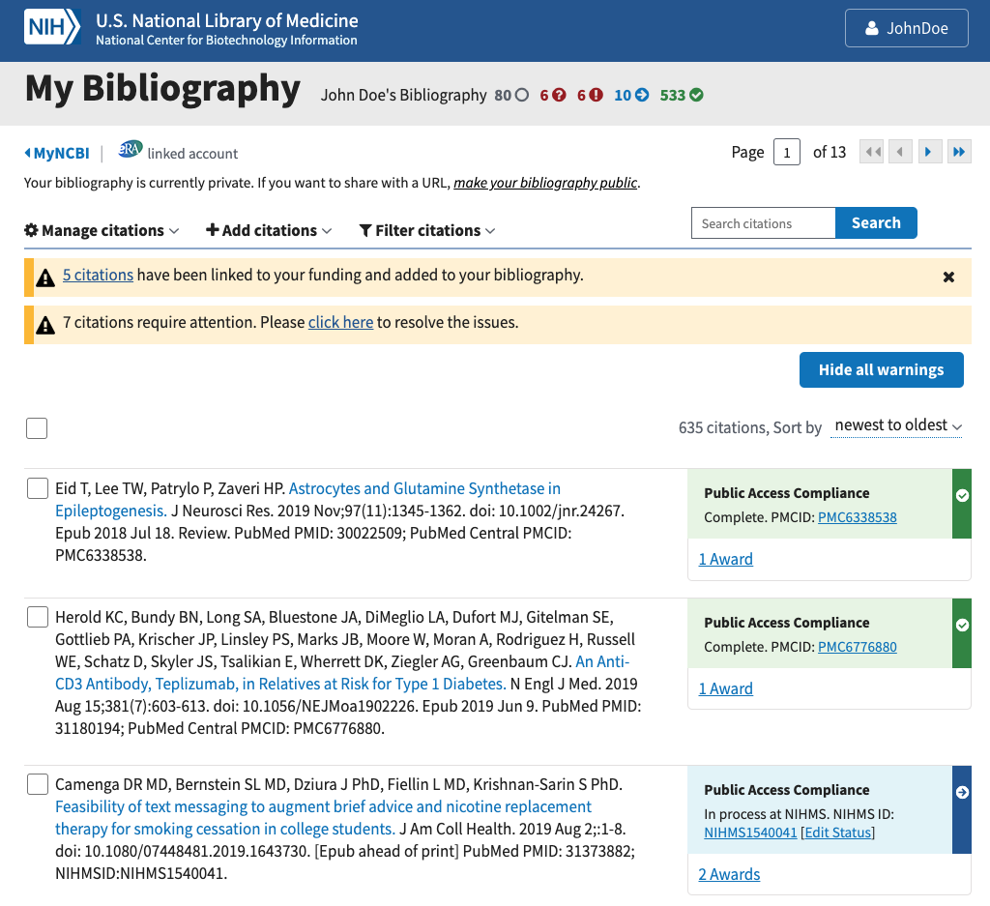
Award View option for eRA-linked users

Slide 38
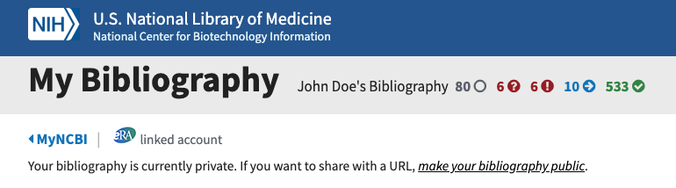
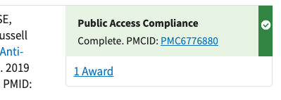
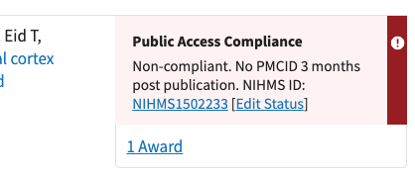
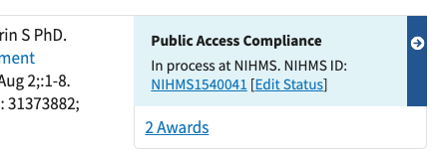
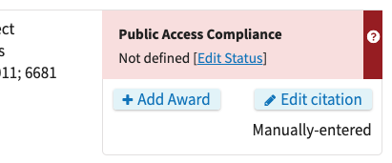
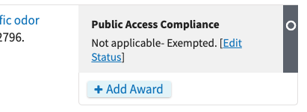
Award View NIHPA compliance codes
Okay!
Not Okay!

Slide 39
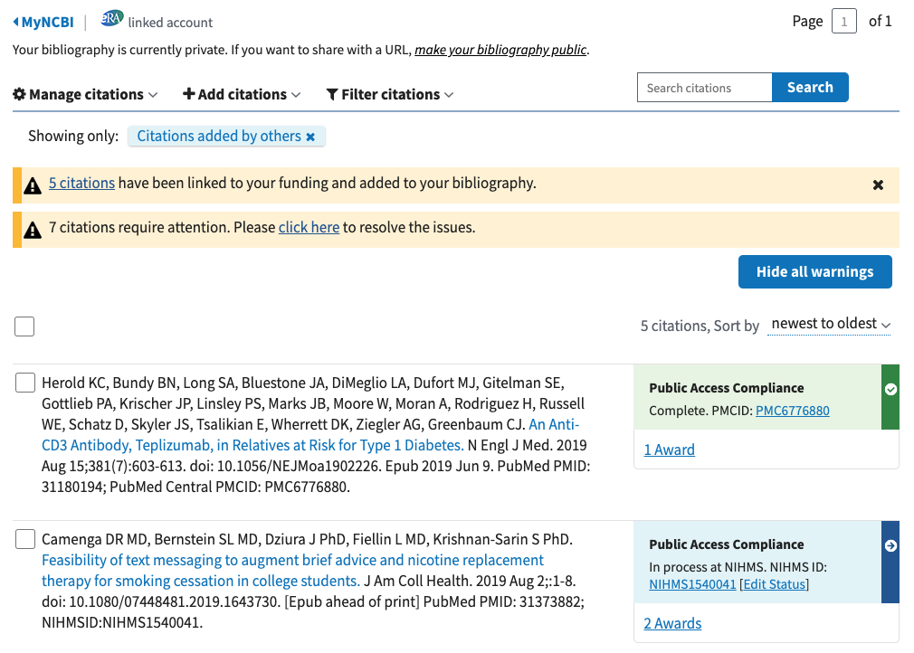
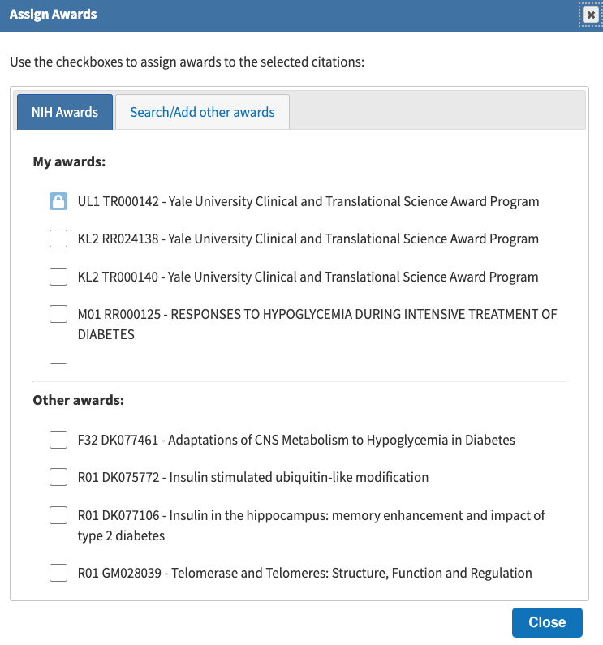
PI adds a new citation to their My Bibliography

Slide 40
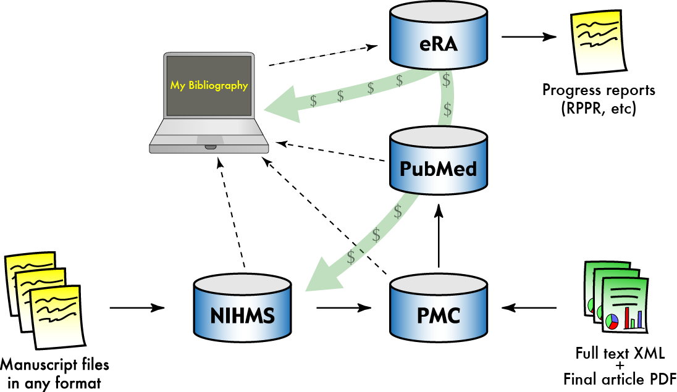
Compliance management with My NCBI

Slide 41
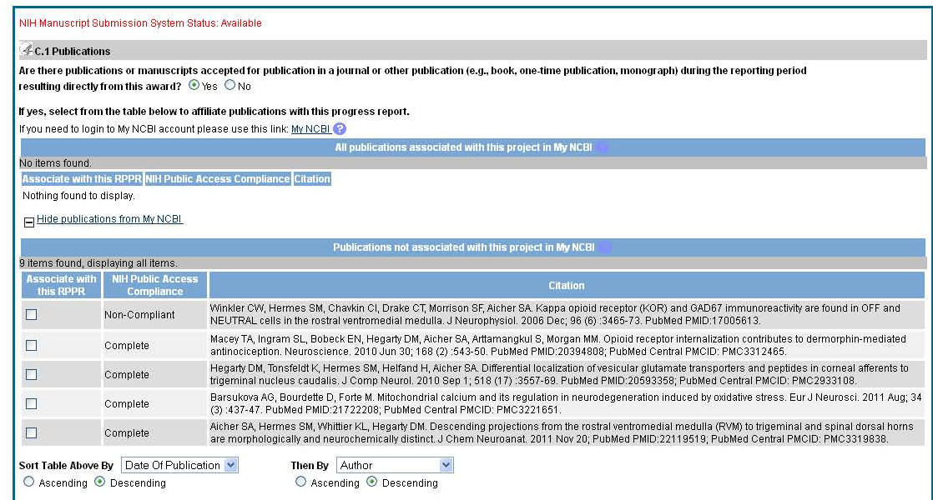
Display on RPPR
10

Slide 42
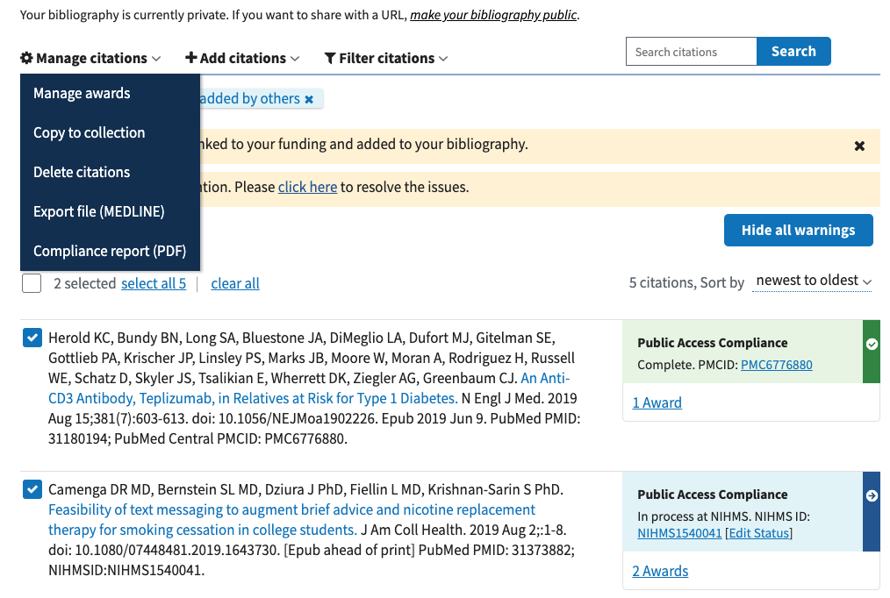
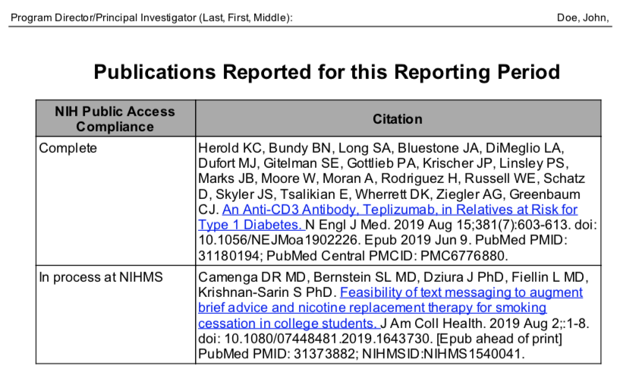
My NCBI PDF reports

Slide 43
Documentation for My NCBI
Using your NCBI account
  https://www.ncbi.nlm.nih.gov/books/NBK3843/
My Bibliography documentation
  https://www.ncbi.nlm.nih.gov/books/NBK53595/
Questions, issues and suggestions
  info@ncbi.nlm.nih.gov

Slide 44
Enhancing compliance
        Scope
        My NCBI and RPPRs

Slide 45
Non-competing continuation awards
For pending non-competing continuation awards (T-5s) with non-compliant RPPRs:
Awards will be placed on hold until grantees have demonstrated compliance
My NCBI is required to report papers, when electronically submitting progress reports using the Research Performance Progress Report (RPPR)
https://grants.nih.gov/grants/guide/notice-files/NOT-OD-12-160.html

Slide 46
RPPR and eNotification
Trigger: When a grantee submits a RPPR to NIH that associates 1 or more publications with the award for which the public access compliance status is “Noncompliant”.
Recipients: to the PD/PI, with a cc to the AO, SO, GMS, IC mailbox, and PO.
Response: The grantee may respond to the eNotification via email or through the Progress Report Additional Materials (PRAM) link.

Slide 47
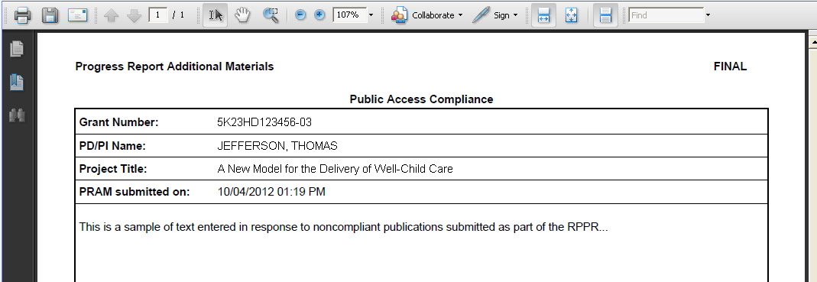
Example: PRAM for Public Access

Slide 48
Public Access and Resource Sharing
If an NIH award’s only contribution to a publication is a shared resource, do not list the publication in section C.1 of an RPPR or in the progress report publication list of a Renewal application.
Instead
  RPPR: opt to list and/or summarize these publications in section B.2. List/ summary does count against two-page limit.
  Renewals: opt to list and/or summarize these publications in the appropriate sharing plan (Data Sharing Plan, Genomic Data Sharing Plan, Model Organism Sharing Plan Resource Sharing Plan, etc.).
List/summary is always optional, and does not have to be complete
Implications: less burden, more accurate reporting
https://grants.nih.gov/grants/guide/notice-files/NOT-OD-16-079.html

Slide 49
Ways institutions can ensure compliance

Slide 50
Preparation is Key to Avoiding Delays in Funding
  Do you have a plan that can withstand
    Miscommunication among authors, and between publishers and authors?
    Forgetfulness?
  Encourage your investigators to:
    Use My NCBI now to track public access compliance
    Associate papers with awards today
    Ensure compliance well before their annual reports are due
      avoid a last minute scramble
    Determine their compliance plan as they write their papers
  Resources at http://publicaccess.nih.gov/

Slide 51
Ways Institutions Can Ensure Compliance
Training
  Policy awareness, submitting papers, preparing citations
Author Support
  Submitting manuscripts
  Answering questions
  Sending out reminders for reports early
  Means to ensure collaborators do not prevent compliance
Support on Publishing Agreements
  Policies
    Coversheets/ Addenda (NIH’s Example: http://publicaccess.nih.gov/nih_employee_procedures.htm)
  Questions/discussion with publishers
Ensuring compliance
  Checking applications, proposals and reports

Slide 52
The NIH Public Access Policy in one slide
The NIH Public Access Policy requires that all peer-reviewed journal articles arising from NIH funds are posted to PubMed Central
You must have evidence of compliance with the public access policy for all peer-reviewed papers upon acceptance for publication
Be proactive to maintain your funding!
  Develop your compliance plan while you are preparing your manuscript.
  How you comply and report compliance depends on the journal you choose.
  Use our public access instruction wizard to develop your plan
NIH wants people to see your work. Over one million people per day use PubMed Central to retrieve more than two million papers to advance research, innovation, education and health.
For more information, see http://publicaccess.nih.gov/

Slide 53
Questions?

Slide 54
Appendices

Slide 55
What are interim research products:
RFI Proposed Definitions
Interim Research Products
Complete, public research products that are not final
Examples
  Preprints are complete and public drafts of a scientific documents. Arguably speeds dissemination, establishes priority, generates feedback, and may reduce publication bias.
  Preregistering protocols is publicly declaring key elements of a research project in advance. May reduce biases like p-hacking.
Since they are not peer-reviewed manuscripts accepted for publication, they do not fall under the public access policy

Slide 56
Interim Research Products
Where
  RPPRs: Preprints in Section C1; other products in section C5
  Applications: Progress Report Publication List, Biosketch
Citation format standards: DOI, list object type (e.g. Preprint, protocol)
Example: Bar DZ, Atkatsh K, Tavarez U, Erdos MR, Gruenbaum Y, Collins FS. Biotinylation by antibody recognition- A novel method for proximity labeling. BioRxiv 069187 [Preprint]. 2016 [cited 2017 Jan 12]. Available from: https://doi.org/10.1101/069187.
To cite preprints arising from NIH awards DOI Recommend CC-BY license Statement: not peer-reviewed Acknowledge funding Declare competing interests | Repository best practices FAIR principles (Findable, Accessible, Interoperable, Reusable) Open metadata Machine accessible and readable Transparent policies Versioning links to published version Tracks key changes Permanent/archival plan

Slide 57
Resources
About the Public Access Policy:
  NIH Grants Policy Statement, Section 8.2.2: https://grants.nih.gov/policy/nihgps/index.htm
  For Sponsored Programs: http://publicaccess.nih.gov/sponsored.htm
  Training materials for PIs and other communications: http://publicaccess.nih.gov/communications.htm
  Questions: PublicAccess@NIH.GOV
The NIH Manuscript Submission System:
  http://www.nihms.nih.gov/
  Tutorials: http://www.nihms.nih.gov/web-help/
PubMed Central:
  http://www.pubmedcentral.nih.gov/
  Information for Publishers: http://www.pubmedcentral.nih.gov/about/pubinfo.html

Slide 58
What is PubMed Central?
List of PMC-participating journals
Full-text and advanced search
Submit a manuscript
http://www.ncbi.nlm.nih.gov/pmc/
Notes:
PubMed Central is a free digital archive of biomedical and life sciences journal literature at the U.S. National Institutes of Health (NIH), developed and managed by NIH's National Center for Biotechnology Information (NCBI) in the National Library of Medicine (NLM).
PubMed Central homepage with links to PMC information and resources, including search.

Slide 59
Search Results in PubMed Central
Filter search results by funding agency or open access license
Search results
< Final published version in PMC
< Author manuscript in PMC

Slide 60
Author Manuscript Display in PMC
Manuscript banner
Identifiers
Link to version of record

Slide 61
Final Published Version Display in PMC
Journal banner

Slide 62
Finding PMCIDs and Using Them in Searches

Slide 63
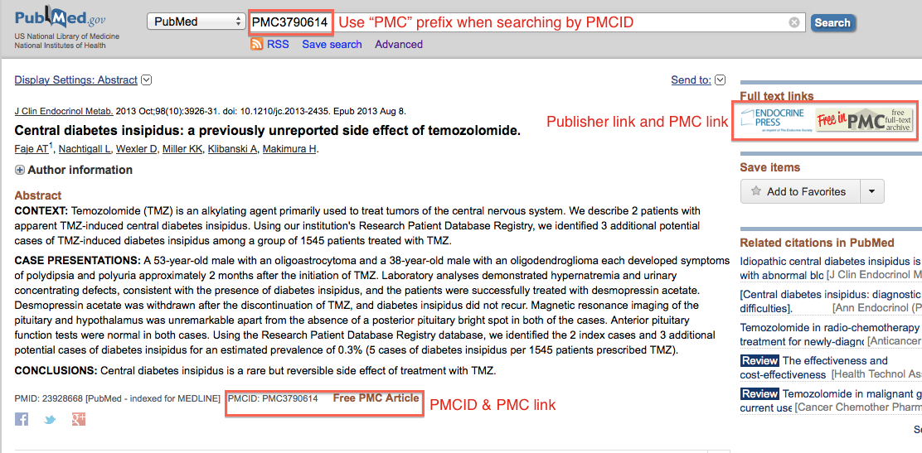
Look up articles with PMCIDs in PubMed

Slide 64
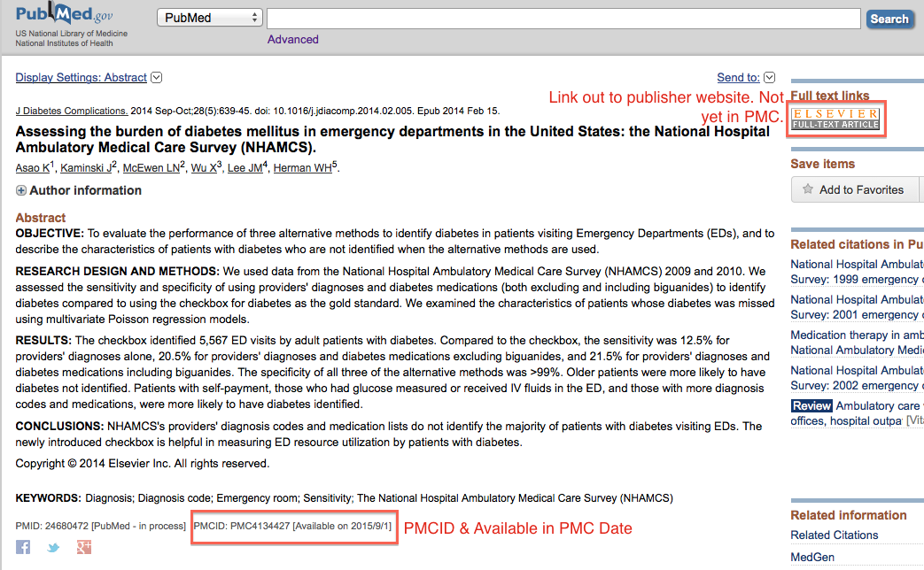
Find PMCIDs in PubMed’s Abstract View

Slide 65
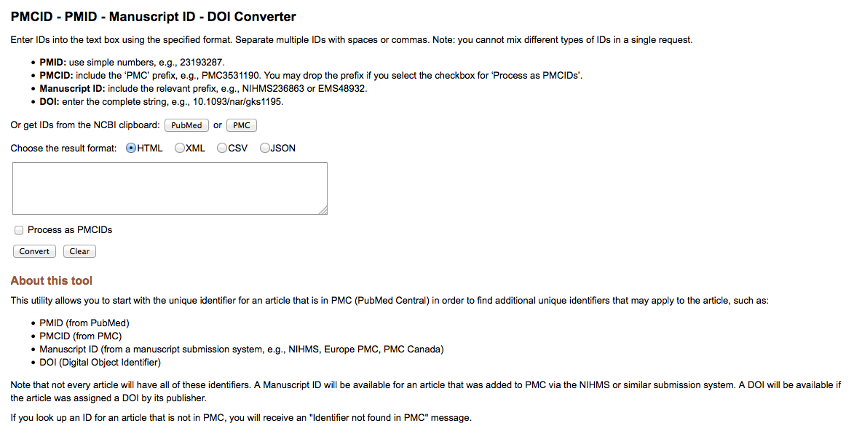
PMCID Converter Tool
http://www.ncbi.nlm.nih.gov/pmc/pmctopmid/
65

Slide 66
NIH Manuscript Submission System: Processing manuscripts

Slide 67
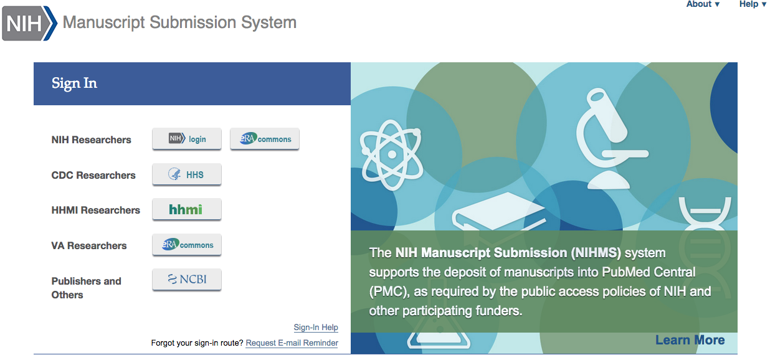
NIHMS Login Options
Each Login route has its own NIHMS account
Submitters must continue to use the same login method for subsequent visits to NIHMS.
Helpful sign in hints
Use the same sign in route each visit.
If you do not remember how you’ve previously signed in, use the “Request E-mail Reminder” link.
NIHMS does not maintain the sign in routes.

Slide 68
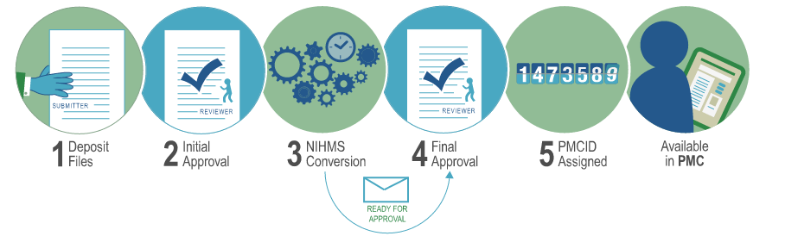
NIHMS Process Overview
https://www.youtube.com/watch?v=IIEBtfnSqMA
Process Notes:
Typically takes about 2-3 weeks from initial approval until first notification of final approval.
Deposit at time of acceptance. Don’t wait until publication or embargo period is up.
PMCID is assigned when final approval is complete and final publication information is available.
* Approval steps must be completed by the assigned Reviewer in NIHMS.

Slide 69
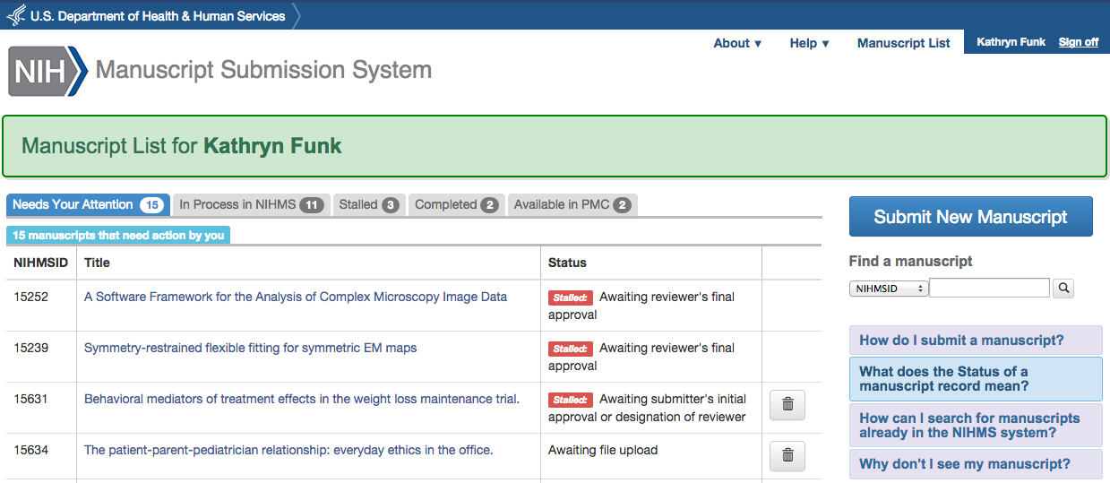
Managing NIHMS Submissions
Navigating the Manuscript List:
Check the “Needs Your Attention” tab.
Check the “Stalled” tab.
Search for submissions.
Submit a new manuscript.
Check the “Available in PMC” tab to view the PMC access statistics for your manuscripts.

Slide 70
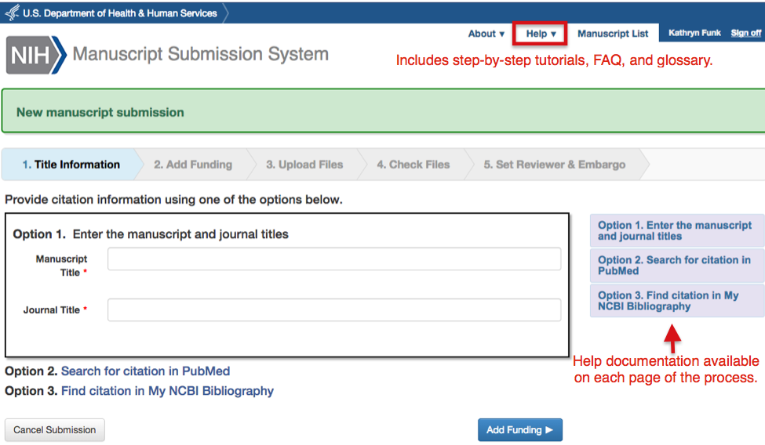
Deposit Files

Slide 71
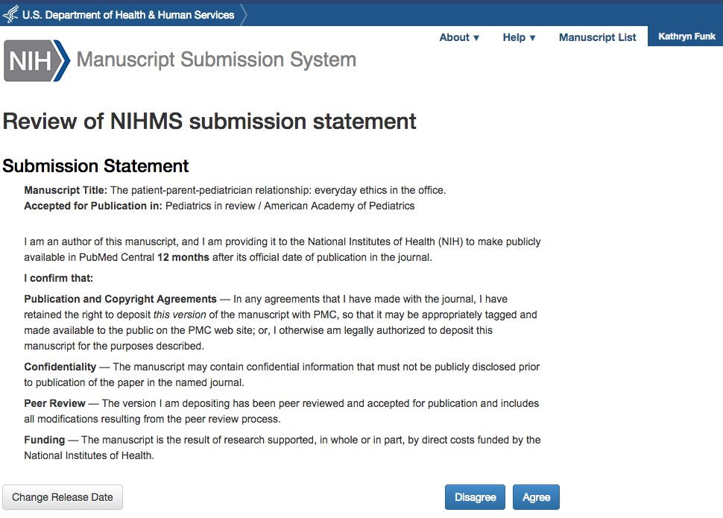
Author Initial Review
Completing the initial review:
Check to make sure that deposited files are complete.
Add relevant funding.
If this is a publisher submission, the embargo will have been set for you.
Review submission statement [pictured here] and “Agree”.

Slide 72
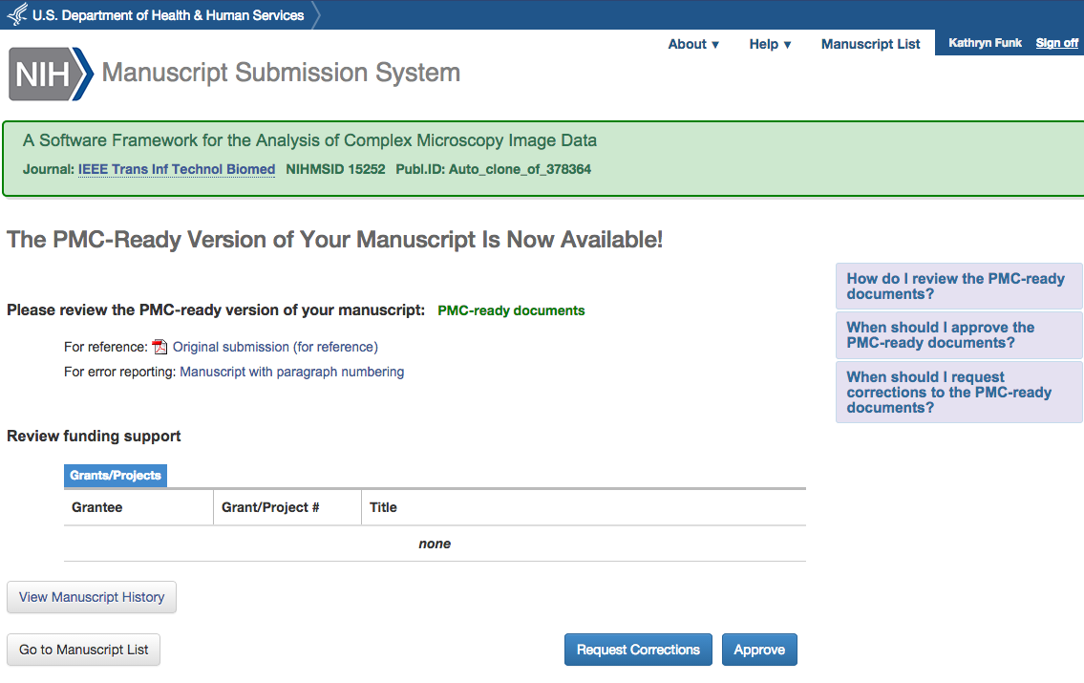
Author Final Review
Completing the final review:
Select “PMC-ready documents” to confirm everything looks okay.
Review funding support.
Either “Approve” or “Request Corrections”
Help information available on the page. See also Help in Navigation.

Slide 73
Public Access Compliance Monitor

Slide 74
What is the Compliance Monitor?
Database of articles, including current compliance status, that are associated with an institution’s (i.e., IPF’s) grants and fall under the NIH Public Access Policy.
GOAL: Give you data to help monitor compliance on an institutional level.

Slide 75
Compliance Monitor Data
PACM
MEDLINE Indexing
My Bibliography
NIHMS
All records are PMID based, ie, Paper has to be in PubMed
Updated twice a week (Wednesdays and Saturdays)
Grant-paper associations come from multiple databases [see graphic]

Slide 76
Benefits of using the Compliance Monitor
Quick summary of institution’s compliance rate
Download reports on non-compliant publications for the entire institution or a single grant
Locate associated IDs for a citation
Track progress of papers in NIHMS
View status changes made in My NCBI, e.g., if a citation is marked as not applicable
For more information, see https://publicaccess.nih.gov/sponsored-programs.htm

Slide 77
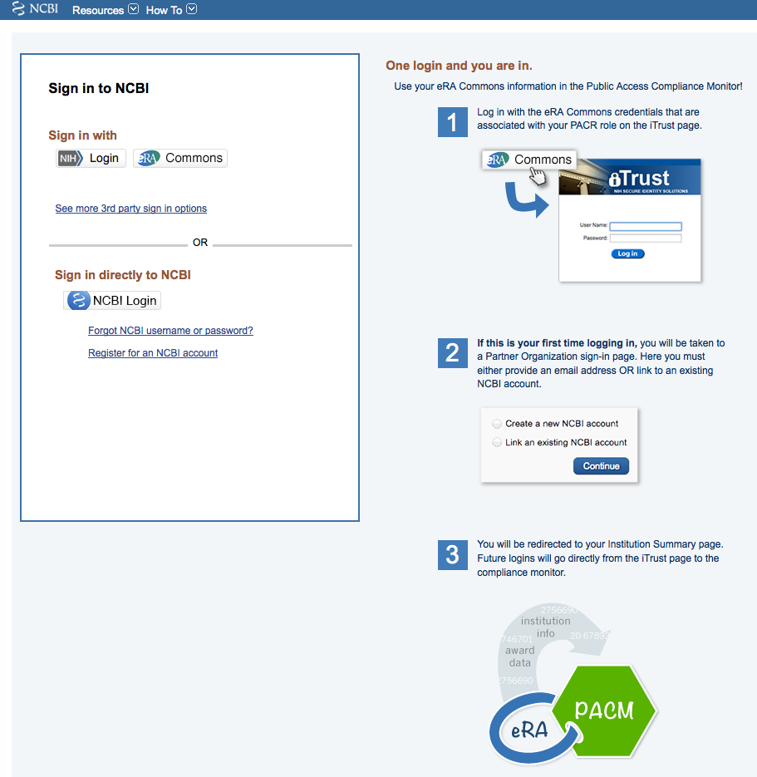
Compliance Monitor Access
PACR Role: Assigned by administrator authorized to assign roles in eRA Commons
Tip #1: Once you are assigned a PACR role, wait 24 hours to log in.
Tip #2: If your institution has multiple IPFs, you will need a PACR role for each.
Tip #3: eRA Commons manages login information, so that is who can troubleshoot login problems (see next slide)

Slide 78
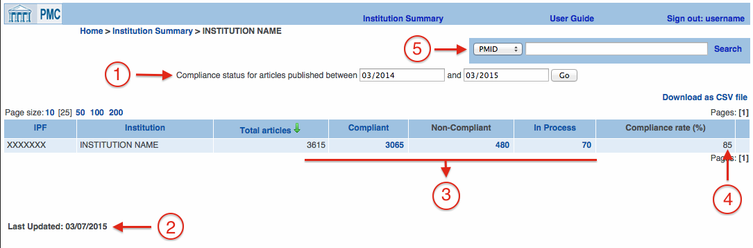
Compliance Monitor: Snapshot of Compliance
Set the date range.
See when data was last updated. (New!)
Overview of current compliance status.
Current compliance rate (for selected date range)
Search for a specific paper by PMID or use the dropdown menu and view article list for a given grant number. (New!)

Slide 79

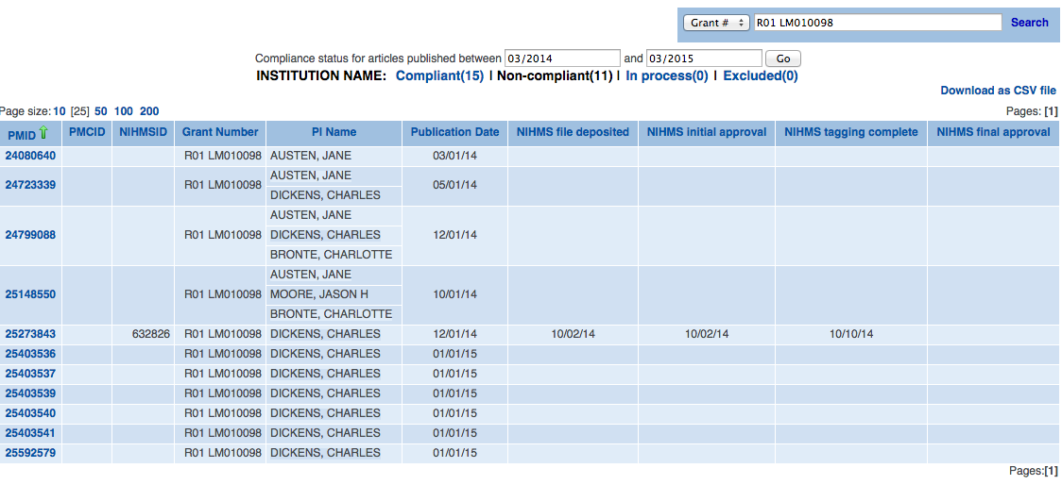
Compliance Monitor: Grant Filter and Article Lists
Grant Filter/Search
Use the same grant format as displayed in the “Grant Number” column.
Default results display is the Non-compliant article list.
Article Lists include
Associated IDs
Associated grant(s) and PI
Publication date (if available)
Key NIHMS dates
Article Lists can be downloaded (next slide)

Slide 80
Compliance Monitor: Downloadable CSV Reports
Identifiers
Grants
Article
Info
NIHMS Info
Article Info
NIHMS Info
Also check out “Understanding a Public Access Compliance Monitor (PACM) Report” by Bernard Becker Medical Library at Washington University:
https://becker.wustl.edu/sites/default/files/PACM_Legend.pdf

Slide 81
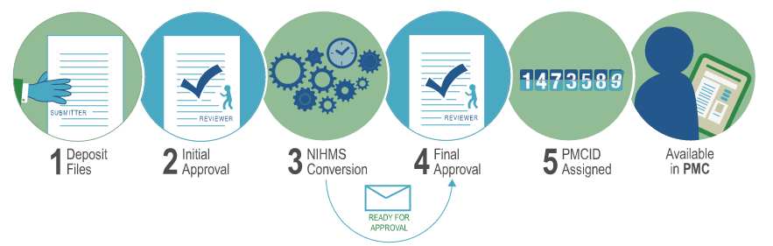
NIHMS Info in the Compliance Monitor
NIHMS Process Overview
Files Deposited
Initial Approval
Tagging Completed
Final Approval
NIHMS dates in PACM

Slide 82
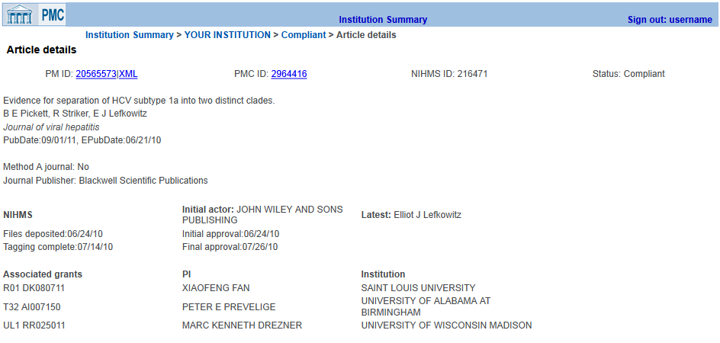
Compliance Monitor: Article Details

