Slide 1
RESEARCH INVOLVING HUMAN SUBJECTS:
REVISED HHS REGULATIONS & Related NIH POLICIES
Jamie O. hernandez– Office for human research protections
Pamela Kearney– NIH Office of extramural research
November 2019

Slide 2
Learning Objectives
Describe the role of OHRP and the HHS regulations for human research protections
Explain some of the changes to the Common Rule and know how to make basic determinations on whether a study needs IRB review
Recognize how NIH will implement the Common Rule changes
Identify updated NIH policies related to human subjects research.

Slide 3
OHRP’s Role in Human Research Protections
OHRP holds the regulatory authority on the HHS Protection of Human Subjects regulations, 45 CFR 46
  Subpart A is referred to the Common Rule
  Revisions to the Common Rule were published on 1/19/17, with a general implementation date of 1/19/18. After subsequent delays, general compliance date: 1/21/2019
OHRP has a distinct role from these HHS agencies:
  FDA – regulates clinical investigations involving drugs, devices, and biologics
  NIH – conducts and supports research that must comply with OHRP regulations

Slide 4
Overview of the Human Subjects Review Process for NIH Grant Applications
NIH Peer Review (contact NIH program officer for assistance)
IRB Process (contact IRB office or OHRP@hhs.gov for assistance)
Follow NIH policies and instructions to submit application
Peer review for appropriateness, adequacy of human subjects protections described
NIH ready to release grant award
Submit study to IRB according to institutional policies
IRB reviews non-exempt human subjects research according to 45 CFR 46
If approval criteria are met, IRB approves non-exempt human subject research
Institution must provide certification of IRB review and approval for non-exempt HSR to NIH before the award can be released
Start Here

Slide 5
Three Pillars of Human Subjects Protections Under the Common Rule
Institutional Assurance of Compliance (Federalwide assurance – FWA)
  Documents institution’s commitment to protecting the rights and welfare of research subjects
Institutional Review Boards (IRB) Review
  Oversees and reviews research by an independent committee with diverse knowledge and perspectives
  Reviews and approves non-exempt human subjects research according to criteria laid out in the regulations
Informed Consent
  Respects research subjects’ autonomy to participate or not
  Helps protect subjects’ interests

Slide 6

Protecting Research Subjects:
A Shared Responsibility
Research institutions
IRBs
Investigators
Sponsors
Regulators

Slide 7

Does my study require irb review?
Applying the basics of the Regulations

Slide 8

Quick Reminder About
When the Regulations Apply
Non-exempt human subjects research conducted or supported by HHS
Non-exempt human subject research covered by the Assurance of Compliance (“check the box”)
Notes:
8
Kevin L. Nellis, MS, MT(ASCP)
February 8, 2008
8

Slide 9

When Do the Regulations Apply?
To determine if your project is non-exempt human subjects research…
Ask these questions in this order:
  Does the activity involve research?
  Does the research involve human subjects?
  Is the research with human subjects exempt?

Slide 10

Determining When an Activity is Non-Exempt, Human Subjects Research (and therefore the Common Rule applies)
1
2
3
Is it research?
Does it involve human subjects?
Yes
Yes
Is it exempt?
No
No
or
Deemed not to be research
Yes
(may require limited IRB review for certain exemptions)
Study requires to IRB review
No
Green text indicates sections that have changed with the 2018 revisions to the Common Rule.

Slide 11
1: Does the Activity Involve Research?
Research refers to a systematic investigation, including research development, testing, and evaluation, designed to develop or contribute to generalizable knowledge
Revised Common Rule
Citation moved from §46.102(d) to §46.102(l) in the revised Common Rule
New: 4 sets of activities specifically deemed not to be research

Slide 12
Activities Deemed Not to be Research in the Revised Common Rule
Scholarly and journalistic activities that focus directly on the specific individuals about whom the information is collected
Government functions with separately mandated protections
Public health surveillance activities limited to those necessary to identify, monitor, assess, or investigate conditions of public health importance
Collection and analysis of materials for criminal justice purposes
Authorized operational activities for national security purposes

Slide 13
Determining Whether the Revised Common Rule Applies
1
2
Is it research?
Does it involve human subjects?
Yes
No
or
Deemed not to be research

Slide 14
2: Does it Involve Human Subjects?
Human subject: a living individual about whom an investigator conducting research
Obtains information or biospecimens through intervention or interaction with the individual, and uses, studies, or analyzes the information or biospecimens; or
Obtains, uses, studies, analyzes, or generates identifiable private information or identifiable biospecimens
§46.102(e)(1)
Revised Common Rule: no substantive changes in interpretation, only language clarifyications

Slide 15
Research with Biospecimens or Private Information that is Not Human Subjects Research
IF:
  Biospecimens or private information were NOT collected specifically for the research study in question (i.e.; there are no interactions or interventions with human subjects)
AND
  investigator(s) cannot readily ascertain identity of the individual(s) to whom data/specimens pertain
THEN: Research is NOT human subjects research.
Coded ≠ Unidetifiable

Slide 16
Determining Whether the Revised Common Rule Applies
1
2
3
Is it research?
Does it involve human subjects?
Yes
Yes
Is it exempt?
No
or
Deemed not to be research
No

Slide 17
Summary of Changes to Exemptions
Pre-2018 Rule (Current)
Revised Common Rule
Educational practices
Educational tests, surveys, interviews, observation of public behavior
Research on public officials
Research on existing data
Public benefit service
Taste and food evaluations
Restrictions added
Expanded *
Removed and replaced *
Expanded old and added new
Expanded with changes
No change
New Exemption # 7 *
New Exemption # 8 *
* New limited IRB review to make certain determinations as a condition of exemption
Notes:
General difference from the pre-2018 rule:
some of the current exemptions have been expanded, and
new exemptions have been added that allow investigators to retain identifiable information that might be sensitive, provided that specified privacy and confidentiality protections are satisfied.
The changes are also intended to exempt more low risk social and behavioral research
Limited IRB review to verify that conditions for certain exemptions (2, 3, 7, 8) are met

Slide 18
Revised Common Rule
Exemption 1: Restrictions Added
Research on normal educational practices in established or commonly accepted educational settings
New: normal educational practices that are not likely to adversely impact:
  Students’ opportunity to learn required educational content, or
  Assessment of educators who provide instruction
  §46.104(d)(1)

Slide 19
Revised Common Rule
Exemption 2: Expanded
Research that only includes interactions involving educational tests, surveys, interviews, and observations of public behavior when
Information recorded cannot be readily linked back to subjects, or
Any information disclosure would not place subjects at risk of harm, or
Identifiable information recorded, with limited IRB review for privacy and confidentiality protection under §46.111(a)(7)
  §46.104(d)(2)

Slide 20
Revised Common Rule
Exemption 3: New (Replacement)
Research involving benign behavioral interventions with adults who prospectively agree, when information collection is limited to verbal or written (including data entry) or audiovisual recording, and:
Information recorded cannot be readily linked back to subjects, or
Any information disclosure would not place subjects at risk of harm, or
Identifiable information recorded, with limited IRB review for privacy and confidentiality protection under §46.111(a)(7)
  §46.104(d)(3)

Slide 21
Revised Common Rule
Exemption 3, cont.
“Benign behavioral interventions”
  These are brief in duration, harmless, painless, not physically invasive, not likely to have a significant adverse lasting impact on the subjects, AND investigator has no reason to think the subjects will find the interventions offensive or embarrassing
Includes authorized deception research
  §46.104(d)(3)(ii)-(iii)

Slide 22
Revised Common Rule
Exemption 4: Expanded
Secondary research use of identifiable private information or identifiable biospecimens (materials no longer need to be “existing”), if:
  Identifiable private information or identifiable biospecimens are publically available, OR
  Information, which may include information about biospecimens, is recorded by the investigator in such a manner that the identity of the human subjects cannot be readily ascertained directly or through identifiers linked to the subjects, the investigator does not contact the subjects or re-identify subjects, OR
Cont.
Notes:
New provisions under exemption 4 – only apply to studies that only involve secondary research.
They do not apply to studies that involve research interventions or interactions with subjects.
This exemption now covers research involving identifiable private information and identifiable biospecimens that are not existing at the time the research is proposed for exemption
First 2 provisions of the new Exemption 4 are essentially an expansion of current exemption 4.
Includes other relatively minor changes that essentially clarify the how such information may be recorded by investigators

Slide 23
Exemption 4 (cont.)
(…) secondary research use of identifiable private information or identifiable biospecimens, if:
  Investigator’s use is regulated under HIPAA as “health care operations,” “research,” or “public health” OR
  Research is conducted by, or on behalf of, a Federal agency using data collected or generated by the government for non-research purposes, and the information is protected by federal privacy standards
  §46.104(d)(4)
Notes:
The HIPAA-related exemption is limited to studies where the recipient investigator’s use of the identifiable private information or identifiable biospecimens is protected under the HIPAA rules.
It does not apply if only the entity disclosing the information or biospecimens is subject to the HIPAA rules, and not the recipient investigator.
Under HIPAA, health info that is de-identified (according to HIPAA stringent criteria) is exempt from it.
Otherwise, restrictions are imposed on how individually identifiable health info collected by covered entities may be used and disclosed (including for research).
The fourth provision under Exemption 4 has limited applicability to Federal researchers and those researchers conducting studies on behalf of the Federal government, such as contractors.
(95, 101-102)

Slide 24
Revised Common Rule
Exemption 5: Expanded
Public benefit and service programs research and demonstration projects
Expanded to apply to such Federally-supported research (no longer limited to Federally-conducted research)
Added requirement that Federal agency publish a list of projects covered by this exemption prior to commencing the research
  §46.104(d)(5)
Notes:
Applies to activities designed to study, evaluate, improve or otherwise examine public benefit or service programs
Expanded to cover research on public benefit and service programs that are not just federally-conducted but also federally- supported.
(103-105)

Slide 25
Revised Common Rule
Exemption 6: No Change
Taste and food quality evaluation and consumer acceptance studies
  §46.104(d)(6)

Slide 26
Revised Common Rule:
NEW Exemptions 7 and 8
Two new exemptions applicable only to secondary research:
Exemption 7: Storage or maintenance of identifiable private information or identifiable biospecimens for secondary research
Exemption 8: Secondary research using identifiable private information or identifiable biospecimens
Both require:
  Broad consent
  Limited IRB review
  §46.104(d)(7) and (8)
Notes:
(108-112)
Limited IRB review:
E7 – BC obtained according to requirements, BC documented or waived, if storage/maintenance changed, privacy and confidentiality protected
E8 – BC obtained according to requirements, BC documented or waived, research is within scope of BC obtained, and not returning individual research results as part of study plan

Slide 27
NEW Allowing the Use of Broad Consent for Secondary Research
  Optional: An alternative to traditional informed consent or waiver of informed consent
    If:
      Identifiable information or identifiable biospecimens were collected with broad consent
    Then, exemptions 7 and 8 may apply respectively to:
    The storage and maintenance of this material (after a limited IRB review)
    Future secondary research use of this material (after a limited IRB review)
Broad consent must include a defined set of elements that cannot be omitted or altered
§46.116(d)-(f)
Notes:
In response to public comment, now functions as offering a new flexibility or alternative to:
Obtaining study-specific consent OR seeking a wavier of consent
And can be used to meet 2 new Exemptions (Exemptions 7 and 8).
Broad consent includes elements of consent from the “basic” and “additional” elements of consent, and some that are unique to broad consent.
Goal to be meaningful, informed consent even though specific research studies do not need to be described. Must provide a general description of the types of research that may be conducted—providing sufficient information to allow a reasonable person to expect that the broad consent would permit the types of research conducted.
When information about specific research is not to be provided, the broad consent must inform subjects that they might have chosen not to consent to some of those specific research studies.
(150-163)

Slide 28
NEW Limited IRB Reviews
Required for exemptions 2(iii), 3(i)(C), 7, and 8 in the revised Common Rule
    Exemptions 2(iii) and 3(i)(C) review:
      For privacy and confidentiality protection under §_.111(a)(7)
    Exemptions 7 and 8 review:
      For safeguards related to privacy and confidentiality protection, and broad consent
Expedited review can be used
One time only, no continuing review required
Notes:
For exemptions requiring limited IRB review, only if the required limited IRB review determinations are satisfied would the study be exempt

Slide 29
Determining Whether the Revised Common Rule Applies
1
2
3
Is it research?
Does it involve human subjects?
Yes
Yes
Is it exempt?
No
No
or
Deemed not to be research
Yes
(be aware of limited IRB review for certain exemptions)*
Study requires to IRB review
No
Green text indicates sections that have changed with the 2018 revisions to the Common Rule.

Slide 30
Revised Common Rule Text
Please refer to the text of the revised Common Rule available on OHRP’s website (hhs.gov/ohrp) for a complete and accurate description of the regulatory requirements

Slide 31
Questions About the Revised Common Rule?
?
?
?
?
?
?
?
OHRP has developed resources about the revised Common Rule at: www.hhs.gov/ohrp
Submit your questions to OHRP@hhs.gov
Stayed connected! Join our listserv at:
  https://www.hhs.gov/ohrp/news/sign-up-for-announcements/index.html

Slide 32
Nih implementation of the revised common rule
Pamela Kearney, M.D.
Director, Division of Human Subjects Research
National institutes of health
November 2019
oep-HS@mail.nih.gov

Slide 33
Learning Objectives
Describe the role of OHRP and the HHS regulations on human research protections
Explain some of the changes to the Common Rule and know how to make basic determinations on whether a study needs IRB review
Recognize how NIH is implementing the Common Rule changes
Identify updated NIH policies related to human subjects research.

Slide 34
NIH Implementation of Revised Common Rule- Basics
No NIH requirement for IRBs to review grant applications and contract proposals
Posting clinical trial consent forms
Changes to exemptions
  Forms, Instructions & Reviewer Guidance Updated
No NIH requirement for certain continuing reviews
See Guide Notice: NOT-OD-19-050
Published January 2, 2019

Slide 35
Removal of Requirement for IRB Review of Application/Proposal
HOWEVER! IRB certification confirming that all protocols described in the application have been reviewed and approved by the IRB is still required
In NO cases will human subjects research be initiated prior to receipt of the certification that the research has been reviewed and approved by the IRB
See Guide Notice:
NOT-OD-19-055
Published January 11, 2019

Slide 36
Posting clinical trial consent forms
Recipients conducting a clinical trial must submit an IRB-approved version of a consent form used to enroll participants on a public federal website:
  ClinicalTrials.gov (English Language Consent forms only)
  Regulations.gov Docket ID: HHS-OPHS-2018-0021 (maintain a copy of the Regulations.gov receipt and tracking number)
NIH Guide Notice:
NOT-OD-19-110
Published May 17, 2019

Slide 37
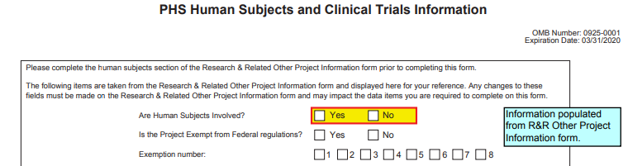
Changes to exemptions
Applications submitted for due dates on or after January 25, 2019 are able to select exemptions 7&8
Decision tool available at https://grants.nih.gov/policy/humansubjects/hs-decision.htm

Slide 38
Continuing review
No NIH requirement for annual review if not required by Common Rule unless otherwise specified in Funding Opportunity Announcements
  Examples: Studies eligible for expedited review, studies that have completed interventions
NOTE: Institutions/IRBs may have additional requirements

Slide 39
Single IRB
NIH sIRB policy and
Common Rule sIRB mandate
ARE NOT THE SAME!
All studies are expected to abide by the provisions of 45CFR46.114 regarding cooperative research, if applicable.

Slide 40
NIH sIRB Policy
APPLIES TO
Domestic sites of multi-site studies
Same/shared protocol
All non-exempt human subjects; not just clinical trials
All new and re-competing applications/proposals
Grants and R&D Contracts
Effective Dates:
Competing grant applications
Application due dates on/after January 25, 2018
Contract proposals
Solicitations issued on/after January 25, 2018
DOES NOT APPLY TO
Exclusions:
  Foreign sites
  Career development (K), institutional training (T), and fellowship awards (F)
Exceptions
  When Federal, State, Tribal, local requirements require local review
      Tribal regulations/policies given specific consideration in order to ensure that the importance of their role is recognized
  Time-limited Exception – ancillary studies to ongoing parent studies without single IRB
    Other Exceptions may be considered:
      When there is a compelling justification
Do not require NIH approval
Require NIH approval
Guide Notice: http://grants.nih.gov/grants/guide/notice-files/NOT-OD-16-094.html

Slide 41
Single irb tips and resources
Reliance agreement samples:
  OHRP’s IRB Authorization Agreement
    http://www.hhs.gov/ohrp/register-irbs-and-obtain-fwas/forms/irb-authorization-agreement/index.html.
  NIH’s National Center for Advancing Translational Sciences (NCATS) Streamlined, Multi-site, Accelerated Resource for Trials (SMART) IRB Reliance Platform Resources
      https://ncats.nih.gov/expertise/clinical/smartirb
NOT-OD-16-109 Scenarios to Illustrate the Use of Direct and Indirect Costs for Single IRB Review under the NIH Policy on the Use of a Single IRB for Multi-site Research
Frequently Asked Questions
  https://grants.nih.gov/grants/policy/faq_single_IRB_policy_research.htm

Slide 42
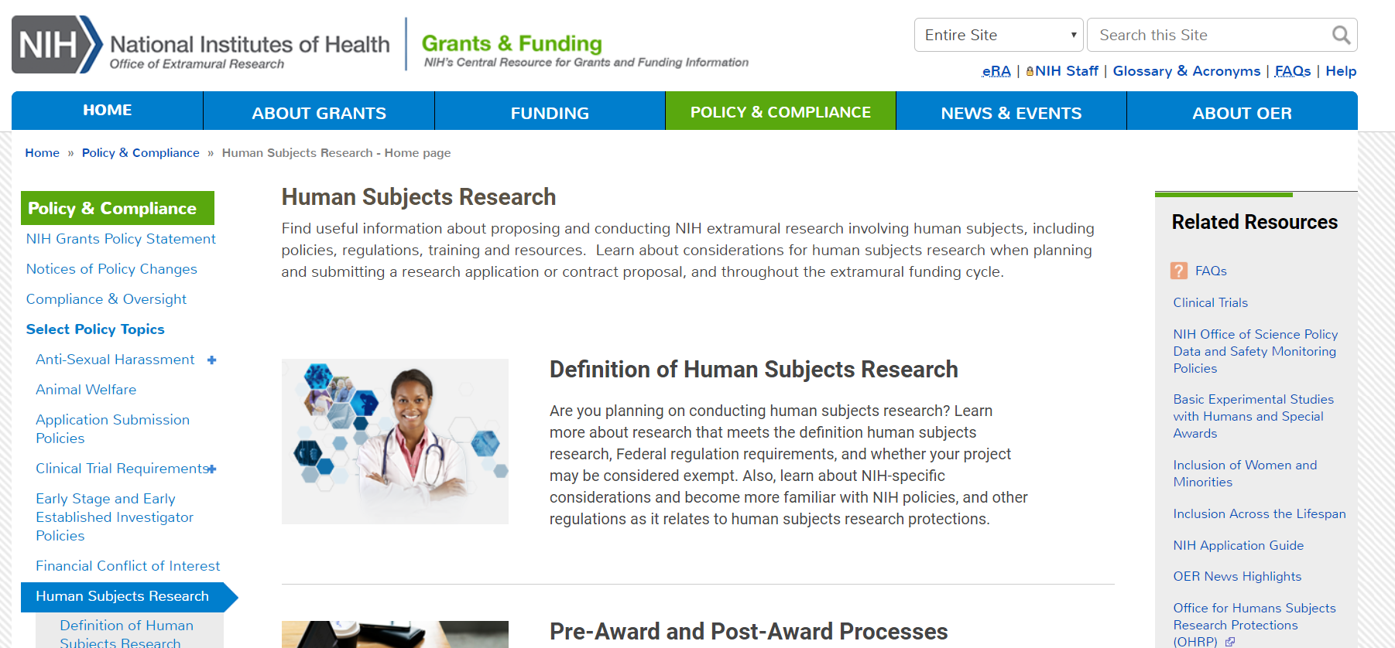
NIH Human Subjects research Website
https://grants.nih.gov/policy/humansubjects.htm
42
Notes:
42

Slide 43

Questions?

