Slide 1
Human Subjects, Clinical Trials & Inclusion
Overview of Key Policies and Tips for Success
Pamela Kearney, MD (NIH/OER); Dawn Corbett, MPH (NIH/OER)

Slide 2
Goals
Understand the requirements and policies for applications involving human participants;
Gain clarity about which requirements apply to different types of studies with human participants;
Know how to choose the correct FOA for your research and how to structure information in your application;
Recognize post award reporting requirements for research involving human participants

Slide 3
Topics for Today’s Discussion
Regulation and Policy Overview
Picking a Funding Opportunity Announcement (FOA)
Developing an Application: Helpful Hints
Just-In-Time and Post-Award Requirements

Slide 4
Regulation and Policy Overview

Slide 5
Human Subjects Research Policies
IRB exemptions
Single IRB
CoCs
FOA Policies
BESH
Human Subjects Research
Inclusion of Women and Minorities
Clinical Trials Policies
GCP Training
Use of Human Materials
Data and Safety Monitoring
Human Subjects Training
Inclusion across the lifespan

Slide 6
When do NIH Human Subjects Polices Apply?
Apply to Human Subjects research as defined in 45 CFR part 46: Protection of Human Research Subjects Subpart A (aka the Common Rule)
  Inclusion policies apply only to clinical research
  Some policies apply only to clinical trials
NIH policies complementary or in addition to the Common Rule

Slide 7
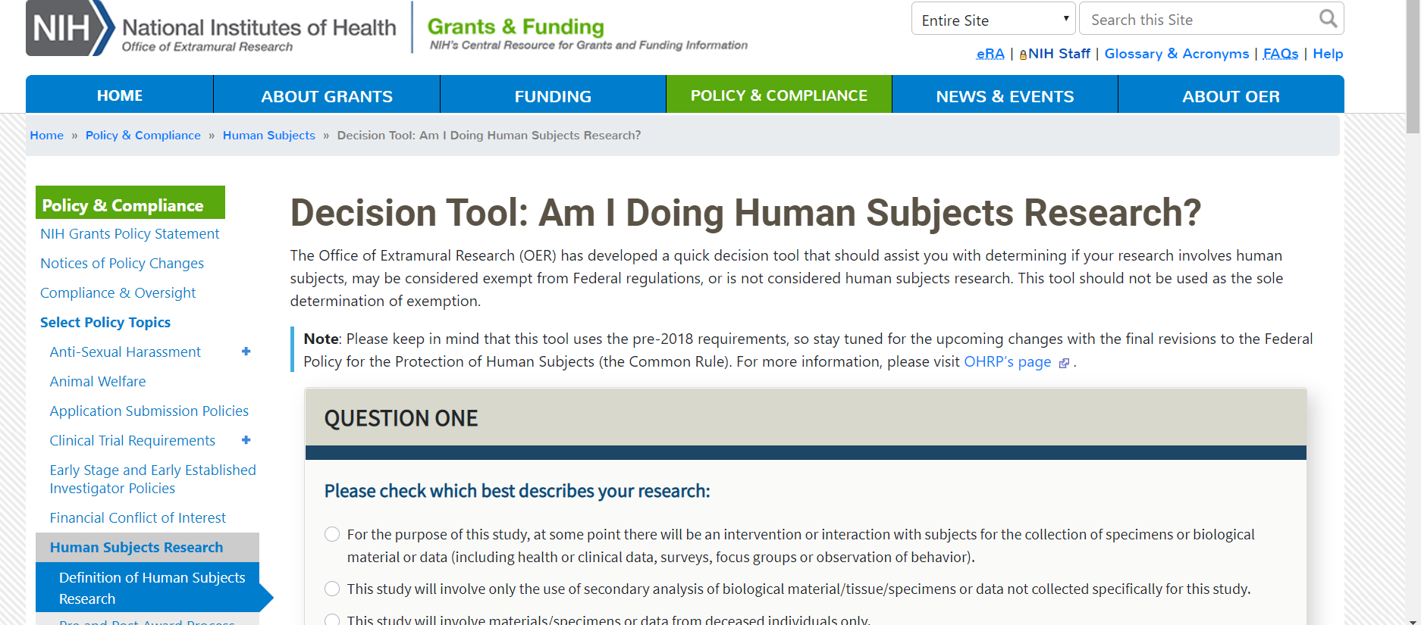
Decision Tool: Am I Doing Human Subjects Research
https://grants.nih.gov/policy/humansubjects/hs-decision.htm

Slide 8

NIH’s Role in Human Research Protections
Evaluate applications/proposals involving human subjects for
  Risks
  Adequacy of protections
  Benefits
  Importance of knowledge to be gained (45 CFR § 690.120)
NIH delegates to peer review

Slide 9
NIH Single IRB (sIRB) Policy
Multi-site domestic studies which involve non-exempt human subjects research must use a single Institutional Review Board (sIRB)
Applies to applications submitted for due dates January 25, 2018 or later
Exclusions:
  Foreign sites
  Career development (K), institutional training (T), and fellowship awards (F)
Some exceptions apply :
  When Federal, State, Tribal, local requirements require local review
  Time-limited exception for ancillary studies
  Other cases with a compelling rationale (rare)
Guide Notice:
NOT-OD-16-094
Published
June 21, 2016

Slide 10
IMPORTANT!!!!
The NIH sIRB Policy and the Federal mandate to use a sIRB under the new Common Rule 45 CFR 46.114
ARE NOT THE SAME!!!

Slide 11

Certificates of Confidentiality (CoC)
What is a Certificate of Confidentiality?
  Prohibits disclosure of names or information, documents, or biospecimens containing identifiable sensitive information. As a result of 21st Century Cures Act:
    To persons not connected to the research
    In any Federal, State, or local civil, criminal, administrative, legislative, or other proceeding, (unless with participants’ consent)
    For any other purpose, with some exceptions
See (NOT-OD-17-109) published September 7, 2017
CoC
Notes:
Alternate text: This graphic illustrates a shield.

Slide 12
Certificates of Confidentiality (CoC)
NIH funded research that was ongoing or commenced after October 1, 2017 is deemed to be issued a CoC
NIH continues to consider requests for certificates for specific projects
Guide Notice:
NOT-OD-17-109
Published September 7, 2017

Slide 13
Human Fetal Tissue
For competing grant applications submitted for due dates on or after September 25, 2019 and R&D contract solicitations published on or after September 25, 2019, applicants must provide:
  a justification of the use of HFT,
  details regarding procurement and costs,
  information about how the applicant/contract offeror will use HFT
  These additional requirements must be met within existing applicable page limits.
NIH will not accept modular budgets for applications for research involving HFT.
Applications that do not address all of the required information, including the detailed budget, will be administratively withdrawn and not reviewed.
Guide Notice
NOT-OD-19-128 NOT-OD-19-137
Published July 26, 2019

Slide 14

Inclusion of Women and Minorities in NIH Research
Public Law (42 U.S. Code § 289a–2) requires:
  Women and minorities be included in all NIH-funded clinical research studies unless there is a compelling rationale for exclusion
  Analyses by sex/gender, race and ethnicity for NIH-defined Phase III clinical trials
    Applicable* NIH-defined Phase III trials awarded December 13, 2017 or later must report results of “valid” analyses to Clinicaltrials.gov. See NOT-OD-18-104
*Applicable clinical trials are drug and device trials subject to Clinicaltrials.gov registration and results reporting requirements under Title VIII of the Food and Drug Administration Amendments Act (FDAAA) of 2007

Slide 15

Inclusion Across the Lifespan
Revision to Inclusion of Children Policy; effective for applications submitted for due dates on or after January 25, 2019 (and for contract solicitations and intramural studies issued after that date).
  See NOT-OD-18-116
Requires individuals of all ages be included in NIH human subjects research unless there are scientific or ethical reasons not to do so
Requires submission of individual-level data on participant age at enrollment in progress reports

Slide 16
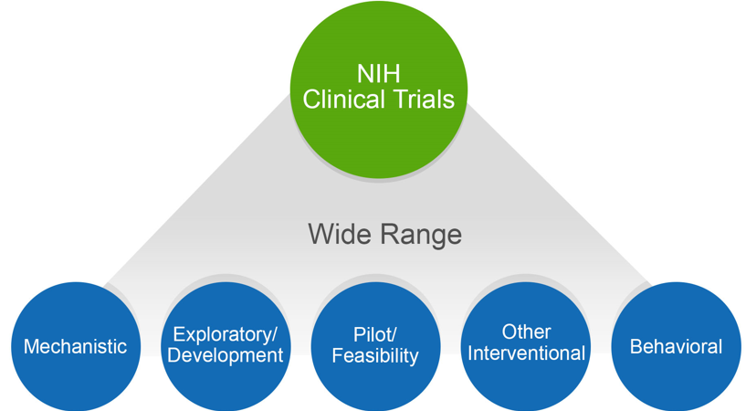
How Does NIH Define a Clinical Trial?
A research study in which one or more human subjects are prospectively assigned to one or more interventions (which may include placebo or other control) to evaluate the effects of those interventions on health-related biomedical or behavioral outcomes.
Helpful resources: https://grants.nih.gov/policy/clinical-trials/definition.htm

Slide 17
Clinical Trial Questionnaire
Does the study involve human participants?
Are the participants prospectively assigned to an intervention?
Is the study designed to evaluate the effect of the intervention of the participants?
Is the effect that will be evaluated a health-related biomedical or behavioral outcome?
Answers determine:
  Appropriate FOA type
  Application form requirements
  Review criteria for evaluation
  Requirement for registration and results reporting
  Requirement for GCP training
**If YES to all questions, study is a clinical trial

Slide 18
Registration & Results Reporting
NIH Policy Requires:
  Submit a plan in the application that outlines compliance with the expectations of the policy
  Register the clinical trial no later than 21 days after enrolling the first participant
  Submit summary results no later than one year after primary completion date
Tip: Attend the ClinicalTrials.gov session for more information

Slide 19
Basic Experimental Studies with Humans (BESH)
BESH studies are a type of Clinical Trial
NIH has extended delayed enforcement for registration and results reporting through September 24, 2021.
Registration and results reporting is still expected, but with flexibility to use alternative publicly available platforms (other than clinicaltrials.gov).
Guide Notice:
NOT-OD-19-126 Published July 24, 2019

Slide 20
Funding Opportunity Announcement (FOA) Policy
  Applications involving clinical trials must be submitted to clinical-trial specific FOAs
  Applications submitted to incorrect FOA will be administratively withdrawn
  Purpose is to:
    Improve NIH’s ability to identify proposed clinical trials
    Ensure key pieces of trial-specific information are submitted with each application
    Uniformly apply trial-specific review criteria
https://grants.nih.gov/policy/clinical-trials/specific-funding-opportunities.htm

Slide 21

Good Clinical Practice Training (GCP)
All NIH-funded clinical investigators and clinical trial staff involved in the design, conduct, oversight, or management of clinical trials should be trained in GCP
GCP training can be achieved through :
  class or course
  academic training program
  certification from a recognized clinical research professional organization
Training should be refreshed every 3 years
Learn more at https://grants.nih.gov/policy/clinical-trials/good-clinical-training.htm

Slide 22
Data and Safety Monitoring
Clinical trials must submit a Data and Safety monitoring plan
  Address overall data and safety monitoring framework
  Describe procedures for adverse event reporting
  Identify the monitor (e.g. PI, independent safety monitor, DSMB, etc.)
Data and Safety Monitoring Board (DSMB) generally required for NIH-defined phase III trials
Review IC-Specific Guidelines at https://humansubjects.nih.gov/data_safety
22

Slide 23
Picking a Funding Opportunity Announcement (FOA)

Slide 24
Types of FOAs
Title Designation | Description
Clinical Trial Not Allowed | Only accepts applications that do not propose clinical trial(s)
Clinical Trial Optional | Accepts applications that either propose or do not propose clinical trial(s)
Clinical Trial Required | Only accepts applications that propose clinical trial(s)
Basic Experimental Studies with Humans (BESH) Required | Only accepts applications that propose clinical trial(s) that also meet the definition of basic research
See Table of FOA Types for additional details

Slide 25
Clinical Trials in F, T & K Applications
Fellowship (F), Training (T), and Research Education (R25/36) FOAs:
Clinical Trial Not Allowed | Trainees and fellows encouraged to gain training/experience in clinical research led by sponsor or mentor, but not permitted to independently lead a clinical trial
Career Development (K) FOAs:
Independent Clinical Trial Not Allowed | K awardee may gain training or experience in clinical research led by a sponsor or mentor, but not permitted to independently lead a clinical trial
Independent Clinical Trial Required | K awardee will independently lead a trial

Slide 26
Developing an Application: Helpful Hints

Slide 27
Developing Your Application
Research Strategy
  Overall strategy, methodology, and analyses of your proposed research
Human Subjects/Clinical Trial Form
  Detailed study information (e.g., eligibility, inclusion, protection and monitoring plans)
In the Research Strategy:
  Refer to information from the Human Subjects/Clinical Trial Form as needed
  Do not duplicate information presented in the Human Subjects/Clinical Trial Form

Slide 28
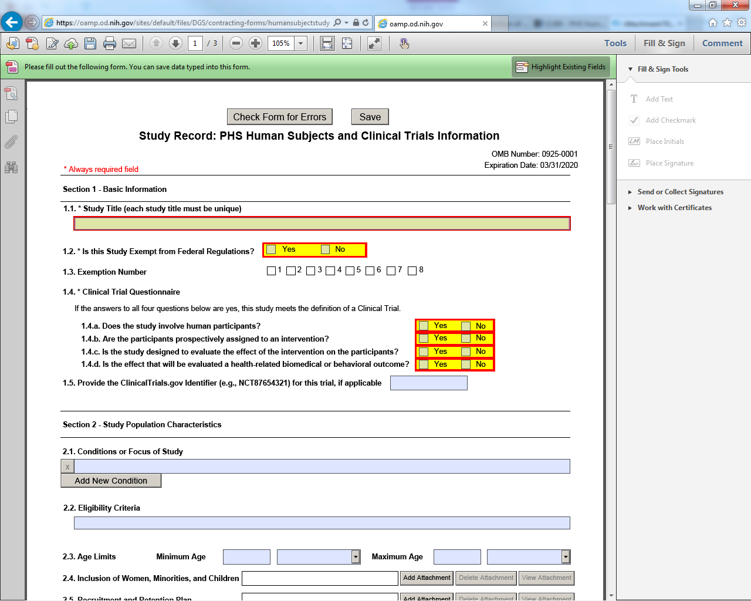
Human Subjects and Clinical Trials Information Form
Main Landing Page
  Some information prepopulated from R&R Other Project Information Form
Study Record(s)
  Add ‘Study Record’ or ‘Delayed Onset Study Record’ for each study in application
See the Application Guide for detailed instructions
SLIDE | 28

Slide 29
Delayed Onset vs. Delayed Start
Delayed Onset
  Human subjects research anticipated but specific plans cannot be described at time of application
  Use “Delayed Onset Study Record”
Delayed Start
  Research plans can be described at time of application, but research will not immediately begin (will occur later in the funding period)
  Use “Study Record”

Slide 30
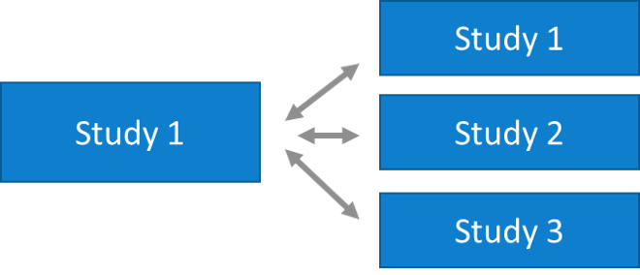
How Many Studies Does My Application Have?
In some cases how to group or split studies is a judgement call
Consider:
  What will be most clear for reviewers
  Not necessarily based on how aims are separated
  May be best to group studies if many of the study details are the same between studies
Study Records live with award for duration of funding and used for post-award reporting
Use a unique (non-numeric) title for each study

Slide 31
Using the Human Subjects and Clinical Trial Form
Form Section | If answered “No” to any questions in Clinical Trial Questionnaire | If answered “Yes” to all questions in Clinical Trial Questionnaire
Section 1 Basic Information | Required | Required
Section 2 Study Population Characteristics | Required | Required
Section 3 Protection and Monitoring Plans | Some fields required; some fields optional | Required
Section 4 Protocol Synopsis | Not permitted | Required
Section 5 Other Clinical Trial-related Attachments | Not permitted | Required only if specified in FOA

Slide 32
Trainees & Fellows Proposing “Clinical Trial Research Experience”:
Answer ‘Yes’ to all 4 questions in Clinical Trial Questionnaire
Complete form Sections 1-3
  Not permitted to complete Section 4 or 5
Statement from Mentor or Sponsor:
  Role of fellow/trainee in proposed clinical trial
  Source of funding for the trial
  Mentor’s relevant experience
  Assurance that the mentor/sponsor will be responsible for the clinical trial

Slide 33
Just-In-Time and Post-Award Requirements

Slide 34
Just-in-Time Requirements
After peer review, during just-in-time period:
  Provide Institution’s OHRP Federal-wide Assurance Number (FWA) if not provided at the time of application
  Certify:
    IRB approval (or exemption)
    Human subjects education for key personnel
34

Slide 35

Just-in-Time Requirements
  Work with Institute/Center staff to resolve unacceptable inclusion concerns
  Provide inclusion enrollment report(s) if missing or needs updated as a result of peer review and/or programmatic adjustments
35

Slide 36
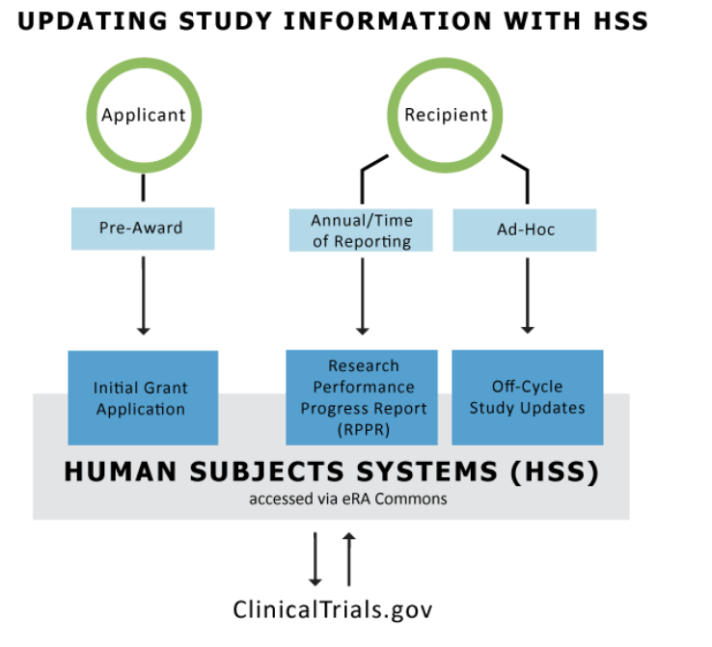
After the Award…Now What?
Provide actual inclusion enrollment data in progress reports
Provide required information for delayed onset studies
Clinical trials complete Section 6 – Clinical Trial Milestone Plan

Slide 37

Participant-Level Data in Progress Reports

Slide 38
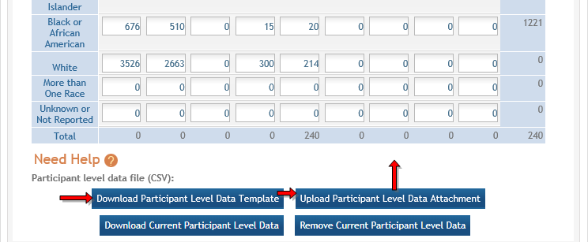
Uploading Participant-Level Data in HSS

Slide 39
After the Award…Now What?
For NIH-defined Phase III Clinical Trials – report status/results of analyses by sex/gender, race, and ethnicity
  For applicable NIH-defined Phase III Clinical Trials, report results by sex/gender and/or race/ethnicity in Clinicaltrials.gov within 1 year of primary completion date
Keep in mind you are expected to follow NIH single IRB policy if site is added

Slide 40
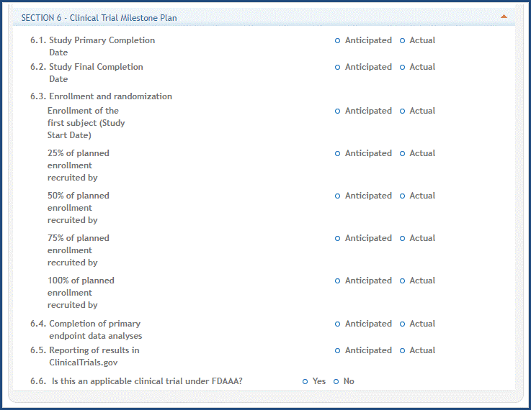
Section 6 – Clinical Trial Milestone Plan
Required for clinical trials that submitted last competing application for due date on or after January 25, 2018
Anticipated dates must be in the future, actual dates must be in the past
Data can be transferred to/from Clinicaltrials.gov

Slide 41
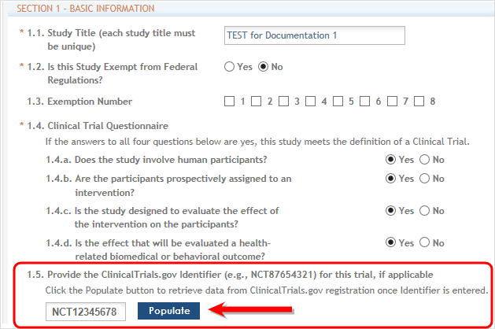

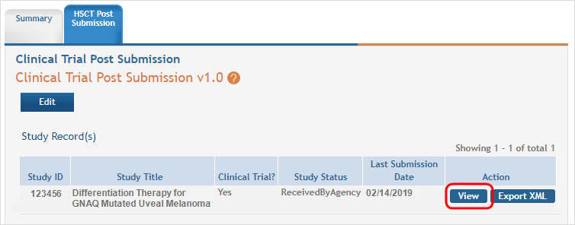
Transferring Data Between Systems

Slide 42
Resources

Slide 43

Useful Resources: Human Subjects Protections and Inclusion
NIH OER Human Subjects Website https://grants.nih.gov/policy/humansubjects.htm
Certificates of Confidentiality https://grants.nih.gov/policy/humansubjects/coc.htm
Single IRB Policy https://grants.nih.gov/policy/humansubjects/single-irb-policy-multi-site-research.htm
Inclusion of Women and Minorities https://grants.nih.gov/grants/funding/women_min/women_min.htm
Inclusion Across the Lifespan https://grants.nih.gov/grants/funding/lifespan/lifespan.htm

Slide 44
Useful Resources: Clinical Trials
Clinical Trials Requirements website: https://grants.nih.gov/policy/clinical-trials.htm
Clinical Trial FAQs: https://grants.nih.gov/policy/clinical-trials/faq-list.htm
Video overview of Human Subjects and Clinical Trials form: https://www.youtube.com/watch?v=nz9NWFhYOG8&list=PLOEUwSnjvqBJeHcb4yai7_fDnFZFPEmQK&index=1
Clinicaltrials.gov Registration and Reporting Help
  Registration: https://clinicaltrials.gov/ct2/manage-recs/how-register
  Results Reporting: https://clinicaltrials.gov/ct2/manage-recs/how-report

Slide 45

Questions

Slide 46
CONTACT US
Dawn Corbett dcorbett@mail.nih.gov
Pamela Kearney pamla.kearney@nih.gov

