Slide 1
GRANT WRITING FOR SUCCESS
Rebekah S. Rasooly, Ph.D.
NINR/NIH

Slide 2
Overview
Start planning early
Apply for the right opportunities
Contact appropriate program staff early
Talk with potential mentors, collaborators, & peers – seek advice from colleagues
Present your ideas clearly and pay attention to review criteria
What to do after review

Slide 3
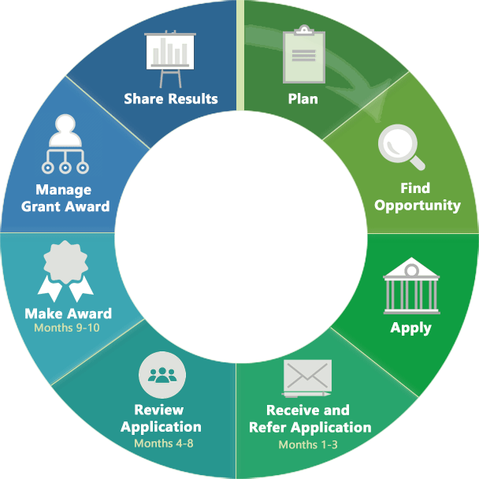
The grant life-cycle
Start planning your application early
Notes:
3
3

Slide 4
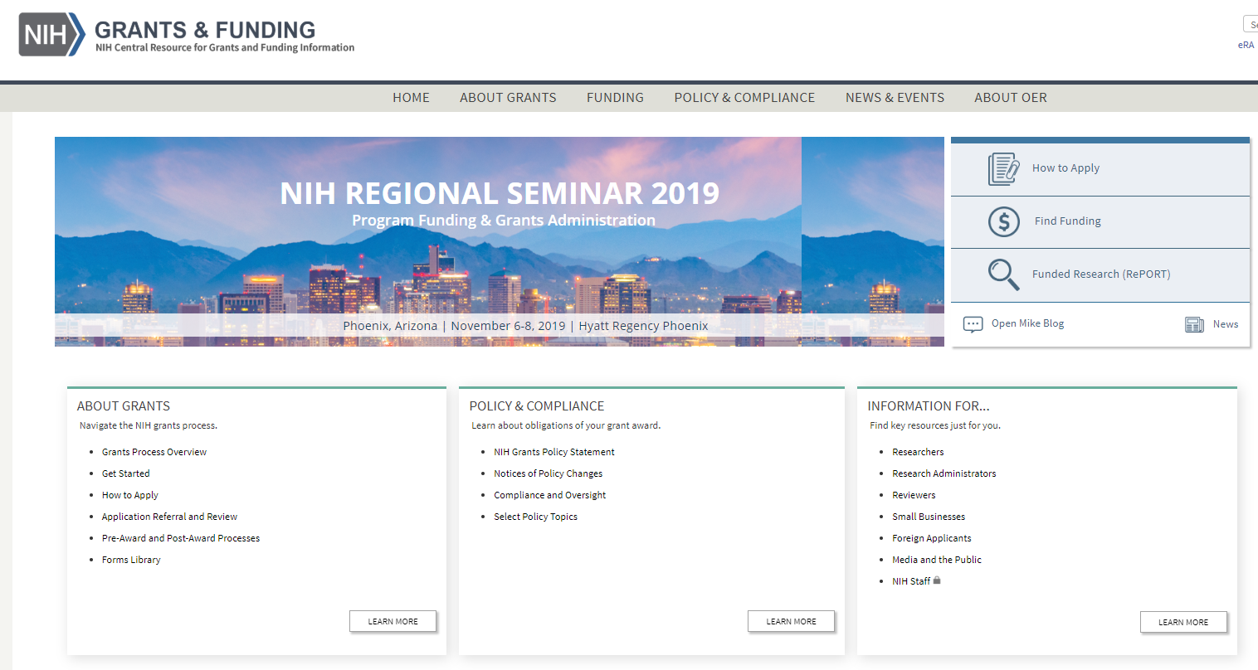
Use NIH resources for help
http://grants.nih.gov

Slide 5
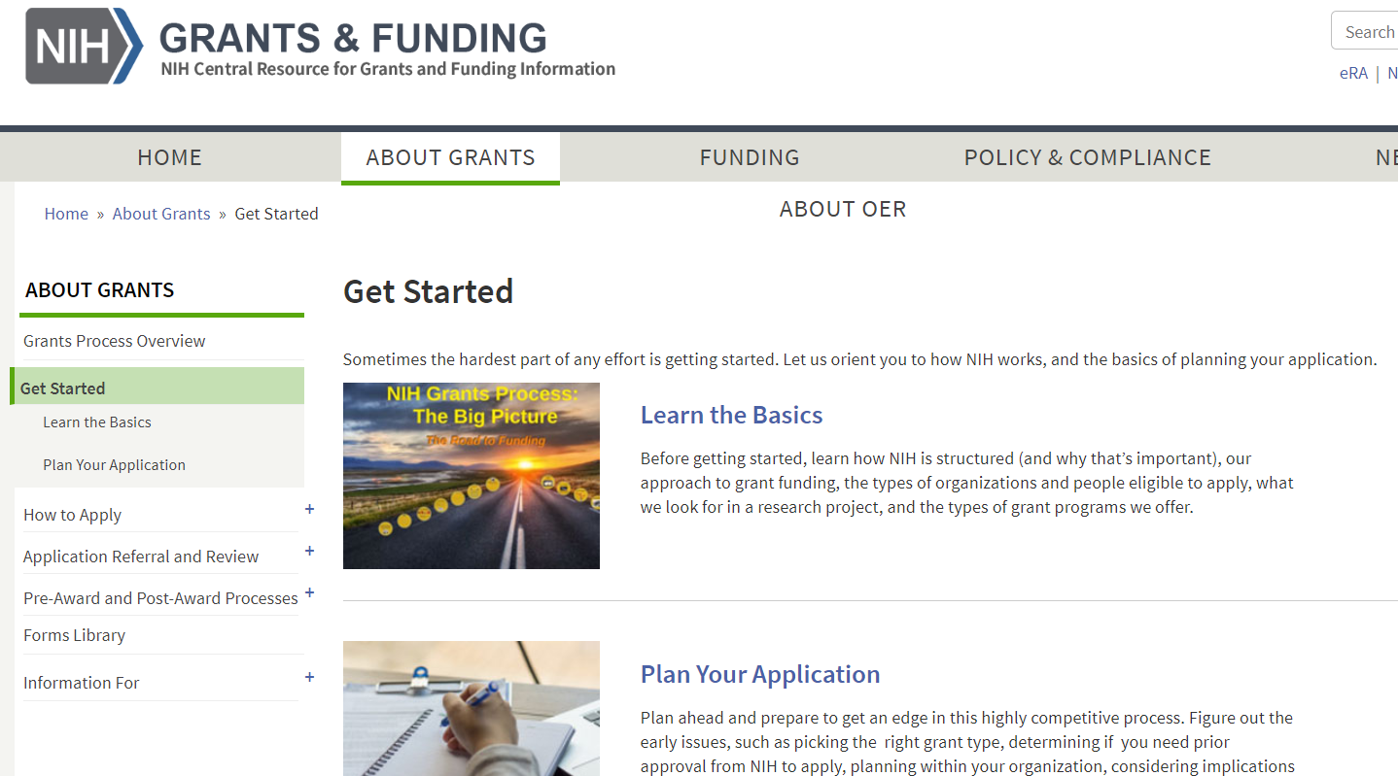
Use NIH resources for help
http://grants.nih.gov

Slide 6
Pre-submission planning timeline
Planning
Writing
Submitting
Months Prior
8 7 6 5 4 3 2 1 mo.
Assess
yourself, field, & resources
Receipt
Date
Outline application structure; write your application
Set up own review committee; determine human & animal subject requirements
Meet institutional deadlines
Brainstorm; research idea; call NIH staff
Get feedback; edit & proofread

Slide 7
Overview
Start planning early
Apply for the right opportunities
Contact appropriate program staff early
Talk with potential mentors, collaborators, & peers – seek advice from colleagues
Present your ideas clearly and pay attention to review criteria
What to do after review

Slide 8
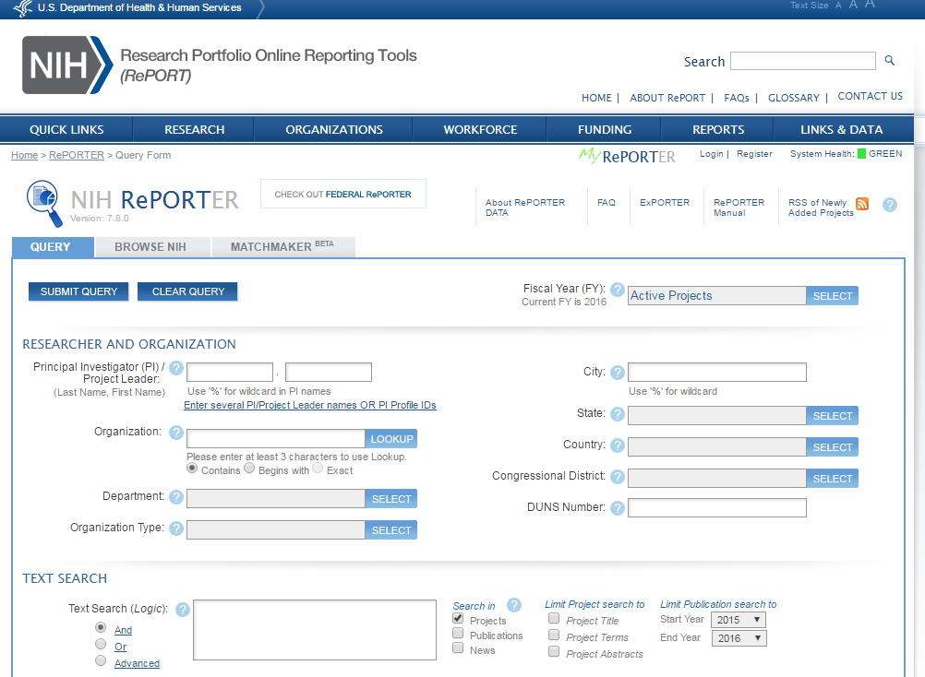
Let NIH Reporter help you find similar work, appropriate IC and study section
http://projecteporter.nih.gov

Slide 9
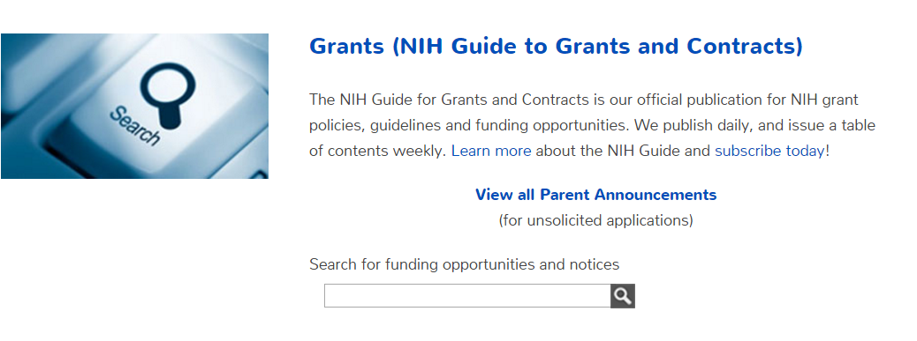
Use the NIH Guide to find funding opportunities
Learn our jargon:
Request for Applications (RFA) – set aside funds, one submission date, special review panel
Program Announcements (PA, PAR, PAS)
“Parent” announcements—investigator-initiated; mechanism specific R01, R03, R15, R21
Notes:
9

Slide 10
Or use our tool to find opportunities for your career stage
https://grants.nih.gov/grants/funding/funding_program.htm
Notes:
10

Slide 11
Are you a new investigator (NI), an early stage investigator (ESI)?
Pertains to R01 applications
NI - never has been awarded a R01
ESI – never been awarded a R01 and is within 10 years of terminal degree
Does it make a difference? YES!
In a study section, NI and ESI R01 applications are clustered and reviewed together
At the institute level, new investigator applications have a preferential ‘payline’ (either all NI’s or just ESI’s, depending on the institute)

Slide 12
R21 and R03 applications
Not every IC accepts these funding mechanisms!!!!
R21 – 2 years for a total of $275,000
‘High-risk, high-reward’
Paradigm shifting
Create a new tool/model for the community
Not a ‘mini’ R01
R03 – 2 years for $50,000/year
These can be used obtain preliminary data and then write a R01

Slide 13
Finding the right opportunity - summary
Use NIH Websites and tools, like NIH Reporter, to understand the mission of NIH Institutes and Centers and find those that might be relevant to your research
Use the NIH Guide or the career stage-specific Websites to identify appropriate Funding Opportunity Announcements (FOA)

Slide 14
Overview
Start planning early
Apply for the right opportunities
Contact appropriate program staff early
Talk with potential mentors, collaborators, & peers – seek advice from colleagues
Present your ideas clearly and pay attention to review criteria
What to do after review

Slide 15
Know your PO, SRO, and GS
Program Officer (PO)
Works in a particular institute
Manages a scientific research portfolio of grants, contracts, and cooperative agreements
Scientific Review Officer (SRO)
Typically works in CSR but also within institutes
Helps ensure that the scientific review group (study section) identifies the most meritorious science for potential funding
Grants Management Specialist/Officer (GS/GMO)
Works in a particular institute; Evaluates applications for administrative content and compliance with policy

Slide 16
What does a Program Official do?
Scientist and administrator
Manages grants, contracts, & cooperative agreements
Identifies needs in scientific areas
Identifies areas of special interest & communicates program priorities
Reports on scientific progress and program accomplishments
Government’s technical representative for funded projects
a.k.a. Program Director/Chief, Health Scientist Administrator

Slide 17
What should I talk about with a Program Official?
Provide a thumbnail sketch of what you have in mind
Ask whether the idea fits the Institute’s interests
Get information from on FOAs
Find out what kinds of grant mechanisms can be used and whether there any priorities for those mechanisms
Ask if the PO is willing to look over a very brief outline of the proposed project or draft specific aims to get general advice
Email to set up a time to discuss, but remember that this is advice, not a review, and you have no obligation to follow the advice given
POs are not allowed to participate in developing or writing grant proposals

Slide 18
Identify appropriate NIH program directors
Start with NIH RePORTER and see what research projects the NIH or any Institute has funded that are similar to yours
Then find the Program Official in the “Details” tab
Notes:
18

Slide 19
Contacting NIH program staff - summary
Use Reporter or other NIH Websites to identify program directors relevant to your research
Contact the program director early in the planning process to get advice about your application and funding opportunities

Slide 20
Overview
Start planning early
Apply for the right opportunities
Contact appropriate program staff early
Talk with potential mentors, collaborators, & peers – seek advice from colleagues
Present your ideas clearly and pay attention to review criteria
What to do after review

Slide 21
Collaborate with others
Collaborate with others
In your department
In other departments
Network at meetings
Stay connected to past colleagues and mentors
Cultivate a strong network that understands the funding process

Slide 22
Find collaborators for your application
Determine the expertise needed to strengthen your research study team and fill gaps in your own expertise
Begin to assemble the research study team early and obtain letters of commitment from them
Consider a multiple project director/principal investigator model if a team science approach would be more effective for your work (but this is a complex decision that you should discuss with a Program Director first!)

Slide 23
Ask colleagues to read your application
Show your draft application to:
Your collaborators
A colleague that does not know what you intend to do
Someone who is not your best friend
Draft “reviewers” must understand:
What you intend to do
Why you believe it is important to do
Exactly how you’re going to do it.
If they don’t get it, you must revise your application!

Slide 24
Seek advice from colleagues - summary
Appropriate collaborators can strengthen your proposal
Colleagues can read your application before you submit it

Slide 25
Overview
Start planning early
Apply for the right opportunities
Contact appropriate program staff early
Talk with potential mentors, collaborators, & peers – seek advice from colleagues
Present your ideas clearly and pay attention to review criteria
What to do after review

Slide 26
General grant-writing tips
Read instructions for application form
Be realistic … not overly ambitious
Discuss potential problem areas and possible solutions
Be explicit
Reviewers cannot read your mind!
Don’t expect reviewers to read between the lines
Don’t assume they know what you intend!
Notes:
26
26

Slide 27
What reviewers look for in an application?
A clean, well-written, easy to follow application
Significance and impact
A strong premise leading to exciting ideas
Clarity of the project’s rationales and goals
Realistic aims and timelines
Rigorous experimental approaches
Discussion of limitations of the study
Reasonable alternatives
Notes:
In thinking upon what one of your peers might generally look for as a reviewer of an application keep the following practical ideas in mind:

Slide 28
Your hypothesis (or hypotheses) is the basis of a strong application
Develop a Strong Research Plan
Make sure that the hypothesis thematically unifies the abstract, specific aims, and the research plan
It must be solidly based on current information.
It must convey the significance of the project
It should be clear
Not so good: “we hypothesize that Chronic Kidney Disease causes cardiovascular disease and early mortality”
Better: “we predict that individuals with CKD are more susceptible to the development of atherosclerosis due to uremic solutes directly activating macrophages and promoting inflammation-induced plaque deposition”

Slide 29
Develop a Strong Research Plan
Specific Aims
This one page grabs the reader immediately, and also gives you a roadmap for your application
Begin with an overall section
State general purpose
Include some key supporting data
State the hypothesis
State long-term objectives and expected impact
Organize the aims in a sequential, numeric format
Tell reviewers what the results will mean!

Slide 30
Develop a Strong Research Plan
Significance
Why is this research important?
Shows your understanding of the overall field
Demonstrates that your questions are novel and important and represent a logical next step in research
Do not write a review article; instead highlight critical gaps that will be addressed by the proposed research
Graphics can be helpful

Slide 31
Develop a Strong Research Plan
Innovation
Show that proposed research is new and unique
Either:
Show how the proposed research would refine, improve, or propose a new application of an existing concept or method.
Or show how the research would shift a current paradigm.
Make a very strong case for challenging the existing paradigm.
Have data to support the innovative approach

Slide 32
Develop a Strong Research Plan
Approach:
Preliminary Studies
If you are applying for a new application, include preliminary studies
Your preliminary studies show availability of key resources, familiarity with the proposed methods and approach to interpreting results
If the data are pertinent to only one Aim, include it in this Aim. If the data are generally relevant, include a section at the beginning of Approach before describing individual aims
Include a progress report if you are applying for a renewal or a revision (competitive supplement)

Slide 33
Develop a Strong Research Plan
Approach
Does your plan flow logically from the literature review and prior studies?
How will each hypothesis be tested?
Do your measures capture the variables needed to test hypotheses?
Why did you choose those measures?
Methods and analyses must match
Consider organizing each aim the same way, including the:
Rationale
Experimental approach
Anticipated results
Alternative approaches/pitfalls

Slide 34
Approach-
Clinical Studies
Develop a Strong Research Plan
For clinical studies, including information in the Research Strategy section about:
overall strategy
methodology
Analyses
Detailed study information belongs in the Human Subjects and Clinical Trials Information form

Slide 35
Align your application with the Review Criteria
Overall Impact
Core Review Criteria
Significance
Investigator
Innovation
Approach
Environment

Slide 36
What is the overall impact of an application?
Two questions drive reviewer determination about the likelihood that the proposed studies will have a strong and sustained impact on the scientific field
Should they do it?
Can they do it?
The overall impact is NOT mathematically related to individual criteria scores.

Slide 37
Core Review Criterion #1
SIGNIFICANCE (Should they do it?)
Does this study address an important problem?
If the aims are achieved, how will scientific knowledge be advanced?
What will be the effect on concepts or methods that drive this field?

Slide 38
Core Review Criterion #1 (cont.)
SIGNIFICANCE (Should they do it?)
Rigor of the prior research (formerly ‘scientific premise’) is part of the review criteria
Consideration of the strengths and weaknesses of published research or preliminary data crucial to the support of the application
Distinct from hypothesis
Assessed as part of the Significance criterion

Slide 39
Core Review Criterion #2
INVESTIGATOR (Can they do it?)
Are the investigators appropriately trained and well suited to carry out this work?
Is the work proposed appropriate to the experience level of the principal investigator and other researchers?
Does the investigative team bring complementary and integrated expertise to the project (if applicable)?
Tip: use the Biosketch to explain your major contributions or any mitigating circumstances that ‘slowed’ your progress

Slide 40
Core Review Criterion #3
INNOVATION (Should they do it?)
Does the application challenge and seek to shift current research or clinical practice paradigms?
Are the concepts, approaches or methodologies, instrumentation, or interventions novel to one field of research or novel in a broad sense?
Is a refinement, improvement, or new application of theoretical concepts, approaches or methodologies, instrumentation, or interventions proposed?

Slide 41
Core Review Criterion #4
APPROACH (Can they do it?)
Are the conceptual framework, design, methods, and analyses adequately developed, well-integrated, and appropriate to the aims of the project?
Does the applicant acknowledge potential problem areas and consider alternatives?
Have the investigators presented adequate plans to address relevant biological variables for studies in vertebrate animals or human subjects, e.g., sex?

Slide 42
Core Review Criterion #4
APPROACH (Can they do it?)
Rigor is now formalized in the stated review criteria
Rigor is defined as ‘strict application of the scientific method to ensure robust and unbiased experimental design, methodology, analysis, interpretation and reporting of results.’
Provide confidence that the research can be reproduced
Consideration of confounding variables, e.g., sex as a biological variable

Slide 43
Core Review Criterion #5
ENVIRONMENT (Can they do it?)
Does the scientific environment in which the work will be done contribute to the probability of success?
Do the proposed experiments take advantage of unique features of the scientific environment or employ useful collaborative arrangements?
Is there evidence of institutional support?

Slide 44
Other review considerations
These sections are also essential:
Human subjects and inclusion of both genders/minorities/across the lifespan
Animal care and use – address all five points
Select agents/biohazards
Model organism sharing plan
Data sharing plan
Authentication of Key Biological Resources
The FOA will list any additional issues that reviewers will be asked to evaluate.

Slide 45
Hallmarks of an outstanding grant application
Strong significance for an important problem in public health: IMPACT is high
High degree of novelty and innovation
Strong track record of a well qualified applicant with compelling publications
Clear rationale
Relevant and supportive preliminary data
Clear and focused approach that provides unambiguous results
Careful attention to details
Spelling, punctuation, grammar, fonts, clarity of data, error bars, spelling, etc.

Slide 46
Common reasons cited for a weak application
Lack of or weak impact – avoid ‘descriptive’ or ‘incremental’ projects
Too ambitious, lacking focus, too many unrelated aims
Unclear or flawed hypothesis or rationale
Applicant track record weak or lacking appropriate expertise
Feasibility unsupported; do not assume that the reviewers are as familiar with the subject as you are
Approach flawed; assuming that everything will work perfectly and leaving out discussion of pitfalls and alternative approaches
Poor writing and lots of errors; small figures and densely packed text.

Slide 47
Overview
Start planning early
Apply for the right opportunities
Contact appropriate program staff early
Talk with potential mentors, collaborators, & peers – seek advice from colleagues
Present your ideas clearly and pay attention to review criteria
What to do after review

Slide 48
After the review
Read the summary statement (don’t take it personally!)
Reread the summary statement
Contact your program officer and be prepared to discuss:
what the reviewers said about your application (after you have summary statement)
Scores and percentiles
the likelihood of funding
the prospects of a revised application
Wait for the AWARD, or
Listen to advice from Program Officer about options

Slide 49
Scoring
Notes:
Don’t spend much time on this just say 1-9 scale

Slide 50
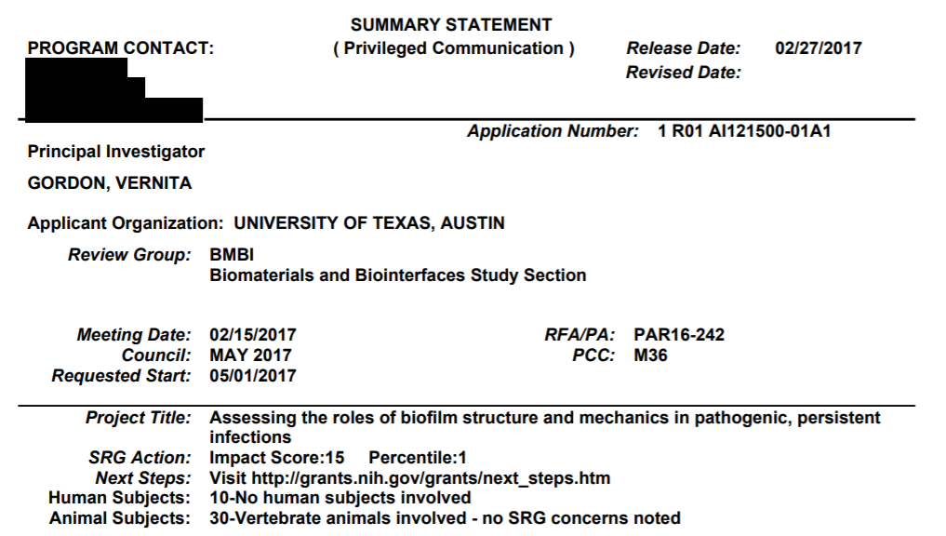
Summary Statement
https://www.niaid.nih.gov/sites/default/files/1-R01-AI121500-01A1_Gordon_Summary-Statement.pdf
Notes:
Each reviewer give their overall impact and scores for the 5 criteria with strengths and weaknesses

Slide 51
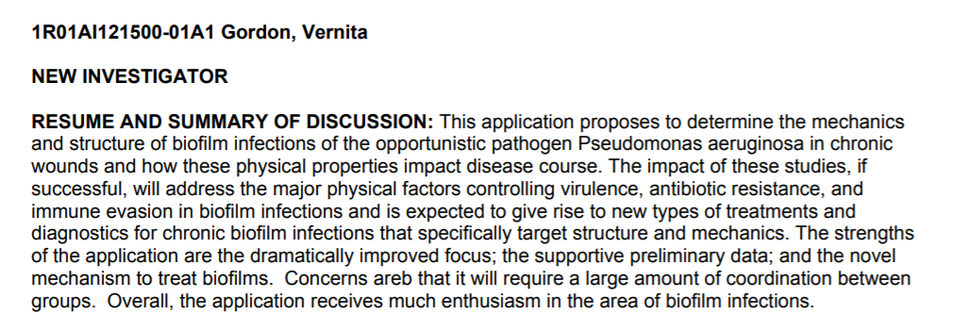
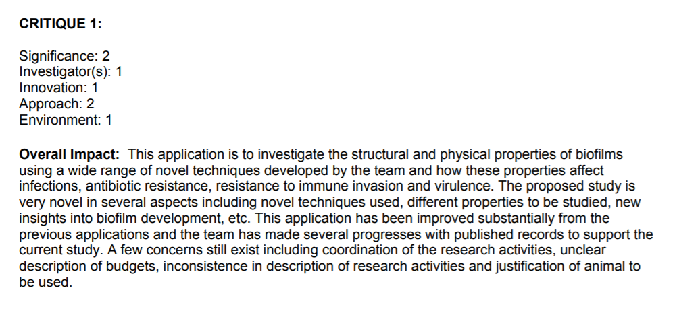
Summary Statement
Written by the SRO based on the final outcome of the discussion, summarizes strengths & weaknesses mentioned by all reviewers, highlights areas of concurrence & disagreement between reviewers.
Written by the individual reviewer to summarize his/her opinion on the overall strengths and weaknesses of the application
These scores are indices only. They have
no mathematical relationship to the priority score
Notes:
Each reviewer give their overall impact and scores for the 5 criteria with strengths and weaknesses

Slide 52
Consider the criteria scores carefully
The written comments and summary of discussion will tell a more complete story
However, pay special attention to Significance and Approach
Low significance, no matter what the other scores are, might be hard to fix
High significance but weak approach may be fixable

Slide 53
If not funded, try again!
You are in good company
Know your options
Get advice, regroup
Contact your Program Officer

Slide 54
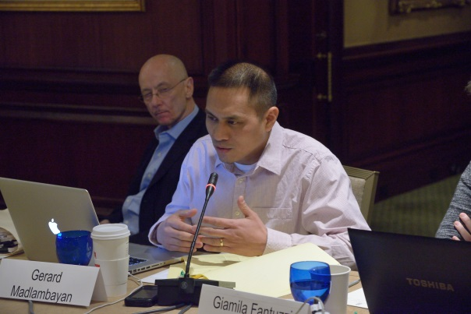
Gain review experience: Early Career Reviewer Program
Train and educate qualified scientists to become critical and well-trained reviewers
Expose investigators to the peer review experience to help make them more competitive as applicants
www.csr.nih.gov/ECR

Slide 55
Revising and resubmitting
Write a clear introduction section
Address all criticisms thoroughly
Respond constructively
Acknowledge and accept the help of reviewers
Don’t be argumentative!
Don’t be abrasive or sarcastic!
Resubmission is an opportunity to improve the entire application

Slide 56
What determines which applications become grants?
Funding Decisions are based on:
scientific merit and impact
program considerations
available funds
Some ICs are strictly “payline,” i.e. pay in priority score order until the money runs out
Other ICs do not use a strict payline, but instead follow IC-specific processes for considering applications for funding
All ICs must justify all their funding decisions based on established criteria
All grants paid must be approved by IC advisory council (second level review)

Slide 57
What not to do:
Don’t start writing less than two months prior to deadline.
Don’t ask a colleague to review a proposal due in 3 days
Don’t write a rambling background review
Don’t propose too much in too many areas
Don’t give up and stuff all your other ideas into Aim 3
Don’t propose experiments for which key reagents or cohorts have to be developed or are not yet in hand
Try to avoid ‘fishing expeditions’ with aims built around “-omics” profiling with no hypothesis

Slide 58
Summary – tips for success
Plan ahead. Outline aims and assemble preliminary data 8-9 months ahead of time. Identify and contact potential collaborators.
At least 6 months prior to deadline, share your outline with a colleague
Rework your specific aims to fit with your preliminary and published data.
Invest time in assembling attractive, self-explanatory figures and diagrams, especially in color.

Slide 59
Use all your NIH Resources
…And WE HOPe YOU find success with NIH funding!

