Slide 1
Finding and Understanding Funding Opportunity Announcements
Amy Mistretta
Sheri Cummins

Slide 2
Learning Objectives
Upon completion of this session, participants will be able to:
Have a thorough understanding of the different types of funding opportunities
Find funding opportunites of interest
Navigate a Funding Opportunity Announcement (FOA) or Notice of Special Interest (NOSI) efficiently to identify all the elements required to submit a responsive, compliant, and complete application

Slide 3
Funding Opportunities

Slide 4
Funding Opportunities
NIH advertises availability of grant support through
Funding Opportunity Announcements (FOAs)
Notices of Special Interest (NOSIs)
More than 1200 active FOAs at any given time
Each FOA has specific requirements and instructions for submitting an application
Know how to find the best FOA for you!

Slide 5
What type of FOAs are available?
Parent Announcements – Trans-NIH; broad FOAs for investigator-initiated research for a specific activity code
Program Announcements (PAs) – One or more NIH ICs; highlight areas of scientific interest
PAS (PA with set-aside funds)
PAR (PA with special receipt, referral, and/or review considerations)
Requests for Applications (RFAs) – One or more NIH ICs; highlight well-defined area of science; set-aside funds and anticipated number of awards
Notices of Specials Interest (NOSIs) – Notices to highlight particular areas of science that ICs are interested in funding
https://grants.nih.gov/grants/how-to-apply-application-guide/prepare-to-apply-and-register/understand-funding-opportunities.htm

Slide 6
Parent Announcements
https://grants.nih.gov/grants/guide/parent_announcements.htm

Slide 7
Types of Notices
Notices of NIH Policy Changes
Policy notices published in the NIH Guide for Grants and Contracts supersede information in the NIH Grants Policy Statement
Compliance with policy updates become a term and condition of award
NIH incorporates policy notices into the annual update of the NIH Grants Policy Statement

Slide 8
Types of Notices
Notice of Information
Notice of Change
Notice of Participation
Notice of Expiration
Notice of Extension
Notice of Correction
Notice of Intent to Publish (NOITP)
Notice of Special Interest (NOSI)

Slide 9
Where are FOAs Published?
Grants.gov
Central location for all federal grant opportunities
NIH Guide for Grants and Contracts
NIH's official publication of notices of grant policies, guidelines and funding opportunity announcements (FOAs)
Subscribe to NIH Guide for Grants and Contracts Weekly NIH Funding Opportunities and Notices email
NIH Institute or Center (IC) websites

Slide 10
Search – Grants.gov

Slide 11
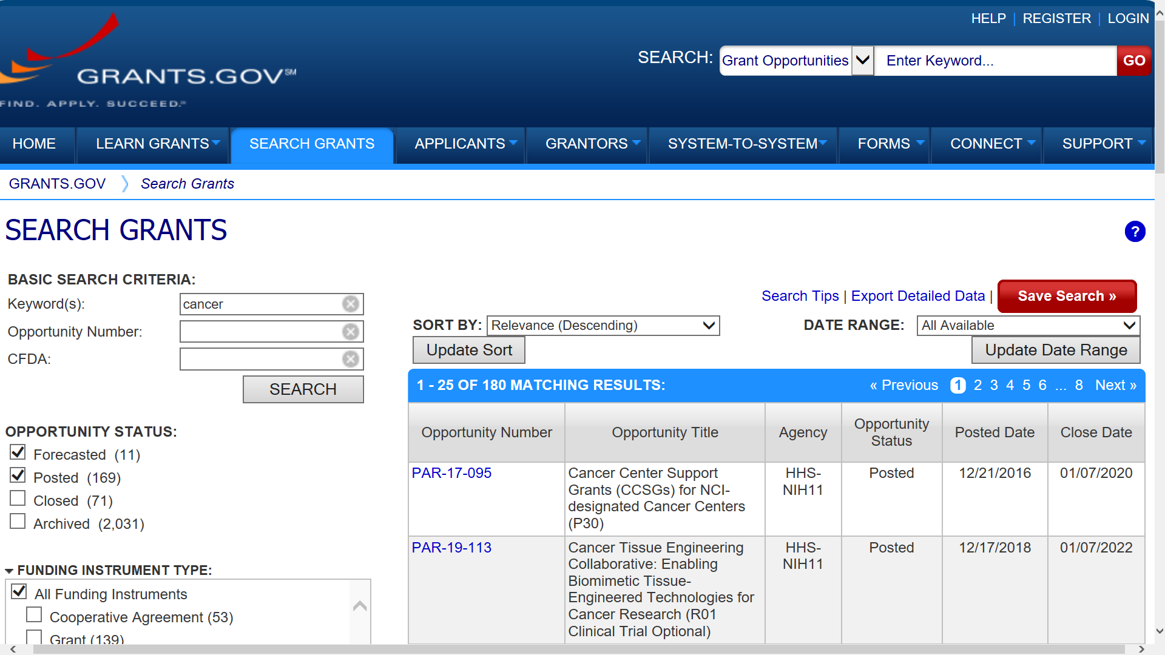
Grants.gov Search Screen
Search by keyword, opportunity number, or CFDA
Export results to .csv file
Search Tips
OR or || (default)
AND or &&
“exact phrase”
Login to your Grants.gov account to Save and Manage searches

Slide 12
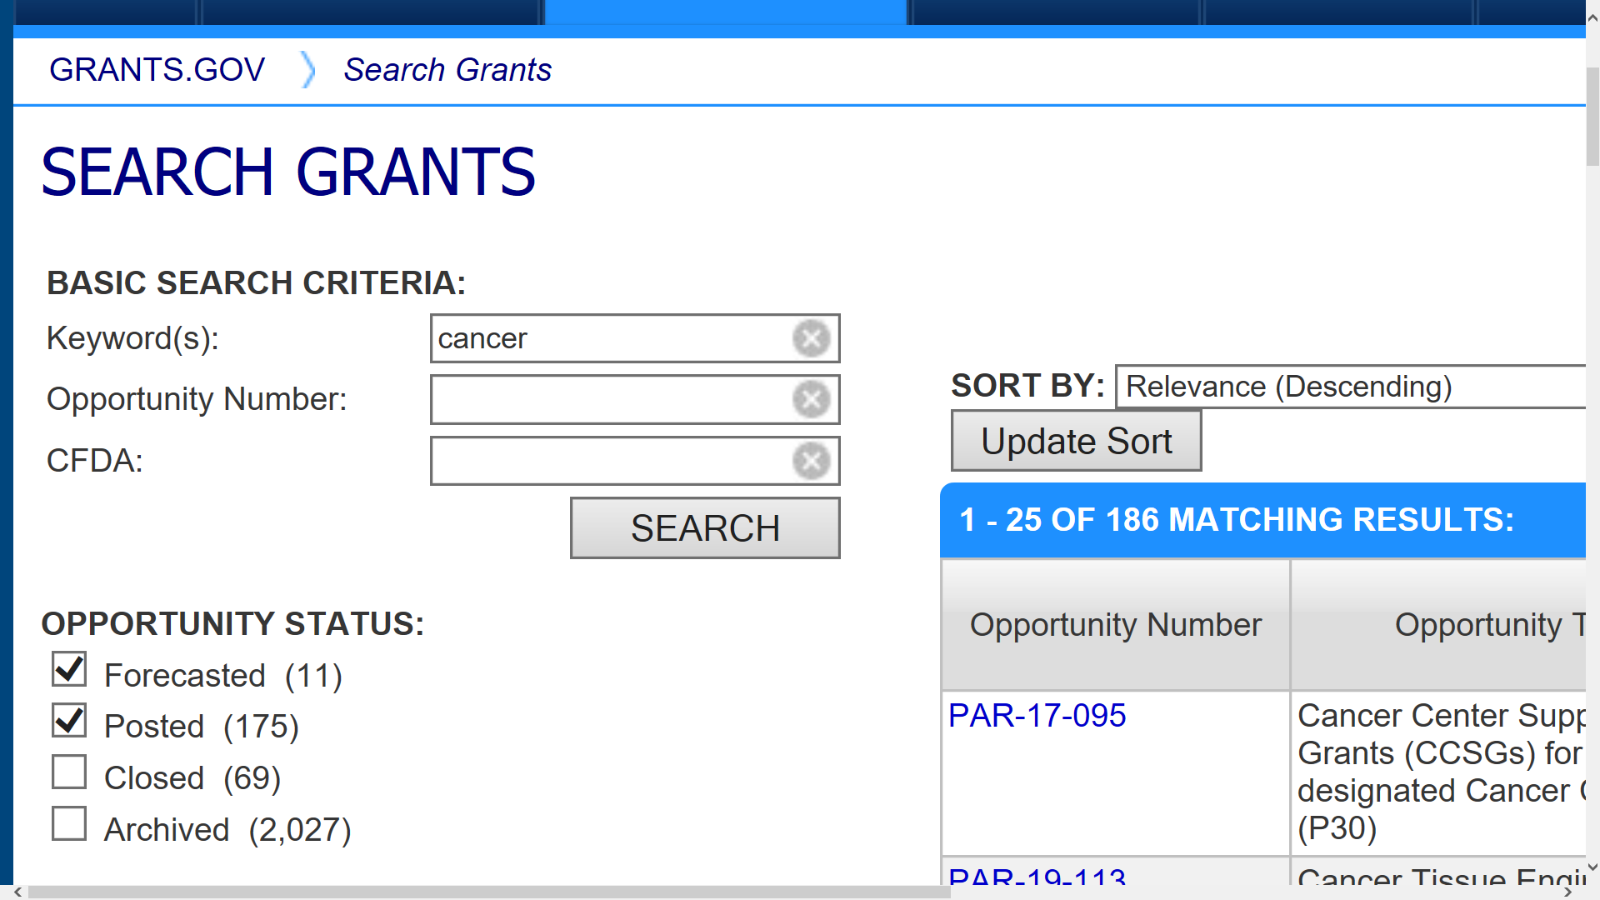
Grants.gov Search Screen – Opportunity Status Filter
Search filters
“Forecasted” lists Notices of Intent to Publish – not published opportunities
Number of results that match the criteria

Slide 13
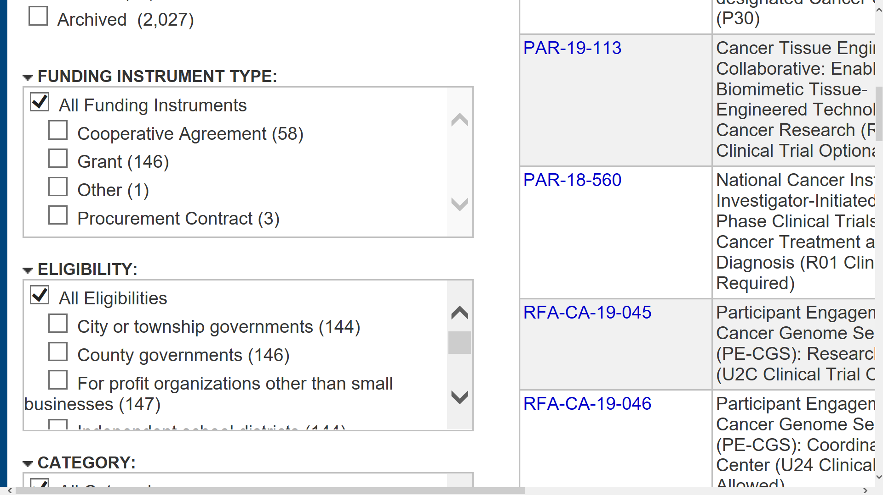
Grants.gov Search Screen – Funding Instrument Type Filter
Funding Instrument Type
Cooperative Agreement (NIH)
Grant (NIH)
Procurement Contract
Other

Slide 14
Grants.gov Search Screen – Eligibility Filter
Eligibility
City or township governments
County governments
For profit organizations other than small businesses
Independent school districts
Individuals
Native American tribal governments
Nonprofits (other than institutions of higher education)
Private institutions of higher education
Public/state controlled institutions of higher education
Public/Indian housing authorities
Small businesses
Special district governments
State governments
Other
Unrestricted

Slide 15
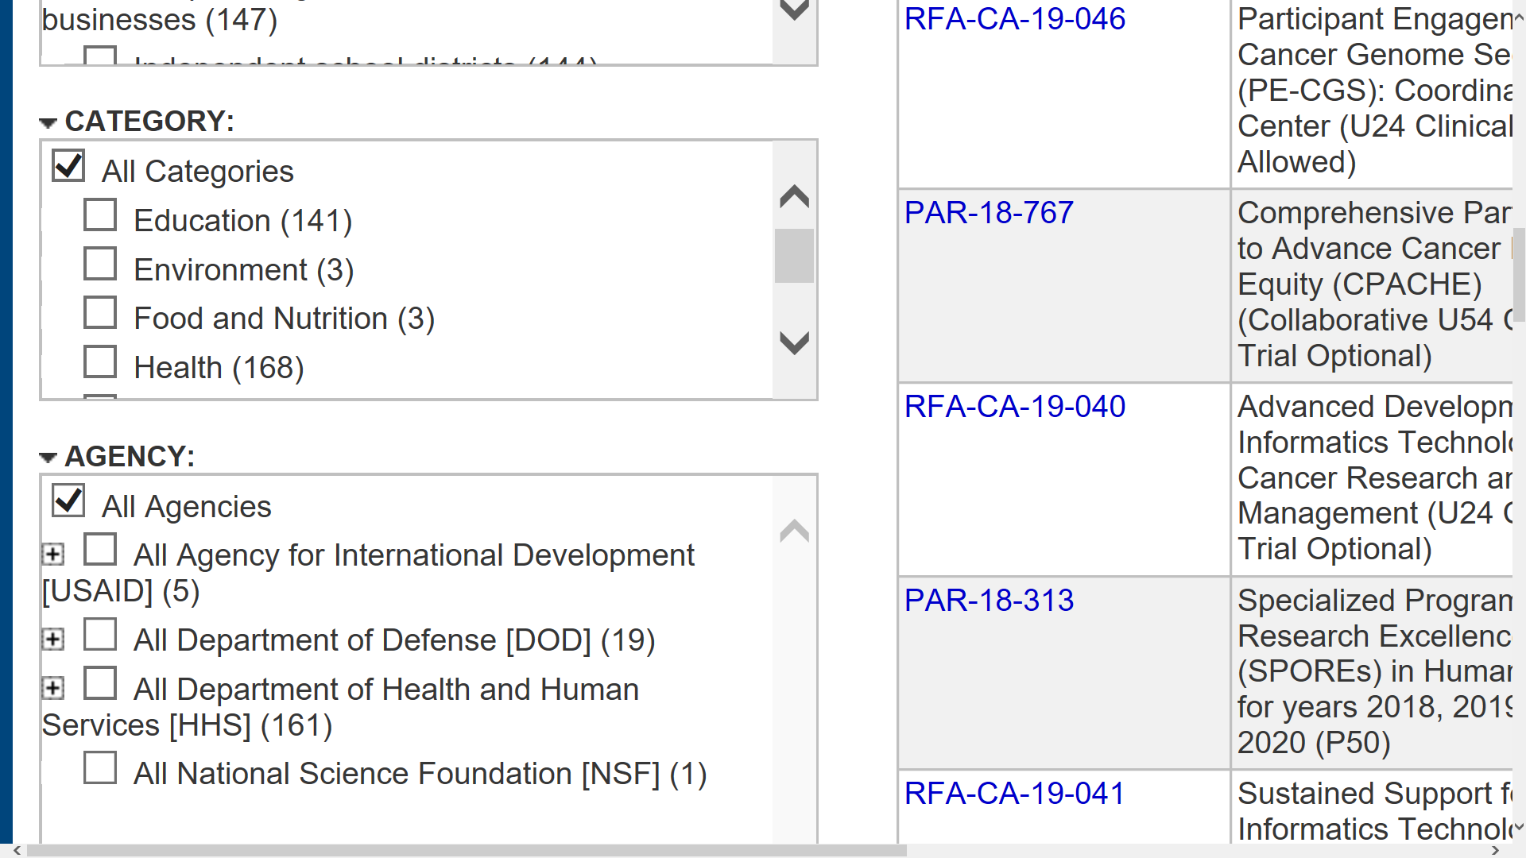
Grants.gov Search Screen – Category Filter
Category
Agriculture
Arts
Business and Commerce
Community Development
Consumer Protection
Disaster Prevention and Relief
Education
Employment, Labor and Training
Energy
Environment
Food and Nutrition
Health
Housing
Humanities
Income Security and Social Services
Information and Statistics
Law, Justice and Legal Services
Natural Resources
Other

Slide 16
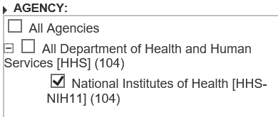
Grants.gov Search Screen – Agency Filter
Agency
All Agencies
Specific Agencies
E.g., All Department of Health and Human Services
Specific Sub-agencies
E.g., National Institutes of Health

Slide 17
Grants.gov Search Screen – Select FOA
Click Opportunity Number

Slide 18
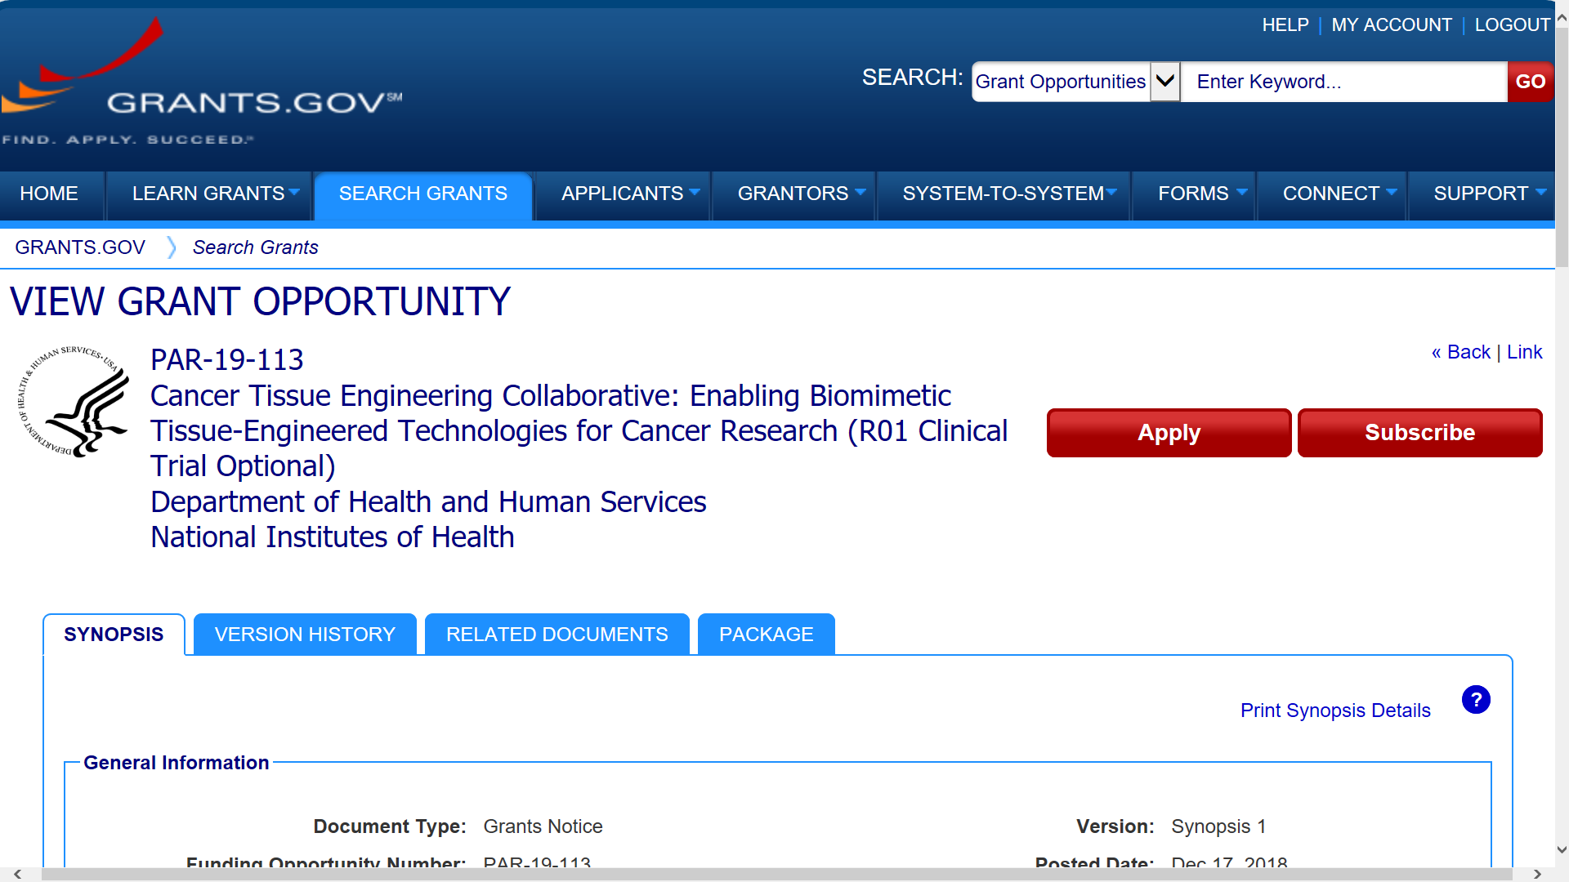
View Grant Opportunity – Apply & Subscribe
Can subscribe to Grants.gov updates for FOA (e.g., new form package; close date change)
Can apply using Grants.gov Workspace (single-project only)

Slide 19
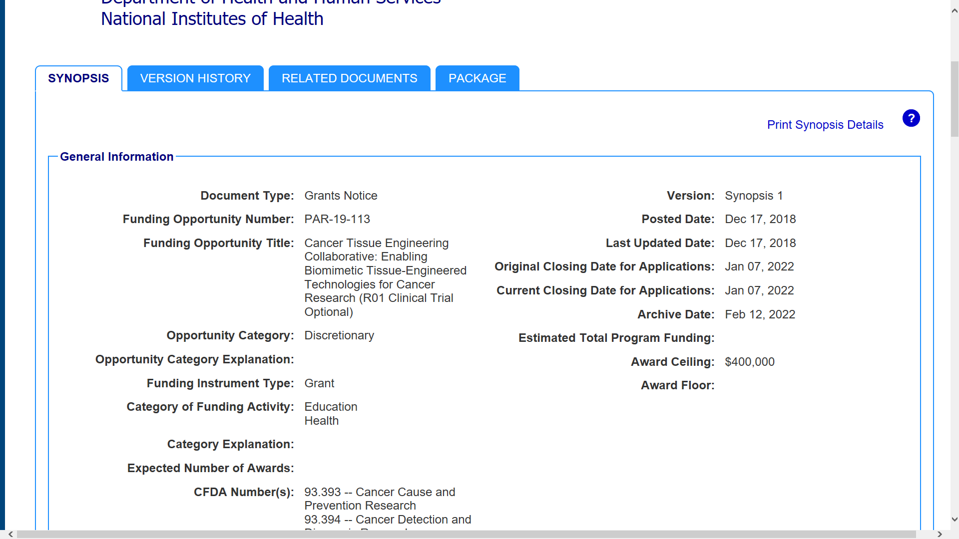
View Grant Opportunity – Synopsis
Grants.gov has a synopsis (subset) of full announcement
General Information

Slide 20
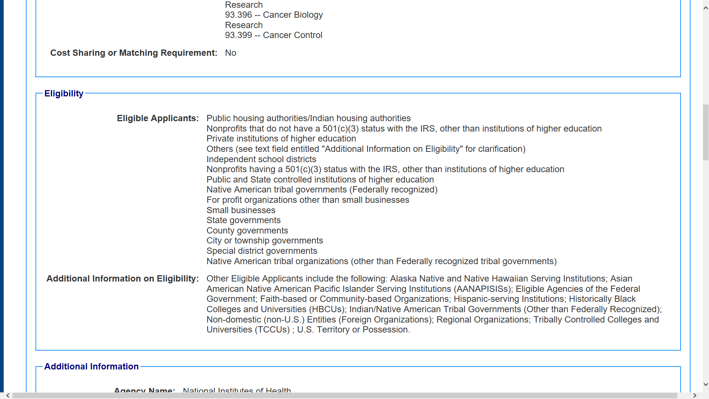
View Grant Opportunity – Eligibility
Organization eligibility categories; full NIH announcement may have additional organization and PI eligibility restrictions

Slide 21
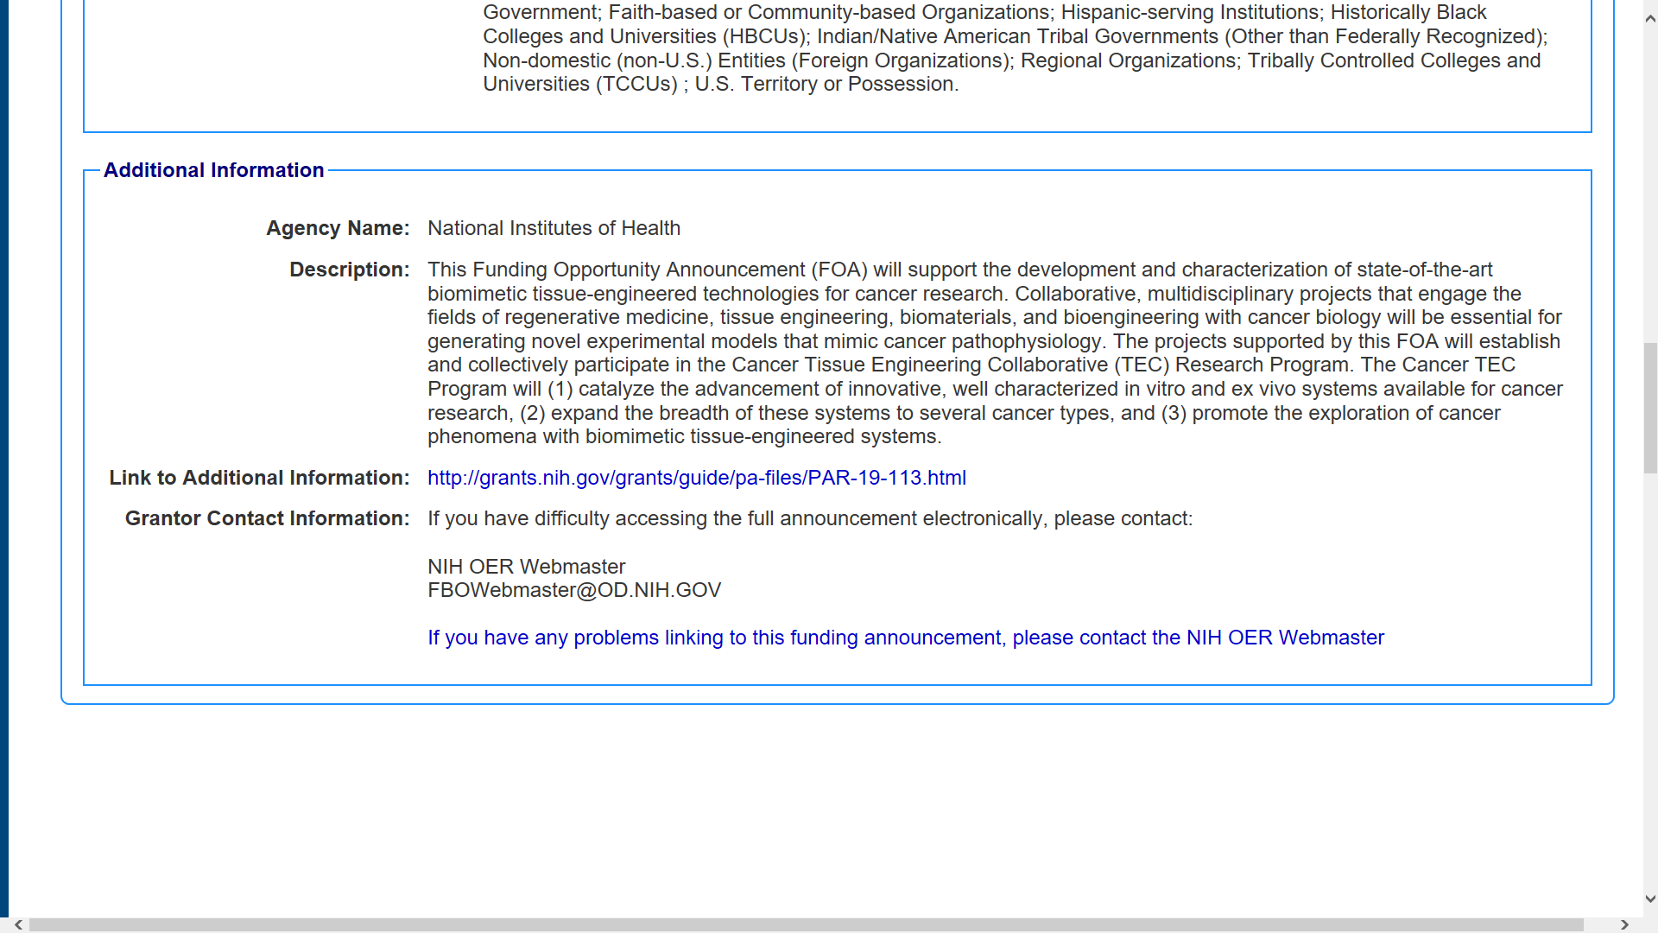
View Grant Opportunity – Additional Information
Description = Funding Opportunity Purpose in NIH Guide for Grants & Contracts
Link to full announcement in NIH Guide for Grants & Contracts
Grants.gov search only searches information available in synopsis
Grants.gov notifications only notify users of changes to synopsis and application package information

Slide 22
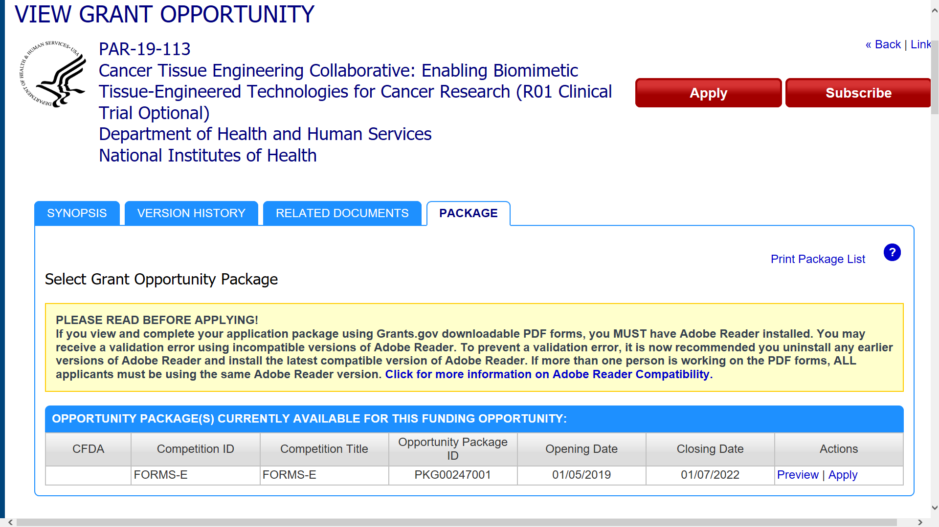
View Grant Opportunity – Package tab
Preview allows you to see the mandatory and optional application forms posted for the opportunity

Slide 23
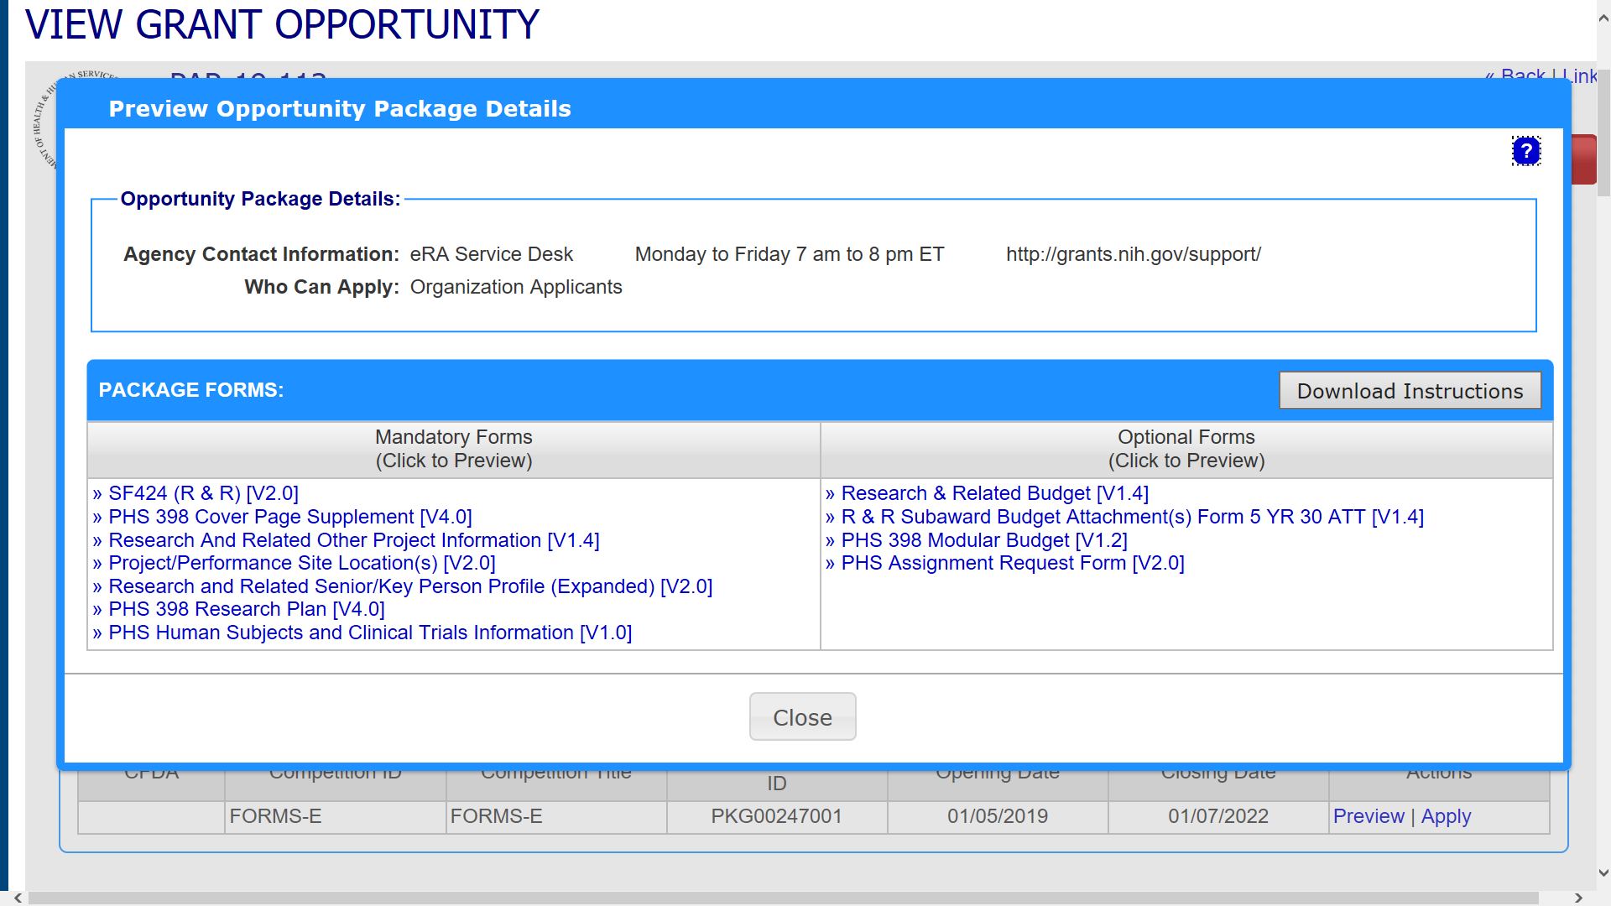
Preview – Available Application Forms

Slide 24
Search – NIH Guide for Grants & Contracts

Slide 25
NIH Guide for Grants and Contracts

Slide 26
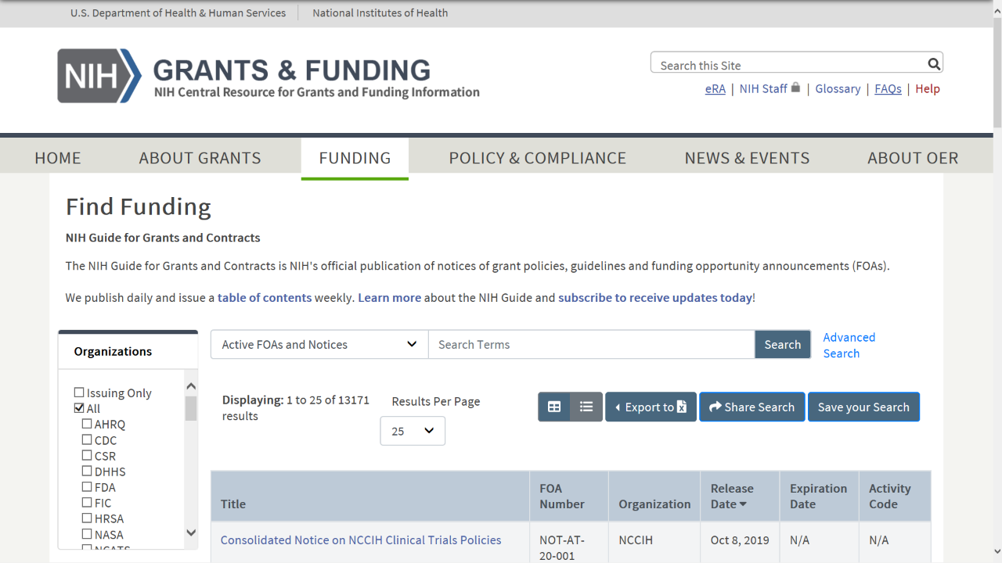
NIH Guide Searching
Enter key words to search by subject area, FOA number
Options to Export, Share or Save searches

Slide 27
NIH Guide Searching
Narrow your search based on
FOA status:
All FOAs (Active and Archived)
Active FOAs
All Notices
Expired FOAs
Set filters to narrow the organizations
Hover over acronyms to expand them
Sort by Release Date

Slide 28
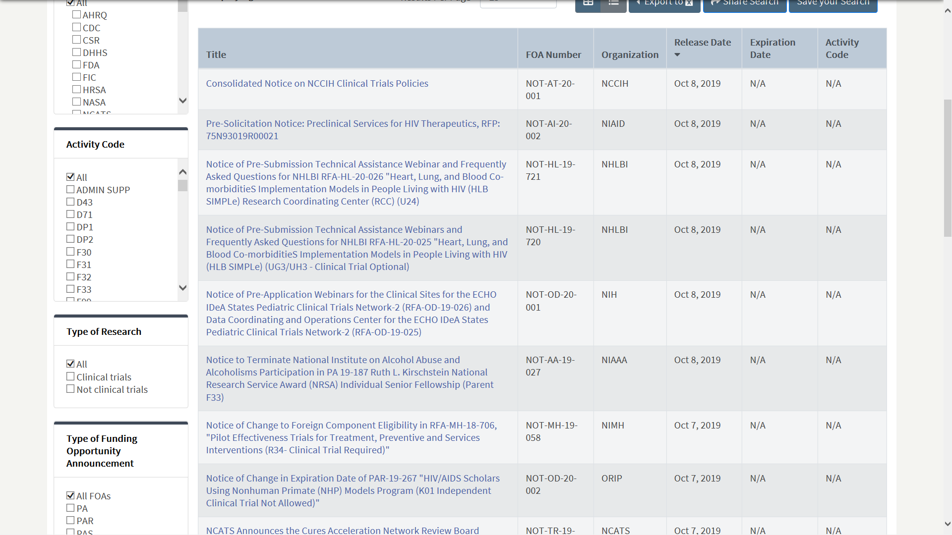
Searching by Activity Code and CT
Activity Code
Choose Clinical Trials Designation

Slide 29
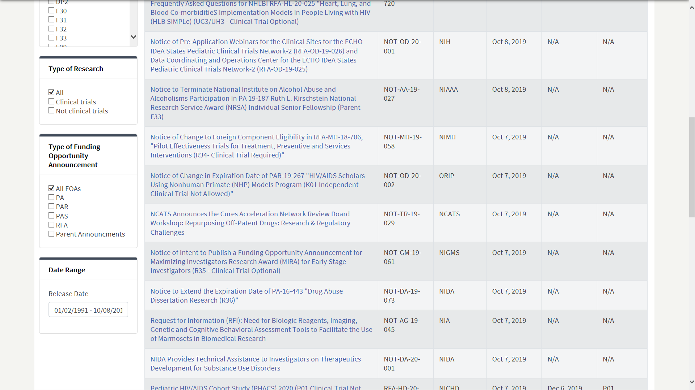
Searching by types of FOAs and date range
Select types of FOAs
Narrow by date range

Slide 30
NIH Guide
Searching using the advanced search
To use more search tools click on ‘Advanced Search’

Slide 31
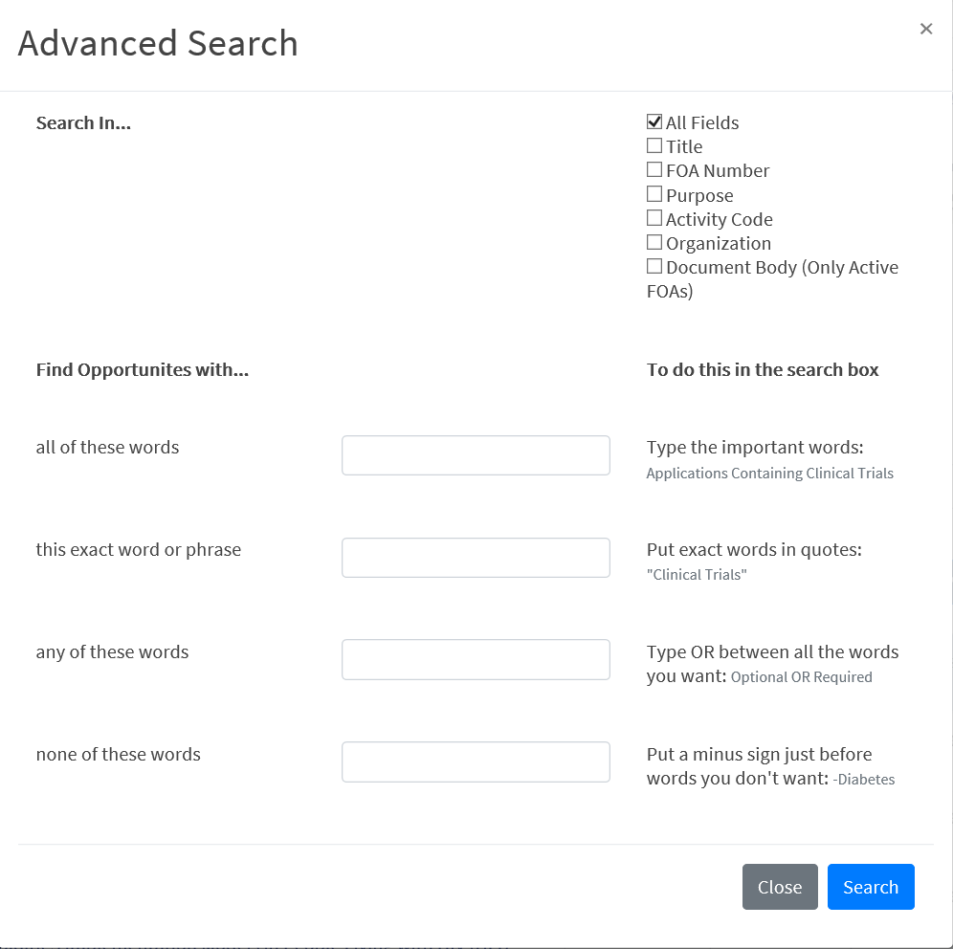
Guide Advanced Search

Slide 32
Search summary
NIH Guide For Grants & Contracts
Grants.gov
NIH FOAs and Notices (policy, change, intent to publish, special interest)
Searches full announcement
Filter to NIH Institute level
Agency-specific filters (activity code, clinical trial allowability)
All federal agency FOAs and Notices of Intent to Publish
Searches synopses
Filter to NIH agency level

Slide 33
Navigating FOAs
Let’s look at a sample FOA …

Slide 34
FOA Table of Contents
Part 1. Overview Information
Part 2. Full Text of the Announcement
Section I. Funding Opportunity Description
Section II. Award Information
Section III. Eligibility Information
Section IV. Application and Submission Information
Section V. Application Review Information
Section VI. Award Administration Information
Section VII. Agency Contacts
Section VIII. Other Information

Slide 35
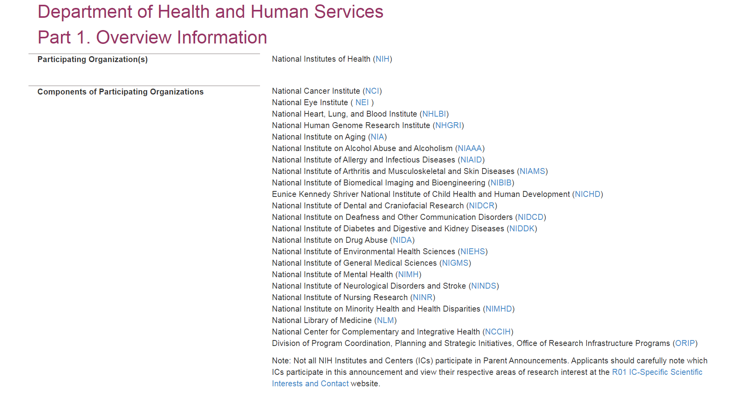
FOA Part 1. Overview Information
Fit within the mission of an organization participating on the FOA or Notice of Special Interest
Learn more
35

Slide 36
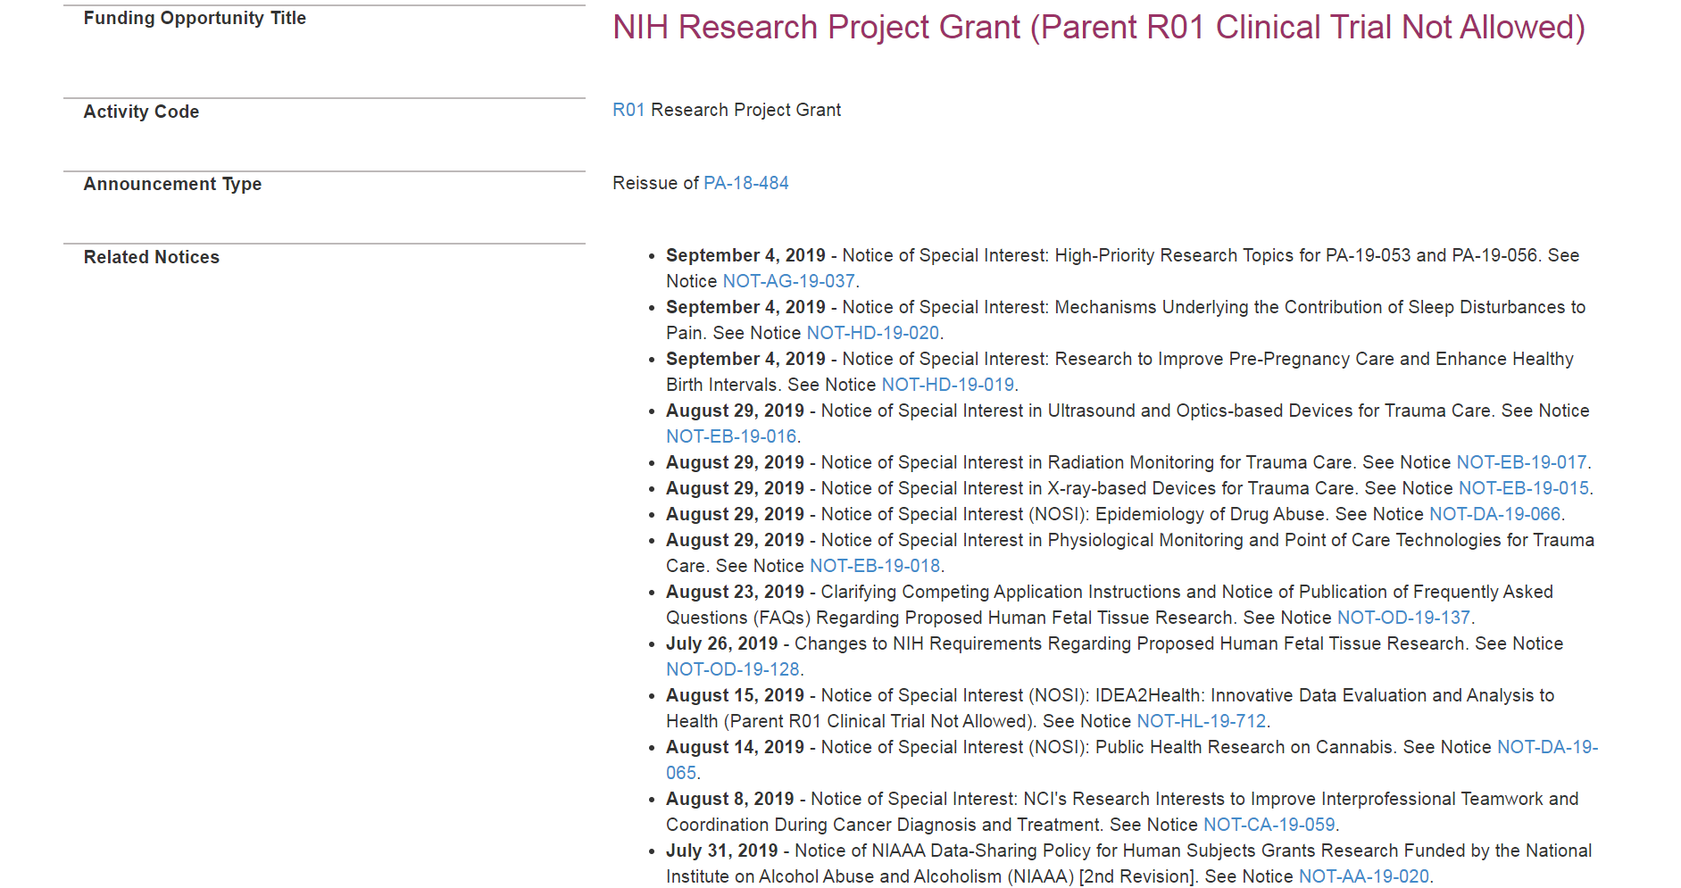
FOA Part 1. Overview Information (cont.)
Most titles include activity code and clinical trial indicator
New or Reissue
Activity code tells you the type of grant program Learn more
Related notices:
Updated instructions
New/updated policy
Notices of Special Interest
36

Slide 37
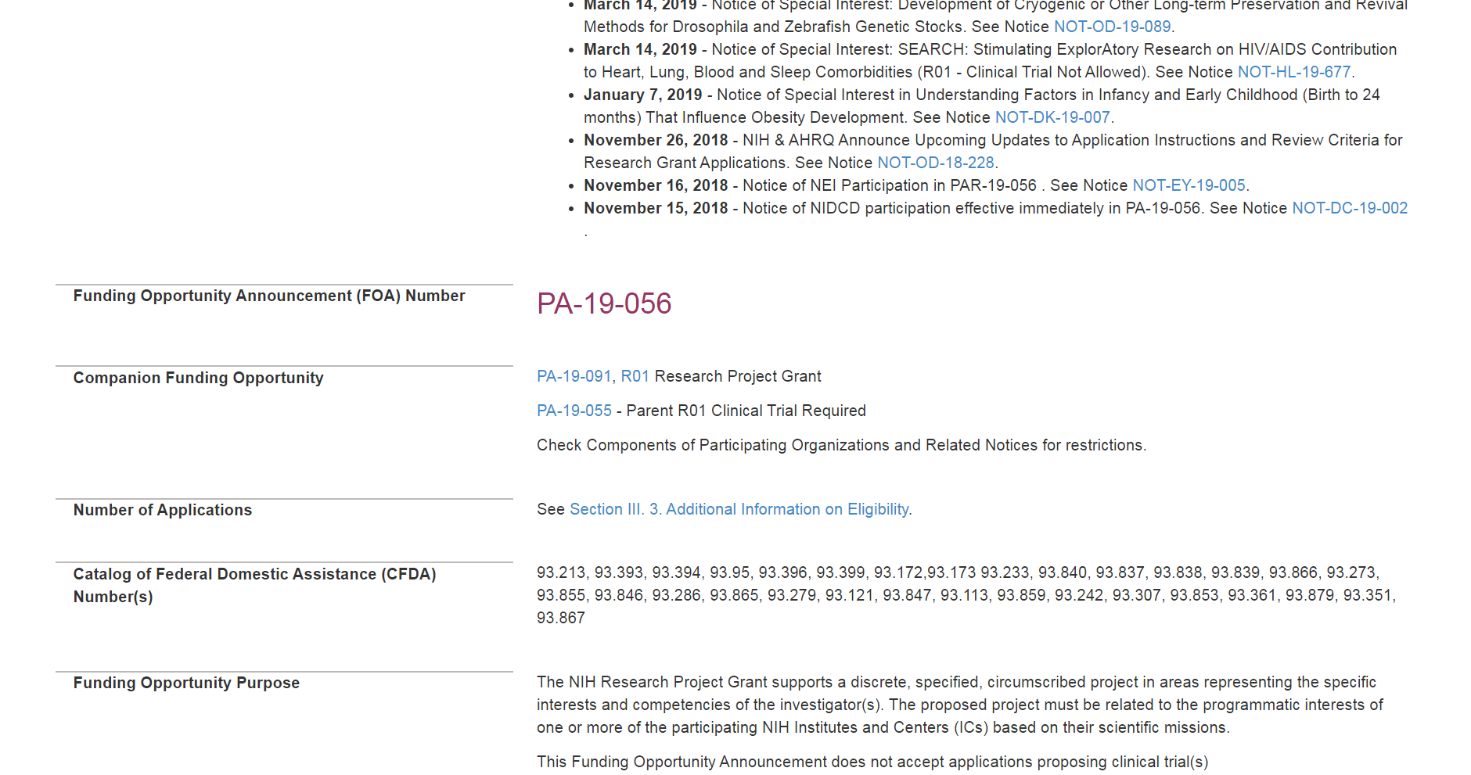
FOA Information
FOA #
Similar FOAs that vary by activity code or clinical trial indicator
Purpose
37

Slide 38
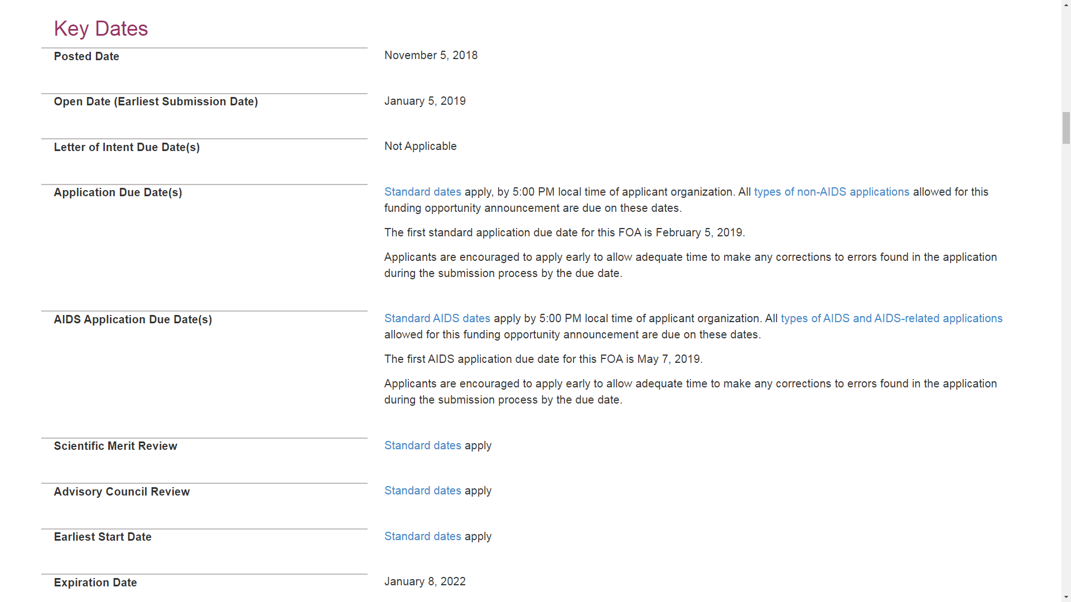
FOA Key Dates
When systems will accept applications
Letters of intent - not required; helpful for planning purposes when requested
Specific dates or link to “Standard dates”
First available due date often noted
If your application has strong focus on AIDS research, special dates apply
Must apply to a due date prior to Expiration Date
38

Slide 39
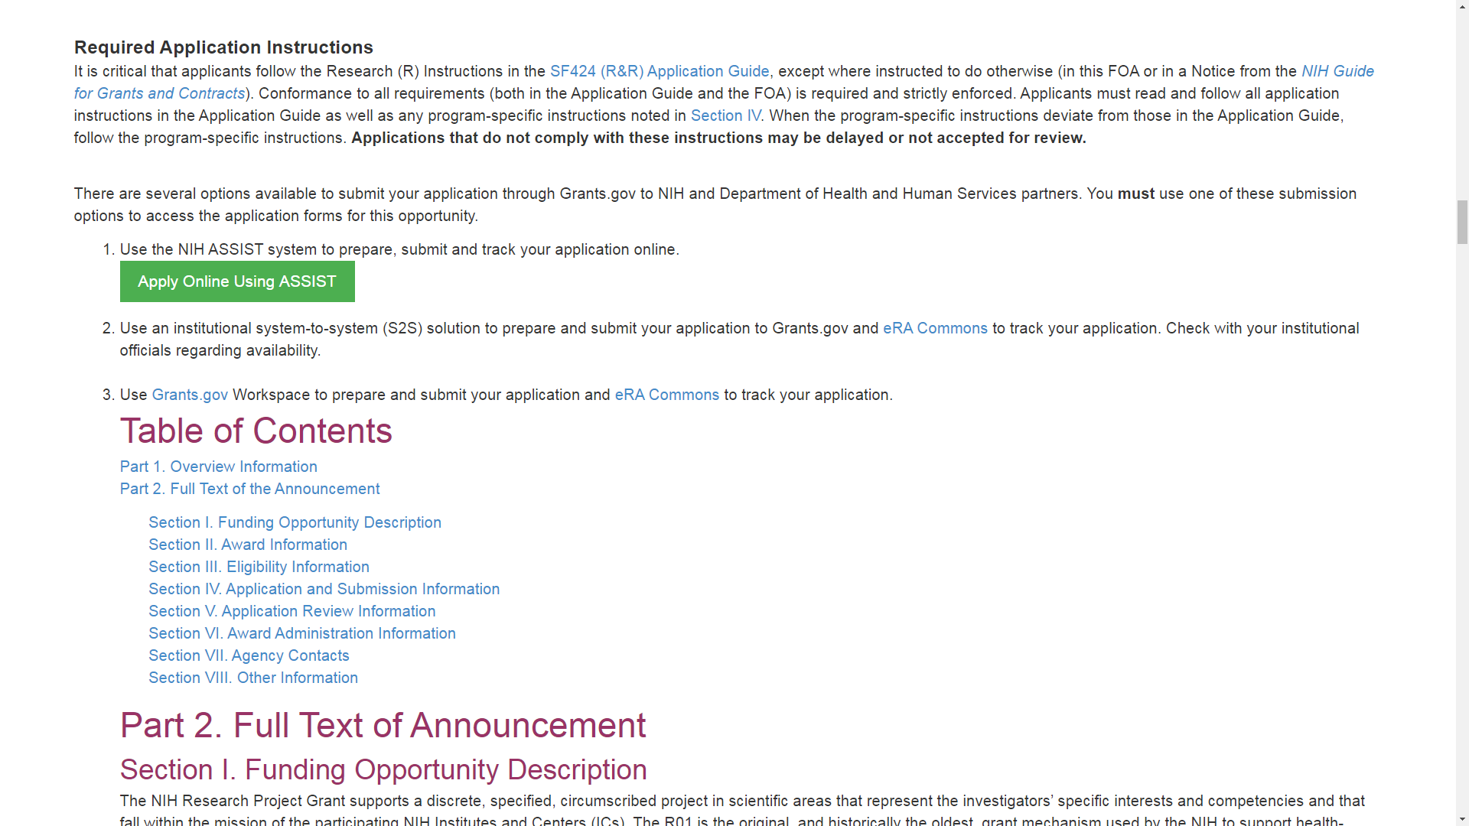
FOA Instructions and Table of Contents
Applicants must follow guidance in:
Application Guide
FOA
Guide notices (including Notices of Special Interest)
39

Slide 40
FOA Instructions and Table of Contents
Access, prepare, and submit your application using
ASSIST,
System-to-system solution, or
Grants.gov Workspace
Learn more
40

Slide 41
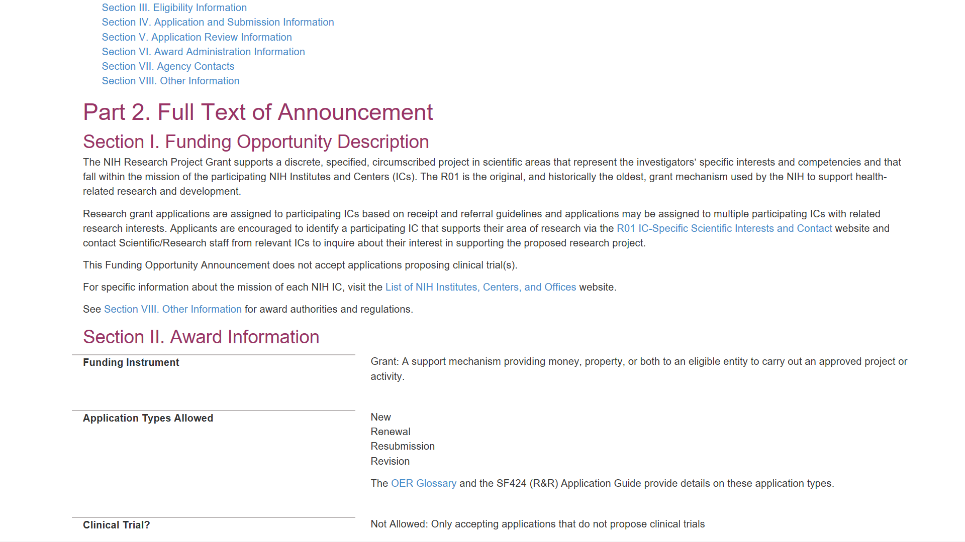
FOA Description
Description
Purpose/goals
Relevant background; importance
Research objectives
Responsiveness statement - scientific areas pursued and/or not pursued
41

Slide 42
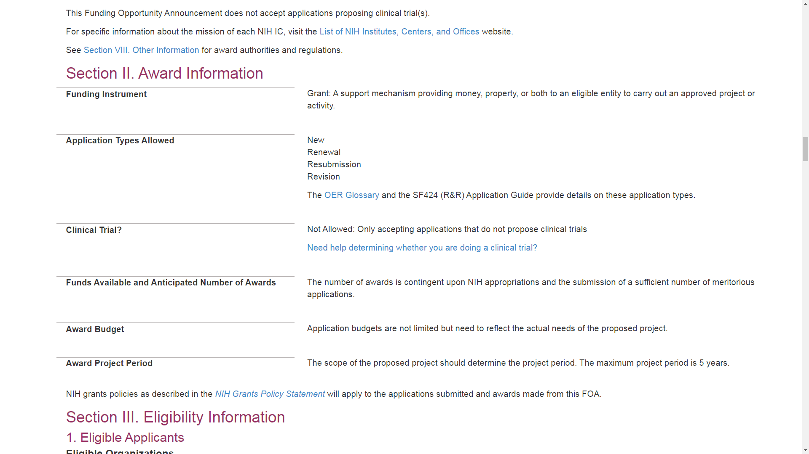
FOA Section II. Award Information
Funding Instruments - Grant, Cooperative Agreement, Other
Application Types - New, Renewal, Resubmission, Revision Learn more
Clinical Trial indicators - Not Allowed, Required, Required – Basic Experimental Studies with Humans, Optional Learn more
42

Slide 43
FOA Section II. Award Information
RFAs and PASs include specific number of awards and total budget commitment
Could include direct cost limits
Award Project Period varies by program; most <= 5 yrs
43

Slide 44
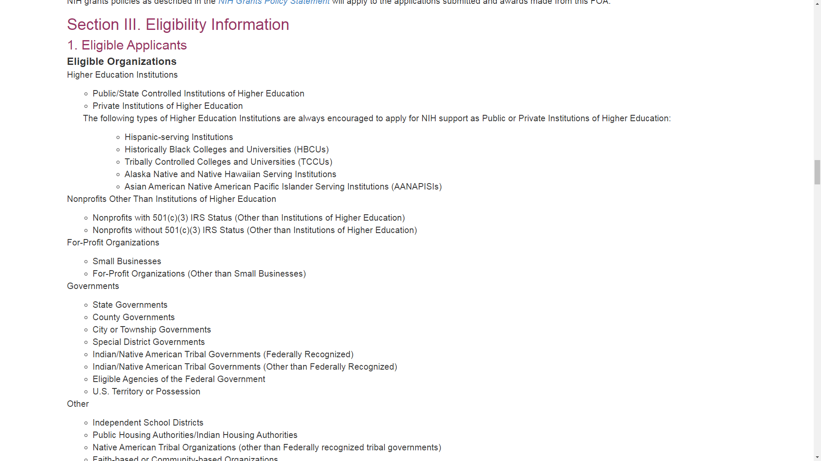
Section III. Eligibility Information
Types of eligible organizations
44

Slide 45
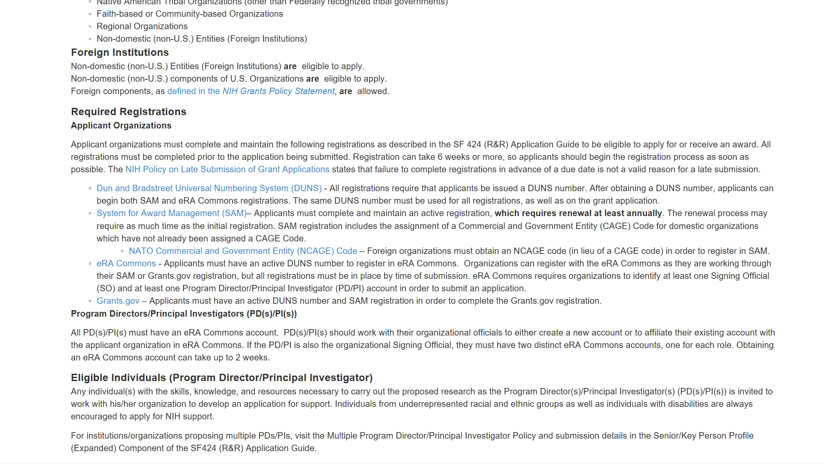
FOA Eligibility & Organization Registration
Indication of whether foreign institutions or components can apply
Required Registrations Learn more
PD/PI eligibility
45

Slide 46
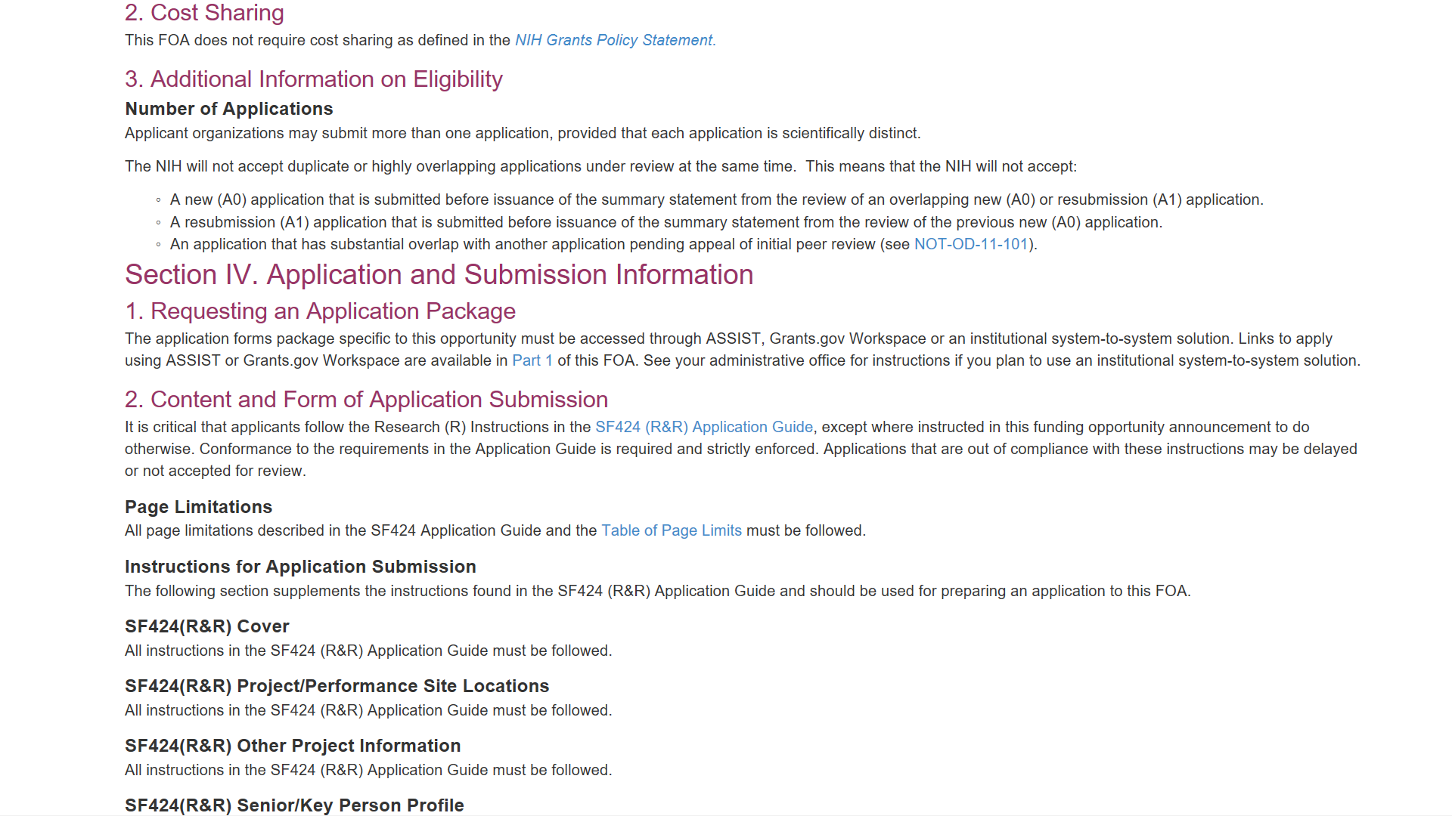
Additional Information on Eligibility & Section IV. Application and Submission Information
Number of applications allowed
Application & Submission Information
Available forms
Applicable page limits
Special instructions in addition to or different from standard Application Guide instructions
46

Slide 47
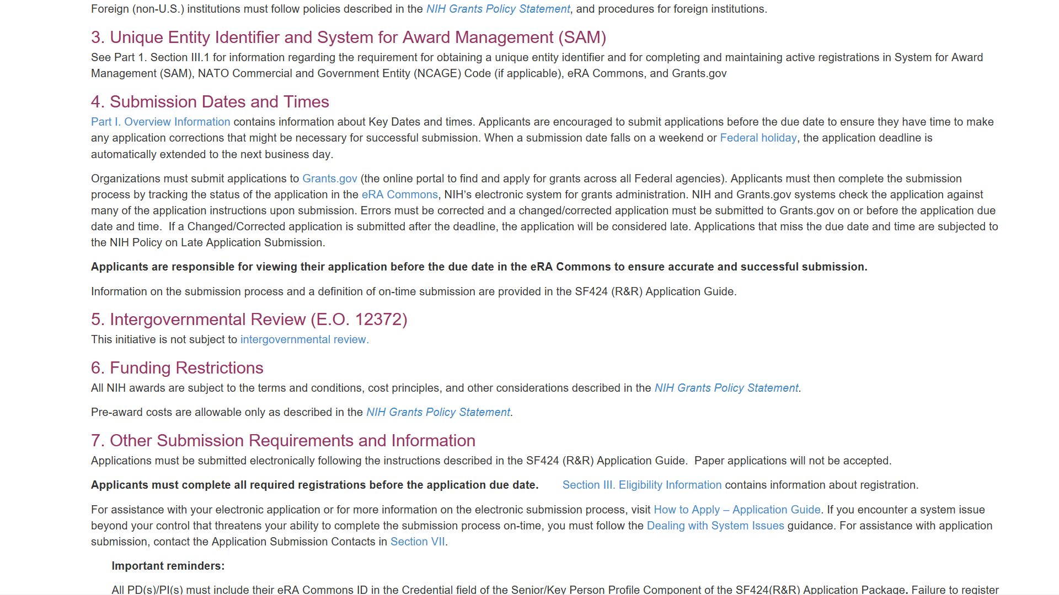
Submission Dates and Times & Funding Restrictions
Important deadline reminders
Submit early
Clear errors by deadline
Check application image in eRA Commons
Awards subject to terms and conditions in the NIH Grants Policy Statement
47

Slide 48
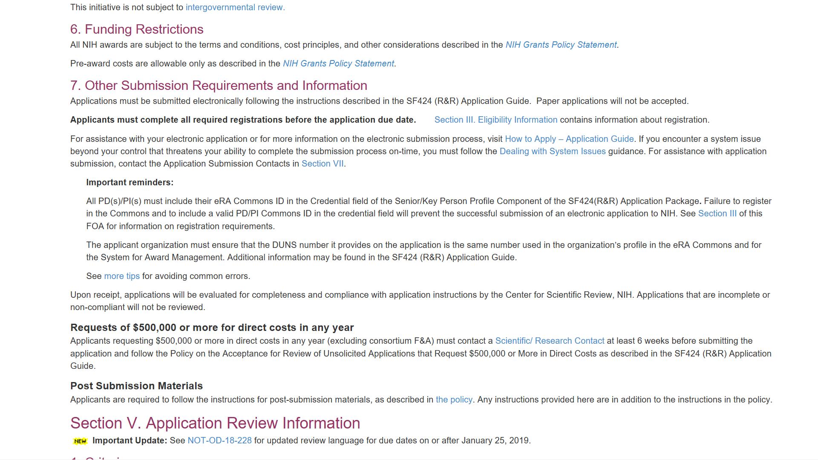
Other Submission Requirements and Information
System issue policy Learn more
Prior approval needed for requests of $500k or more in direct costs in any year Learn more
Post-submission materials policy Learn more
48

Slide 49
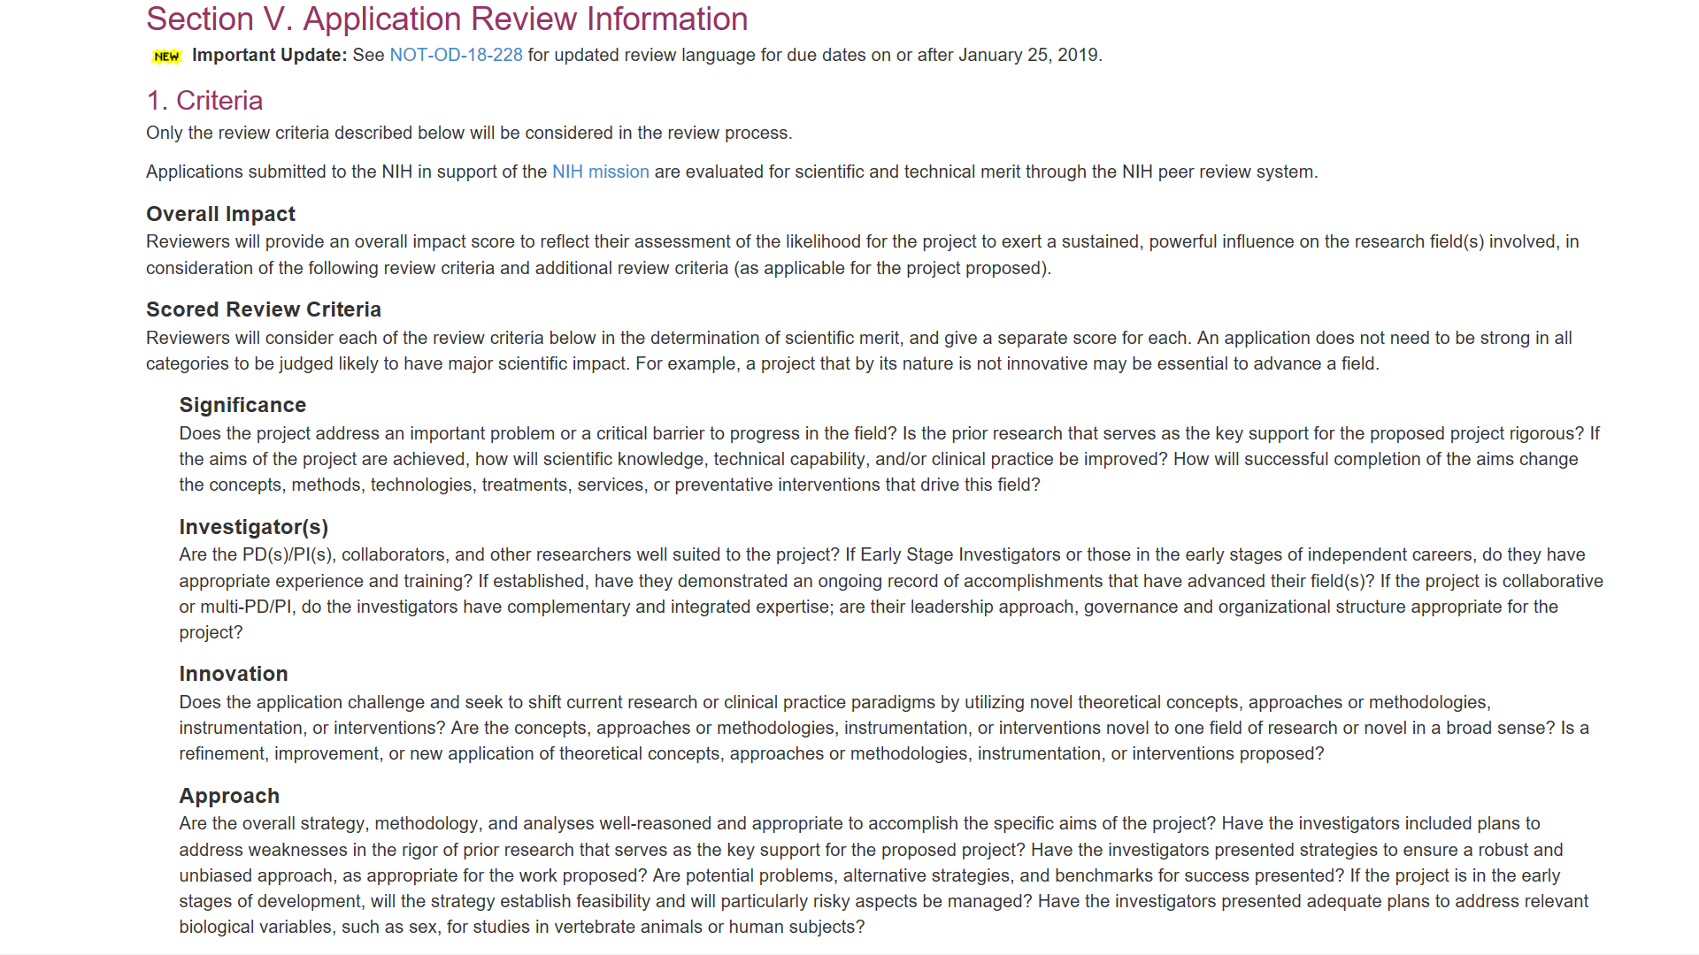
Section V. Application Review Information
Review Information
Many active FOAs have a link to updated review language
Standard review criteria used to evaluate scientific and technical merit
RFAs and PARs may have non-standard review criteria
49

Slide 50
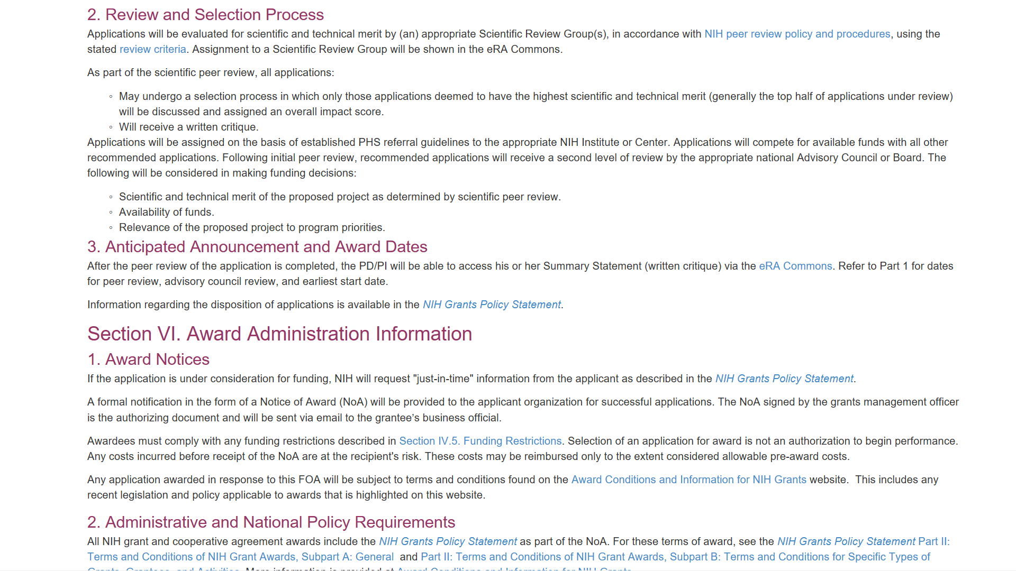
Review and Selection Process
Funding considerations
Scientific/technical merit
Availability of funds
Relevance to program priorities
Award Notices – could include FOA-specific provisions to be included in Notice of Award (NoA)
50

Slide 51
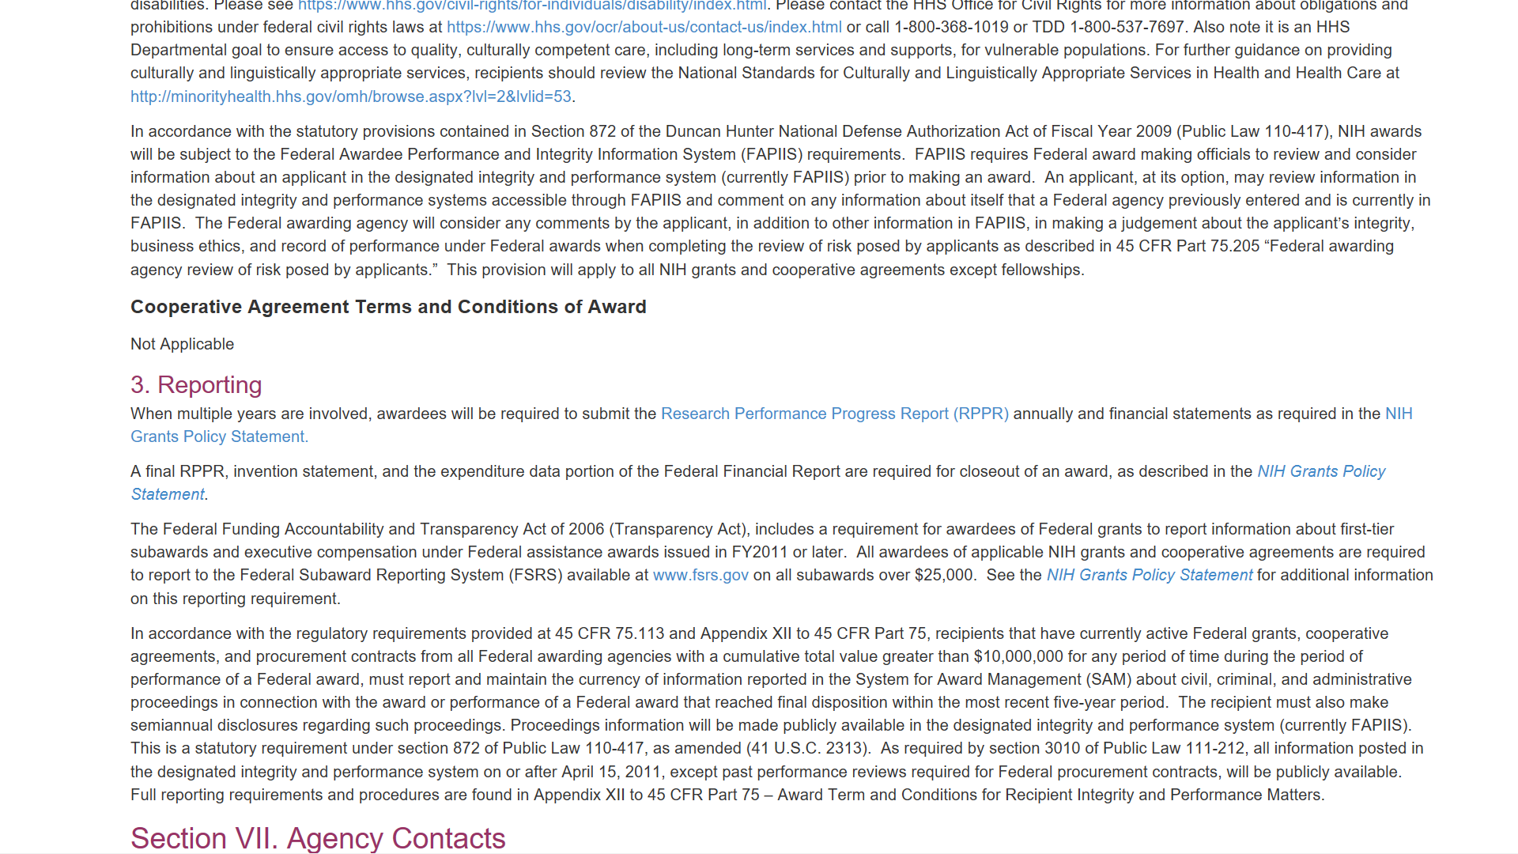
Reporting
Cooperative Agreement Terms and Conditions of Award – used for U activity codes
Reporting requirements
51

Slide 52
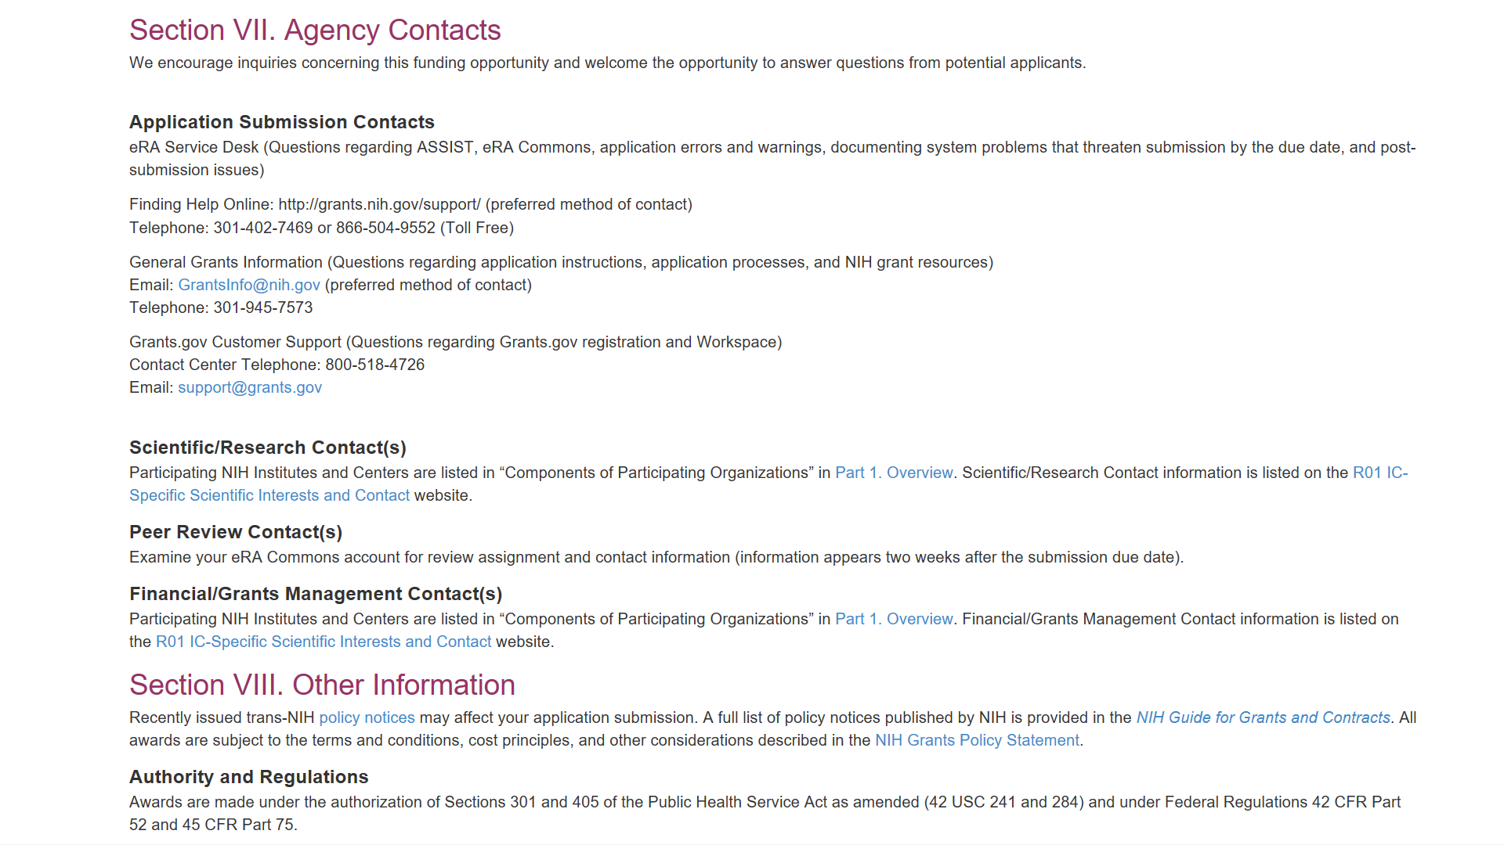
Section VII. Agency Contacts
eRA Service Desk – eRA Commons & ASSIST support
General Grants Information – general inquiries on NIH grant process
FOA-specific scientific, review, and financial contacts
------------
Check eRA Commons after submission for application/grant specific contacts
52

Slide 53
Notices of Special Interest (NOSIs)

Slide 54
Understanding NOSIs
Transitioning non-Parent Program Announcements (PAs) to Notices of Special Interest (NOSIs) to highlight scientific/research topics
Existing PAs will remain active until their expiration date
Focus on scientific and unique aspects of opportunity rather submission process
NOSIs point to existing FOAs (often parent announcements) for the submission of applications

Slide 55
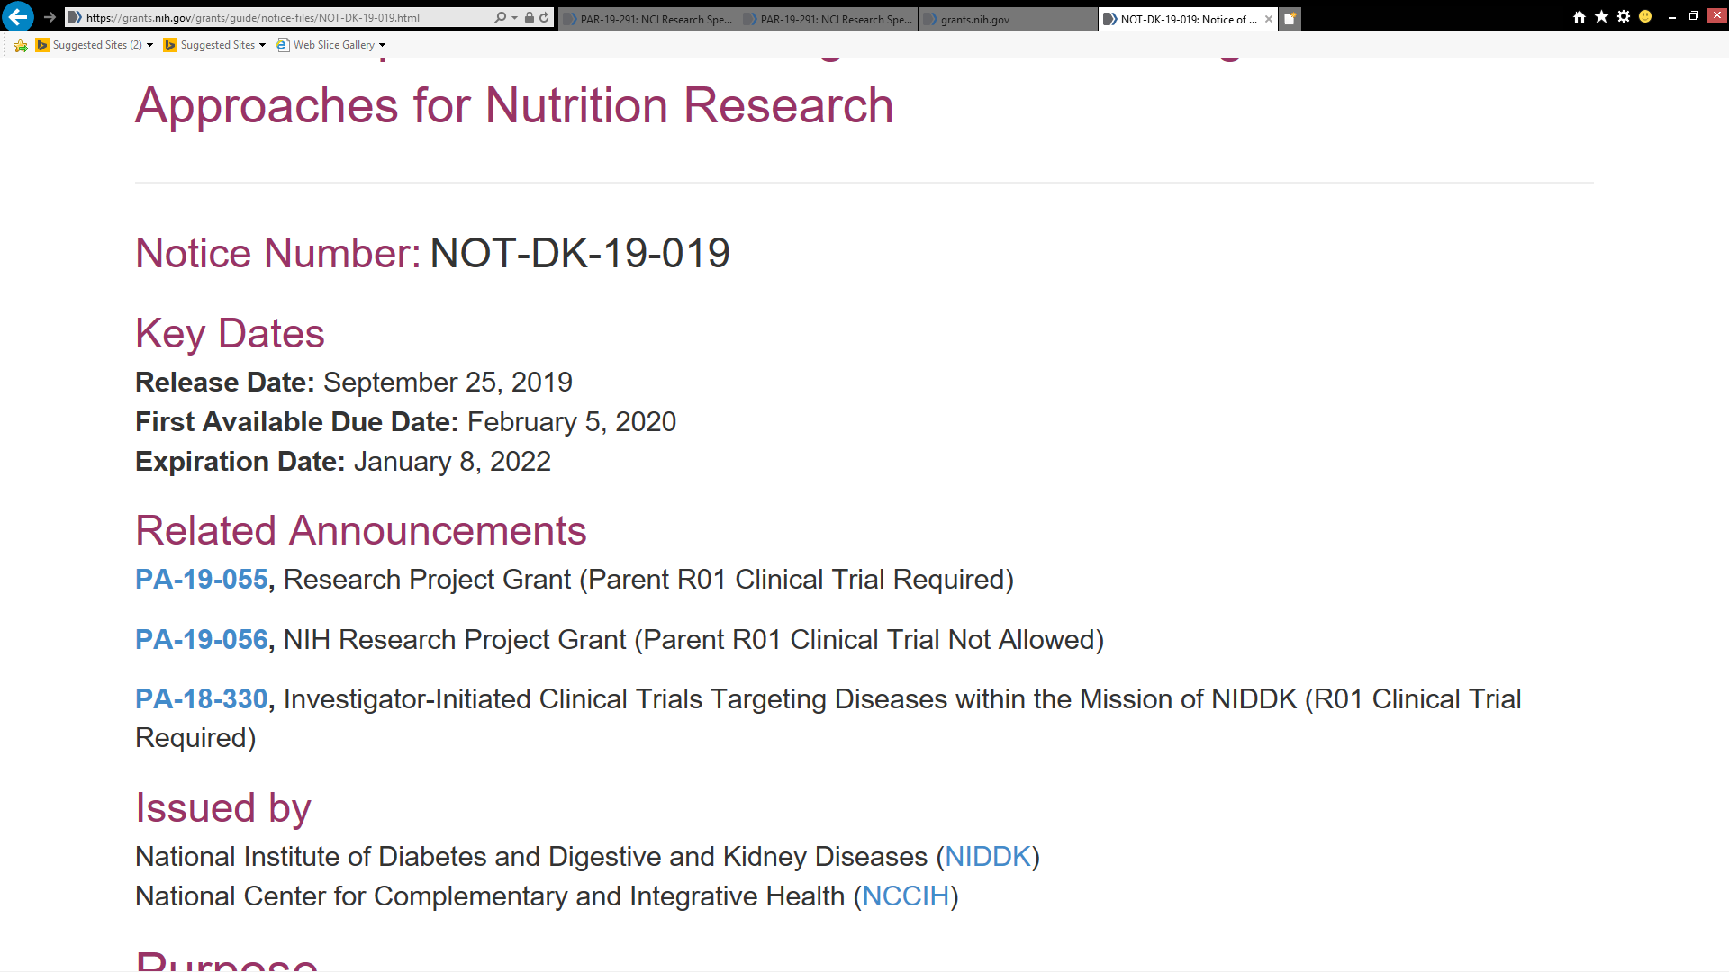
Sample Notice of Special Interest (NOSI)
NOSI number
First available due date
NOSI has own expiration date
Related Announcements include NOSI updates and FOAs used for submission
Participating Institutes/Centers (ICs); may be different than FOA

Slide 56
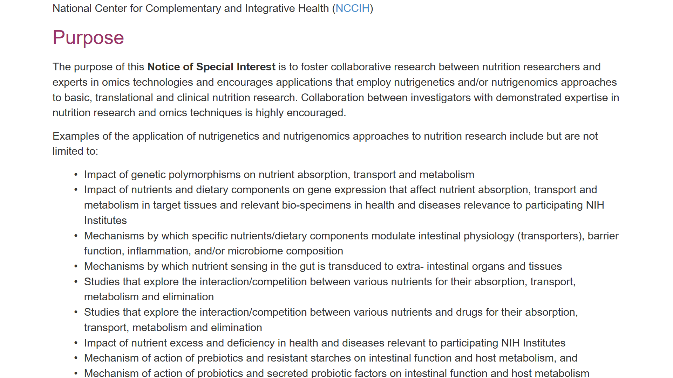
NOSI – Purpose
Purpose of notice and topics of special interest

Slide 57
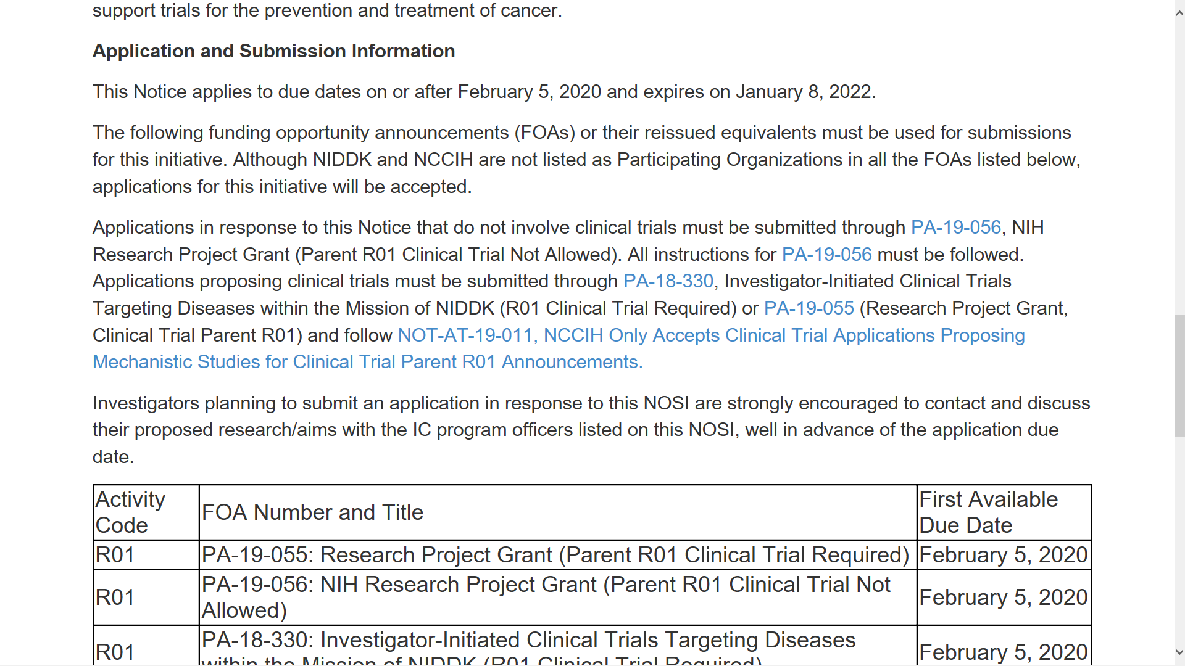
NOSI – Application Submission Information
Application Submission Information
Use listed FOAs or their reissued equivalents through NOSI expiration date
FOAs used for submission

Slide 58
NOSI – Contact Information
Must include NOSI number in Agency Routing Identifier field of SF424 (R&R) form
Must follow all NOSI terms/instructions or application may be withdraw
Contacts

Slide 59
Let’s check what you learned …
Pop Quiz

Slide 60
Where can you find NIH Funding Opportunities?
NIH Guide for Grants & Contracts
Grants.gov
Institute and Center Websites

Slide 61
Where can you find these? (NIH Guide, Grants.gov or Both)
Notice of Intent to Publish
NIH FOAs
Both
Both
Notices of Correction
NIH Guide
DOD FOAs
Grants.gov
Notices of Special Interest
NIH Policy Notices
NIH Guide
NIH Guide
NEXT SLIDE

Slide 62
True or False? Letters of Intent are required.
TRUE
INCORRECT Letters of Intent are NOT required.
CORRECT! Letters of Intent are NOT required, though helpful for review planning.
FALSE
NEXT SLIDE

Slide 63
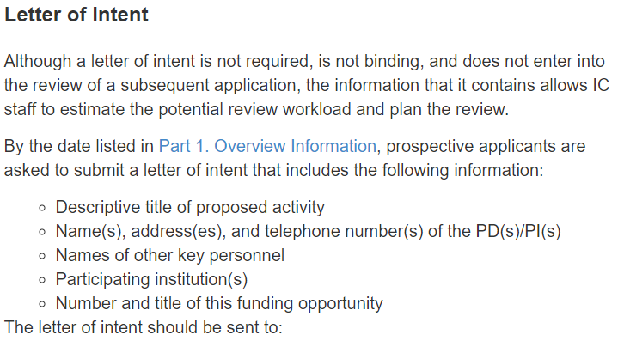
Letter of Intent Request in FOA

Slide 64
How would I know if a notice is published to update a FOA?
Check Related Notices section of FOA
Recheck before you submit, for late breaking updates
Monitor The NIH Guide for Grants and Contracts
Subscribe to NIH Guide for Grants and Contracts Weekly NIH Funding Opportunities and Notices email
Remember – subscribing in Grants.gov for change notifications only provides a subset of NIH updates

Slide 65
Sample – Weekly NIH Funding Opportunities and Notices

Slide 66
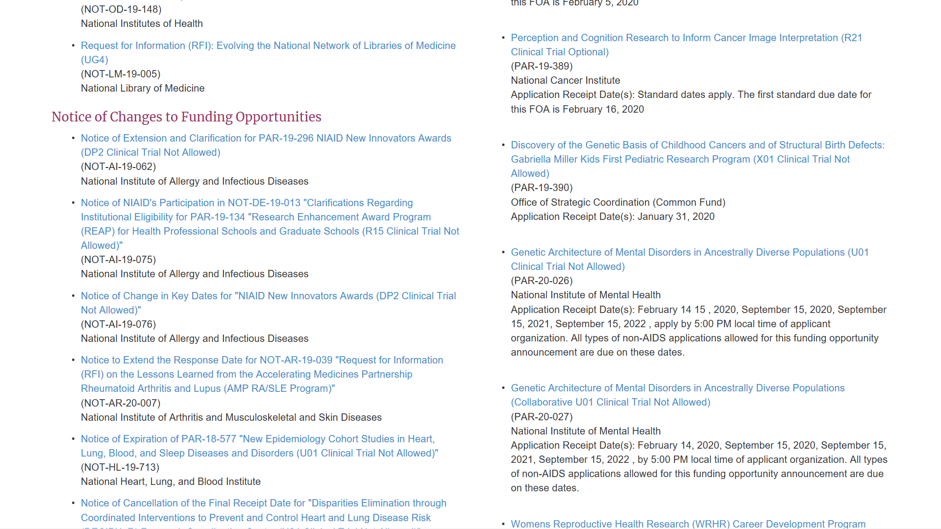
Sample – Weekly NIH Funding Opportunities and Notices (more)

Slide 67
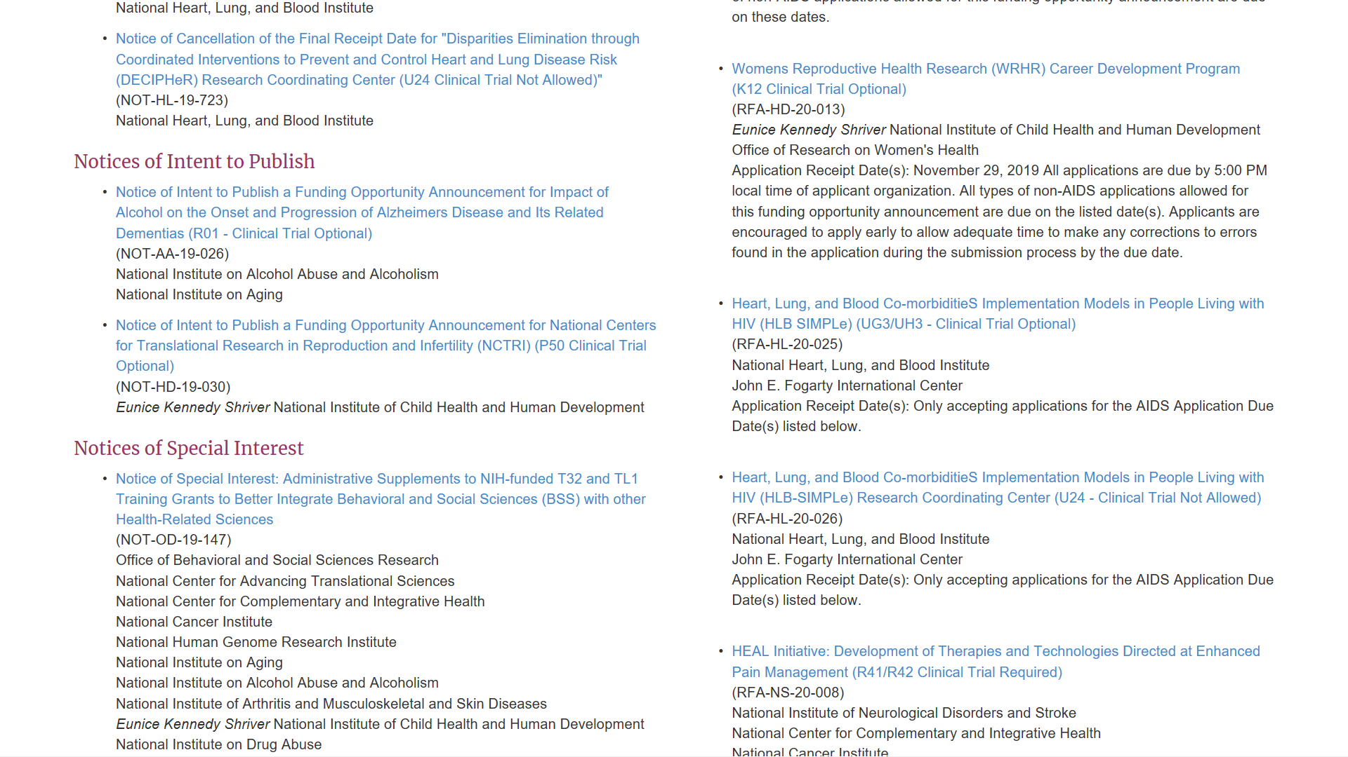
Sample – Weekly NIH Funding Opportunities and Notices (and more)

Slide 68
Resources

Slide 69
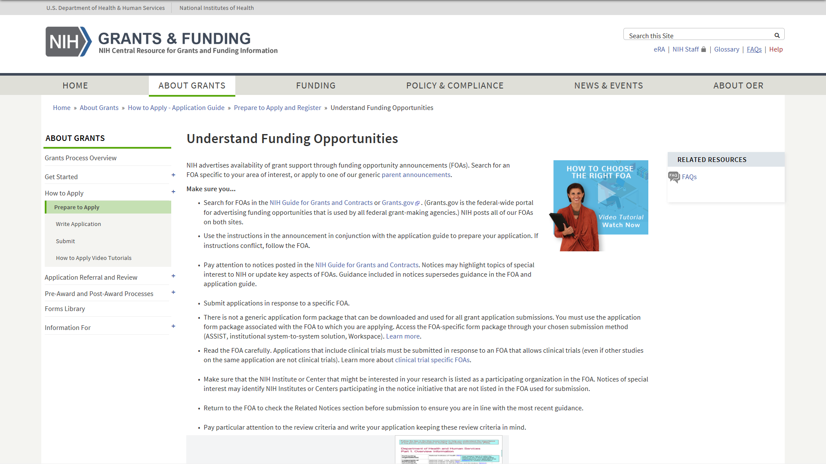
Understand Funding Opportunities
For more information on FOAs, please visit:
https://grants.nih.gov/grants/how-to-apply-application-guide/prepare-to-apply-and-register/understand-funding-opportunities.htm

Slide 70
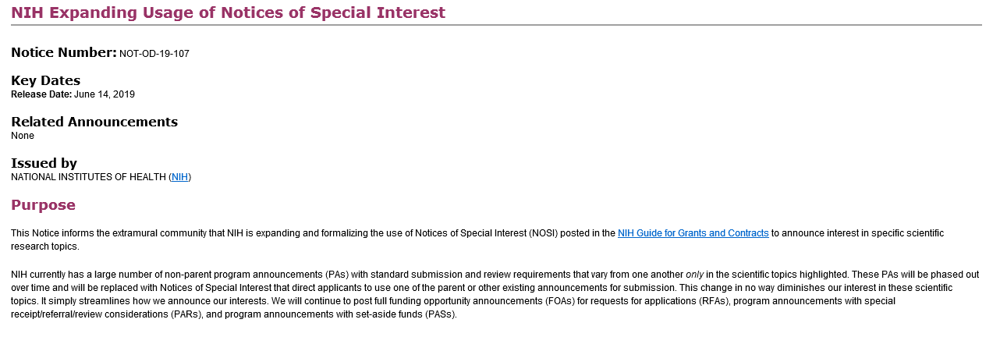
NOSI Guide Notice – NOT-OD-19-107

Slide 71
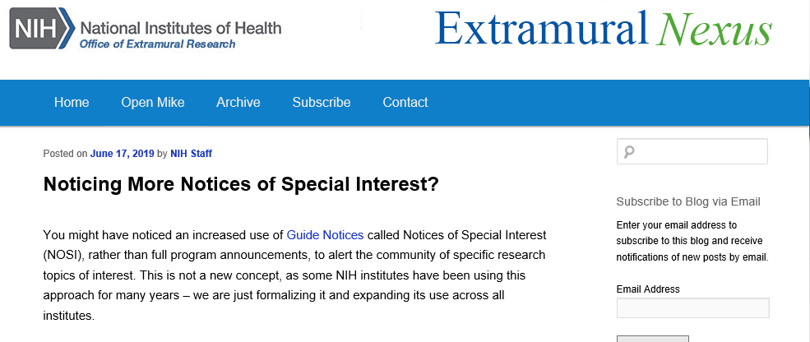
Extramural Nexus Article on NOSIs
https://nexus.od.nih.gov/all/2019/06/17/noticing-more-notices-of-special-interest/

Slide 72
Questions

